Slide 1

IT 3123
Hardware and Software Concepts
Encryption and Cryptography Concepts
Securing Communications
Notice: This session is being recorded.

Slide 2
Cryptography
Cryptography: secret writing with ciphers.
  crypt (kryptós): hidden, secret
  graph (gráphein): writing
Cryptology: the art and science of making and breaking secret ciphers.
Cryptanalysis: analysis of cipher text (and other information) to attempt to derive plain text.

Slide 3
Goals of Cryptosystems
Protection of confidentiality
Protection of integrity
  Message integrity
  Non-repudiation (origin integrity)
  Authentication (origin integrity)
Do not address availability. (The CISSP CBK says it does, but that’s bogus.)
Notes:
The Certified Information Systems Security Professional (CISSP) Common Body of Knowledge says
cryptography also protects availability. That is something of a stretch to say the leas

Slide 4
Plaintext and Ciphertext
The Cæsar Cipher:
Now is the time!
Opx jt uif ujnf!
Plaintext
Ciphertext
Notes:
Challenge students to solve this one by inspection.

Slide 5
Cryptography = Algorithm + Key
Algorithm: A procedure for transforming plain text and a key to cipher text. The algorithm is generally assumed to be well-known. (Kerckhoffs’ principle.)
Key: A secret, often random, collection of data that is combined with a plain text message to produce cipher text.
Notes:
Not to be confused with Kirchhoff's circuit laws.

Slide 6
Three Major Areas
Symmetric key (classical) cryptography: Security depends upon a secret (the key) shared between sender and recipient.
Hash functions: transform an input into a fixed-size output with properties that depend on the function.
Public key cryptography: Depends upon a pair of keys, one public and one private.

Slide 7
Symmetric Key Cryptography
Sender, receiver share common key (or the same principal.)
  Keys may be the same, or trivial to derive from one another
  Sometimes called classical cryptography
Two basic types
  Transposition ciphers
  Substitution ciphers
  Combinations are called product ciphers
Notes:
In symmetric or classical cryptography, there’s one key. The sender and the receiver each have a copy of it. If they don’t have the same thing they’ve got something that can be trivially converted from one to another. There are two kinds of classical cryptography ciphers: transposition ciphers and substitution ciphers. In transposition ciphers we’re mixing things up, we’re transposing characters. In Substitution ciphers like the Cæsar cipher, we’re substituting one character for another. It’s possible to do both of those things and when I have a cipher that does both of those things that’s called a Product Cipher.

Slide 8
Symmetric Key Cryptography
Encrypt by applying the key to the plaintext using an algorithm.
Decrypt by reversing the process using the same key and the inverse algorithm.
Mnemonic: symmetric, shared key and secret key are all the same thing and they all start with S.

Slide 9
Symmetric Key Cryptography
Plaintext
Cipher text
Sender
Secret Key
Unsecure channel
Cipher text
Secret Key
Plaintext
Recipient
The two “secret keys” are the same.
Notes:
Here is the picture of that. Up in the top yellow block, we combine the plain text and the key using some algorithm to produce a cipher text. That cipher text can then be transmitted over an unsecure channel and I have to say that my slides used to call that an insecure channel and then some wise person asked me whether psychiatry could help. So I had to go find every instance of insecure and change it to unsecure because a psychiatrist can’t fix this problem.
At the other end we take the cipher text and the same key, same key, combine them using an inverse algorithm to recover the plain text, the unencrypted message.

Slide 10
About Breakable Encryption
A cryptosystem is “breakable” if, with enough time and information, it can theoretically be “cracked.”
Either by determining the key or otherwise obtaining the plaintext.
We must assume the algorithm is known. (Kerckhoffs’ Principle.)
A cryptosystem that is breakable may require considerable effort. That is known as being “computationally secure.”

Slide 11
Computational vs. Absolute Security
Absolutely secure: There is no way to recover the plaintext from the cipher text without the key. (And the algorithm)
Computationally secure: The time to recover the plaintext from the cipher text is so great that the message has little or no value by the time it can be decrypted.
How long does “We attack at dawn!” need to remain secure?
Notes:
Cryptosystems can be either absolutely secure or computationally secure.
A cryptosystem is absolutely secure if there is no way to recover the plaintext without the key. (And, of course, the algorithm.) The one time pad is an absolutely secure cryptosystem.
Most cryptosystems are computationally secure. That means there exists a way to crack the system, but it would take so long that the information would be valueless when recovered. At first that may seem to be a serious limitation, but consider how long a message like, “We attack at dawn!” must remain secure. For many computationally secure systems, the time to break the cipher could be hundreds of thousands of years.
Even for more practical examples, a cryptosystem that will withstand attack for a few decades is likely to be sufficient. Let me suggest a different and perhaps more real world question. How long, if I want to encrypt credit card numbers for me, my own credit card numbers. I’m 60-harrumph years old. How long does that system need to withstand attack by the Ukrainian Mafia?
Yeah, until I die! It’s a pretty good bet that another 60 years is good enough, right? It’s a pretty good bet that I am not around here charging stuff to my American Express card 60 years from now. So the cryptosystem doesn’t have to stand up for 600,000 times the age of the universe, withstanding an attack for 60 or 100 years is plenty good enough.

Slide 12
Computational Security
Brute force: Try every possible key combination to see which one appears to decrypt the message.
Shortcut attacks: For a particular algorithm, there may exist a mechanism that is less work than brute force for extracting the plain text from the ciphertext.
Example: letter frequency analysis in the Cæsar cipher.
Cracking a “breakable” system could take thousands of years even though a mechanism is known.
Notes:
Cryptosystems can be cracked in two ways. One way is to try all possible keys. This is the brute-force mechanism. If I have a 256 bit key, as we do with AES encryption which we haven’t talked about yet. There are 2 to the 256 power possible keys. 2 to the 256 power is an extremely big number. The last time I tried to figure out how long it might take to break a message encrypted with a key like that I got an answer that was something like 600,000 times the age of the universe. In other words, a very long time.
There are a couple of ways to crack a cryptosystem. One of them is the brute-force system, try every possible key and see if the message that comes out makes sense. Now that can actually be automated, at least a little bit, because we can write computer programs that recognize English text, or, in fact, text in Russian or Hebrew, or whatever language we hope that the message, we suspect that the message is in. So it’s not as bad as having somebody lay eyeballs on 2²⁵⁶ messages; that it’s not an easy thing to do.

Slide 13
Key Strength and Security
Encryption is (now) a mathematical operation
The strength is in the key! Assume that the bad guys know the algorithm.
However, the algorithm must be free from “shortcut attacks.”
Keys should be long and random.
Keys are applied over blocks of data. Brute force attack: try all possible key combinations. 40-bit key: 2⁴⁰ combinations.
Notes:
August Kerckhoffs – 19th Century French cryptographer.
Also” Shannon’s maxim: The enemy knows the system.

Slide 14
One-Time Pad
One-time pad: A cipher with a random key at least as long as the message, used only once.
  Provably unbreakable
  Why? Any part of the ciphertext is equally likely to correspond to any plaintext.
Example: HELLO produces ciphertext EQNVZ.
A brute force attack with determines that EQNVZ = HELLO.
But it also determines that EQNVZ = LATER.
Both possibilities, and every other five letter word, are equally probable!
Notes:
The key must be at least as long as the message, and the key can be used only one time.

Slide 15
About the One-Time Pad
Each key must be used only one time.
Warning: keys must be random, or you can attack the cipher by trying to regenerate the key.
Approximations, such as using pseudorandom number generators to generate keys, are not random, but may be adequate in some cases.
Notes:
Keys used only once because otherwise an adversary will have two or more samples of ciphertext with different plain text. This defeats the goal of making the key as long as the message.

Slide 16
“Trustworthy” Encryption Systems
Based on sound mathematics
Analyzed by experts
Withstand the test of time
“It’s not as easy as it looks!”
Notes:
So trustworthy Symmetric encryption systems, secret key encryption systems, need to be based on sound mathematics. This is not the sort of thing that you make up in your spare time. Okay? Not without a Ph.D. in mathematics with some concentration in cryptography.
I will give you a counter example. Has everyone heard of the WEP algorithm for securing WiFi? Is anyone still using it? Shouldn’t because it is trivial to crack. It was invented by electrical engineers who know a whole lot of stuff about radio waves. They didn’t know enough about cryptography. And they invented a crypto system that’s trivial to crack and people still laugh at them. So there’s plenty of real crypto systems out there for you to use you don’t need to invent one. Should be analyzed by experts and should withstand the test of time. And the crypto systems that we have used and standards have really done that. I’m going to tell you in a minute that the data encryption standard is now obsolete. But it’s obsolete because of its short key length, not because of a problem in the algorithm, although there are some problems in the algorithm.
And so, as with almost everything in information technology, it’s not as easy as it looks. For us, we’re going to be users of cryptography rather than developers. Pick a good one and stick with it.

Slide 17
The Advanced
Encryption Standard
NIST selected Rijndael as Advanced Encryption Standard, successor to DES effective in May, 2002.
Designed to withstand attacks that were successful on DES.
Notes:
Advanced Encryption Standard - There were some short cut attacks on the data encryption standard, some analytical attacks that made it somewhat less than ‘try everything’. And AES is particularly designed to withstand those attacks.
Rijndael was adopted by NIST in November, 2001 and became an official U.S. standard in May, 2002.

Slide 18
The Problem with Secret Keys
You use secret-key cryptography to protect unsecure transmission or storage.
Problem: how does the recipient get the secret key!?!
(Out of band transmission is one secure way, but often one could simply transmit the message, and not just the key, if a secure channel exists. )
Key Exchange Problem
Notes:
There's a problem with secret key crypto. Remember that Vernam cipher and the punched paper tape? And you need a copy of the tape to encrypt and another copy to decrypt? The problem is, how do you get the other copy where it needs to be? If I can simply transmit a message that is the key, well I don’t need to encrypt stuff. I’ve got a secure channel.
And so during World War II we put the punched paper tape in a steel box, chain it to James Bond’s wrist and put him on an airplane. This is a lot of trouble. This is a lot of trouble. That lot of trouble is called the “Key exchange Problem.” If I have a mechanism for transmitting the key out of band, like, stick it in a steel box and chaining it to James Bond’s wrist, often I could’ve just sent the message that way. Right? Message can’t be decrypted until the key gets there. Might just as well put the secret message in the steel box and chain it to James Bond’s wrist since the key can only be used once.

Slide 19
Key Exchange Algorithms
Physical transfer of keys.
Use of asymmetric encryption (public key encryption) to exchange keys. (No forward secrecy.)
An algorithm specifically designed for key exchange, e.g., Diffie-Hellman Elliptic Curve key exchange algorithm.
Notes:
For symmetric encryption to work, the two parties to an exchange must share the same key, and that key must be protected from access by others. Key distribution can be achieved in a number of ways. For two parties A and B:
1. A key could be selected by A and physically delivered to B.
2. A third party could select the key and physically deliver it to A and B.
3. If A and B have previously and recently used a key, one party could transmit the new key to the other, encrypted using the old key.
4. If A and B each have an encrypted connection to a third party C, C could deliver a key on the encrypted links to A and B.
Options 1 and 2 call for manual delivery of a key. For link encryption, this is a reasonable requirement, because each link encryption device is only going to be exchanging data with its partner on the other end of the link. However, for end-to-end encryption, manual delivery is awkward. In a distributed system, any given host or terminal may need to engage in exchanges with many other hosts and terminals over time. Thus, each device needs a number of keys, supplied dynamically. The problem is especially difficult in a wide area distributed system.
Option 3 is a possibility for either link encryption or end-to-end encryption, but if an attacker ever succeeds in gaining access to one key, then all subsequent keys are revealed. Even if frequent changes are made to the link encryption keys, these should be done manually. To provide keys for end-to-end encryption, option 4 is preferable.

Slide 20
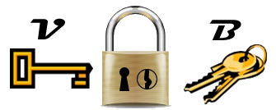
A Very Strange Lock
If locked with B, can only be unlocked with V. (B won’t unlock it.)
If locked with V, only unlocked with B.
So, B and V are inverses of one another with respect to this lock.
Notes:
This lock must be locked with a key; just snapping the hasp will not do.

Slide 21
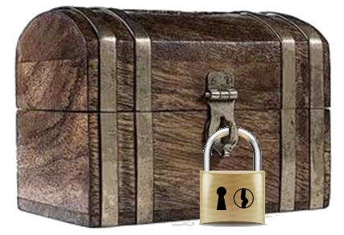
Idea…
Give each of your friends a lock and a B key
You keep the only V key.
Your friends can send you a locked box (locked with the B key) that only you can open because you have the only V key.
Notes:
Note: Other friends, with key B, cannot open the lock. So, it doesn’t matter how many people have B keys.

Slide 22
Public Key Cryptography
Also known as “asymmetric key cryptography.”
Encrypt with one key (publicly available).
Decrypt with a different key, known only to the recipient.
How? Trapdoor functions!
Functions that are easy to compute, but for which the inverse is intractable.

Slide 23
Trapdoor Functions
Functions that are easy to compute, but for which the inverse is intractable.
293 × 307 is easy.
Find the prime factors of 89,851!
Now try finding prime factors of a 100-digit number.
Notes:
Mention Shor’s Algorithm for quantum computers.

Slide 24
Public Key Cryptography
With public key cryptography, one creates a pair of keys, k_{v} (private) and k_{b} (public).
A ciphertext message, C is formed from a plaintext message M: C = f(k_{b},M)
Deriving M from C and k_{b} is intractable.
Deriving k_{v} from k_{b} is intractable.
However, M=f(k_{v},C) is straightforward to compute, but computationally intensive.

Slide 25
Computational Effort
Public key encryption can be 10,000 times more computational work than secret key encryption.
Why? We are dealing with difficult arithmetic (exponentiation) on very large (hundreds of digits) numbers.
Notes:
Public key crypto is cool, but it has the problem that it’s a lot of work. It’s a lot of computational work. We make the electrons earn their money by dealing with these hundred digit prime numbers. As a rough estimate, it might be 10,000 times more work than using symmetric key cryptography. And so if I were going to encrypt the PowerPoint file of today’s slides, I would have time to walk up the hill, have a combination plate for lunch and come back before the encryption finished on my university-issued computer. There’s nothing conceptually difficult, right? The problem is that the arithmetic is difficult. We’re dealing with difficult arithmetic on big numbers.

Slide 26
Public Keys with Less Computation
Asymmetric encryption is time-consuming… up to 10,000 times more work than secret key encryption.
Solution: generate a random, one-time secret key, the session key.
Encrypt the message with the secret key.
Encrypt the secret key with the recipient’s public key.
Send encrypted message and encrypted key.
Notes:
The solution is: don’t use public key encryption to encrypt messages directly. Generate a one-time random key. Encrypt the message with a one-time random key and a symmetric key encryption algorithm. That random key, which we will call a session key, is short. It’s 256 bits maybe. Encrypt the session key with the recipient’s public key. Don’t encrypt the whole message; just encrypt the session key. Send the encrypted message and the encrypted key. And now we have done public key crypto but with much less computation than if we encrypted a whole long message.
This solves the key exchange problem.

Slide 27
Quantum Resistant Public Key Cryptography
Finding the prime factors of very large numbers is hard for von Neumann computers.
It is not hard for quantum computers.
Shor’s algorithm can crack asymmetric key cryptography in seconds.
Happily, there are no quantum computers large enough to do that.
Experts estimate we have until about 2030.

Slide 28
2030 is not that far away!
In 2016, NIST announced that it would select quantum-resistant public key algorithms.
NIST published a list of 26 finalists in 2019.
They expect to publish a final draft of quantum-resistant algorithms in 2024.
Notes:
https://blog.cloudflare.com/a-relatively-easy-to-understand-primer-on-elliptic-curve-cryptography/

Slide 29
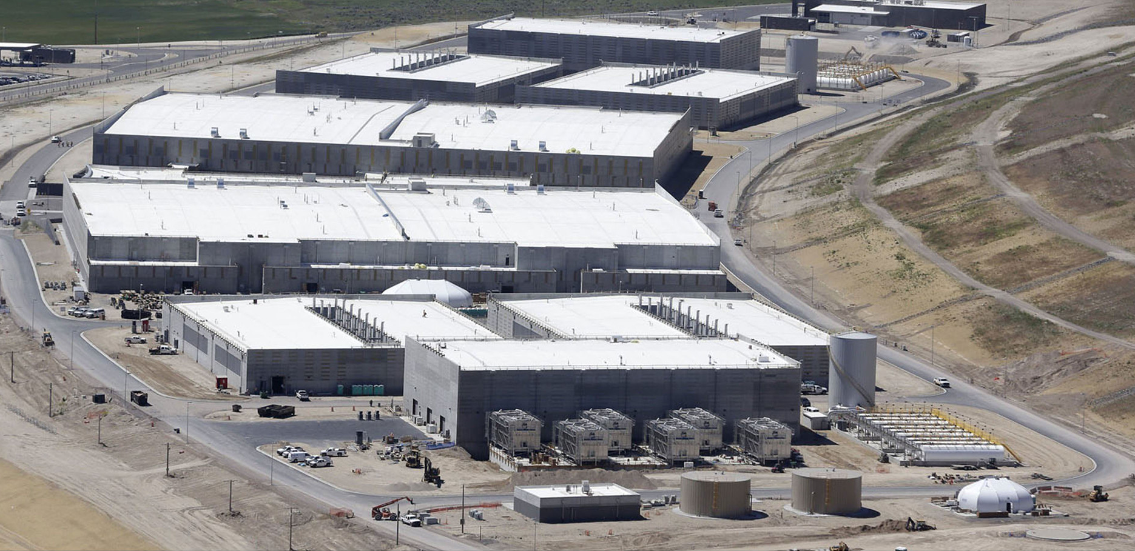
NSA Data Center
NSA Data Center, Bluffdale Utah
Felton Davis CC-BY
Notes:
This is the Utah Data Center, a new home for the NSA's exponentially expanding information trove. The $1.7bn facility, two years in the making, hosts computers to store gargantuan quantities of data from emails, phone calls, Google searches and other sources. Sited on an unused swath of the national guard base, it employs around 200 technicians, spans 1 million sq ft and use 65 megawatts of power. The NSA says they do not illegally spy on “U.S. persons,” but have admitted “incidental” collection of data on U.S. persons.

Slide 30
Forward Secrecy
A problem with using asymmetric cryptography for key exchange is that, if the recipient’s private key is compromised, the contents of all past and future messages are also compromised.
Solution: do not use asymmetric crypto for key exchange…
Use Diffie-Hellman Elliptic Curve key exchange.
Use public key crypto for authentication.
Notes:
Elliptic Curve Diffie-Hellman is beyond the scope of this course.
Use of public key crypto for authentication (digital signature) is discussed next.

Slide 31
Public Key Digital Signature
Some public key cryptography algorithms work both ways; the keys are inverses of one another!
Bob encrypts a message with his private key.
Anyone can decrypt it using Bob’s public key.
Only Bob could have encrypted it, so, it is “signed” by Bob.
Uhhh, but anyone can decrypt it; there is no confidentiality. (This is exactly analogous to a handwritten signature.)
Notes:
For the RSA algorithm and some others.
It is analogous if you believe that handwritten signatures are distinctive. Anyone can read a handwritten signature, but only one person could have written it.

Slide 32
Cryptographic Hash Functions
Idea: Detect tampering with messages.
Needed: A function that “characterizes” or “fingerprints” a message in some way.
Characteristics of a strong hash function:
  h(m) for message m is easy to compute.
  Deriving m from h(m) is infeasible.
  Given m, finding m′ such that h(m′ )= h(m) is infeasible (protects integrity by resisting collision attacks.)

Slide 33
Digital Signature Improved
Bob computes a “digest” of a message using a hash function; this is smaller than the message and of fixed size but has the property that changing the message changes the computed digest.
Bob encrypts the digest with his private key.
Anyone can decrypt the digest using Bob’s public key, but only Bob could have encrypted it. The message is digitally signed.
If the digest matches the message, the message has not been altered.

Slide 34
Digital Signature
Message
Encrypt with Sender’s Private Key
Message Digest
Message
Encrypted Digest
Notes:
Green boxes are not encrypted. Amber box is encrypted, but not confidential because it can be decrypted with a public key.

Slide 35
Digital Signature
Message
Encrypted Digest
Sender’s Public Key
Decrypted Digest
?
=
Computed Digest
If the digests are equal, the sender is assured, and no tampering has occurred.

Slide 36
Digital Signature with Confidentiality
Bob computes a digest over a message and encrypts it with his private key.
Bob encrypts message and digest with Betty’s public key.
Only Betty can decrypt the message because it needs her private key. The message is confidential.
She decrypts and verifies the digest using Bob’s public key. The message is signed.

Slide 37
Digital Signature with Confidentiality
Message
Encrypted Digest
Encrypt with Sender’s Private Key
Encrypt with
Recipient’s Public Key
Encrypted, Digitally-Signed Message
Notes:
But there is no forward secrecy. If the recipient’s private key is compromised, all past and future messages can be decrypted.

Slide 38
Digital Signature with Confidentiality
Encrypted, Digitally-Signed Message
Recipient’s Private Key
Message
Encrypted Digest

Slide 39
Digital Signature with Confidentiality
Message
Encrypted Digest
Sender’s Public Key
Decrypted Digest
?
=
Computed Digest

Slide 40
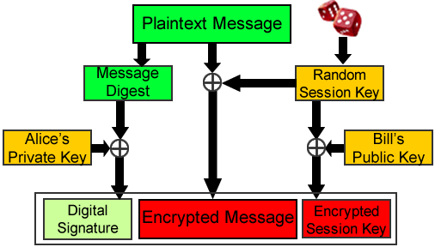
Signature and Hybrid Crypto
Notes:
We can combine the idea of hybrid cryptography using a session key and the idea of a message digest and digital signature to get the benefits of both. In the diagram, green represents plain text, red ciphertext, and orange cryptographic keys. The digital signature is shown in light green. It’s the message digest, enciphered with Alice’s private key. It remains green because anyone can decipher it using Alice’s public key.
Yes, I am going to ask you about this on the test. The question will say, “Be sure you correctly identify sender and recipient, public and private.” You’ve got four keys—sender’s private key, sender’s public key, recipient’s private key, and recipient’s public key. If you don’t know which one to use when, one of two things happens. Your message doesn’t get encrypted at all. Anybody can read it. Or a message gets encrypted so that nobody can read it. There’s only one right way to do this. Let’s look again. The message digest gets encrypted with the sender’s private key. The session key gets encrypted with the recipient’s public key. This is really easy to figure out because this is the sending end of the message. All you’ve got to do is ask yourself, “What keys can the sender know?” I package everything together and send it off to the recipient of the message. The recipient first decrypts the session key using recipient’s private key, decrypts the message using the encrypted message and the session key, and then validates the digital signature the same way that I’ve showed you earlier, using the sender’s public key.

Slide 41
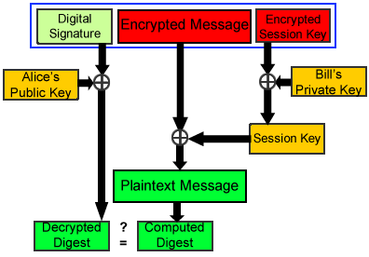
Decrypting the Message
Notes:
The process is reversed to decrypt the message. Note that we use the sender’s (Alice’s) public key to decrypt the message digest that is the digital signature. We use the recipient’s (Bill’s) private key to decrypt the session key. The session key is then used to decrypt the message. Once again, there is no forward secrecy.

Slide 42
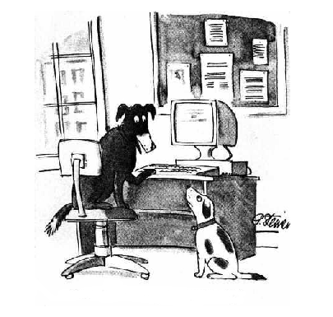
On-Line Identity
On the Internet, nobody knows you’re a dog.
Copyright © 1993 The New Yorker
Notes:
I believe the use of the 20-year-old cartoon in the educational setting to be fair use.

Slide 43
Proving Identity:
Digital Certificates
Contains:
  Principal’s identity
  Principal’s public key
  Identity of signer
  Digital Signature
Principal’s Identity
Amazon.com
Principal’s Public Key
mQGiBD9aAvwRB
Hash, other information
SHA-256
Everything is plain text except the digital signature, which is a cryptographic hash (digest) encrypted by the signer’s private key.
Signer’s Identity
Verisign
Digital Signature
B157 ACE3 9788
Notes:
Here is a schematic diagram of a digital certificate. It contains the principal’s identity, the corresponding public key, the hash used and other information, and the identity of the signer. The digital signature is a hash over the information in the certificate, encrypted with the signer’s private. Anyone can decrypt the hash using the signer’s public key, recompute the hash, and compare the two. If they are equal, the digital certificate is assumed to be valid.

Slide 44
Changing the Public Key
Evil Eve substitutes her
public key for Amazon’s, a
man-in-the-middle attack.
The digital signature is no
longer valid (because the
data have changed.)
Evil Eve must gain access
to the signer’s private key
(signing key) to forge a
new digital signature.
We hope this is hard!
Principal’s Identity
Amazon.com
Eve’s Public Key
DfIZOkhURN
Hash, other information SHA-256
Signer’s Identity
Verisign
Digital Signature
B157 ACE3 9788
Notes:
If Eve can substitute her public key for George’s, the digital signature will no longer validate. To complete the deception, Eve must recompute the digest over the changed certificate, and encrypt it with the private key of the signer. So, she must have access to the private keys of the signer(s) of the certificate. We hope this is hard. Other alternatives for Eve are: execute a collision attack against the hash that constitutes the signature, which we hope is hard, compromise the storage of the CA’s public key, which we also hope is hard, or convince some CA, not necessarily the original one, to issue a fraudulent certificate.
In the web of trust model, such a certificate can have more than one signature. For each signature, the signer’s identity and the encrypted hash code are repeated.
If Evil Eve tries a collision attack and succeeds, then your confidentiality is toast. That’s why we want to use a hash function that we believe to be highly collision-resistant. That’s why we would not use MD5 in digital signatures that we’re taking seriously anymore. That is how the Flame malware worked, was by generating collisions over digital signatures. There was a lot of crypto that made Flame actually work like it worked. We’re going to use SHA-256 and not MD5 anymore.

Slide 45
Securing Communications
The pandemic of 2020 caused a lot of jobs to transition to remote work.
Some are back on-site but many are not.
That has made securing data communications much more important.

Slide 46
Transport Layer Security (TLS)
Transport layer security service (originally SSL) originally developed by Netscape.
Subsequently became Internet standard RFC2246: Transport Layer Security (TLS.)
Uses TCP to provide a reliable end-to-end service.
May be provided in underlying protocol suite or embedded in specific packages.
Notes:
One of the most widely used security services is the Secure Sockets Layer (SSL) and the follow-on Internet standard known as Transport Layer Security (TLS), the latter defined in RFC 2246. SSL is a general-purpose service implemented as a set of protocols that rely on TCP. At this level, there are two implementation choices. For full generality, SSL (or TLS) could be provided as part of the underlying protocol suite and therefore be transparent to applications. Alternatively, SSL can be embedded in specific packages. For example, Netscape and Microsoft Explorer browsers come equipped with SSL, and most Web servers have implemented the protocol. We discusses SSLv3. Only minor changes are found in TLS.

Slide 47
TLS Record Protocol Services
Message integrity
  using a message authentication code with shared secret key.
Confidentiality
  using symmetric encryption with a shared secret key defined by Handshake Protocol
  Algorithms negotiated: AES, IDEA, etc.
  Message is compressed before encryption
Forward Secrecy optional with Diffie-Hellman Elliptic Curve Key Exchange.
Notes:
SSL Record Protocol defines two services for SSL connections:
• Message Integrity: The Handshake Protocol also defines a shared secret key that is used to form a message authentication code (MAC), which is similar to HMAC
• Confidentiality: The Handshake Protocol defines a shared secret key that is used for conventional encryption of SSL payloads. The message is compressed before being concatenated with the MAC and encrypted, with a range of ciphers being supported as shown.

Slide 48
Protecting the Perimeter
Prior to 2020, many organizations had focused primarily on protecting the perimeter; that is, protecting the network from outside intrusion.
This strategy depended on firewalls and intrusion detection systems.

Slide 49
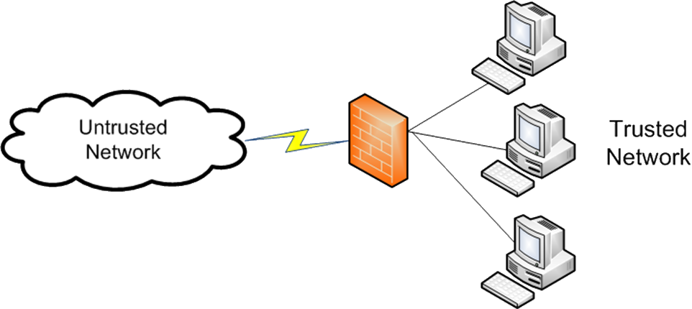
Firewalls
A firewall is a router, general-purpose computer, or appliance…
That controls the flow of packets between a trusted and an untrusted network, or between segments of a trusted network.

Slide 50
Intrusions
Intrusion: type of attack on information assets in which the instigator attempts to gain entry into or disrupt system.
Incident response: identification of, classification of, response to, and recovery from an incident.
Intrusion prevention: consists of activities that seek to deter an intrusion from occurring.
Notes:
Today we’re going to talk about intrusion detection. We must first define intrusion. It is an attempt or a success in entering into or disrupting a system. So I’m either trying to break in to someone’s computer system, or I have tried and I have succeeded in doing it.
An intrusion is a type of attack on information assets in which the instigator attempts to gain entry into a system or disrupt the normal operations of a system with, almost always, the intent to do malicious harm.
Incident response is the identification of, classification of, response to, and recovery from an incident, and is frequently discussed in terms of prevention, detection, reaction and correction.
Intrusion prevention consists of activities that seek to deter an intrusion from occurring.
Intrusion detection consists of procedures and systems that are created and operated to detect system intrusions.
Intrusion reaction encompasses the actions an organization undertakes when an intrusion event is detected.
Intrusion correction activities finalize the restoration of operations to a normal state, and by seeking to identify the source and method of the intrusion in order to ensure that the same type of attack cannot occur again, they return to intrusion prevention—thus closing the incident response loop.
Incident response is figuring out what we’re going to do. Identification that an incident has taken place, classifying the incident, responding and then recovering. We talked about that on the very first day of class when we talked about prevention detection, response and recovery. Intrusion prevention is that collection of activities that to try to deter or prevent intrusions. Intruders, these are the guys who are trying to break into our system. I ought to send them to graduate school and then they wouldn’t have time for that kind of nonsense. But, this is trespass. All trespasses hostile are unwanted, right? If you’re not hostile or unwanted you’re not trespassing. Your book says that the effect might be from annoying to serious. I disagree with that, it’s always serious. Even if someone breaks into a system and does nothing. You’ve got to be able to prove to your own satisfaction that they didn’t do anything. And that can be an expensive and time-consuming operation.

Slide 51
Intrusion Detection
  A security service that monitors and analyzes system events for the purpose of finding and providing real-time or near real-time warning of attempts to access system resources in an unauthorized manner.
Notes:
The definitions shown from RFC 2828 (Internet Security Glossary) summarize the issues we are discussing.
Intrusion detection is a service. It’s a combination of hardware software procedures that analyzes what’s going on with a system or network for the purpose of providing warning about unauthorized access attempts. We’d like to provide that warning pretty close to the time that the unauthorized access attempt is detected. We don’t want to do it tomorrow morning. We want to do it within a matter of a few minutes.

Slide 52
IDS Locations (NIST)

Slide 53
Enabling Remote Access
Virtual private network (VPN).
A VPN uses encryption to “tunnel” traffic though a public network like the Internet.
Because traffic is encrypted, it cannot be examined by others.
Can be used point to point to connect branch offices.
Can be used to connect individual remote workers.

Slide 54
Endpoint Security
Much more important with large remote workforce.
“Endpoints” are more than computers; include tables and mobile devices.
Endpoints include “things” like point-of-sale devices, smart watches, teller machines, medical devices, and anything that connects to the corporate network.

Slide 55
More than Virus Protection
Virus and malware protection is included.
Includes firewall functions.
Includes central management of the collection of endpoints.
Includes end-to-end encryption (VPN).

Slide 56
Something to Try
Download GPG4Win (or MacGPG)
Create your own public/private key pair (use the largest key size available)
Upload your public key to a key server
Obtain a friend’s public key; encrypt a document and send to friend as email attachment.
Have a friend sign your public key.
http://bitmonger.blogspot.com/2013/05/its-time-to-encrypt-your-email.html

Slide 57
Questions

