Slide 1

IT 3123
Hardware and Software Concepts
Computer Security Concepts
Notice: This session is being recorded.

Slide 2
Announcements
Course evaluations are open.
Quiz 7 due tonight.
Optional assignment due Wednesday.
Quiz 8 will be released on Friday, due Monday, May 1. Read Chapter 7 of the textbook before attempting the quiz!
Review on Monday, May 1; will cover only material since exam 2.

Slide 3
What Does “Secure” Mean?
A system that does what it is intended to do and nothing else. – Charles Pfleeger
“A computer is secure if you can depend on it and its software to behave as you expect.”
– Garfinkle and Spafford

Slide 4
Thinking About Security
[Do not fall into] the classic security misapprehension error: the idea that either you’re “secure” or you’re not.
The real question, as we all know, should be, “against what sort of attacks am I vulnerable?”
–Curt Sampson
Notes:
Security people call “what sort of attacks” a threat profile.

Slide 5
Specifying Security
Security is specified by policy.
Policies are organizational laws; they state what must happen, what may happen, and what must not happen.
A system the behavior of which does not violate organizational policies is, by definition, secure.
So, effective security is impossible in the absence of policy.

Slide 6
Organizational Security Policy
Every organization needs a written security policy document…
…to define acceptable behavior, expected practices, and responsibilities.
  makes clear what is protected and why.
  articulates security procedures / controls.
  states responsibility for protection.
  provides a basis to resolve conflicts.
Notes:
A written security policy document is fundamental to define acceptable behavior, expected practices, and responsibilities. Without written policies, users and administrators are left to decide important security-related issues for themselves. The policy document also provides valuable support for IT staff and lower-level managers in convincing higher-level managers of the need for a particular expenditure or commitment of resources.
A security policy plays four important roles:
1. makes clear what is being protected and why.
2. articulates the security procedures, controls, and standards used in the organization.
3. clearly states the responsibility for that protection.
4. provides basis on which to interpret and resolve any later conflicts that may arise.
To fulfill these roles, the security policy must reflect security decisions made by executive management. Hence, decision makers must:
1. Identify sensitive information and critical systems.
2. Incorporate local / national laws; contractual obligations, relevant ethical standards.
3. Define institutional security goals and objectives.
4. Set a course for accomplishing these goals and objectives
5. Ensure have necessary mechanisms for accomplishing the goals and objectives.

Slide 7
Policies and Controls
Policy says what is, and is not, allowed
  What must happen, what may happen, what must not happen.
  This defines “security” for the site/system/etc.
Controls enforce policies.
Application of controls in the absence of supporting policy could be detrimental to security!
Notes:
Policy: may be expressed in
natural language, which is usually imprecise but easy to understand;
mathematics, which is usually precise but hard to understand;
policy languages, which look like some form of programming language and try to balance precision with ease of understanding
Mechanisms: may be
technical, in which controls in the computer enforce the policy; for example, the requirement that a user supply a password to authenticate herself before using the computer
procedural, in which controls outside the system enforce the policy; for example, firing someone for ringing in a disk containing a game program obtained from an untrusted source
The composition problem requires checking for inconsistencies among policies. If, for example, one policy allows students and faculty access to all data, and the other allows only faculty access to all the data, then they must be resolved (e.g., partition the data so that students and faculty can access some data, and only faculty access the other data).

Slide 8
Properties of Information Security
Confidentiality
  Keeping data and resources hidden from unauthorized personnel
Integrity
  Data integrity (integrity)
  Origin integrity (authentication)
Availability
  Enabling access to data and resources when and where they are needed.
Notes:
Confidentiality: a good example is cryptography, which traditionally is used to protect secret messages. But cryptography is traditionally used to protect data, not resources. Resources are protected by limiting information, for example by using firewalls or address translation mechanisms.
Integrity: a good example here is that of an interrupted database transaction, leaving the database in an inconsistent state (this foreshadows the Clark-Wilson model). Trustworthiness of both data and origin affects integrity, as noted in the book’s example. That integrity is tied to trustworthiness makes it much harder to quantify than confidentiality. Cryptography provides mechanisms for detecting violations of integrity, but not preventing them (e.g., a digital signature can be used to determine if data has changed).
Availability: this is usually defined in terms of “quality of service,” in which authorized users are expected to receive a specific level of service (stated in terms of a metric). Denial of service attacks are attempts to block availability.

Slide 9
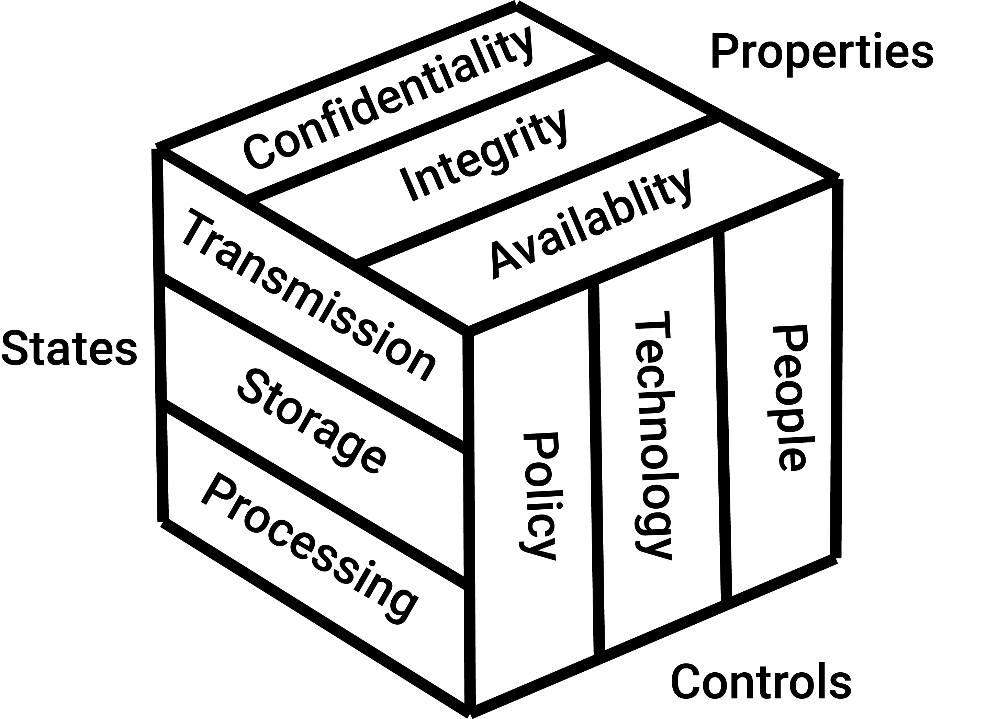
What Else? The McCumber Security Model
National Security Telecommunications and Information Systems Security Committee
Notes:
This graphic informs the fundamental approach of the chapter and can be used to illustrate the intersection of information states (x-axis), key properties of C.I.A. (y-axis) and the three primary means to implement (policy, education and technology).
In 1991, John McCumber created a model framework for establishing and evaluating information security (information assurance) programs, now known as The McCumber Cube. This security model is depicted as a three dimensional Rubik's Cube-like grid.
The concept of this model is that, in developing information assurance systems, organizations must consider the interconnectedness of all the different factors that impact them. To devise a robust information assurance program, one must consider not only the security goals of the program (see below), but also how these goals relate specifically to the various states in which information can reside in a system and the full range of available security safeguards that must be considered in the design. The McCumber model helps one to remember to consider all important design aspects without becoming too focused on any one in particular (i.e., relying exclusively on technical controls at the expense of requisite policies and end-user training).

Slide 10
Assets to be Protected
Hardware
Software
Data
Infrastructure (including communications facilities)
People

Slide 11
The Attacker’s Triad: DAD
Disclosure: compromises confidentiality
  Outside attackers
  Insiders
  Programming or other errors
Alteration: compromises integrity
  Accidental or malicious alteration
  Programming or equipment failure
Denial: compromises availability
  Deliberate attacks
  Failures of systems or environment

Slide 12
Who Are These Attackers Anyway?
Intelligence agencies (including U.S.)
Criminals
Misguided or malicious insiders
Corporate spies
Vandals
Poorly-socialized adolescents
Others…

Slide 13
Where Are They?
Outsiders
  Network-based attacks
  Physical attacks
Malicious insiders
  May have authorized access to systems they attack
  May be in positions of trust
Other insiders: Non-malicious mistakes made by those with authorized access.

Slide 14
Vulnerabilities, Threats, Risks
Vulnerability: a weakness that could allow a system to enter a state not permitted by policy.
Exploit: (n) a mechanism for taking advantage of a vulnerability.
Threat: a circumstance that could allow a vulnerability to be taken advantage of.
Risk: the circumstance that both a threat and a corresponding vulnerability exist. Risk is the probability of the threat being realized.

Slide 15
Goals of Information Security
Prevention Prevent attackers from violating security policy.
Detection Detect attackers’ violation of security policy.
Response and Recovery
  Stop attack, assess and repair damage.
  Continue to function correctly even if attack succeeds.
  Return system to a state consistent with policy.
Notes:
Prevention is ideal, because then there are no successful attacks.
Detection occurs after someone violates the policy. The mechanism determines that a violation of the policy has occurred (or is underway), and reports it. The system (or system security officer) must then respond appropriately.
Recovery means that the system continues to function correctly, possibly after a period during which it fails to function correctly. If the system functions correctly always, but possibly with degraded services, it is said to be intrusion tolerant. This is very difficult to do correctly; usually, recovery means that the attack is stopped, the system fixed (which may involve shutting down the system for some time, or making it unavailable to all users except the system security officers), and then the system resumes correct operations.

Slide 16
Computers and Networks
Previously, computer systems could be secured by locking them up.
Most computers are now connected to networks, and to the Internet.
So, threats can be physically remote.

Slide 17
Risk Management
Risk management: process of identifying and controlling risks facing an organization.
Risk identification: process of examining an organization’s current information technology security situation.
Risk control: applying controls to reduce risks to an organizations data and information systems.
Notes:
Introduction
The Security Systems Development Life Cycle (or SecSDLC) is a process framework or methodology that can be used in a flexible fashion to assist organizations in deploying information security initiatives.
Risk identification is the formal process of examining and documenting the current information technology security situation.
Risk identification is conducted within the larger process of identifying and justifying risk controls, known as risk management.

Slide 18
Information Risk
Use of information technology creates risk to
  Confidentiality
  Integrity
  Availability
of information assets
Risk may be direct (to the asset itself)
Or indirect (business interruption, damage to reputation, legal liability, etc.)

Slide 19
Asset Identification and Valuation
Iterative process; begins with identification of assets, including all elements of an organization’s system. (people, procedures, data and information, software, hardware, networking equipment, documentation)
Assets are then classified and categorized.
Notes:
Asset Identification and Valuation
This iterative process begins with the identification of assets, including all of the elements of an organization’s system: people, procedures, data and information, software, hardware and networking elements.
Then, we classify and categorize the assets adding details as we dig deeper into the analysis.

Slide 20
Threat Identification
Realistic threats need investigation; unimportant threats are set aside.
Threat assessment:
  Which threats present danger to assets?
  Which threats represent the most danger to information?
  How much would it cost to recover from attack?
  Which threat requires greatest expenditure to prevent?
Notes:
Threat Identification
Each of these threats identified has the potential to attack any of the assets protected.
If we assume every threat can and will attack every information asset, this will quickly become more complex and overwhelm the ability to plan.
To make this part of the process manageable, each step in the threat identification and vulnerability identification process is managed separately, and then coordinated at the end of the process.

Slide 21
Vulnerability Identification
Specific avenues (weaknesses) threat agents can exploit to attack an information asset are called vulnerabilities.
Examine how each threat could be perpetrated and list organization’s assets and vulnerabilities.
Notes:
Vulnerability Identification
We now face the challenge of reviewing each information asset for each threat it faces and creating a list of the vulnerabilities that remain viable risks to the organizations.
Vulnerabilities are specific avenues that threat agents can exploit to attack an information asset.

Slide 22
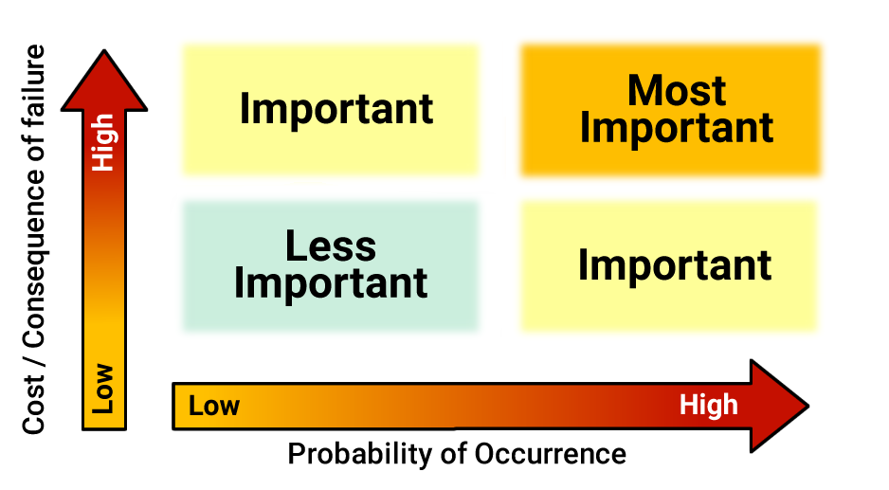
Risk Management
Notes:
With risks classified, it is possible to design policies, technical controls, and
people controls like procedures to reduce the risks. The figure provides guidance on which controls to design and implement first. Clearly, one should address those risks with both a high probability of occurrence and a high cost if the threat is realized.
However, the figure does not account for the cost of controls. It may be advantageous to implement some less important controls early in the process if they are easy and cheap. It may also be necessary to forego some controls entirely if their cost or technical complexity exceeds what the organization can support. Such an analysis is called a cost-benefitanalysis.Cost-benefit analysis compares the financial benefit of adding a control (itself determined by risk of loss) with the cost of proposed controls

Slide 23
Security Trends
Vulnerabilities up.
Incidents up.
Losses up.
  Virus contamination.
  Data disclosure.
  Hardware theft.
Attacks becoming more sophisticated (and knowledge needed by attackers decreasing.)

Slide 24
Identity
Principal: a unique entity, perhaps a person.
Identity: specifies a principal.
Authentication: binding of a principal to a representation of identity internal to the system; all access, resource allocation decisions assume binding is correct.
Identification: “Who are you?” [bbrown]
Authentication: “Prove it!” [xyzzy]
Notes:
We’re supposed to be talking about identification and authentication today, and we need some definitions in order to do that.
The first definition is that of principle, and that is a unique entity like maybe a person, so I could be a principle, so could you. An identity specifies a principal. So I have a number of identities. Triple-0 48096 is my banner identity. “bbrown’ is my email identity. Robert L. Brown is my legal identity, and so on. All of those things specify me and they’re used for different purposes.
Authentication is the binding of that representation of identity to some internal system.
And to make that a little shorter, identification asks who you are and authentication says prove it.
All of the access decisions and all of the resource allocation decisions that a system makes depend on correct binding of identity. So if you can get access to my banner password--please don’t. If you can, you could go post grades for yourself, ‘cause I can post grades for you. Right? If an incorrect binding takes place, then all the rest of security having to do with access and resource allocation fails. And there are some bad problems with that but let me finish the slide first. To repeat, identification asks the question, who are you. And for a number of the systems around here, I am “bbrown” so that’s what I type in. Authentication is the challenge that says prove it, and I type a password like xyzzy. That is not my password. It has never been and it never will be. It is the mnemonic for vector multiplication in three dimensions, also a fake password from the Adventure game from long ago.

Slide 25
Authenticating Identity
One or more of the following factors
  Something you know (e.g. password)
  Something you have (e.g. badge, smart card)
  Something you are (e.g. fingerprints, retinal characteristics)
Multi-factor authentication: Two or more authenticators, e.g. something you know and something you have, such as password and smart-card.
Notes:
So I can authenticate that is, I can do the ‘prove it’ part in one or more of three factors: something I know, something I have and something that I am. So something I know might be a password. Something I have might be a Smartcard, as the one I use to unlock the door, or even a metal key. If I’m the only one who’s supposed to have the key to my car, then this key authenticates me to the car as somebody who should be allowed to drive it. Even though the car is not as smart as some computers, it’s an authenticator. The third factor is something you are. My state-issue laptop has a fingerprint reader on it which I have never bothered to setup because the laptop spends most of its life closed in a docking station and the fingerprint reader’s inside, which makes it useless. But fingerprints something I am, some biometric identification, retinal scan, hand geometry. Put your hand on a sensor. Different people’s hand geometries are all different. I can use two or more of those authenticators, and that’s called Multi-Factor Authentication. Some, but not all of the card readers that work the door locks in this building have keypads on them. And I might be given a personal identifying number and the Smartcard. What that buys me, and that’s something I have, the Smartcard and something I know, the number. What that buys us in terms of security is, if I lose the wallet containing the Smartcard, as things stand right now, anybody can get into any room I’m allowed to get into, just by waving the wallet in front of the reader. If we were using Two Factor identification, Smartcard and identifying number, then the loss of my wallet, or the Smartcard, really, does not compromise security of these rooms all by itself. I’ve still lost my wallet but people can’t use it to get into the classrooms to which I have access. That’s Multi-Factor Authentication.

Slide 26
Uses of Identity
Access control
Accountability
Notes:
Okay, so we use identity, this is, who are you? And then, prove it. So we’ve authenticated that identity. For accountability, for knowing who did what, and for access control. Who’s allowed to do what.

Slide 27
Users
Exact representation tied to system.
Example: Unix systems, login name, used to log in to system. Logging usually uses this name.
User identification number (UID): unique integer assigned to user. Kernel uses UID to identify users.
Notes:
Okay, so if we want to identify users, like me, the exact representation depends on the system. Often, and for both UNIX and Windows, there’s going to be a username, like BBrown. For Windows in the active directory arena, there’s going to be a domain name there too. There’s going to be a domain name too. The example on the slide is UNIX, there’s a log-in name like BBrown and that gets mapped during the log-in process to a user identification number, and integer number that the internal system is going to use to identify BBrown. So the log-in name and the UID both identify the same principle.

Slide 28
Groups
Used to share access privileges
First model: alias for set of principals
  Processes assigned to groups.
  Processes stay in those groups for their lifetime.
Second model: principals can change groups.
  Rights due to old group discarded; rights due to new group added.
  This is a way to implement role-based access control; a role is a group membership tied to function.
Notes:
Also in UNIX we have this idea of groups. A group is nothing more than a set of users. I can have membership in several groups. There’s a default group that’s assigned when I log in but I can change groups.

Slide 29
Password Authentication
Widely used user authentication method
  user provides name/login and password.
  system compares password with that saved for specified login.
Authenticates ID of user requesting access and:
  that the user is authorized to access system.
  determines the user’s privileges, based on claimed identity.
Notes:
The front line of defense against intruders is the password system. Virtually all multiuser systems require that a user provide not only a name or identifier (ID) but also a password. The system compares the password to a previously stored password for that user ID, maintained in a system password file. The password serves to authenticate the ID of the individual logging on to the system. In turn, the ID determines whether the user is authorized to gain access to a system, the privileges accorded to the user, and is used to determine discretionary access controls.

Slide 30
Passwords
Sequence of characters:
  Examples: 10 digits, a string of letters, etc.
  Generated randomly, by user, by computer with user input.
Sequence of words: Examples: pass-phrases “open sez me!”
Algorithms: Examples: challenge-response, one-time passwords.
Notes:
Okay, password: sequence of characters. Sometimes limited to eight. Sometimes limited to something else. Four digits for your bank number. All the money you have in the bank is protected by four digits. Happily college teachers don’t have money in the bank so that isn’t a real big problem for us. In addition to those memorized sequences of characters, we might end up with some randomly generated sequences of characters, or we might use sequences of words, which provides an opportunity for much stronger authentication. I can remember “open says me,” and the alternate spelling of says much better than I can remember eight random characters much more. So don’t use any of these as passwords. I might also use an algorithm. The computer provides me with a number and I know that the algorithm is multiply the number by two, add one to it and type that back in. And I’m going to get a different number the next time. Although someone who could intercept the exchange between me and the computer could soon figure out the simple algorithm like that one.

Slide 31
Problem: Storage of Passwords
Store as clear text.
  If the password file is compromised, all passwords are revealed.
Encrypt file?
  Need to have decipherment, encryption keys in memory.
  Reduces to previous problem.
Store one-way hash of password.
  If file is compromised, attacker must still guess passwords or invert the hash (Note: automated “guessing” can be an exhaustive search.)
Notes:
Okay, so how do I store passwords? Storing them as clear text is bad. Some people who worked with Yahoo - Yahoo Voice is the thing that used to be associated content before Yahoo bought them out, have a system that stored passwords in plain text. And somebody hacked into it and all of the associated content, Yahoo Voice’s passwords are posted on file sharing sites. Now here’s the really bad news about that. Yahoo Voices used an email id as the identifier because email ids are pretty good identifiers because they’re unique. There’s only one bob.brown@gmail.com and that would be me. If you use the same password for Yahoo Voices as you use for bob.brown @gmail.com now the bad guys are going to have both your email account name and password to it. Oops!
So we don’t store passwords as clear text. If I were going to use a cipher like a symmetric key cryptography system then I’ve got to have the key available because I can’t decipher, decode the passwords without the key and so encrypting in ciphering the password file is no better than storing it as plain text. Because if I can hack in and get the file I can get the key too. Has to be accessible. The way passwords get stored these days is as a one-way cryptographic hash. Remember the considerations for cryptographic hash? One of them was it was easy to compute, but one of them was given the hash of a message, h of m deriving the message, m from the hash code is intractable. And so, that’s what we do. We do a one-way hash so that you can never get the plain text password back given that hash code.
So how do I check the passwords?
I run the password that’s typed in to the same hash algorithm and compared what was stored with what I got. If they’re equal, unless there’s been a collision in the hash algorithm. If they’re equal then we believe that the person who’s doing the typing knows the password.
Student: But if you have say, a hundred thousand users then there’s you know, a collision between two users passwords that’s not such a big deal.
Not such a big deal, if you get lucky.
The adversary doesn’t happen to try the collided password with each of the users. ‘Cause it’s going to work for both of them. One password is going to unlock two accounts even though the two users think they have different passwords.

Slide 32
Dictionary Attack
An attacker compromises the (hashed) password file.
The hash algorithm is known, so the attacker hashes every word in a large dictionary.
If a hash in the password file matches a hash in the dictionary file, the corresponding dictionary word is the password. Oops.
Notes:
What the bad guys, the adversaries want to do is download at least the user id file and maybe the hashed passwords and then they want to pound on it with computing at their leisure. And there’s some awesome password cracking mechanisms made out of multiple instances of GPU cards so we’re doing the fast parallel processing that you get out of that graphics processor. Then you stick 16 of these right in a chassis and end up running some large number, 128 cracking operations in parallel, every very small fraction of a second. Scary stuff going on. Passwords are on their way out for that reason. Am I brave enough to predict on the way out when? No. But passwords are not safe. Even good passwords are not safe. The attacker still has to guess the password. But if the attacker has the hash code then I can try as many passwords as I want to until I get one that produces the same hash code. And it doesn’t make any difference whether it produces it because I’ve correctly guessed the hash code, or because there’s a hash collision. As long as I get the right hash code I have a password that’ll work. Do you believe that? It’s true, unhappily. So we want to use hash functions that are collision-resistant.

Slide 33
Salt: Foiling Dictionary Attacks
A random value called the salt, different for each user, is concatenated with the password before hashing.
The attacker can presumably get the salts because they must be stored with the hashed passwords.
But the attacker must now hash each dictionary word with each salt; much more work!

Slide 34
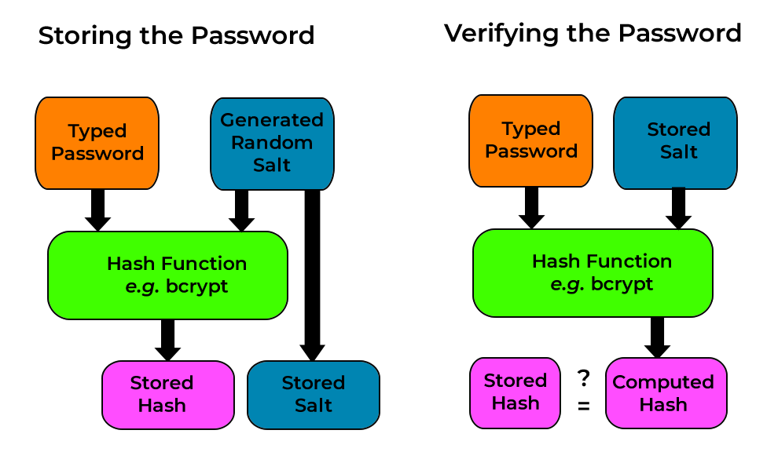
Using Salted Passwords

Slide 35
Strength of a Password
Expressed as “bits of entropy,” log₂ of number of possible values if the password is selected randomly.
Example: A bank ATM PIN
  10 symbols, so 3.32 bits (roughly) per digit.
  Four digits, so 3.32 × 4 = 13.28 bits
  About 2^{12.28} or about 5,000 tries to guess a random PIN
  Only if the PIN is chosen randomly. (If I used my birth year, ten guesses would likely be enough.)
Notes:
We express the strength of a password as bits of entropy, how much potential randomness is there. Actually, the slide says it better, log2 of possible values if the password is selected randomly given some alphabet and some length. An example is the automatic teller machine personal identifying number on a bank, typically four digits. Our alphabet is the decimal digits. There are ten of them. About 3.3 bits per digit. Where that comes from is log₂10. You can type that into Google, and it’ll tell you the answer, right. You can guesstimate it yourself because 3 bits of entropy would give you 8 values. 2³ is 8. Four bits would give you 16. It’s somewhere between 3 and 4, and it’s closer to 3 than 4. You can estimate that stuff without being able to take log₂10 in your head and without typing it into Google or into your calculator. Four digits in that personal identifying number, so about 13¼ bits of entropy all together. That means that it would take about 5,000 tries to guess a random personal identifying number. 5,000 is about half of 2^{13.24}.
There’s another way of thinking about that. There are 10,000 combinations of four digits. On the average, you’d have to try half of them. If you just started at 0000, 0001, on the average you’re going to hit it by the time you’ve gone halfway through.
If the PIN is chosen randomly. If I decided—and I didn’t, so just don’t even think about it. If I decided to use my birth year as my personal identifying number. Everybody knows that I’m 60–harrummmph years old. It would take you far fewer tries because of the thing that I just told you which you already knew. Ten guesses is going to be enough. There’s only ten possible birth years for somebody who is 60-harrummph in 2013. Do you see the importance of randomness even for something like that personal identifying number? If there’s some kind of pattern, all this business about bits of entropy business is blown right out the window. Do not use your birth year, your street address, the last four digits of your Social Security Number, or any other four-digit number that’s already something else. Make one up!

Slide 36
Another Example
Alphanumeric passwords (letters and numbers)
If case-insensitive, there are 36 symbols and 5.17 bits of randomness each.
Make it case-sensitive: There are 62 symbols and 5.95 bits. Adding case-sensitivity increased entropy by less than one bit!
Eight-character password: 5.95 × 8 = 47.6 bits.
Notes:
Alphanumeric passwords, letters and numbers. If we’re going to do a case-insensitive password, then there are 36 symbols—26 letters, 10 digits. About 5.17 bits of randomness. 2⁵ is 32. A little bit more than that. Five and a little bit of change. If you actually take log(2³⁶), you get 5.17.
If I make it case-sensitive, I have increased the number of symbols to 62. There are 52 upper and lower-case letters and 10 digits. Notice what happened to my random, my bits of entropy. Only from 5.1 to 5.9. Making the password case-sensitive added less than 1 bit of entropy. If I had an eight-character password, then I have about 47.6 bits of entropy, 5.95 x 8.

Slide 37
Yet Another Example
Assume a password from the list of 500 most common passwords:
http://www.whatsmypass.com/the-top-500-worst-passwords-of-all-time
About 9 bits of entropy. (2⁹ = 512)
So, about 256 searches
¼ second at 1,000 per second!
Notes:
Here’s the example that ought to get everybody’s attention. If you follow the link that’s on the slide, you will find the list of 500 most common passwords. You should look at that list.. If your password is on this list, change it today. You only have about 9 bits of entropy. 2⁹ is 512. If I’m searching sequentially through all of the passwords on that list of 500 most common, on the average I go about halfway through it. On the average, I’ll make 256 tries before I guess your password if it’s on that list. If I can test at 1,000 a second, I do that in a quarter of a second. I can really test in billions per second if I do something with some GPU cards. I can essentially guess a password out of that list in time that is so close to zero, we can’t even bother measuring it.

Slide 38
Strength of a Password
Anderson’s formula:
P probability of guessing a password in specified period of time.
G number of guesses tested in one time unit.
T number of time units.
N number of possible passwords (|A|)
This is really the bits of entropy.
Then P ≥ TG/N.
Notes:
Anderson’s formula: We want to pick the probability of guessing a password within a specified time. We’re going to set G to the number of guesses in one time unit. T to that specified time. Let us say that I wanted—just as an example, and I’m not going to try to work this one out. Let us say that we want to be able to have a probability of 50% or less guessing the password in 100 years on a computer that can make a million guesses per second. That’s how we’re filling this in. Probability, 50%. Some period of time, 100 years. Some number of guesses per second. I can make that be 1 million or even 1 billion. The number of possible passwords is the cardinality of the alphabet. The size of the password within its alphabet. Let us say an eight-character password with all 95 printable characters allowed. That would be 8⁹⁵ power, unless it’s 95⁸ power. I can take time times number of guess per second divided by N, the number of possible passwords. That’s going to give me P.
Ross Anderson, Security Engineering
|X| means the cardinality of the set X. In this example, A is the set of all possible values that could be used to prove identity. This one addresses finding computationally secure passwords. Anderson’s formula applies iff the passwords are random.

Slide 39
Example
Goal
  Passwords drawn from a 94-character alphabet
  Can test 10⁹ guesses per second
  Probability of success to be ≤ 0.5 over a 365-day period
  What is minimum password length required?
Solution
  N ≥ TG/P = (365×24×60×60)×10⁹/0.5 = 6.31×10¹⁶
  Choose s such that 94^{i} ≥ N
  So s ≥ 9, meaning passwords must be at least 9 characters long. But only if they’re random!
Notes:
94 characters is the printable ASCII set.
Six characters gets you 6.9 x 10¹¹ combinations.
Suppose that I have a 94-character alphabet. Printable characters except space maybe. I can test 10⁴ guesses per second. I want the probability of success in this case to be less than half within a year. The question then is what is the minimum password length I have to have given those parameters? What has happened here is that we’ve refactored this thing to get N on the left. N has got to be greater than or equal to time times number of guesses divided by probability. We’re doing time in seconds because we have guesses per second. 365 days times 24 hour times 60 minutes times 60 seconds gives us our time, times 10⁴ guesses per second divided by 0.5. That gives us 6.3x10¹¹. I need to choose s, the password length, such that the sum of 94^{i} from 0 to s, the length, is greater than or equal to N.
Do I need to do that again? Yes.
If I have a one-character password, that is 94¹. Plus two-character password, 94². Three-character password, 94³. All the way up to s, whatever it will be. I’m going to set s such that this comes out to be greater than or equal to 6.3x10¹¹, namely 6.9 x 10¹¹ combinations.
[Student asking a question.]
10⁴, so 10,000 guesses per second. I can make this 10⁸ and go through there and plug the formulas some more. It’ll work for any number of guesses per second you like. What’s going to happen is that the password gets longer and longer.
I guess the good news—and none of this is on the slide. I say that for the benefit of the people who are trying to do this by remote control. I guess the good news is that there are a number of programs. Password Safe is one of them that will memorize your passwords for you and let you use truly long and random passwords. You have one master password that opens your password safe. It is never used anywhere else. Password Safe or one of the other, KeyPass, LastPass—there are several of them—will store your password file for you and fill passwords in on the Web for you. I have not experimented with any one of these things, although I’m going to mess around with the Password Safe one. There are others. The reason that I have picked Password Safe is that it was designed by Bruce Schneier, who is a pretty well-known cryptographer. I have a fair amount of confidence that it works. Unlike some of the others, it does not require a network connection. Nothing is stored anyplace else. If you lose your hard drive, you’re toast. So you need to be backing that stuff up. That’s where we’re ending until somebody gets a better way of doing two-factor authentication.

Slide 40
Users Make Bad Choices
Users may pick short passwords
  In one study, 3% were three characters or less, easily guessed
  System can reject choices that are too short
Users may pick guessable passwords
  So, crackers use lists of likely passwords
  One study of 14000 encrypted passwords guessed nearly 1/4 of them
  It would take about 1 hour on fastest systems to compute all variants, and only need 1 break!
Notes:
Users pick short, bad, guessable passwords. If you say, “Go pick a password,” you’re toast. Your textbook says in one study, 3% of passwords from a password file were three characters or less. I start with aaa and trudge through until I am done. I can do all of them much faster than I can get a cup of coffee. I can make my system reject choices that are too short, but then we have to go back to how long does the password have to be? And how long does it have to be requires some assumptions about guesses per second and how long the password has to withstand that kind of an attack.
People pick guessable passwords. Another researcher got a list of 14,000 passwords off of a system and, using the list of likely passwords, guessed a quarter of them.
One study of nearly 14,000 encrypted password, was tested, with results, which the author rightly characterizes as frightening, shown in Table 3.2 in the text, where nearly one-fourth of the passwords were guessed. The test involved about 3 million words. Using the fastest Thinking Machines implementation listed earlier, the time to encrypt all these words for all possible salt values is under an hour. Keep in mind that such a thorough search could produce a success rate of about 25%, whereas even a single hit may be enough to gain a wide range of privileges on a system.

Slide 41
User Selection
People pick easy to guess passwords:
Based on account names, user names, computer names, place names.
Dictionary words (also reversed, odd capitalizations, control characters, “elite-speak”, conjugations or declensions.)
Too short, digits only, letters only.
License plates, acronyms, social security numbers.
Personal characteristics or foibles (pet names, nicknames, job characteristics, etc.)
Notes:
People will choose amex for their American Express account password. Please don’t do that. It’s easy to remember. People will use dictionary words or they will permute a dictionary word, capitalize things weirdly, use this “elite-speak” stuff where we substitute digits for letters that look the same, use conjugations or declensions of verbs. Short words, digits only, letters only. 12345678 is about number 8 or 10 on the list of most common passwords.
License plate numbers, acronyms, Social Security Numbers, personal characteristics. I think I told about hacking into my co-worker Tracy’s computer with the name of her dog. I bet you she hasn’t done that in a long time.

Slide 42
Proactive Password Checking
Analyze proposed password for “goodness”
Always invoked
Can detect, reject bad passwords for an appropriate definition of “bad.”
Discriminate on per-user, per-site basis.
Needs to do pattern matching on words.
Needs to execute subprograms and use results, a spell checker, for example.
Easy to set up and integrate into password selection system.
Notes:
We can, when someone is setting or changing a password— Many of you have taken Web Development, and you had to change your password. The server griped at you if you entered a dictionary word or a password that was too short or any one of a number of other combinations. We can run a program that checks passwords as they are being set up and reject those that are bad, except we need a suitable definition of bad. Password+ is one of those things. I think we mention its name on the next slide. A password checker needs to be able to do pattern matching. We can do that with regular expression. Execute subprograms like a spell-checker. If I check the spelling of a word, I instantly know whether or not it’s a dictionary word. If it’s spelled right, it’s a dictionary word. We would like such a checker to be easy to set up.

Slide 43
About “Forcing” Compliance
“Your password must be eight characters and must have at least one capital letter, one small letter, one digit, and one punctuation mark.” – The Security Nazis
That is less secure than a random password from the 94 printable characters.
Random password: about 6.55 bits of entropy per character, 52.4 bits for an 8-character password.
Notes:
The Security Nazis—and we have some of them around here—set up rules for passwords. I happen to have an account with IBM Corporation as part of my employment with the state of Georgia. The folks downtown have said, “You’ve got to change your IBM password every 30 days. It has to be these number of things.” Guess what. I change it every 30 days by adding 1 to a number that is embedded in the middle of it. If you can find one of my IBM passwords, you can find all of them. You really probably need to find two to detect the pattern. If you found two of them, you can find them all. That password Nazi business made things much worse rather than more secure.

Slide 44
That Restricted Password
One capital letter 4.70 bits
One small letter 4.70
One digit 3.32
One punctuation 5.05
Four unrestricted 23.62
Total 43.97 bits
The unrestricted password, if selected randomly, is over 256 times more secure than the forced password.
Notes:
Suppose we say you’ve got to have at least one capital letter, one small letter, one digit, and one punctuation mark. We can prove, by looking at bits of entropy, that such a password is less secure than a random password chosen from the same alphabet. The random password, eight characters out of 94 printables, about 6½ bits of entropy per character, so 52 bits for an eight-character password. If I’m going to have one capital, one small, one digit, and one punctuation, suddenly I’ve constrained the alphabet. One capital letter gets me 4.7 bits of entropy. One small letter, another 4.7. A digit, 3.32. We saw that earlier in the day. Punctuation, there’s a fair amount of punctuation marks. A little more than 5. The remaining four are unrestricted. I’ve constrained four of the eight characters in that password. The adversary doesn’t know which four but knows that four of them are constrained. Instead of 52 bits of entropy, I have 44 bits of entropy. The unrestricted password is 256 times more secure than the one that the password Nazis make you use if the unconstrained password is truly random. That’s the deal. If the unconstrained password is password, then all bets are off. We’re doomed.

Slide 45
Password Aging
Forcing users to change passwords after some time has expired.
Give users time to think of good passwords.
Don’t force them to change before they can log in.
Warn them of expiration many days in advance.
Notes:
Password aging. A password expires after some time. I don’t like that. The reason that you would want to change your password is you have some belief that it has been compromised. As long I don’t have any belief that my password has been compromised, why would I change a good password? Especially if I’m going to have to change it very frequently like every 30 days. I’m going to build something that has a pattern in it because that’s the only way that I can deal with it. If I build something that has a pattern in it, it’s not random anymore.
From a system viewpoint, if we want to force user not to reuse passwords, we can record the previous ones and make sure that they’re not just doing A-B-A-B-A-B. The author talks about blocking changes for some period of time. It’s a bad, bad idea. Here’s the thought. If I allow people to change their passwords anytime they want to, they’ll change it to something long and horrible and then immediately change it back, which people might really do. If I have blocked password changes and the password really does become compromised, then the system is toast! Even if the user is warned, “Your password has been compromised,” before anything bad happens, they’ll sit there and say, “So? I can’t change it. Changes are blocked. What do you want me to do?” If that happens to be your bank account, that’s kind of bad news. What that means is you need a better class of bank.
If one is going to age passwords, give them some time to think about it and warn of the expiration many days in advance. I think aging passwords is a bad idea. Change passwords if they’re compromised; otherwise, leave them alone.
From Cliff Stoll’s book…
I have a PDF version of the book (as well as my hard copy) so I will used chapters rather then page numbers:
"From the mail file of an engineer:
"Hi, Ed!
I'll be on vacation for the next couple weeks. If you need to get any of my data, just log into my account on the Vax computer.
Account name Is Wilson, password Is Maryanne (that's my wife's name). Have fun!"
The hacker had fun, even if Ed didn't." - Chapter 4
"In a physicist's area, he found one: an old file that described the way to get into a Cray supercomputer at Lawrence Livermore Labs.
To keep people from guessing passwords into their supercomputer, Livermore also used random computer-generated passwords, like agnitfom or ngagk. Naturally, nobody can remember these passwords. Result? Some people save their passwords in computer
files. What good is a combination lock when the combination's scribbled on the
wall?"
[...]
"That's him," I said. "The hacker found the password a couple hours ago. Got
the password from a command file here in Berkeley."
"I'll kill that account. Cromwell can use our system, when he learns to keep his passwords secret." She saw the problem as ignorant users, not unfriendly systems that forced people to use bizarre passwords like agnitfom."- Chapter 16
Hope that helps.

Slide 46
One-Time Passwords
Password that can be used exactly once
  After use, it is immediately invalidated
Challenge-response mechanism
  Challenge is number of authentications; response is password for that particular number
Problems
  Synchronization of user, system
  Generation of good random passwords
  Password distribution problem
Notes:
A one-time password is one that can be used exactly once, and it is invalidated. You can do that with an electronic token that generates a pseudo-random sequence. You can do it with a pad of paper with passwords on it. I cross this one off after I use it and cross that one off and cross that one off. Use the first one that’s not crossed off. Of course you could mess up. Resynchronizing is not going to be easy.
Challenge response. We send a number and do some kind of computation on that number, possibly by looking up a password in position n in the list. There are some problems with one-time passwords. One of them is synchronization of user and system. Generating good random passwords is not easy. Using math.rand isn’t going to make it. The bad guys can use math.rand too. Distributing passwords is a problem.

Slide 47
Hardware Support
Token-based
  Used to compute response to challenge
    May encipher or hash challenge
    May require PIN from user
  magnetic stripe card
  memory card
  smartcard
Temporally-based
  Every minute (or so) different number shown; computer knows what number to expect when.
  User enters number and fixed password.
Notes:
There is a gadget called a YubiKey. That is USB thingy that’s about that long and apparently made out of titanium or something because it’ll go on your key ring. That will generate a series of one-time random passwords. I’ve ordered one of these things to mess with it. It looks like it’s good for some.
I can use token-based authentication. That’s the YubiKey thingy. I can use something that is computational, in this case, a USB key with a chip on board that can do computations. It can do encipherment or maybe run the challenge through a hash code. I can use a magnetic stripe card for a password. This is something you have. Or a memory card or a smartcard. The difference between the two is the smartcard has computational capability. The memory card does not. The RFID that I use to open this door is a memory card, no computation. It provides the same number every time I swipe it at the door.
We talked about the RSA Secure ID sometime fairly recently. This is the gadget that produces a new pseudo-random number in the window every 90 seconds or so. The computer knows what number is expected because it knows the same pseudo-random sequence. The user enters the number from the hardware-based token and a fixed password. We’ve got two-factor authentication. Something you know, that fixed password. Something you have, the token which provides the pseudo-random number.

Slide 48
Memory Card
Stores but does not process data.
Magnetic stripe card, e.g. bank card.
Electronic memory card.
Used alone for physical access.
With password/PIN for computer use.
Drawbacks of memory cards include:
  need special reader.
  loss of token issues.
  user dissatisfaction.
Notes:
A smartcard is credit-card shaped but has a processor, memory, and I/O and is typically powered by induction. There’s no battery on there. There is an electric field in the reader that induces current into the smartcard enough to power it while it is being used.
Memory cards can store but not process data. The most common such card is the bank card with a magnetic stripe on the back. A magnetic stripe can store only a simple security code, which can be read (and unfortunately reprogrammed) by an inexpensive card reader. There are also memory cards that include an internal electronic memory. Memory cards can be used alone for physical access, such as a hotel room. For computer user authentication, such cards are typically used with some form of password or personal identification number (PIN). A typical application is an automatic teller machine (ATM). The memory card, when combined with a PIN or password, provides significantly greater security than a password alone. An adversary must gain physical possession of the card (or be able to duplicate it) plus must gain knowledge of the PIN. Among the potential drawbacks are the following [NIST95]:
• Requires special reader: This increases the cost of using the token and creates the requirement to maintain the security of the reader’s hardware and software.
• Token loss: A lost token temporarily prevents its owner from gaining system access. Thus there is an administrative cost in replacing the lost token. In addition, if the token is found, stolen, or forged, then an adversary now need only determine the PIN to gain unauthorized access.
• User dissatisfaction: Although users may have no difficulty in accepting the use of a memory card for ATM access, its use for computer access may be deemed inconvenient.

Slide 49
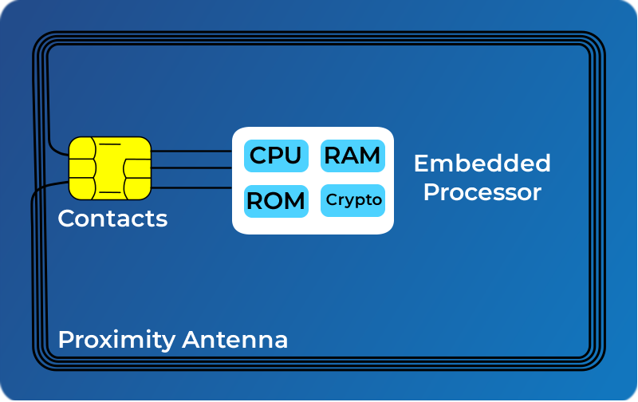
Smartcard
Credit-card like.
Has own processor, memory, I/O ports.
  Wired or wireless access by reader.
  May have crypto
  co-processor.
  ROM, EEPROM,
  RAM memory.
Executes protocol to
authenticate with
reader/computer.
Smart card base image by Aurélien Greuet. CC-BY-SA
Notes:
For user authentication to computer, the most important category of smart token is the smart card, which has the appearance of a credit card, has an electronic interface, and may use any of the possible authentication protocols (static, dynamic password, challenge-response; see text). A smart card contains within it an entire microprocessor, including processor, memory, and I/O ports, as shown in Figure 3.4 from the text. Some versions incorporate a special co-processing circuit for cryptographic operation to speed the task of encoding and decoding messages or generating digital signatures to validate the information transferred. In some cards, the I/O ports are directly accessible by a compatible reader by means of exposed electrical contacts. Other cards rely instead on an embedded antenna for wireless communication with the reader. A typical smart card includes three types of memory. Read-only memory (ROM) stores data that does not change during the card’s life, such as the card number and the cardholder’s name. Electrically erasable programmable ROM (EEPROM) holds application data and programs, such as the protocols that the card can execute. It also holds data that may vary with time. Random access memory (RAM) holds temporary data generated when applications are executed. Figure 3.5 in the text illustrates a typical interaction between a smart card and a reader or computer system. An alternative to the smart card is a small, inexpensive flash memory device known as a USB dongle. It has the same functionality as a smart card, but connects to the existing USB port on a computer, hence it does not need a specific card reader.
Image: publicdomainvectors: https://publicdomainvectors.org/en/free-clipart/Credit-Card-Vector-Template/3631.html

Slide 50
Biometric Authentication
Authenticate user based on one of their physical characteristics.
Fingerprint and facial geometry most common.
Also, hand geometry, retina, and iris.
Static (image) and dynamic (motion) signature recognition.
Notes:
Biometrics. Remember those three factors were something you know like a password; something you have like a USB key or even a metal key; something you are, some characteristic of your biology, your iris geometry.
Accuracy and cost. Voice recognition, fairly cheap but not at all accurate. Facial recognition is a hard, hard problem. Signature recognition. The cost is going up, but the accuracy is still sitting down there near zero. Hand geometry. In the middle, fingerprint and retina print. Middle in cost for both of those and middle accuracy. High accuracy and high cost, the image of one’s iris. If you look into your eyes and see what they look like. Some problems with those, and I think it must be on the next slide is people are going to get reactions like mine. “Not with my eye you don’t. Not with that laser, thank you very much.”
A biometric authentication system attempts to authenticate an individual based on unique physical characteristics.These include static characteristics, such as fingerprints, hand geometry, facial characteristics, and retinal and iris patterns; and dynamic characteristics, such as voiceprint and signature. Compared to passwords and tokens, biometric authentication is both technically complex and expensive, and have yet to mature as a standard tool for user authentication to computer systems. Figure 3.6 from the text gives a rough indication of the relative cost and accuracy of the most common biometric measures:
• Facial characteristics: define characteristics based on relative location and shape of key facial features, such as eyes, eyebrows, nose, lips, and chin shape.
• Fingerprints: the pattern of ridges and furrows on the surface of the fingertip, believed to be unique across the entire human population. Automated fingerprint systems extract a number of features to use as a surrogate for the full pattern.
• Hand geometry: identify features of hand,: e.g. shape, lengths & widths of fingers.
• Retinal pattern: formed by veins beneath the retinal surface is unique and therefore suitable for identification. Uses a digital image of the retinal pattern by projecting a low-intensity beam of visual or infrared light into the eye.
• Iris: Another unique physical characteristic is the detailed structure of the iris.
• Signature: each individual has a unique style of handwriting, especially in signatures.
• Voice: patterns are more closely tied to physical and anatomical characteristics of the speaker, but still have a variation from sample to sample over time from the same speaker, complicating the biometric recognition task.

Slide 51
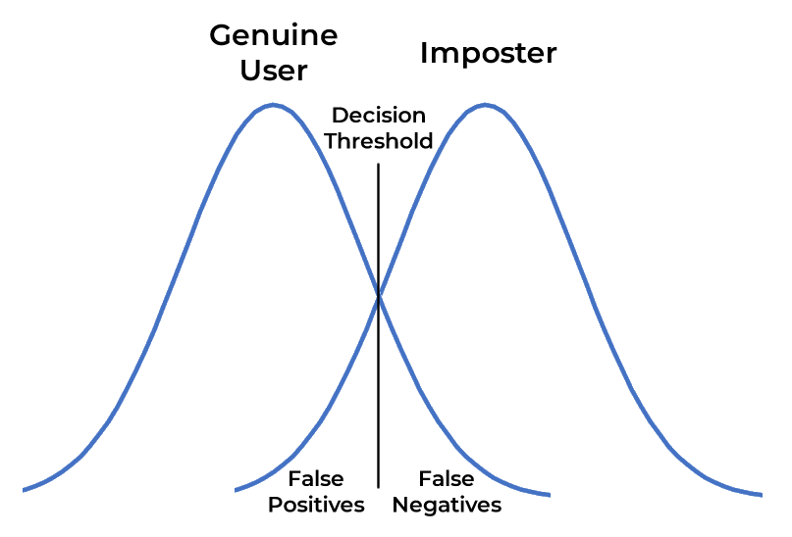
Biometric Accuracy
Multiple tries never get identical templates.
So, there are problems of false match / false non-match.
Notes:
Another picture from the textbook. The point here is that there is some overlap. Impostor profile on the left hump of this camel-looking graph. Genuine user on the right hump. And some overlap. In the blue area, we have a false negative. It’s the legit user, but the system decides they are not legit. In the grey area, we have the false positive. It’s an impostor, but the system lets the impostor in. Don’t have perfect checking here.
In any biometric scheme, some physical characteristic of the individual is mapped into a digital representation. For each individual, a single digital representation, or template, is stored in the computer. When the user is to be authenticated, the system compares the stored template to the presented template. Given the complexities of physical characteristics, we cannot expect that there will be an exact match between the two templates. Rather, the system uses an algorithm to generate a matching score (typically a single number) that quantifies the similarity between the input and the stored template. Figure 3.8 illustrates the dilemma posed to the system. If a single user is tested by the system numerous times, the matching score swill vary, with a probability density function typically forming a bell curve, as shown. On average, any other individual should have a much lower matching score but again will exhibit a bell-shaped probability density function .The difficulty is that the range of matching scores produced by two individuals, one genuine and one an imposter, compared to a given reference template, are likely to overlap. In Figure 3.8 a threshold value is selected so that if the presented value is s>=t then a match is assumed, and for s< t, a mismatch is assumed. The shaded part to the right of t indicates a range of values for which a false match is possible, and the shaded part to the left indicates a range of values for which a false nonmatch is possible. The area of each shaded part represents to probability of a false match or nonmatch, respectively. By moving the threshold, left or right, the probabilities can be altered, but note that an decrease in false match rate necessarily results in an increase in false nonmatch rate, and vice versa.

Slide 52
Assumptions
Assumes biometric device accurate in the environment in which it is used!
Assumes transmission of data to validator is both tamperproof and correct.
Notes:
Everybody is all hot to do biometric authentication and maybe even biometric identification. First off, the technology is getting better but isn’t really ready for prime time. Then there are assumptions. One of them is that the measurement device is accurate in the environment in which it’s used. Do you believe that fingerprint readers will get grime on them if enough people use them?
The Denver airport a few years ago was going to be completely automated baggage handling, untouched by human hands. Sure as shooting, they could crush those suitcases without anybody ever touching them because they fell out of the train cars and then got run over. The underlying problem, or a worse problem -- I can make bigger sides on the little baggage train cars. The cars barcodes and reflective tape on the side. The barcode identifies the car. The computer says, “Ah, this is car 1234. It needs to go over to gate A7.” The barcodes got dirty because it’s dirty down in the train tunnels under the airport. All of a sudden they weren’t readable anymore. The same thing can happen in this case.

Slide 53
Other Problems
Acceptance of biometrics.
Cost.
Normal variability.
Single point of failure.
Recognition speed.
Possibility of forgery.
Notes:
We also have to worry about all of those things we talked about when we were talking about passwords and key exchanges. Transmission from the reader to the validator is tamper-proof and correct. Correct transmission is not hard these days. We have error-checking codes and things like that. Tamper-proof transmission, that’s a lot harder. Can I tap the wire coming out of that reader and, when the dean waves his card at it, capture that and play it back into the wire later or into a different wire? I can open this door, but he can open doors I can’t. I bet I could.
Student: I read an article a while back that says that -- I don’t remember who it was or what it was, but they found a way to get biometric data from the database that it was stored in and take that and recreate the fingerprints on it.
Professor: Oh yeah!
Student: They’re going to be able to just use that to not only to make it into that one place, but they can get into all of the places like you just said by just taking the data from where it was stored.
Professor: Right! If I can construct a mathematical model of my fingerprint and inject it into a biometric system that’s trying to read my fingerprint, I can go anyplace my finger, his finger will let me. Of course there’s also the story about the mafias who needed to get into the fingerprint protected area. The guy whose finger it was would not cooperate with them at all, so they took it with him. Left him there, just took his finger.
[Can’t hear student.]
A piece of Scotch tape has fooled fingerprint readers. This stuff all sounds slick. It sounds very cool. It is not usually, mostly ready for primetime.
We talked about acceptance already. “Not with my eyes you don’t. Not with that laser.” Cost. Normal variability. Recognition speed might not be as good as one wants. Then we have forgery. “I’ll just take your finger with me. We don’t need you.” You take the finger right along or take the Scotch tape or whatever.

Slide 54
Identification vs. Authentication
Does this fingerprint belong to John Doe?
To whom does this fingerprint belong?
Two very different questions.
The second is much harder. Do not conflate the two.

Slide 55
Identification and Authentication
It is not uncommon for system designers to confuse these very different concepts.
Example: consider the Social Security Number as identifier and authenticator.
  It’s a pretty good identifier.
  Is it a good authenticator?
  OK… what were they thinking of?
Notes:
I have already said this once. Systems designers confuse identification and authentication. Identification is Who are you? and authentication is Prove it. The thing that chaps my buns is people like credit card companies want me to give my Social Security Number to prove who I am. Does that happen to you? If it hasn’t, it will. How many people have my Social Security Number? A lot. Let’s think about it. All of my financial paperwork goes through, first, the IT office. There are three or four people in there. Then the dean’s office, we’re up to six. Then over to payroll and finances, a dozen people who work there. Right around here, 18 or 20 people have access to it. A whole bunch of people in my bank. A whole bunch of people at American Express, who’s my credit card company. Everybody in the HR and payroll offices where I have worked before because I had this Social Security Number a long time. It’s a pretty good bet that there are hundreds of people who legitimately know my Social Security Number. It’s a dandy identifier. At least in theory, there’s only one of it, and it belongs to me. It is a terrible authenticator because there are hundreds of people besides me who know it. When I ask you about the difference between identifiers and authenticators, you’re going to remember that.
I’ve already talked about the difference between biometric authentication—which, while not ready for primetime, works fairly well—and identification. If you think that biometric identification ought to be pretty easy, I want you to think about— Who watches crime shows on TV? “Well Inspector, we have a partial fingerprint here. We’ll send it to the FBI.” But they probably won’t be able to do anything with it. Identification is hard.

Slide 56
“Knowledge-Based Authentication”
A thoroughly bogus idea!
Premise: Only you will know things like:
  Your former address
  Your mother’s maiden name
  Your Social Security Number.
All of these can be researched.
Authenticators should never be researchable!

Slide 57
Questions

