Slide 1

IT 3123 Hardware and Software Concepts
Operating System Internals File Management
Notice: This session is being recorded.
Notes:
This is about 10 minutes too long.

Slide 2
Announcements
Course evaluations are available.
Chapter 6 updated in PDF, but not ePub.
Assignment 5 is due at 11:59 PM.
I will try to have it graded by the end of the day on Tuesday.
The optional assignment will be released on Wednesday and due on April 26 at 11:59 PM.

Slide 3
Bootstrapping
Execution begins with bootstrap loader (mini-loader, IPL) stored in ROM.
Looks for OS program loader (UEFI or MBR.)
Loads bootstrap code into RAM.
Transfers control to bootstrap code.
Boot code loads OS or another loader program.
Loader program in OS used to load and execute user programs.
Notes:
MBR is master boot record. UEFI is Unified Extensible Firmware Interface, the successor to the master boot record. Partition tables are different. MBR uses an MBR partition type, UEFI uses GPT : GUID Partition Table. GUID is globally unique ID. Reasons: support more partitions (MBR limited to 4) and larger disks. MBR is limited to 2 TiB, GPT 18 exbibytes.

Slide 4
OS Internal Functions
Process Scheduling
CPU Scheduling
File Management
Memory Management
Virtual Memory

Slide 5
Primary Kernel Functions
File manager: translates logical file requests into specific physical I/O requests.
I/O Control System (IOCS): performs resource allocation and device management.
Memory management: determines if it is possible to load programs and data into memory and if so, where in memory.
Scheduler: allocates time for the program to execute.

Slide 6
Operating System Services
Manages communication with other computers
Network Services
File management
Device management /
Resource allocation
Memory management
Scheduling
Monitor (Kernel)
Translates logical file requests
IOCS (I/O control system)
Load programs into memory; allocates mem.
Allocates execution time
Provides overall system
control

Slide 7
Multiprogramming System
The OS must allocate resources (CPU, memory, I/O) to multiple processes
Different scheduling routines are used for different objectives

Slide 8
Processes
Process: basic unit of work in the OS.
A program together with all the resources that are associated with it as it is executed.
Program: a binary file, instructions in machine language.
Process: a program being executed.
PID (process ID): a unique identifier for each process.

Slide 9
Process Creation and Context
Process creation
Forking, spawning, cloning a new process.
Parent and child processes.
Process context
All relevant register data including the program counter.
Allows interruption and restart transparently.

Slide 10
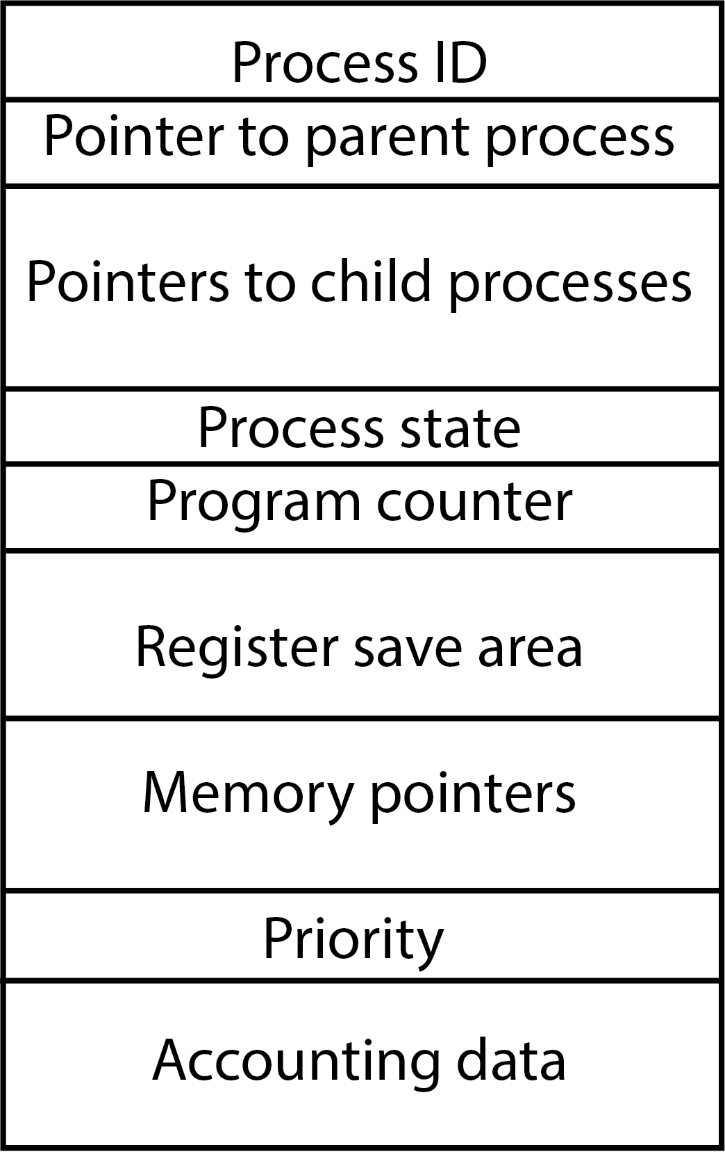
Process Control Block
A block of data for each process in the system.
Contains all relevant information about the process.
Typical process control block on the right.

Slide 11
Process States
Three primary process operating states
Ready state
Running state
Waiting (blocked) state.
Dispatching - Move from ready state to running state.
Wake-up - Move from blocked state to ready state.
Time-out - Move from running state to ready state.
Process completion
killed, terminated, destroyed.
Additional states – suspend, swap.
Resumption – Move from suspended state to ready state.

Slide 12
O.S. Scheduling Tasks
Task | Description
High-level scheduling | Adding a program to the pool of programs being executed.
Short-term scheduling (dispatching) | Deciding which process shall be executed next by the CPU.
Mid-level scheduling | Swapping processes to/from disk.
I/O scheduling | Deciding which process’s pending I/O request shall be handled by an available I/O device

Slide 13
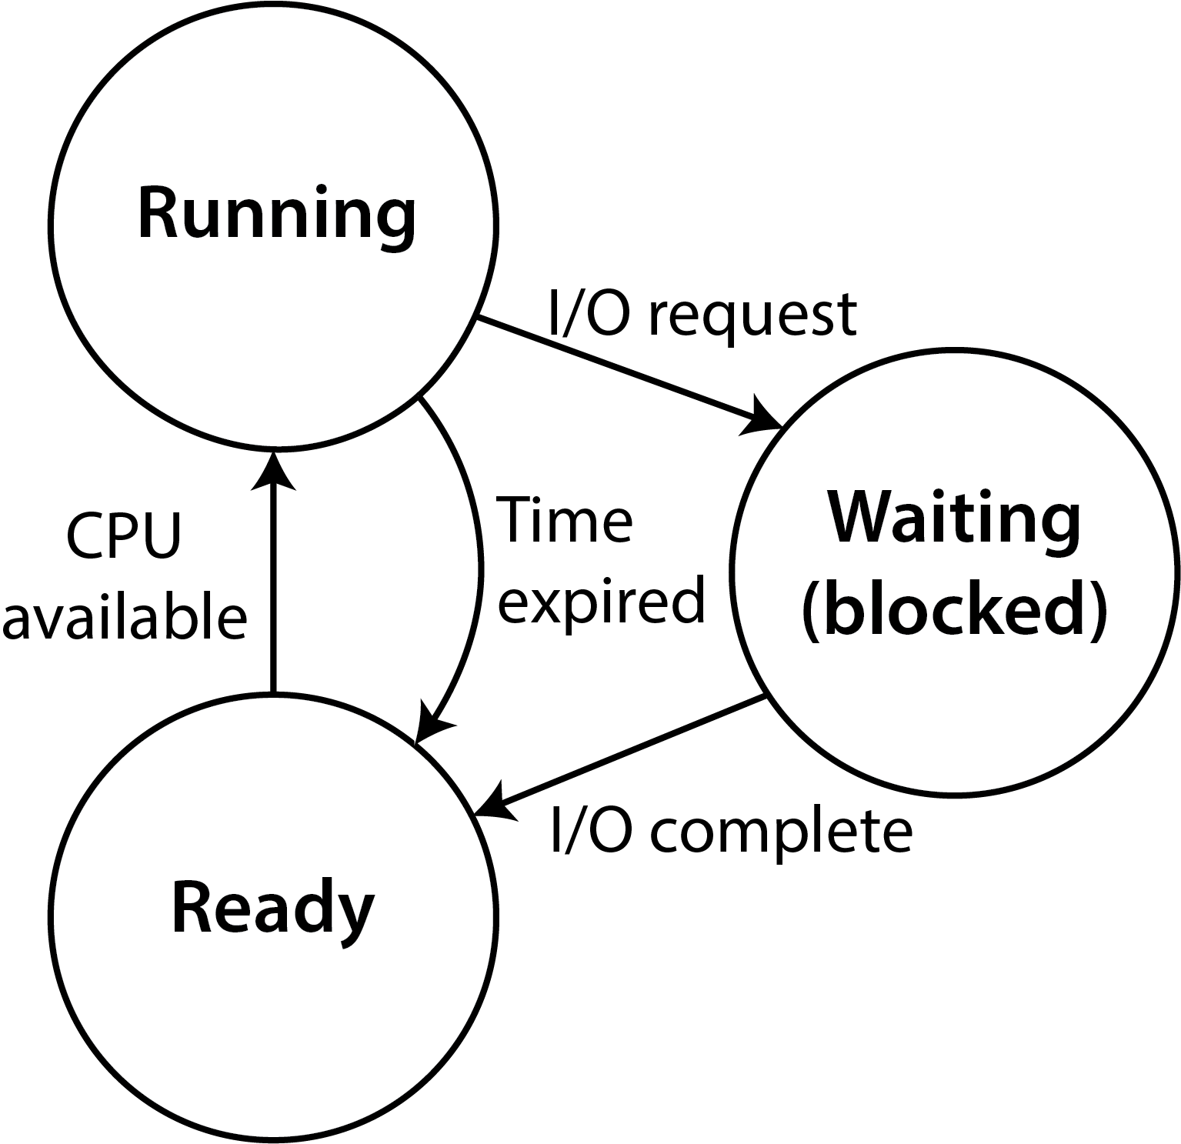
Program Dispatching
OS loads new program
Program ends

Slide 14
Dispatching Objectives
Provide minimal and consistent response time.
Maximize CPU utilization.
Maximize resource utilization.
Promote graceful degradation.
Prevent starvation.

Slide 15
Dispatching Mechanisms
First in, first out (FIFO) Unfair to short processes and I/O bound processes
Priority Scheduling
Job with the highest priority is selected.
If multiple jobs have the highest priority, then dispatcher selects among them using FIFO

Slide 16
Preemptive Dispatching
Round robin
Inherently fair and maximizes throughput.
Dynamic Priority
Based on ratio of CPU time to total time process has been in the system.
Smallest ratio has highest priority.
Linux, Windows 2000 and up.
Notes:
each process gets the same amount of time, simple and inherently fair, good on maximizing throughput, jobs penalized for IO,
UNIX variation - calculates a dynamic priority based on the ratio of CPU time to total time, if no jobs have I/O this reduces to RR

Slide 17
Threads
‘Miniprocess’ that can be run independent of other parts of the process:
Event-driven programs
Shares parent’s control block
Shares resources allocated to its parent process including primary storage, files and I/O devices.
Advantage of process/thread families over multiple independent processes:
Reduced OS overhead for resource allocation and process management
A thread needs less information than a normal PCB.

Slide 18
Secondary Storage (Disk) Scheduling
The CPU is about a million times faster than a magnetic disk.
Because the disk is comparatively so slow, it makes sense to use some CPU time to optimize disk operations. The operating system schedules disk operations (instead of first-come, first-served.)
The seek operation, moving the heads from one track to another, is the most time consuming.
Goal: minimize seek operations and seek distances.

Slide 19
Disk Scheduling Algorithms
First-Come, First-Served (Naïve approach)
Shortest Distance First
Indefinite postponement problem
Scan (elevator algorithm)
Works like the elevator in a building: the disk head does not change direction until all requests in the current direction are served.
Disk head moves (more or less) smoothly from outer edge to center and back.
Does not travel further than needed in either direction.
Possible disadvantage: middle of disk gets serviced twice.

Slide 20
Introduction to Files
Files:
Named collections of data.
On non-volatile storage (usually disk).
Require a one cluster (allocation unit) minimum.
Associations to programs.

Slide 21
File Management System
Provides a logical view for the user and hides the physical implementation.
Manages directory structures and space allocation for each I/O device.
Permits manipulation of data within a file.
Requests data transfers from I/O device drivers.
Provides file security and protection of file integrity.

Slide 22
File Management and I/O Functions
Separation between the two allows:
I/O devices can change while keeping the file system the same.
Redirecting data from one device to another is simple.

Slide 23
Operations on a File as a Whole
Copy, Move.
List, Print.
Load and execute a program.
Load file into memory.
Store file from memory.
Append data from memory to file.
Compile, assemble a file.

Slide 24
File Stream Operations
The file is viewed as a stream of bytes
Open a file.
Read a specified number of bytes from file.
Write a specified number of bytes to a file.
Move the file pointer forward or backward.
Move file pointer to beginning of a file.
Close a file.

Slide 25
File Record Operations
The file is viewed as a collection of records
Open a file.
Retrieve a record (read).
Add a record to a file (add).
Delete a record (delete).
Modify contents of a record (update).
Close the file.

Slide 26
File Access Methods
Sequential
Direct (Random)
Indexed

Slide 27
Sequential Access
File is read in sequence from beginning to end.
Majority of all files are accessed sequentially.
Program source and binary files.
Sound, video, pictures.

Slide 28
Direct (Random) Access
Assumes file is made up of fixed length logical records.
Hashing is a common method used to calculate the location of an internal logical record.
Simplified hashing example: “Brown” = 66, 114, 111, 119, 110 66 + 114+ 111+ 110 + 110 = 520 (record location.)
Problem: collisions.

Slide 29
Indexed Access
Two (or more) physical files.
A “base file” containing the data.
Index files with pointers into the base file.
The index files are organized so that they may be easily searched by key.
Example: Find the one record with the Employee Number 115030.
Example: Find all records with last name of “Brown.”

Slide 30
Blocks and Clusters
Block: a physical segment of a disk track holding data, often 4,096 or 512 bytes.
Cluster: a collection of physical blocks treated as one unit by the file system; 1K – 64 K or more. Also called an “allocation unit.”
Large cluster sizes waste space
on average,1/2 of last cluster is unused
large clusters and small files make matters worse.
Notes:
The cluster is the smallest unit of disk space that the operating system can allocate. No matter how small a file is, it will take at least one cluster on disk. Exception: Microsoft’s NTFS stores very small files, about 1 K or less, in the directory structure, specifically in the master file table, or MFT.

Slide 31
Contiguous Storage Allocation
Assign consecutive clusters to hold the file.
Access is simple for both sequential and direct methods.
Disadvantages
There must be enough space available.
Must consider file growth.
File may need to be moved if it outgrows its space.
Fragmentation of disk (holes where deleted files used to be.)

Slide 32
Contiguous Storage Allocation
Allocation strategies to minimize fragmentation:
First-fit
Best-fit
Eventually disk becomes fragmented anyway.
Defragmenting involves moving (many) files.
Solid-state drives should not be defragmented.

Slide 33
Indexed Allocation
Non-contiguous.
All link pointers are stored together in one or more blocks called the index block.
One set of index blocks per file.
Advantages
Fragmentation is less a problem.
Can be used for random access.
Disadvantage
Slower due to additional access of the index block.
Additional disk seeks needed.

Slide 34
Directory Operations
Create a new (empty) file.
Move a file from one directory to another.
Rename a file.
Append one file to another.
Delete a file.

Slide 35
UNIX i-nodes
Indexed file allocation.
Index block contains
File attributes
10 direct blocks
single, double and triple indirect blocks.
Advantages
Fast for small files
Can accommodate very large files – 100’s of gigabytes.

Slide 36
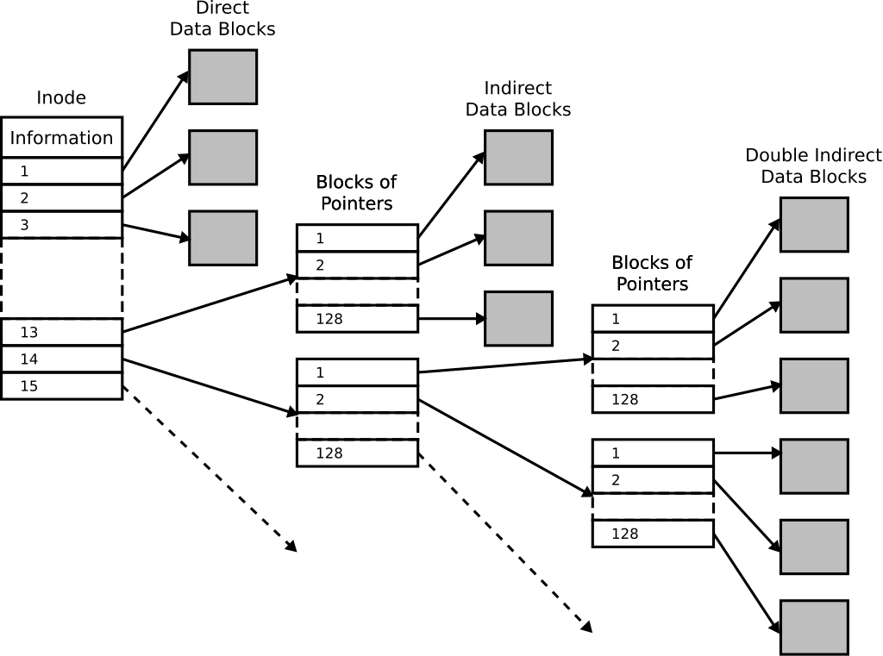
UNIX i-nodes
Wikimedia user timtjtim. CC BY-SA.

Slide 37
Windows - NTFS
Introduced with Windows NT 3.1 (1993).
Dynamically sized volumes.
Volumes may be a fraction of a disk or span many disks.
Master File Table (MFT) of 1 KiB records.
1st 16 records are attributes of the MFT itself.
Each file has an MFT entry.
Very small files (< 1 KiB) are stored directly in the MFT.

Slide 38
More NTFS Features
Access Control Lists (ACLs) allow very granular file sharing.
Journaling of metadata.
Compression.
Encryption.
Volume shadow copy.
Transactions (deprecated).
Notes:
Journaling (of metadata only) records updates of file system metadata before changes are committed to disk; that allows returning the file system to a consistent state after a crash or other failure.
Volume shadow copy allows a program such as a backup program to copy files in a consistent state; updates to open files are pended from the view of the backup, but visible to other programs. When the backup completed, updates are made permanent.
NTFS transactions ensure that updates, including updates to multiple files, either succeed or fail as a whole. “Partially updated” is not possible. Microsoft warns that transactions may not be available in future versions of NTFS.

Slide 39
Free Space Management
Bit map method
one bit for each cluster
to indicate if it is used
or free
Easy to search quickly
Linked list method
Pointer to first free cluster
Each free cluster has a pointer to the next
Clusters are allocated from the beginning
Deleted files are placed at the end
Cluster number
0-15 | 100100001111010
16-31 | 100111010010000
32-47 | 0001000000000000

Slide 40
Directory Structure
Provides a means of organization so that files can be located easily and efficiently.
Hides the physical devices from the logical view of the files.
Contains file attributes.

Slide 41
Directory Structure
Partitions
Independent subsections of a device.
Volume
Directory structure for a particular partition.
Needs to be mounted to be incorporated into the overall file system structure.

Slide 42
Tree-Structured Directory
Hierarchical with a top-level root directory from which all other directories stem.
All directories and files have names.
Separator
Used to indicate subdirectories and files located in a directory
/ UNIX.
\ MS-DOS, Windows.

Slide 43
Paths
Pathname:
Absolute – full pathname starting from the root directory.
Relative – pathname is created starting from the current directory.
Search Paths: Directory locations that the operating system uses to locate files.

Slide 44
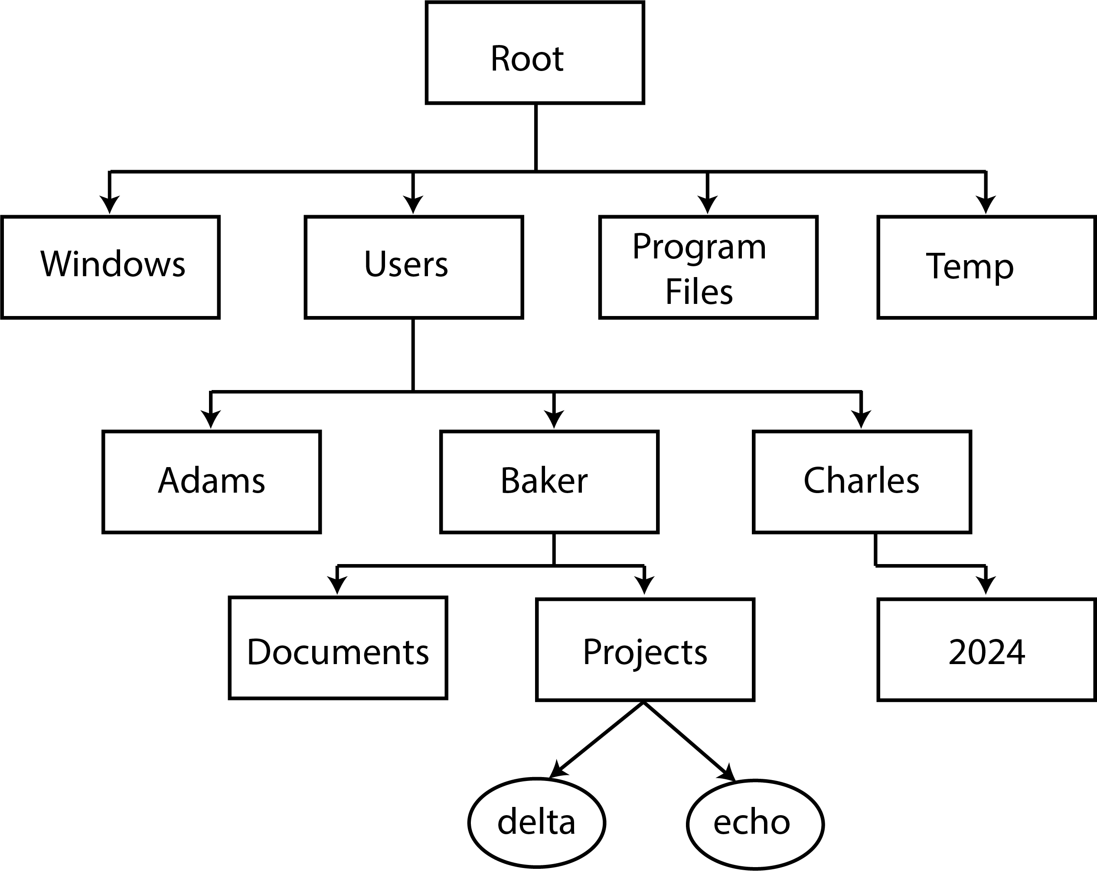
Tree-Structured Directory

Slide 45
Graph Directory Structures
Tree-structure that permits links between separate branches of the tree; a directed acyclic graph, or DAG.
Advantage: Easy user access.
Disadvantages: Possible cycles and dangling links.
Examples:
Windows shortcuts, links, and junctions.
UNIX hard and symbolic links.
Macintosh aliases.

Slide 46
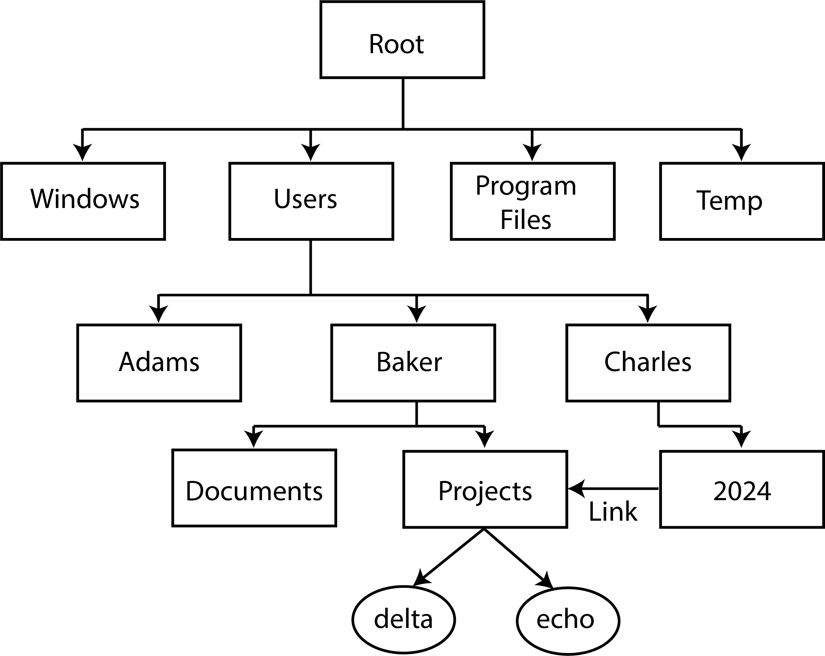
Directed Acyclic Graph Directory
Notes:
If a link is created between Charles’s “2024” directory and Baker’s “Projects” directory, Charles will see “projects” in 2024, will be able t open “projects,” and will be able to see and possibly update the files, with proper permissions.

Slide 47
Graph with a Cycle (Bad!)
Notes:
As long as the link from Charles’s “2024” and Baker’s “Projects” exists, it is forbidden to create a link from “Projects” to “Charles” because that would create a cycle in the graph. Consider a program such as one to back up files. It wants to visit every file in every directory. It visits “Charles” and finds a link to “2024.” Within “2024” it finds a link to “projects” and goes there. It finds and backs up files delta and echo, finds a link to “Charles” and follows it…

Slide 48
File Protection
Passwords.
Read, write, and execute protections.
ACL – access control list, permissions.
Unix – access: owner, group, everyone; permissions: r, w, x.

Slide 49
Resilient File System (ReFS)
Introduced by Microsoft in Windows Server 2012.
Intended to be a replacement for NTFS.
Uses 64-bit numbers for file size, directory size, etc. to handle very large files and very large disks.
Built-in self-check and with redundancy, self-correction.
Can include mirroring and parity redundancy.
At first, useable only for data storage.
It is now possible to boot from a ReFS file system.
Notes:
https://en.wikipedia.org/wiki/ReFS

Slide 50
ZFS
A file system originally designed by Sun for Solaris. Now both Oracle proprietary and open source as OpenZFS.
128-bit values allow extremely large files and file systems.
Checksums validate all data.
Redundancy with mirroring and parity, RAID Z. (Overcomes problems with RAID 5.)
Limited OS support.

Slide 51
Network OS Services
Access to data files on other computers on the network.
Print services
Print requests are redirected by the OS to the network station that manages the requested printer.
Other peripheral sharing services.
Messaging services.
API network services.
Security and network management services.
Remote processing services.

Slide 52
Access for a Networked OS
File Request
File Manager Steering
Local Request
Remote Request
Local O.S. File Manager
Network File Manager
Remote O.S. File Manager
Remote System

Slide 53
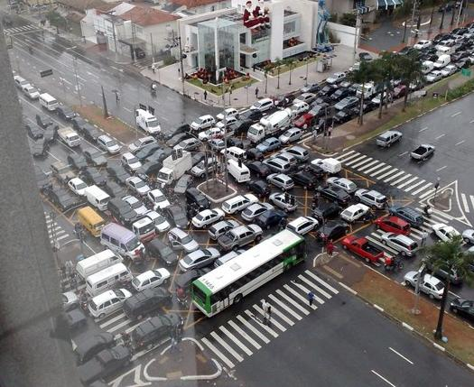
Deadlock
Two processes, each having resources that the other needs in order to proceed
Mechanisms:
Prevention
Avoidance
Detection and recovery
http://www.cs.nyu.edu/courses/fall08/G22.2250-001/lectures/diagrams/gridlock.jpg

Slide 54
Deadlock Example
Programs A and B each acquire a block of memory; together, they’ve taken it all.
Time passes and the programs run, then each program needs more memory, but there is none left.
Neither can proceed until the other releases memory: deadlock!
Unless the OS intervenes, both programs will wait indefinitely.
But either program would have been OK had the other not been running at the same time.

Slide 55
Deadlock Recovery: Preemption
In the previous example, A and B are deadlocked because no more memory is available.
The OS can preempt one process by swapping it to disk, freeing its memory.
The other process runs, and when complete, the process swapped out is allowed to run.
Resources such as optical drives are not preemptable.

Slide 56
Deadlock Prevention
Safest approach.
Also, the most potentially costly to operational efficiency.
Example:
Require a program to make all resource requests at one time.
Deadlock cannot occur because the OS will not grant any request until it can grant all.
However, the program cannot later do things like request more memory.

Slide 57
Deadlock Avoidance
The OS has the idea of a “safe level” of each resource.
A process must announce, but not necessarily allocate, its maximum amount of each resource.
The OS will not grant resources that would leave the remaining pool below the safe level.
Example: Banker’s Algorithm
A bank has a safe level of cash – a level that will let it meet most customers’ needs.
A withdrawal that would take cash below the safe level must wait until more cash comes in.

Slide 58
Deadlock Detection and Recovery
Simple to implement because deadlocks are allowed to occur.
Bad when things go wrong.
The OS attempts to detect deadlocks – the “everything stops” condition. Time consuming.
Recovery could include terminating one of the processes to release its resources; the process must be restarted after undoing work already done.

Slide 59
Questions

