Slide 1

IT 3123 Hardware and Software Concepts
Memory Management Virtual Memory
Notice: This session is being recorded.

Slide 2
What the OS Needs from the Hardware
Hardware and software are logically equivalent only if both are error-free.
A robust multiprogramming operating system needs three things from the hardware:
Privileged instructions
Protected memory
A timer that can generate interrupts.

Slide 3
Memory Management
The operating system must allocate memory to multiple processes in a multiprogramming environment.
Physically, memory is just an array of bytes.
The operating system must make sense out of that.

Slide 4
Memory Protection
If malicious or erroneous programs could read any area of memory, confidential information could leak.
If such programs could write any area of memory, they could corrupt other programs or the operating system.
Sometimes programs need to read or write areas of memory belonging to the OS.
Memory protection schemes control this.

Slide 5
Memory Protection Methods
Some IBM operating systems assigned a 4-bit code to processes and blocks of memory.
Processes could not read or write memory with non-matching codes.
Another mechanism is to assign base and limit registers to each process.
Processes could only access memory within those addresses.
Virtual memory provides another solution.

Slide 6
Memory Partitioning
Fixed partitioning: If you don’t have a big enough free partition, a program cannot run.
Variable: most flexible, but leads to…
Memory fragmentation
Free memory space is fragmented.
JGrasp
JGrasp
Word
Word
O.S.
O.S.
O.S.
O.S.

Slide 7
Allocation Strategies
First fit: fastest, but can leave small “holes”
Best fit: always leaves small holes.
Biggest fit: may leave an area big enough to be useful.
First fit / best fit: The remaining area is unusably small.
Biggest fit: two potentially useful areas of memory are left.
New Program
JGrasp
JGrasp
JGrasp
New Program
O.S.
O.S.
O.S.

Slide 8
Internal and External Fragmentation
Internal fragmentation: Memory has been assigned but is not being used.
External fragmentation: Memory is unassigned, but too small to be useful.
Fragment
Assigned
JGrasp
JGrasp
Fragment
New Program
O.S.
O.S.
Internal Fragmentation
External Fragmentation
Notes:
In the internal fragmentation example, Jgrasp has been assigned the memory marked by the curly brace, but is only using a part of it. The rest is unused and represents internal fragmentation. The fragment will not be recovered until the Jgrasp process enads.

Slide 9
Memory Relocation
Programs are compiled and linked to specific starting addresses, often zero.
Addresses must be adjusted (relocated) unless relative addressing is used.
This is part of memory management.
Next program must load here. Address is not predictable at link time.
JGrasp
Word
O.S.

Slide 10
Overlays
Programs are divided into small logical pieces for execution.
Pieces are loaded into memory as needed.
Overlays are managed by the application program, not the OS. (Messy!)

Slide 11
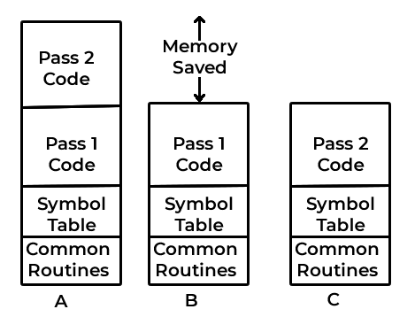
Why Overlays?
Notes:
A shows a hypothetical two-pass assembler program. Without overlays, the code for both passes is loaded into memory. B and C show the same program with the pass 2 not loaded in B, and then overlaying the pass 1 code in C.

Slide 12
Automating Overlays
Logical Physical
Pages
Page Frames
Notes:
Overlays can be automated by dividing a program’s address space into pages. 4 KiB is a common size for a page, but modern computers with large memories may use much larger pages. Physical memory is divided into “page frames” that are the same size as the virtual pages. This is the basis for virtual memory.
The red line shows that the pass 1 code occupies a part of a virtual page. When using virtual memory, the remainder of that page would be unused.

Slide 13
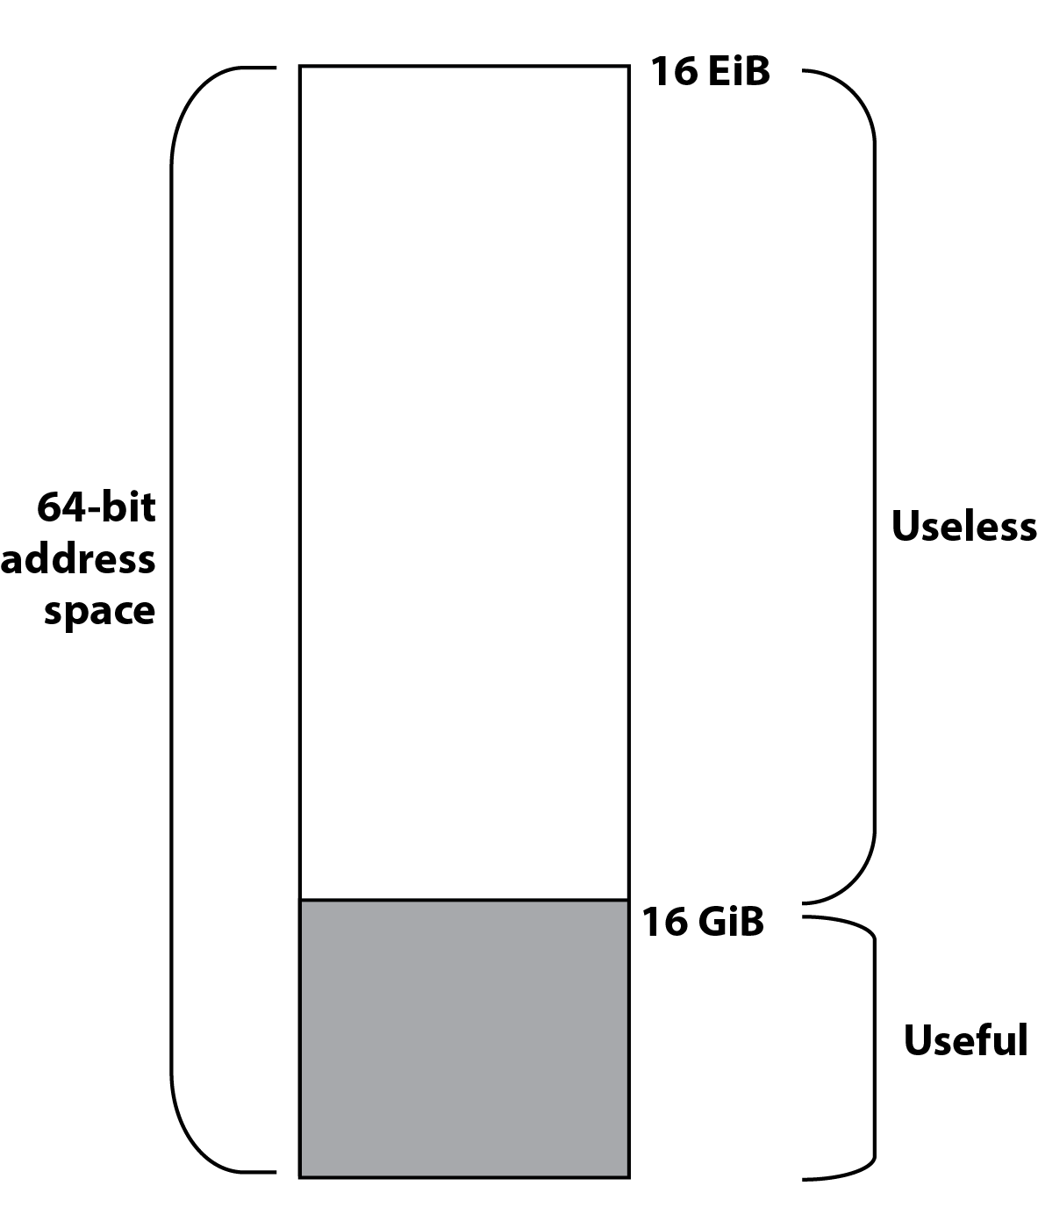
Usable and Unusable Address Spaces
Memory map: This computer has a 64-bit address space, but only 16 gibibytes of installed memory. The remaining memory is addressable, but not useful because there is no memory installed.
Notes:
A 64-bit address spans 16 exbibytes, but this computer has only 16 gibibytes. On startup the OS tests or queries memory to see how much is available.

Slide 14
Virtual Memory
Virtual memory increases the apparent amount of memory by using far less expensive hard disk space.
Provides for process separation (memory protection.)
Demand paging: Pages brought into memory as needed.
Page table: Keeps track of what is in memory and what is still out on hard disk.

Slide 15
Locality of Reference
Temporal locality of reference: If a page has been used recently, it is likely to be used again “soon.”
Spatial locality of reference: If an area of memory is accessed, nearby areas are likely to be accessed “soon.”

Slide 16
Locality of Reference
Most memory references are confined to small regions.
Well-written program in small loop, procedure or function.
Data likely in array and variables stored together.
Working set: Number of pages sufficient to run program normally, i.e., satisfy locality of a particular program at a particular moment.
Thrashing (bad) Too many page faults affect system performance.

Slide 17
Transparent Virtual Memory
The programmer codes as though the entire logical address space were available.
Virtual memory is transparent to the programmer. (It’s there, but you can’t see it.)
The entire program and in-memory data is stored on disk.
Pieces of the program and data (pages) are read into main memory (page frames) as needed. This is demand paging.
Paging takes time, even with solid-state drives.

Slide 18
Vocabulary: Frames and Pages
 | Program | Memory
Unit | Pages | Frames
Address | Logical | Physical
Size | 2 to 4KiB or more. | Same as logical page
Amount | Address bits in effective address | Amount of installed memory

Slide 19
Virtual Addresses
Virtual addresses are considered to have two parts: page number and offset.
We could divide a 32-bit address like this: 20 12 Virtual Page Offset
It’s really just a “flat” address when it reaches the memory management unit. The parts are used to find a real address from the virtual address.

Slide 20
Any Page in Any Frame
Page Table
Virtual Page
One possible mapping of
16 virtual pages
onto a main memory
with eight page frames. Many other mappings are also possible.
15 | 1 | 7
14 | 1 | 6
13 | 1 | 3
12 | 0
11 | 0
10 | 1 | 0
9 | 0
8 | 0
7 | 1 | 2
6 | 1 | 4
5 | 1 | 5
4 | 0
3 | 1 | 1
2 | 0
1 | 0
0 | 0
Main Memory
Page Frame
Page 15
Page 14
Page 5
Page 6
Page 13
Page 7
Page 3
Page 10
7
6
5
4
3
2
1
0
Notes:
The valid bit, that column of 0/1 in the table, shows whether a particular page is already in main memory. If it is, the page table entry shows the physical page frame in main memory that holds this virtual page. If the valid bit is zero, the page table entry is not valid and an attempt to access addresses within that page generates a page fault.
The fact that virtual page 5 is in page frame 5 is a coincidence; it doesn’t make any difference.

Slide 21
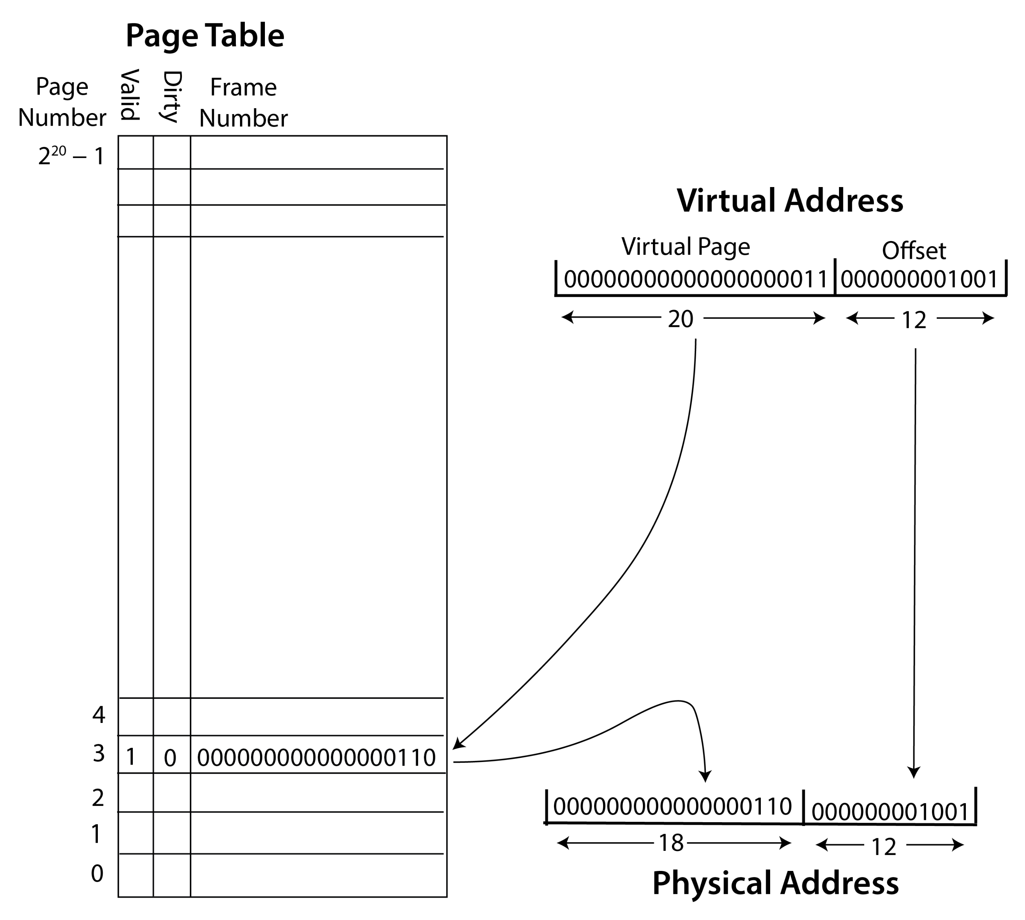
Address Translation
Formation of a 30-bit main memory (physical) address from a virtual address.
4KiB pages, so address within page is 12 bits; 2¹² = 4,096. This is called the offset.
The remainder of the virtual address (32 – 12 = 20) is the page number.
The page frame is looked up from the page table.
The offset is copied to form a 30-bit physical address.

Slide 22
Page Faults
What happens when a reference is made to a page not in memory, i.e., not in a page frame?
That’s a page fault.
A page fault is not an error!
A page fault causes an interrupt. The operating system runs and loads the page from disk into a page frame.
The OS then restarts the instruction that caused the page fault.

Slide 23
Page Faults
Page Frame
Pages not in main memory:
page fault when accessed
1
2
3
4
5
6
7
8
9
10
11
6
4
8
10
1
2
7
Disk
1
2
3
4
5
6
7
8
9
10
11
Page file
Virtual Memory Pages

Slide 24
Steps in Handling a Page Fault
When a page table entry is referenced and the valid bit is zero, the memory management unit generates an interrupt.
The operating systems runs and locates the needed page on disk.
If there is no empty page frame, one is evicted.
The page from disk is loaded into a page frame.
The page table is updated.
The instruction that caused the page fault is restarted.

Slide 25
Page Replacement Algorithms
Page fault - page is not in memory and must be loaded from disk.
The OS may have to evict a page from memory.
Algorithms to manage page replacement:
First-In, First-Out FIFO – Bélády’s Anomaly (1969) increasing number of page frames results in more page faults!
Least Recently Used LRU
Least Frequently Used LFU
Notes:
From Wikipedia, the free encyclopedia
In computer storage, Belady's anomaly states that it is possible to have more page faults when increasing the number of page frames while using FIFO method of frame management. Laszlo Belady demonstrated this in 1969. Previously, it was believed that an increase in the number of page frames would always provide the same number or fewer page faults.
In common computer memory management, information is loaded in specific sized chunks. Each chunk is referred to as a page. The central processor can only load a limited number of pages at a time. It requires a frame for each page it can load. A page fault occurs when a page is not found, and might need to be loaded from disk into memory.
When a page fault occurs and all frames are in use, one must be cleared to make room for the new page. A simple algorithm is FIFO. Whichever page has been in the frames the longest is the one that is cleared. Until Belady's anomaly was demonstrated, the FIFO algorithm was assumed to be acceptable.
Both least recently used and least frequently used appear to make the bookkeeping worthwhile.

Slide 26
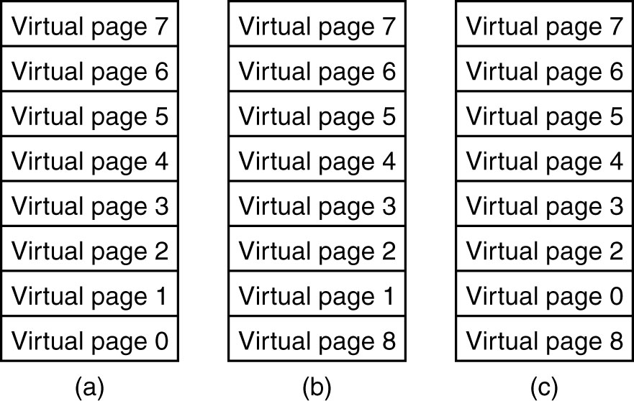
Problem with the LRU Algorithm
Notes:
Eight page frames, but nine needed. From (a) to (b) virtual page 0 is the least recently used; we replace it with page 8. We need page 0 again, but now page 1 is least recently used, so it is evicted. But we’ll need page 1 next.
Solution: more memory to satisfy the locality requirement of this program.

Slide 27
The “Dirty Bit”
If a page to be replaced has not been changed, it can simply be discarded.
Otherwise, it must be written to disk before a new page can be brought in. (A time-consuming process.)
Many virtual memory systems implement a “dirty bit” in the page table.
It is set to zero when a page is first loaded into a page frame.
It is set to one when the page is modified.

Slide 28
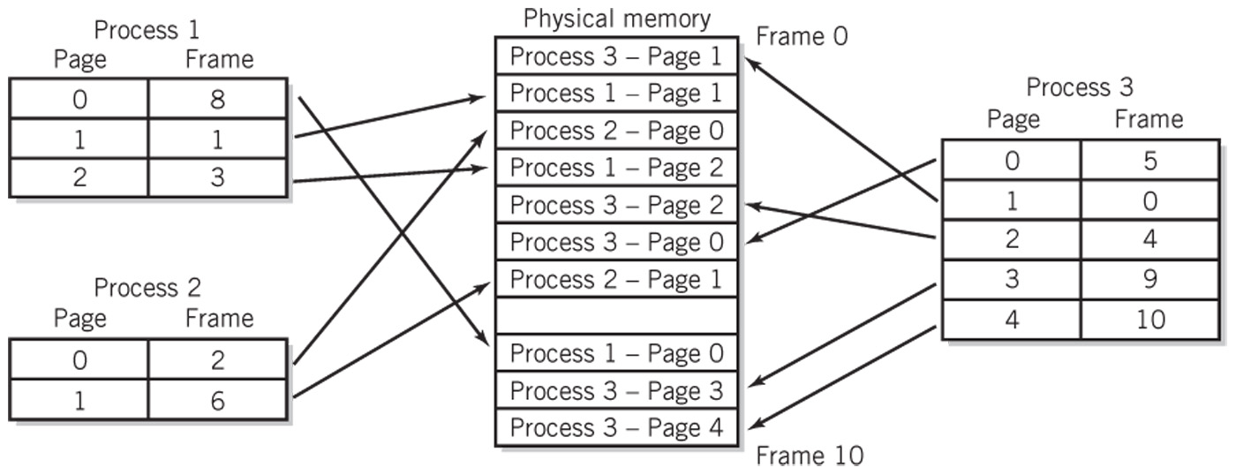
Mapping Multiple Processes
Each process has its own page table.
Only the OS can update the page tables.

Slide 29
How Big Are Pages?
About half the last page is unused.
However, the page table must be in memory, and smaller pages mean larger page tables.
Larger pages use I-O more effectively.
Four KiB (4,096 bytes) is a common choice. It matches the block size of modern disks.
64 KiB pages and even one GiB “hugepages” may be coming with very large memories.
Notes:
Windows used 4 KiB pages on x86-64 devices. https://devblogs.microsoft.com/oldnewthing/20210510-00/?p=105200

Slide 30
Page Table Implementation
Single-level page tables need one entry for every possible virtual page.
For 32-bit addresses and 4 KiB pages, the page table needs 2³² / 2¹² = 2²⁰ or over a million entries.
Every process needs its own page table.
With 64-bit addresses and 4 KiB pages, the page table would have 2⁵², entries. That’s 4,503,599,627,370,496. 4.5 quadrillion!

Slide 31
Solution: Multilevel Page Tables
For an ordinary page table, we’d divide a 32-bit address like this: 20 12
We could instead divide it like this: 10 10 12
We need one top-level table with 1,024 entries.
We only need second-level entries for pages actually used.
Multi-level page tables are sparse.

Slide 32
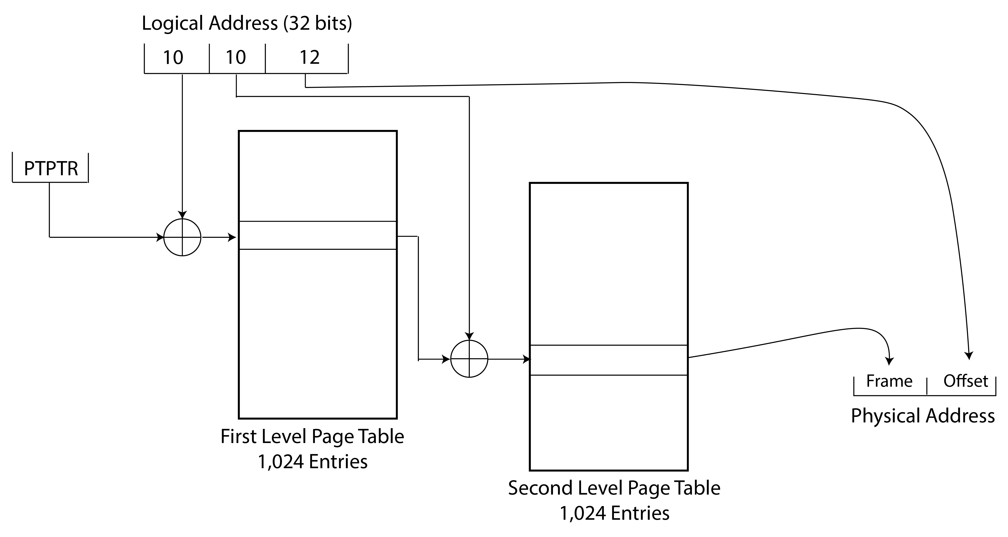
Two Level Page Table
Notes:
PTPTR is the page table pointer, a register in the memory management unit. Circle-Plus is integer addition of address. The entries in the first level page table provide the starting addresses of the second level (and subsequent) page tables. The second part of the logical address is an index into the second level page table. Only the second level tables for which the program uses addresses are needed; this arrangement provides for sparse page tables. The size of the frame address part is not shown in the diagrams; it can be anything the designer needs

Slide 33
Real 64-bit Computers
Real 64-bit computers use four page table levels.
They also cheat slightly and use 48-bit memory address registers, so they only generate 48-bit addresses.

Slide 34
A Problem with Paging
A register-to-register instruction needs only one memory reference, to fetch the instruction.
If virtual memory is implemented, the instruction needs two memory references, one to read the page table and another to fetch the instruction.
Because memory access is slow, that extra memory reference is bad.

Slide 35
Transaction Lookaside Buffer
Solution: transaction lookaside buffer (TLB).
The TLB is cache memory for the page table.
Has about 16 to 64 entries that are copies of recently used page table entries.
Uses associative memory to search all entries in one operation.
Like cache and virtual memory, the TLB works because of locality of reference.

Slide 36
Virtual Memory Tradeoffs
Disadvantages
Page file takes up space on disk
Paging takes up resources of the CPU
Paging takes time
Advantages
Programs share memory space
More programs can run at the same time
Programs can run even if they cannot fit into memory all at once
Process separation (memory space protection)

Slide 37
Memory Protection and Virtual Memory
If every program has the full logical address space available to it, then any address is valid and in the program’s address space.
So, there is no way for a program to generate an address that belongs to the OS or another program.
Problem: Sometimes a program needs access to memory owned by the OS.
Solution: Allow the program and the OS to share some part of the virtual address space.

Slide 38
Segmentation
Another memory management technique; used with or without virtual memory.
Gives the programmer more than one address space.
Reference to the multiple address spaces is through segment registers.

Slide 39
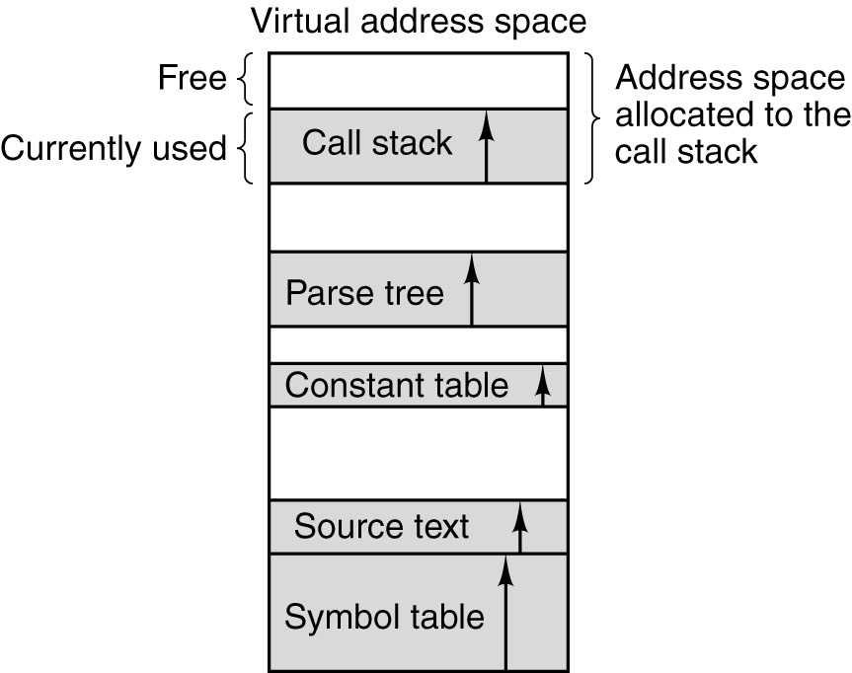
Why Segmentation?
In a one-dimensional address space with growing tables,
one table may bump into another.

Slide 40
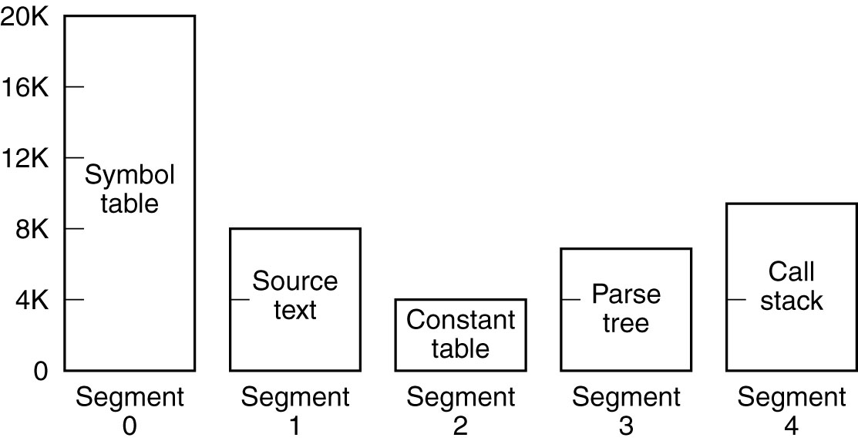
Segmentation
A segmented memory allows each table to grow or shrink independently of the other tables.

Slide 41
Paging vs. Segmentation
Consideration | Paging | Segmentation
Need the programmer be aware of it? | No | Yes
How many linear address spaces are there? | 1 | Many
Can virtual address space exceed memory size? | Yes | Yes
Can variable-sized tables be handled easily? | No | Yes
Why was the technique invented? | To simulate large memories | To provide multiple address spaces
Notes:
https://www.cs.umd.edu/~meesh/411/CA-online/chapter/289/index.html

Slide 42
Virtual Memory vs. Caching
Cache speeds up memory access
Virtual memory increases the amount of perceived storage
Independence from the configuration and capacity of the memory system
Low cost per bit compared to main memory

Slide 43
Questions

