Slide 1

IT 3123 Hardware and Software Concepts
Software and Software Development
Notice: This session is being recorded.

Slide 2
Announcements
Please pick up your copies of exam 2; you need it to study for the final.
Chapter 6 has been updated in PDF form, but not in ePub form.
There will be an optional assignment, released after assignment 5 is graded.
Please complete the course evaluation.

Slide 3
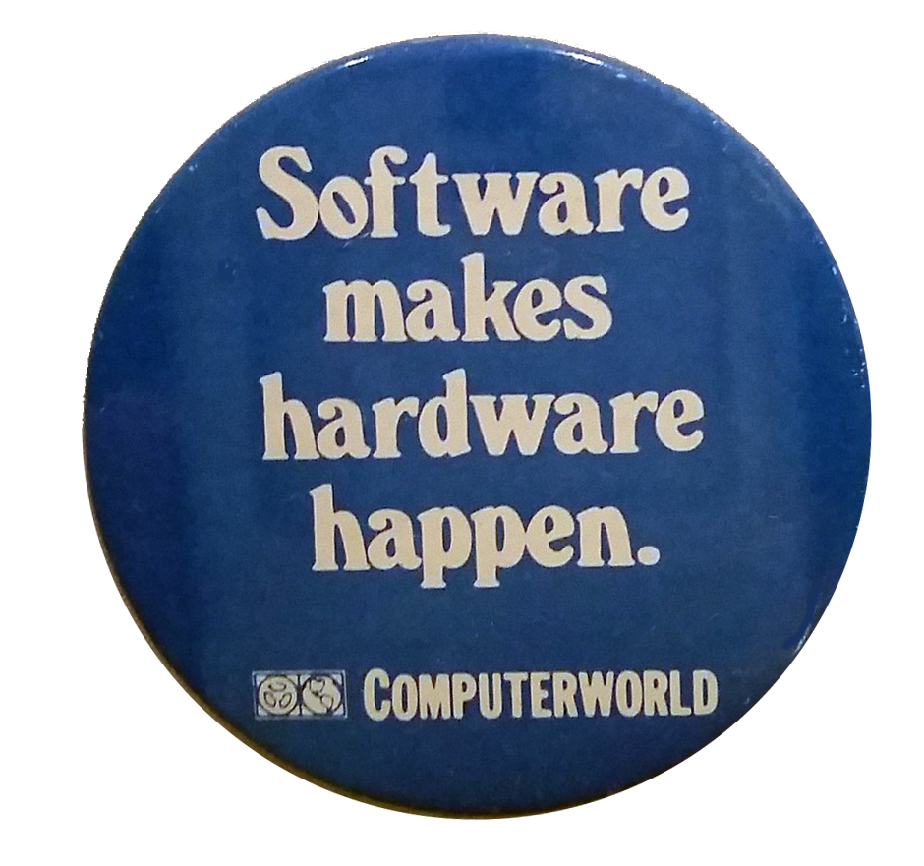
Software Makes Hardware Happen
Hardware and software are logically equivalent.
However, general purpose hardware needs software to define its purpose.
Most computers have at least two layers of software: operating system and application.
Notes:
The button is an advertising novelty from the Computerworld newspaper, distributed in the early 1970s.

Slide 4
Undecidable Problems
There is a class of problems that “look computable” but are not.
The halting problem is a famous problem that was proven to be undecidable.
Halting problem: Write a program that, given another arbitrary program and its input, can determine whether that program will loop forever or eventually halt.
See Scooping the Loop Snooper.
Notes:
Alan Turing proved that it is impossible to write a program that, given another arbitrary program and its input, can determine whether that program will loop forever or eventually halt.
Wikipedia has a list of undecidable problems: https://en.wikipedia.org/wiki/List_of_undecidable_problems
For an amusing proof that the halting problem is undecidable, see Geoffrey K. Pullum’s poem “Scooping the Loop Snooper” which you can find here https://www.cs.columbia.edu/~tal/3261/sp12/Pullum.htm and at many other locations on the World Wide Web.

Slide 5
Intractable Problems
Intractable problems are computable, but doing so with even the fastest computers would take an impractically long time.
Public Key encryption is computationally secure because finding the prime factors of very large numbers would take decades.
The Traveling Salesman problem is another example of an intractable problem.
Notes:
We see public key encryption in chapter 7.
The traveling salesman problem: Given a list of cities and their distances, find the shortest route that visits each city exactly once and returns to the origin city. This problem is applicable to things as diverse as package delivery, microchip design, and DNA sequencing. A brute force solution to this problem involves checking each possible route. The run time of such a solution is proportional to the factorial of the number of cities. For seven cities, that’s (7-1)!/2, or 360 routes to check. Increase the number to eight and there are 20,160 possible routes. With only 15 cities, there are 43,589,145,600 possible routes. A program that could check 100 routes per second would require almost 14 years to run!

Slide 6
Heuristics
Many intractable problems have heuristic algorithms that will find near-optimal solutions in much less time than a full solution.
A heuristic is an algorithm that is a practical approach to a problem, but not one guaranteed to produce an optimal solution.
There are effective heuristics for route planning.

Slide 7
Time Complexity
You would like not to waste time developing software for intractable problems.
The time complexity of an algorithm is expressed in Big-O notation.
Big-O notation considers only the part of the algorithm for which time grows most rapidly as a function of the number of cases.
Example: Searching an unordered list has a time complexity of O(n) for n items.

Slide 8
Big-O Examples
O(1) Constant time; the number of items is irrelevant.
O(log n) Logarithmic time; divide-and- conquer problems like binary search.
O(n) Linear time; if the number of items doubles, the time doubles.
O(n log n) Loglinear time; certain sort algorithms.
Notes:
An example of o(1) is “print the first item in a list..” It make no difference how long the list is. Another: accessing an element of an array given its index. It makes no difference how big the array is.

Slide 9
Algorithms to Avoid
O(n²) Polynomial time
O(2^{n}) Exponential time
O(n!) Factorial time
Notes:
The constant 2 and really be any constant.

Slide 10
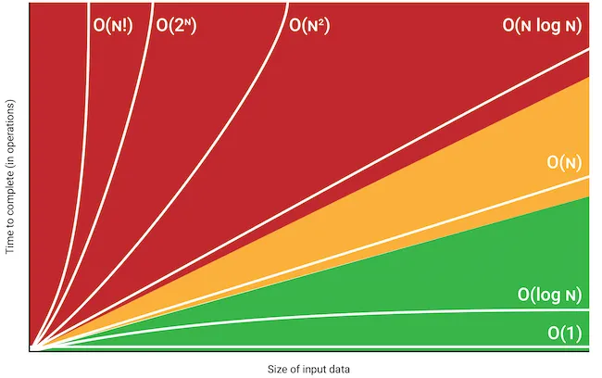
Comparison
Mohit Varikuti

Slide 11
Space Complexity
Space, i.e. memory, complexity can also be expressed using Big-O notation.
There exist algorithms that trade space for time; they run faster with more memory.

Slide 12
Why Software is Hard
“Software entities are more complex for their size than perhaps any other human construct because no two parts are alike.” − Brooks (1987)
Brooks believed that “the hard part of building software to be the specification, design, and testing of this conceptual construct” of data items, algorithms, and invocation of functions.
The fact that it is hard has led to a culture of “design as we build” in software construction.

Slide 13
It Wasn’t Always Hard
The fact that software is hard came as a surprise to users of computers.
The “first generation” of programmers translated well-defined mathematical formulae to machine language. The job was already rigorously specified.
Software became hard when programmers tackled new kinds of problems not already defined by mathematical formulae.

Slide 14
The Result?
Mariner spacecraft destroyed after an error in guidance program took it off course. $18,000,000.
Between 1985 and 1987, the Therac-25 radiation therapy machine gave patients doses of radiation hundreds of times larger than prescribed resulting in injury and death.
The USS Yorktown was dead in the water because of a divide-by-zero error. (1997)
Notes:
F-22 Raptor aircraft experienced computer crashes when they crossed the International Date Line in 1992. Another error in spacecraft software caused the destruction of an Ariane 5 rocket in 1996 at a loss of $370 million

Slide 15
Software Engineering
Much of the development of computing has been funded by the military.
NATO leaders were alarmed by numerous, expensive software failures.
NATO software engineering conferences in 1968 and 1969 to define best practices.
Spectacular and dangerous software failures continued.

Slide 16
Software Engineering Defined
“the application of a systematic, disciplined, quantifiable approach to the development, operation, and maintenance of software; that is, the application of engineering to software; the study of approaches to the application of engineering to software.”
– IEEE, 1990

Slide 17
Classical Engineering
The classical engineering disciplines have their foundations in the physical laws of physics and chemistry, and ultimately in mathematics.
Software engineering does not have that foundation.
So, software engineering is necessarily a set of best practices.
Best practices can and do evolve.
Notes:
A study of those best practices is beyond the scope of this book but learning them is essential for anyone who will do software development

Slide 18
Programming
Programming:
Producing a sequence of instructions…
In binary form for a computer…
To solve a particular problem
Writing a program requires:
Understanding of computer systems
Understanding of the programming language
Understanding of the problem

Slide 19
Programming Languages
The earliest programming was done in the language of the machine, namely numbers.
Programs called assemblers were written to translate mnemonics like add to numbers.
Assemblers quickly evolved to handle more of the bookkeeping of programming.
An assembler produces one machine instruction per line of code and is specific to one computer architecture.
Notes:
The fact that assembler language is specific to one architecture meant that a new computer of different architecture required rewriting an organization’s portfolio of programs.

Slide 20
High-Level Languages
Adoption of high-level languages began in the late 1950s.
Could be machine-independent.
Closer to the language of the programmer than the language of the machine.
High-level languages require translator programs called compilers.
One high-level language statement generated several machine instructions.

Slide 21
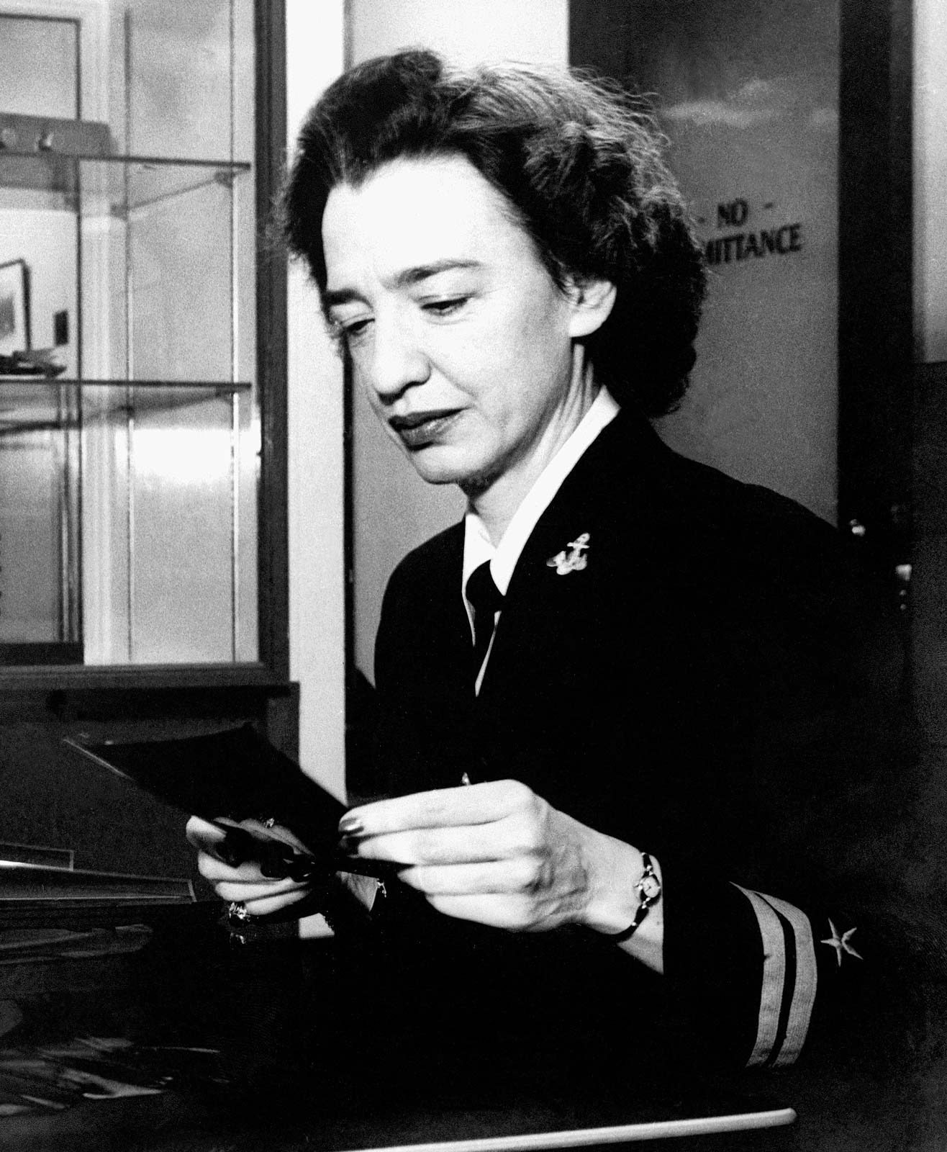
Fortran and COBOL
Two early high-level languages were Fortran and COBOL.
Grace Murray Hopper was a particular champion of COBOL.
She was able to get a require- ment that any computer bought by the Navy have COBOL available.
COBOL still runs much of the financial world, and Fortran much of science.
Notes:
Hopper induced the Navy and much of the Federal government to require high-level languages to be available when buying computer hard- ware. The COBOL and Fortran languages were developed with little theoreti- cal information about the requirements of high-level languages. More modern languages like Java and Python were designed specifically to prevent certain kinds of programming errors.

Slide 22
Procedural and Fourth Generation Languages
Procedural languages: the programmer writes code describing how to accomplish a task.
Fourth generation languages: the programmer describes what should be done. Example: select all records from the faculty table with last name “Brown.”

Slide 23
Language Components
Lexicon
All legal words in the language
Meaning and type
Syntax
grammar rules
Semantics
meaning of commands

Slide 24
Compilers
Compilers translate high-level language into low-level machine instructions.
High-level language: Source code.
Machine-level: Object code.
Program changes, including bug fixes, require recompiling.

Slide 25
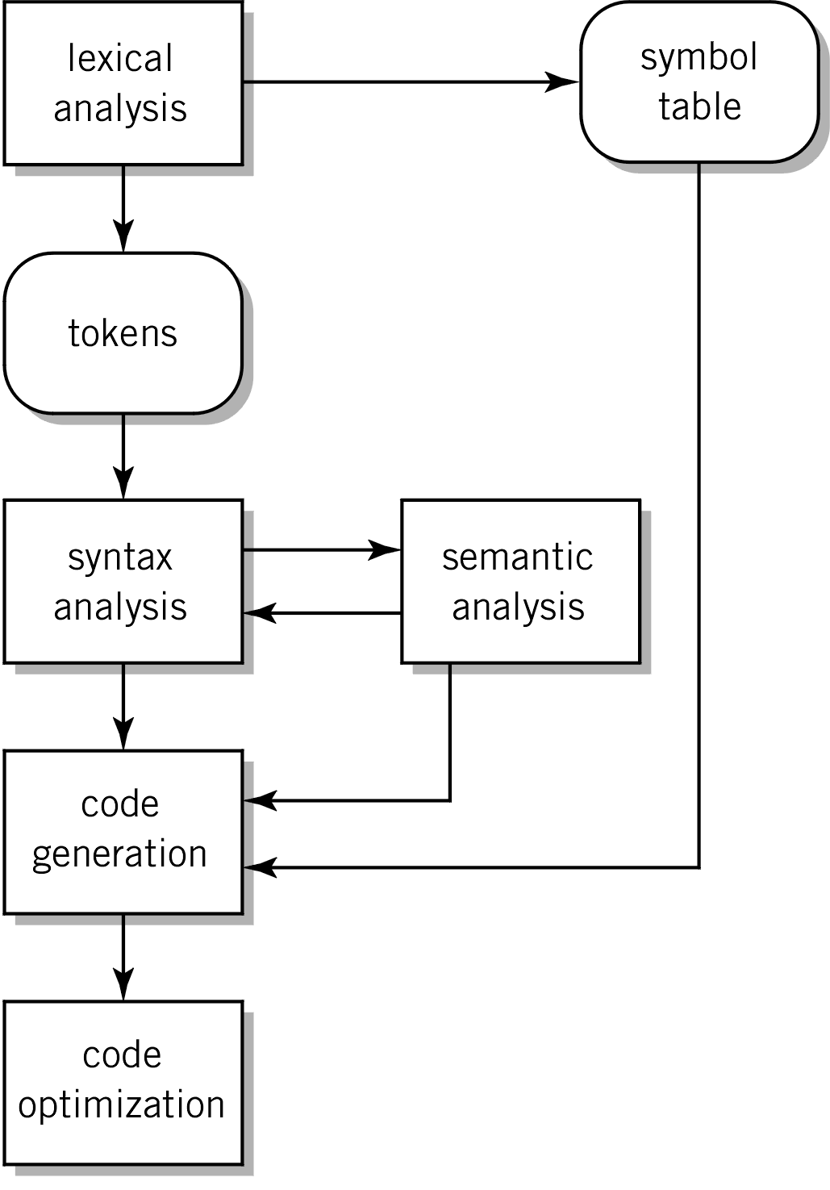
The Compilation Process
Updates internal tables
Checks for errors
Generates machine instructions or library calls

Slide 26
Optimization
Compiler analyzes code in order to
Reduce amount of code
Eliminate repeated operations
Reorganize parts of the program to execute faster and more efficiently
Use computer resources more effectively
Example
Move a calculation repeated within the body of a loop that does not use any value modified by the loop
Different compilers can produce different results!

Slide 27
Linking
Object
file or object
module
Executable file
Linker
C library
Notes:
Libraries – collections of prewritten functions and subroutines that are made available to perform commonly required activities. Keyboard entry, screen display, file I/O,

Slide 28
Linkers
Searches program libraries to find library routines used by the program.
Library: collection of pre-written functions and subroutines made available to perform commonly required activities.
Determines the memory locations that code from each module will occupy and relocates instructions by adjusting absolute references.
Resolves references among files.

Slide 29
Why Link?
Construct single executable program from multiple object code files compiled at different times.
Program can be subdivided into components and parceled out to different developers.
Example: Main program and multiple subroutines written and compiled by different programmers at different times.

Slide 30
Loader
Loads binary files that have been linked into main memory.
Dynamically links and loads any modules not already linked.
Program is ready for execution.
Notes:
Determines size of the text and data segments
Creates a new address space for the program
Copies program from the executable into the new address space
Copies arguments to the stack
Initializes the machine registers
Jumps to a startup routine and calls the main
Determines size of the text and data segments
Creates a new address space for the program
Copies program from the executable into the new address space
Copies arguments to the stack
Initializes the machine registers
Jumps to a startup routine and calls the main

Slide 31
Evolution of High-Level Languages
The first high-level languages were developed with little theory of what such languages should do.
Later languages were designed specifically to prevent certain kinds of programming mistakes.

Slide 32
Interpretive Languages
Faster processors allowed a new approach.
An interpreter reads statements in a high-level language and immediately executes the equivalent machine instruction.
Some interpretive languages generate an intermediate form called bytecode.
The Java language exposes the bytecode to the programmer; Python does not.

Slide 33
Interpreters
Reads source code and executes equivalent machine instructions one statement at a time. (Note: No translation to machine code.)
Disadvantages
Longer to execute, particularly bad for loops (but bytecode can minimize this.)
Uses more memory.
Advantage
Faster testing and code modification
Examples of interpreted languages
Java, Python Perl, PHP

Slide 34
Structured Programming
The Structured Programming Theorem: Corrado Böhm and Giuseppe Jacopini, proved the structured programming theorem, which states that the only control structures needed in programming are sequence, selection, and iteration. (1966)
Edsger Dijkstra’s letter Goto considered harmful. (1968)
Try/Catch blocks remove the last justification for goto.

Slide 35
Object Oriented Programming
Goal: A library of standardized parts from which programs can be built.
Programs are implemented as collections of objects, each of which has specified attributes, or data, and behaviors, or executable code.
Three properties:
Encapsulation
Inheritance
Polymorphism
Notes:
Standardized parts in programming could be, but aren’t yet, as important as interchangeable (standardized) parts in manufacturing.
Encapsulation hides the internal data and algorithms of an object from anything outside the object itself. So, a more efficient algorithm could be substituted so long as it did not affect those parts of the object explicitly declared as public.
Inheritance allows creating a new object with the attributes and behaviors of an existing object and adding new attributes and behaviors. An example might be a class PERSON with attributes such as date of birth. The class STUDENT might inherit from PERSON and gain attributes like student number and grade point average. The usefulness of this approach becomes clearer when we consider another class, FACULTY, that also inherits from PERSON and gains attributes like department and academic rank.
Polymorphism literally means “many shapes” or “many forms.” The form of an operation or result can depend on the number or type of the parameters, or on the object on which a method is called. A very simple example of the first type is the multiplication operator. In most languages, the same operator, often *, can be used to multiply integers, floating point numbers, or a mixture. An ex- ample of the second type might be a method to return an ID number. If used in reference to a STUDENT object, one gets a student ID number, but if used in reference to EMPLOYEE, one gets a payroll ID number.

Slide 36
Integrated Development Environments
Integration of:
Program editor
Compiler
Debugger.
Examples:
MS Visual Studio
MS Visual Basic
Jgrasp.

Slide 37
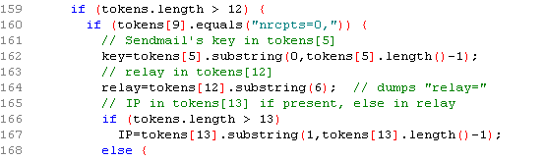
Program Editors
Specialized Editors
Language-aware
“Understand” the syntax of a language
Sometimes able to identify syntax errors
Integration with compiler in IDE

Slide 38
Debuggers
Debuggers are language-specific.
Debuggers allow the programmer to:
Set breakpoints
Step through programs
Check variable values

Slide 39
Version Control
Keeps track of every module in a system.
Tracks changes.
Allows changes to be undone.
Systems like Git allow branching.
Adding a new feature is done with a branch.
The main branch always contains production-quality code.

Slide 40
Programming Languages
Machine specific (Assembler)
High level (Compiler)
Procedural (how)
Fourth-generation (what)
Object oriented (Compiler)

Slide 41
Language Translation
Assembler: the language of the machine; one machine instruction per line of code.
Compiler: closer to human languages; multiple machine instructions per line of code.
Interpreter: Reads each line of source code and immediately performs the equivalent machine instructions.

Slide 42
Source and Object
Source code: a program in human-readable form.
Object code: a program that has been translated to machine language.
Bytecode: Intermediate form used by some interpretive languages.

Slide 43
Programming
Programming:
Producing a sequence of instructions
In binary form for a computer
To solve a particular problem
Writing a program
Understanding of computer systems
Understanding of the programming language
Understanding of the problem

Slide 44
Questions

