Slide 1

IT 3123
Hardware and Software Concepts
Network Topologies
Data Transmission
Notice: This session is being recorded.

Slide 2
Anouncements
Quiz 5 is due tonight.
Assignment 4 is also due tonight.
Assignment 5 has been released, due April 17.
Quiz 6 will be released Friday morning so that you have two weekdays to decide when to take it. It covers all of data communications.

Slide 3
Defining “Channel”
Communication channel
  The path for the message between two communicating nodes.
  May include intermediate nodes that forward packets to the next node.
  Interfaces at each end of the connection may be different.
Channel (alternate definition): one of several signals available on a broadband medium. Television and radio channels are examples.
Notes:
In this course we will generally say “communication channel” when the first definition is wanted.

Slide 4
More Communication Terms
Link: a segment of a communication channel.
Bandwidth:
  Bit rate of a link or of the overall communication channel.
  The theoretical amount of information a link can carry per second, measured in Hertz.
  The range of frequencies passed by the medium with little attenuation.
Medium: the carrier of signals.
  Guided – communications limited to a specific path. Examples: wire, fiber-optic cable.
  Unguided – communications not limited to a specific path. Examples: radio, light.

Slide 5
Channel Characteristics
Data transmission directionality
  Simplex – messages are carried only in one direction
  Half-duplex – messages are carried in both directions but only one direction at a time
  Full duplex – messages are simultaneously carried in both directions
Number of connections
  Point-to-point
  Multipoint
Digital vs. Analog
End node interfaces
  Wired or wireless Ethernet
  Bluetooth, DSL or cable link, modem, etc.

Slide 6
Data Routing
Circuit switching: Dedicated communication channel between source and destination for duration of connection.
Virtual circuit
  A channel path that is used to send packets between two end nodes.
  Intermediate nodes may be shared with other channel paths.
Packet switching: (datagram switching)
  Each packet is routed from node to node independently based on various criteria.

Slide 7
Communication Models
OSI reference model and TCP/IP model
Implemented as a hierarchical protocol stack.
Each layer of the stack at the sender node contributes information that is used by the corresponding peer layer at the receiver node.
Different protocols for the different aspects of communication.

Slide 8
Advantages of Models
Models separate tasks and include well defined interfaces between the tasks.
Simplifies design of protocols.
Permits modification or substitution of protocols without affecting unrelated tasks.
Permits a system to select only the protocols needed for a particular application.

Slide 9
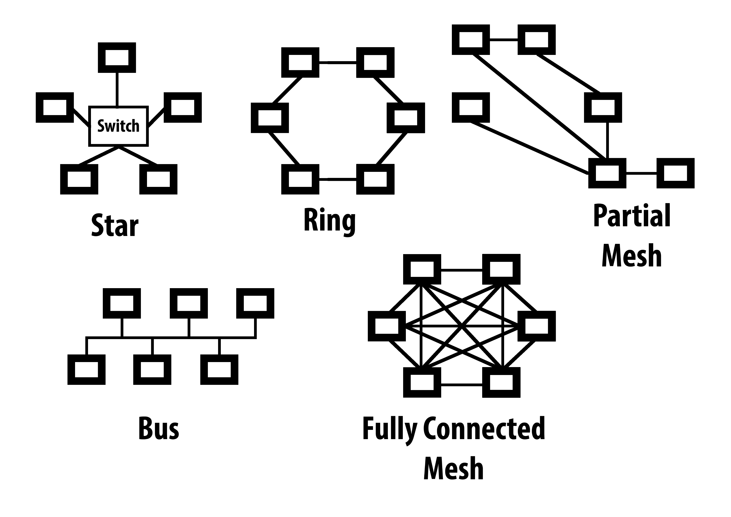
Five Network Topologies
Notes:
Mesh topologies are characterized by multiple connections to some or all nodes.

Slide 10
LAN Topologies: Star
Each station connected point-to-point to a central station, usually with two one-way links (full duplex).
Switching in the central station connects pairs of nodes together, or
Central hub connects all nodes together.
Central node can broadcast info or can switch frames among stations.
Failure of central station causes entire network to go down.

Slide 11
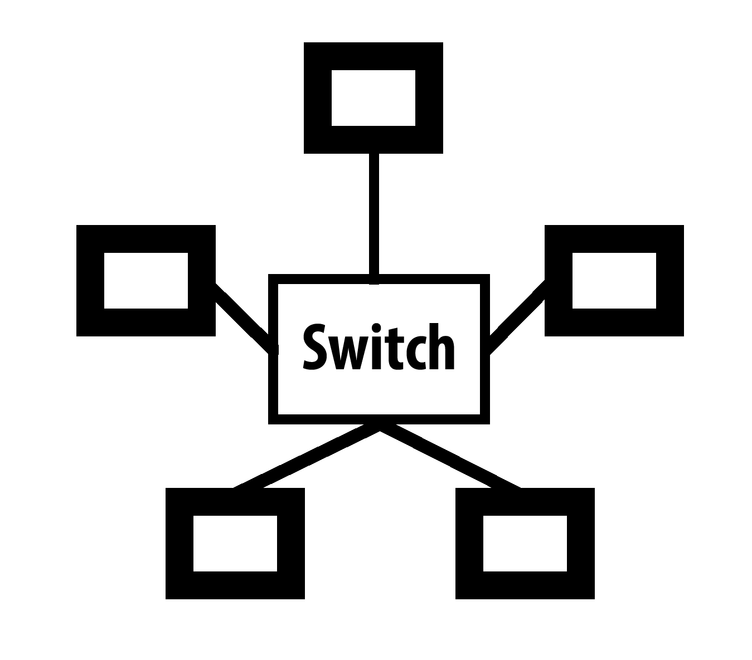
Star LAN Diagram
A switched Ethernet is a physical and logical star topology with the switch as the central node.

Slide 12
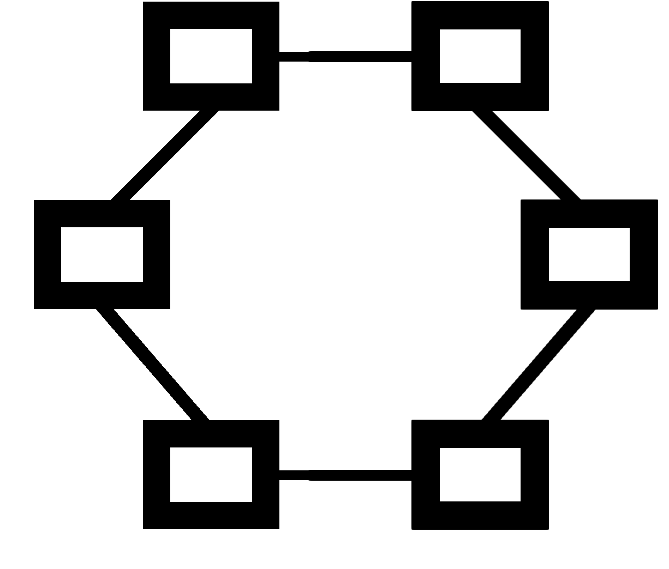
Ring LAN Diagram
Notes:
In a ring network each node must actively pass signals to the next node, and must be able to connect incoming and outgoing links passively when powered off. That makes a pure ring network impractical in the case that a node is completely removed from the ring.

Slide 13
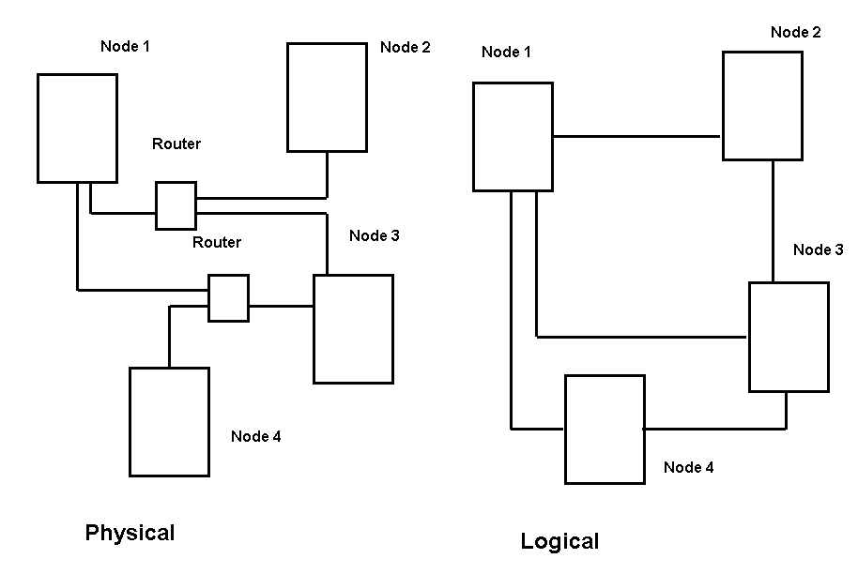
Physical and Logical Topologies
http://www.cse.wustl.edu/~jain/cse567-08/ftp/topology/
Notes:
The physical topology shows where the wires or other media go. The logical topology shows how nodes are connected, that is, shows the neighbors of each node.

Slide 14
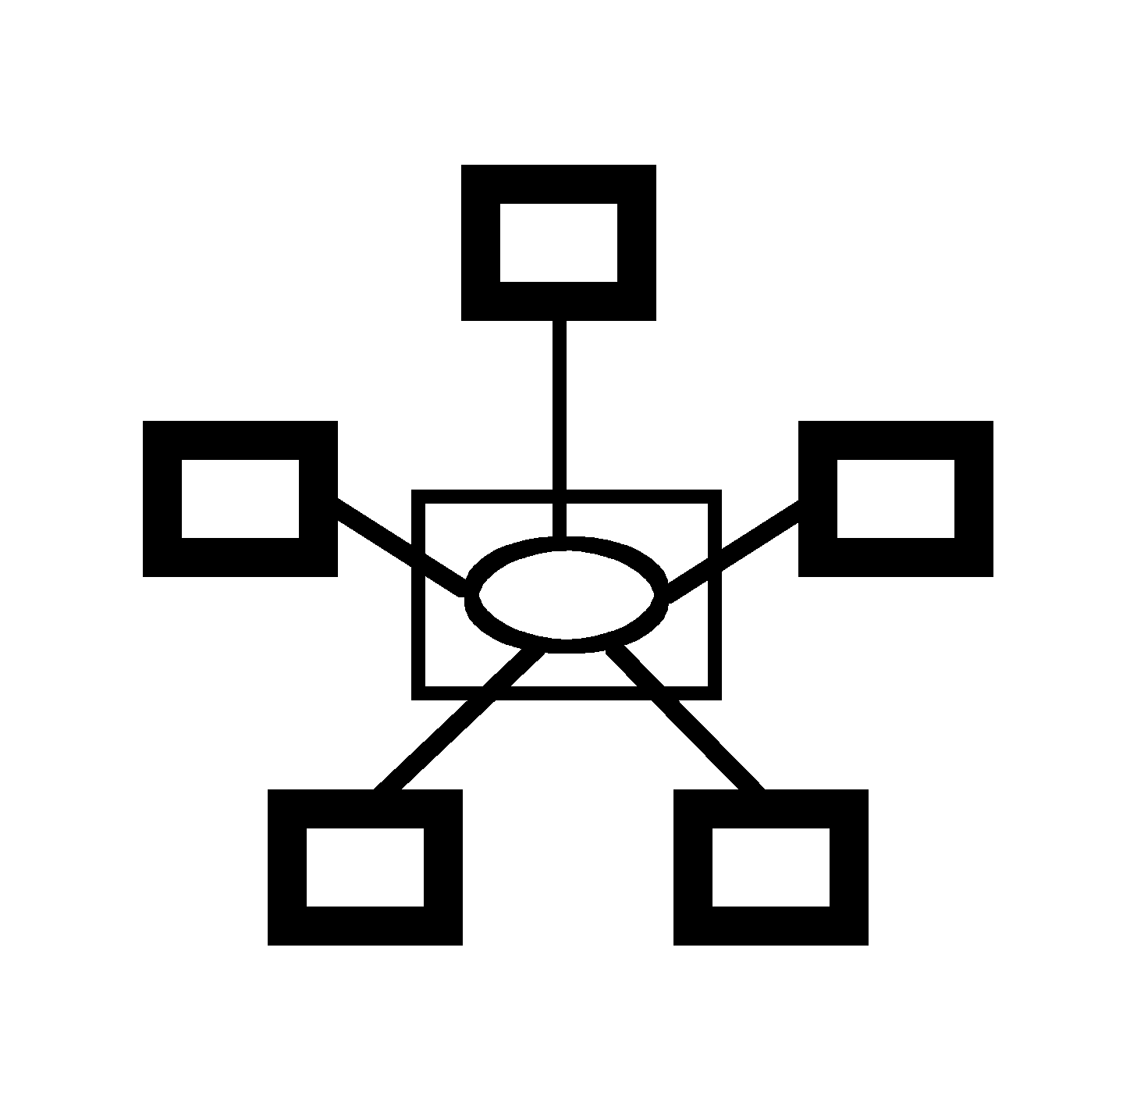
Physical Star, Logical Ring
Notes:
A physical ring is impractical in the case of removed nodes. A physical star and logical ring can work because logic in the central device can connect upstream and downstream devices if one node is removed. The IBM Token Ring network operated this way.

Slide 15
Hierarchical Networks
Also called tiered Ethernet or “backbone” networks.
The “backbone” connects LANs and provides access to external networks.
The chief motivation is to improve performance by creating separate networks for groups of nodes that primarily communicate with each other.
Communication between LANs is enabled only when necessary.
The overall range of a network can be extended beyond the limits of a single LAN.
Can be viewed as a hierarchy of LANs.

Slide 16
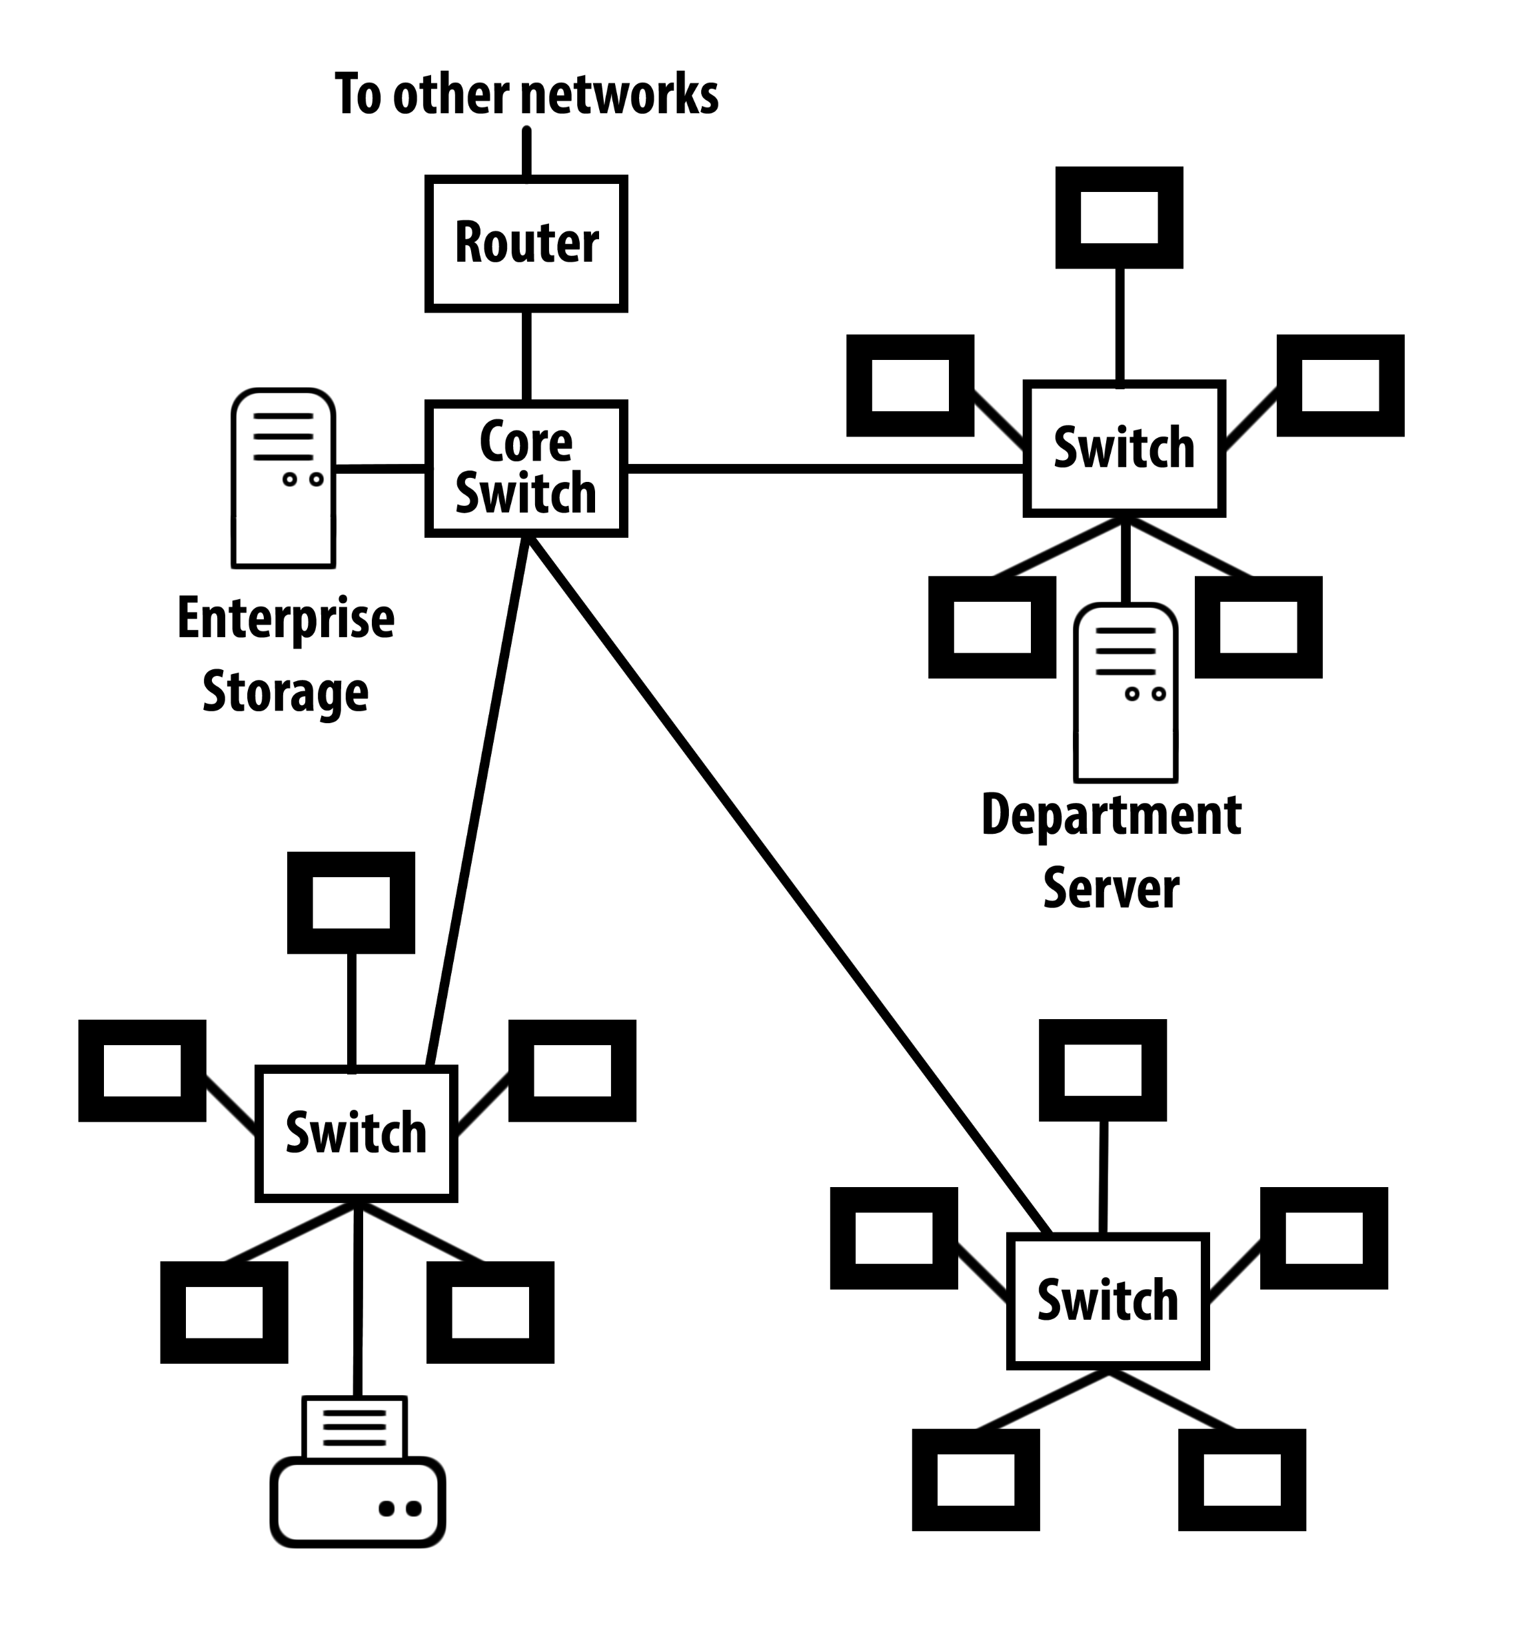
Hierarchical Network

Slide 17
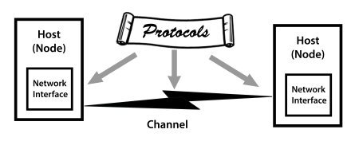
Communication Channel

Slide 18
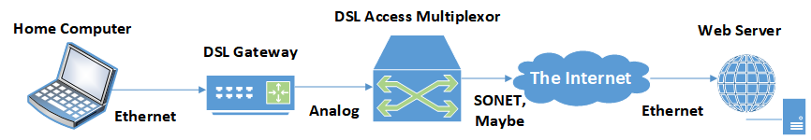
Communication Channels:
Many Ways to Implement
Link
Link
Link
Link
Communication Channel
Notes:
The link to the Internet is “SONET, maybe” because it could be MPLS, ATM, Ethernet, or something else.

Slide 19
Communication Channel
Characterized by:
Signaling transmission method.
Bandwidth: amount of data transmitted in a fixed amount of time.
Direction(s) in which signal can flow.
Noise, attenuation, and distortion,
time delay (latency) and time jitter.
Notes:
Jitter is variation in latency. Some packets arrive much sooner or much later than others.

Slide 20


Signaling Transmission Method
Analog: Signal takes on a continuous range of values
Discrete: Signal takes on only finite, countable set of values.
Digital: Binary discrete signals.
Choice depends on the transmission medium.
Analog
Digital
Time
Notes:
The analog and digital waveforms do not represent the same information. (The analog waveform is a violin note.)

Slide 21
Digital Signals
Binary discrete signals
Frequently preferred because they are less susceptible to noise and interference – reliable!

Slide 22
Signaling Technology
Signal carriers
  Electrical voltage
  Electromagnetic radio wave
  Switched light (also electromagnetic wave)
Data are represented by changes in the signal as a function of time.
“On the wire,” these changes are analog, even for “digital” signals.

Slide 23
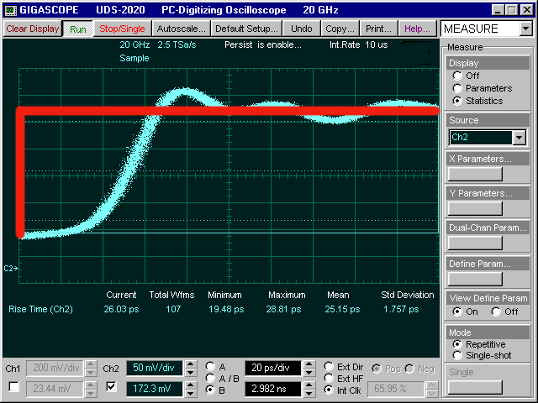
“Rise Time” of Digital Signal
Notes:
The red line indicates a perfect transition from zero to one. The blue oscilloscope trace indicates an actual low-to-high transition. It is analog in nature.

Slide 24
Sine Wave
Common natural occurrence.
Basic unit of analog transmission.
Amplitude: wave height or power.
Frequency: repetitions per second, expressed in Hertz (Hz).

Slide 25
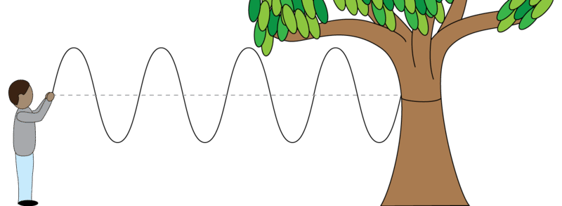
Sine Wave Frequency
Period: amount of time to trace one complete cycle of the wave
Wavelength : distance spanned by a sine wave in space
Frequency: cycles per second, i.e., number of times sine wave repeated per second
Unit of bandwidth: Hertz = 1 cycle/sec (Really 1/T)
Notes:
It is convenient to think of Hertz as cycles per second, tut the strict definition is inverse time, 1/T.

Slide 26
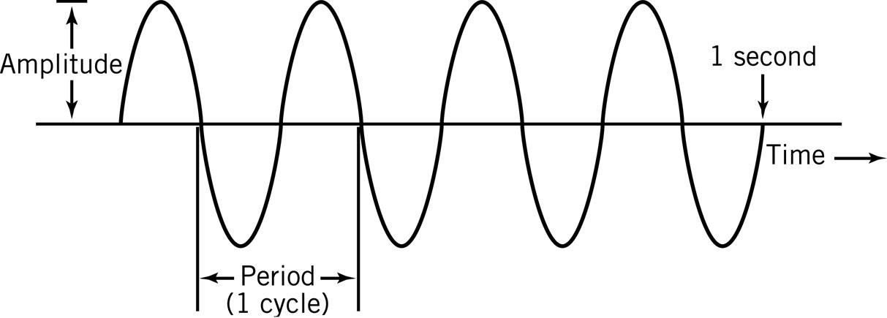
Sine Wave Frequency
f = 1/T f is the frequency of the sine wave and where T is the period measured in seconds.
λ = c / f λ is the wavelength of the sine wave and c is the speed of light in the transmission medium.
Notes:
λ Lambda = wave length

Slide 27
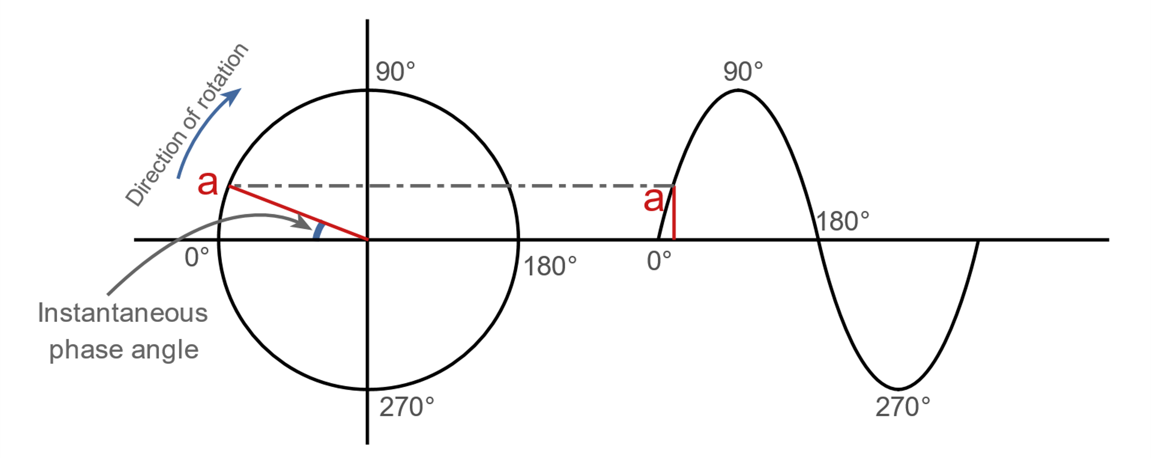
Phase Angle
Points on a sine wave are frequently designated in degrees.
Notes:
If you could roll a bicycle wheel along a track ½ its height off the floor and connected a marker to the tire, you would draw a sine wave.

Slide 28
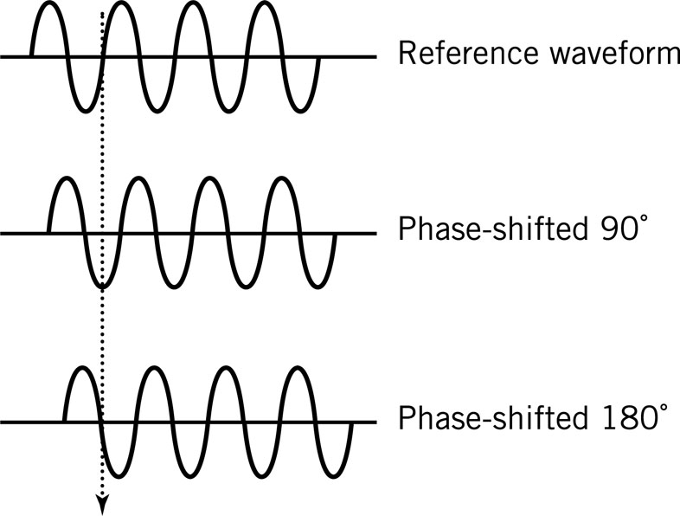
Phase-Shifted Sine Waves
Difference, measured in degrees, from a reference sine wave.
The phase shift can convey information.

Slide 29
Waveform Representation
All waveforms can be approximated as the sum of sine waves of different frequencies, phases, and amplitudes
Spectrum: frequencies that make up a signal
Bandwidth: range of frequencies passed by the medium with little attenuation
Filtering: controlling the channel bandwidth to prevent interference from other signals

Slide 30
Signal Frequencies
Sound waves: approximately 20 Hz to 20 KHz
  Stereo systems: 20-20,000 Hz for high fidelity.
  Phones: 40-4000 Hz for voice but limits speed of data.
Radio waves: 60 Hz to 300 GHz
  AM radio: 550 KHz to 1.6 MHz, 20 kHz bandwidth.
  FM radio: 88 MHz to 108 MHz, 100 kHz bandwidth.
  TV: 54 MHz to 700 MHz, >4.5 MHz bandwidth.
  Cell phones, Wi-Fi wireless networks: 800 MHz to 5.2 GHz or more.
Visible light: 400 THz to ≈790 THz, but usually expressed as wavelength: about 380 to 750 nanometers.
Notes:
Infrared is slightly lower frequency than visible light, ultraviolet slightly higher. X-rays come next in the spectrum.

Slide 31
Sine Waves as Carriers
A sine wave produces a single, pure tone.
The orchestral note middle A is a 440-Hz sine wave.
To represent the signal, modulate one of the three characteristics: amplitude, frequency, phase.
Example: AM or amplitude modulated radio station at 1100 kHz modulates amplitude of the 1100 kHz sine wave carrier.
Demodulator or detector recovers the original signal.

Slide 32
Modulating Digital Signals
Two possible values: 0 and 1
Three techniques, based on the three properties:
  Amplitude
  Frequency
  Phase

Slide 33
Amplitude Modulation
Two possible values: 0 and 1.
Also called ASK: amplitude shift keying: Represents data by holding the frequency constant while varying the amplitude.

Slide 34
Frequency Modulation
Two possible values: 0 and 1.
Also called FSK: frequency shift keying: Represents data by holding the amplitude constant while varying the frequency.

Slide 35
Phase Modulation
Two possible values: 0 and 1.
Also called PSK: phase shift keying: Represents data by an instantaneous shift in the phase or a switching between two signals of different phases.

Slide 36
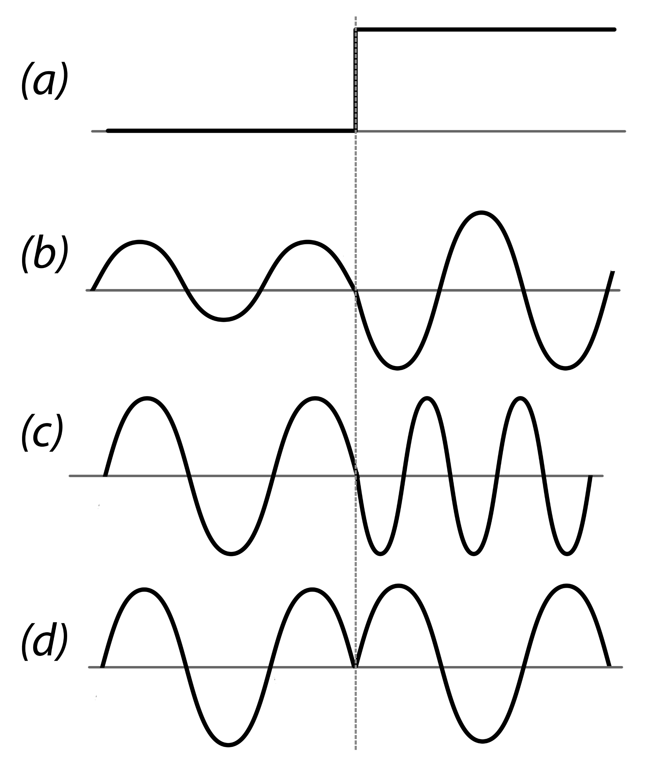
Modulating Digital Signals
Digital signal
Amplitude modulation
Frequency modulation
Phase shift modulation

Slide 37
Modulating More than
One Property
Baud: one signal event per second. Corresponds to one bit per second if only one property is modulated.
We can modulate more than one property.
Quadrature amplitude modulation (QAM) modulates both amplitude and frequency.
Can send up to four bits (QAM-16) per signal event.
Notes:
“Baud” is named for Émile Baudot, French telegraph engineer and inventor of the Baudot code, the first digital transmission code.

Slide 38
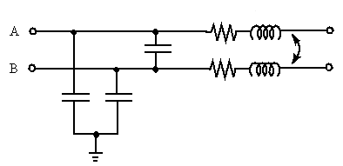
Ideal vs. Real Channels
Ideal channel: Signal goes in one end, comes out the other after a delay proportional to channel length.
Real channel: Noise, attenuation (loss of signal strength), distortion of wave form.
Signal
In
Signal
Out

Slide 39
Attenuation
Attenuation: loss of strength (amplitude) of the signal.
A function of the nature of the transmission medium and the physical length of the channel.
Amplifiers: restore original strength of the signal (but also amplifies noise).
Signal-to-noise ratio: Strength of the signal in relation to power of the noise measured at the receiving end.
It is more difficult to separate the signal from noise at higher transmission speeds.

Slide 40
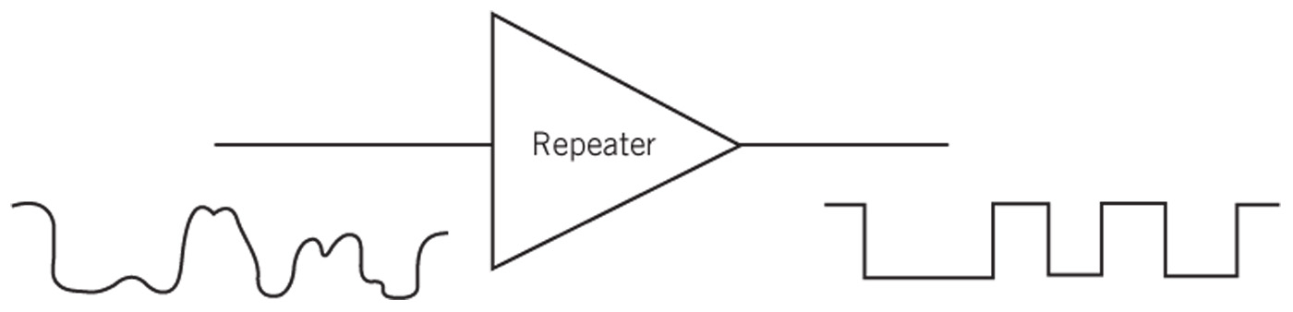
Repeaters and Digital Signal Quality
Signals are subject to noise, attenuation, distortion.
Digital signal quality is less affected than analog signal quality because there are only two levels.
Repeaters:
  Exactly recreate signals at intervals of distance.
  Use: transmit digital signals over long distances.
Error correction techniques are available.
Notes:
Distances may be miles or thousands of feet. Example T-1 (1.5 MB) signals are typically repeated every 6,000 feet. (why? Because telephone manholes are typically spaced about 6,000 feet apart.)

Slide 41
Multiplexing:
More than One Signal
In time division multiplexing, each signal gets a time slot on the transmission medium.
T-1 telephone trunk circuits use time division multiplexing with 24 time slots.
In frequency division multiplexing, each signal occupies a different frequency band on the transmission medium.
The optical form of frequency division multiplexing is wave division or λ (lambda) division multiplexing.
Notes:
Television channels are an example of frequency division multiplexing.
On fiber optic cable, frequency division multiplexing is called “wave division multiplexing” or “lambda division multiplexing. The Greek letter lambda is the standard symbol for wavelength.

Slide 42
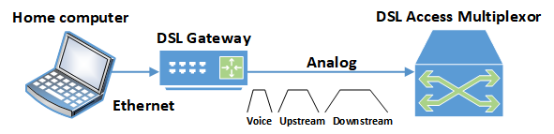
Digital Subscriber Line
Three “bands” of data, frequency division multiplexed, on one transmission medium.
Note that the downstream data band is much wider than the other two. Voice is narrowest.
Notes:
The downstream band is widest because in typical use more data will flow toward the home gateway than away. This is because small upstream packets request large downstream data such as web pages or streaming music or video.

Slide 43
Bandwidth
Bandwidth: The range of frequencies passed by the medium with little attenuation.
One or more digital signals: modulated sine waves of different frequencies, all of which must be within the bandwidth of the medium.
Higher frequencies give higher data rates.
Media with wider bandwidth range of frequencies) can have higher data rates.
Data rates usually measured in bits per second.
Notes:
When there are two or more signals with different carrier frequencies, the result is frequency division multiplexing.

Slide 44
Broadband and Baseband: Simplified
Baseband: Only one signal travels on the communication medium, e.g. a voice telephone line. (It could be a very fast signal, like gigabit Ethernet.)
Broadband: Two or more independent signals, like “channels” on cable television travel on the medium.
Broadband is now (mis)used to mean “fast,” even when only one signal is involved.

Slide 45
Broadband and Baseband: Stricter
‘Broadband” requires modulated carrier waves, and so implies frequency division multiplexing.
In the strictest sense, time division multiplexing directly onto the wire is baseband, because there is only one signal stream on the wire.

Slide 46
Baseband: EE Version
An electrical engineer will tell you that:
A baseband signal starts at zero Hz and goes up to some maximum frequency.
It’s “baseband” because it occupies that “base” frequency starting at zero Hz.
There can be only one baseband signal on a channel because there’s only the one “base” band starting at zero Hz.

Slide 47
Broadband: EE Version
An electrical engineer will tell you that:
A broadband signal has maximum and minimum frequencies that can occur anywhere within the frequencies that the communication medium can carry.
So, more than one signal is possible on the medium.
Notes:
Very strictly speaking, there might be only one signal on a “broadband” channel, but that’s almost never the case.

Slide 48
Misinformation
The distinction between baseband and broadband has little or nothing to do with:
Speed of transmission.
Transmission medium (cable, wire, radio, etc.)
Direction of transmission.
Whether the underlying data are digital or analog in nature.

Slide 49
Synchronizing Digital Signals
Synchronizing digital signals is difficult.
Asynchronous transmission:
  Clear start and stop signals.
  Small number of bits at a tine, usually one byte.
  Use: low-speed modems, Ethernet frames.
Synchronous transmission:
  Continuous digital signal.
  Use: high-speed modems and point-to-point methods.

Slide 50
Reception Errors
Synchronous transmission depends on the transitions between zero and one to maintain timing.
Long strings of zero or one, no transitions, can allow the receiver’s clock to drift.
If a bit is missed or sampled twice, everything after is wrong.

Slide 51
Preventing Reception Errors
Reception errors are prevented by using encoding methods that ensure a minimum number of transitions.
Example: 100 Mb Ethernet encodes one extra bit with each group of four bits to be sure there is at least one bit transition every five bits. This is called 4B5B encoding.
Higher speeds use different encoding mechanisms to maintain synchronization.

Slide 52
Transmission Media
Means used to carry signal
Characterized by:
  Physical properties
  Signaling method(s)
  Bandwidth
  Sensitivity to noise
Guided (or “bounded”) media: confine signal physically to some kind of cable
Unguided media: broadcast openly, but possibly in a specific direction.

Slide 53
Electrical Media
Require complete circuit: 2 wires: one to carry the signal, second as a return to complete the circuit.
Wired media or just “wire.”
  Inexpensive and easy to use.
Signals carried as changing electrical voltage or current.

Slide 54
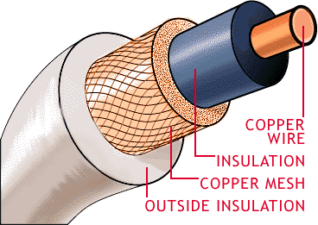
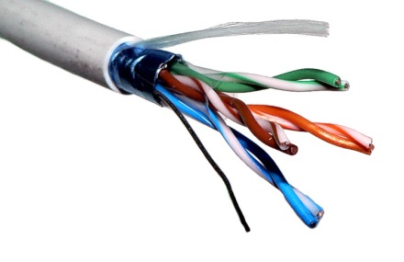
Types of Cable: Copper
Coaxial cable
  Wire surrounded by insulation.
  Copper shield around insulation.
    Acts as signal return
    Shields from external noise
  High bandwidth: 100 Mbps.
    Example: analog cable TV with FDM for dozens of channels at 6 MHz
Twisted pair
  Most local area networks;
  phone lines in buildings.
  More susceptible to noise than coaxial cable.
  Used for shorter distances and slower signals.

Slide 55
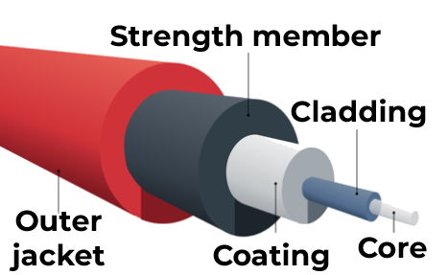
Types of Cable: Fiber Optic
Fiber optic cable
  Consists of glass fiber thinner than
  human hair.
  Uses light to carry signals
  Laser or light-emitting diode
  produces signal.
Advantages
  Light waves: high frequency means high bandwidth.
  Less susceptible to interference and tampering.
  Lighter than copper cable.
Disadvantage
  Difficult to use, especially for multipoint connections.
Structure of fiber optic cable
© OFS Fitel LLC.
Used by permission; re-use requires license.

Slide 56
Electromagnetic Waves
Microwaves
  Frequencies below light but above 1 GHz
Unguided medium
  Tightly focused for point-to-point use.
  Highly susceptible to interference.
Applications
  Large-scale Internet backbone channels.
  Direct satellite-to-home radio and TV.
  IEEE 802.11 Wi-Fi.
  Bluetooth.

Slide 57
Questions

