Slide 1

IT 3123 Hardware and Software Concepts
The Internet Protocol Suite
Notice: This session is being recorded.

Slide 2
Announcements
Quiz 5 will be due on Wednesday. (Assignment 4 is also due on Wednesday.)
Quiz 6 remains due on the 10th.

Slide 3
Internet Protocols
Protocols are rules for communicating
TCP/IP: Transmission Control Protocol / Internet Protocol; the basic transport protocol of the Internet.
HTTP: Hypertext Transfer Protocol; the protocol of the World Wide Web. Uses TCP/IP for transport.
So, TCP/IP is a “lower level” protocol and HTTP is a “higher level” protocol.

Slide 4
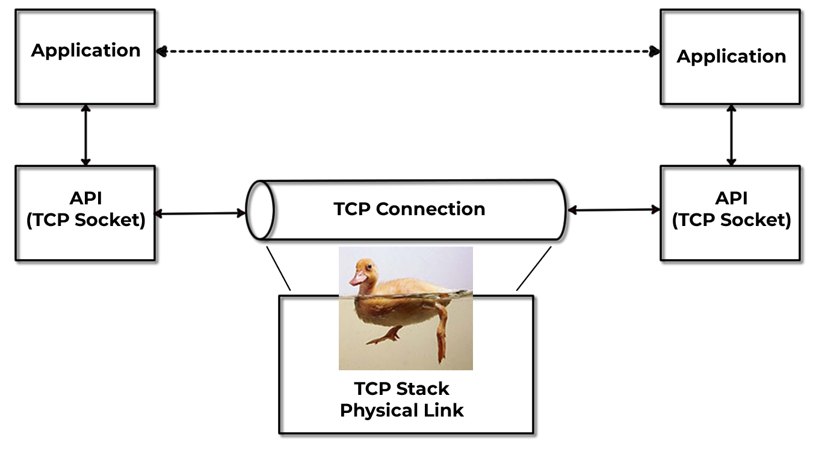
Logical Connection View of TCP
Notes:
The dotted line indicates that the two applications appear to be directly connected. The actual connection is through a TCP socket and a pipe that represents the logical connection. The TCP stack and physical link are represented by a duck. On top of the water, the duck rides along nice and easy, but there's a lot of paddling going on underneath.

Slide 5
The Internet Protocol Stack
The Internet model is different from and simpler than the OSI model.
7. Application Layer 6. Presentation layer 5. Session Layer 4. Transport Layer 3. Network Layer 2. Data Link Layer 1. Physical Layer
The Internet Model
The OSI Model
SMTP, HTTP, telnet, etc.
TCP or UDP Internet Protocol (IP)
Ethernet, WAN protocols, etc.

Slide 6
TCP/IP
Transmission Control Protocol/Internet Protocol
Based on five protocol layers
Layers 1 and 2 are not actually specified in the standard. However, the TCP/IP model recognizes the existence of these layers as a necessity.
The TCP/IP protocol suite encompasses an integrated suite of numerous protocols that work together and guide all aspects of communication.
Notes:
In computer networking, the Stream Control Transmission Protocol (SCTP) is a Transport Layer protocol, serving in a similar role to the popular protocols Transmission Control Protocol (TCP) and User Datagram Protocol (UDP). It provides some of the same service features of both: it is message-oriented like UDP and ensures reliable, in-sequence transport of messages with congestion control like TCP.
http://en.wikipedia.org/wiki/Stream_Control_Transmission_Protocol

Slide 7
The TCP/IP Stack
Layer 5 Application Layer
HTTP SMTP DNS SSH …
Layer 4 Transport Layer
TCP UDP SCTP
Layer 3 Network (Routing) Layer
IP ICMP DHCP ARP
Layer 2 Data Link Layer
Depends on underlying network.
Layer 1 Physical Layer
Depends on underlying network.
Notes:
In computer networking, the Stream Control Transmission Protocol (SCTP) is a Transport Layer protocol, serving in a similar role to the popular protocols Transmission Control Protocol (TCP) and User Datagram Protocol (UDP). It provides some of the same service features of both: it is message-oriented like UDP and ensures reliable, in-sequence transport of messages with congestion control like TCP.
http://en.wikipedia.org/wiki/Stream_Control_Transmission_Protocol

Slide 8
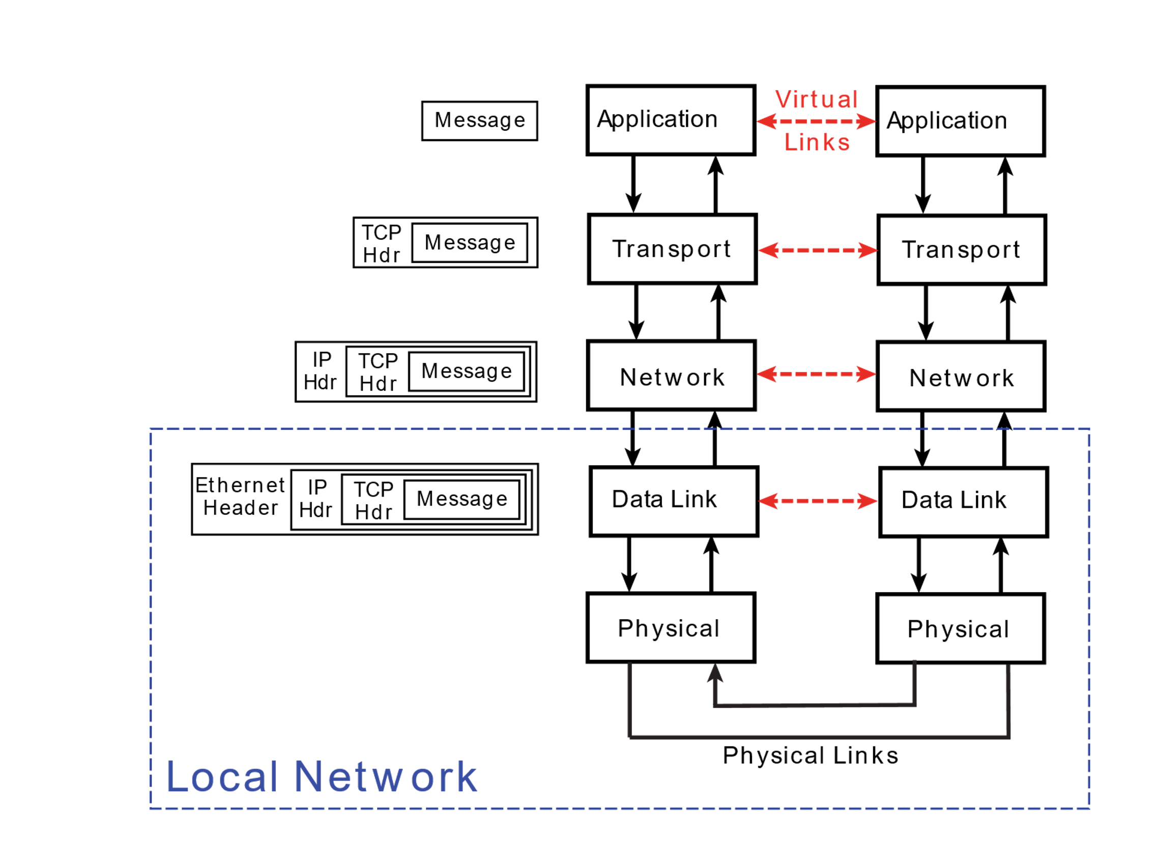
Operation of TCP/IP Model
Notes:
At the transport layer, that could be a UDP or SCTP header.
Doesn’t have to be Ethernet at the lowest level. Could be token ring, 802.11 radio, etc. Physical links could be fiber or radio waves, etc.

Slide 9
Application Layer (Layer 5)
Layer where message is created.
Includes any application that provides software that can communicate with the network layer.
Sockets
Originated with BSD UNIX.
Provide the interface between the application layer and transport layer.
Used by applications to initiate connections and to send messages through the network.
A means for adding new protocols and keeping the network facilities current in their offering.

Slide 10
Transport Layer (Layer 4)
Provides services that support reliable end-to-end communications.
Generates the final address of the destination.
Responsible for all end-to-end communication facilities.
Packetization of the message, breaking up of the message into packets of reasonable size takes place at this level.
Two major protocols:
TCP
UDP
Notes:
SCTP: Stream-control transmission protocol -- byte streams, e.g. telephone. See p. 392

Slide 11
Transport Layer Protocols: TCP
TCP (Transmission Control Protocol)
Provides reliable delivery service.
Sending and receiving TCP node each create a socket.
Control packets are used to create a full duplex connection between the sockets.
A single TCP service can create multiple connections that operate simultaneously by creating additional sockets as needed.
Routing is the responsibility of the network layer (layer 3).

Slide 12
Transport Layer Protocols: UDP
UDP (User Datagram Protocol)
Unreliable, connectionless service.
No acknowledgment of receipt by receiving node.
Example: streaming video.

Slide 13
“Reliable” and “Unreliable”
The Postal Service: Reliable or not?
In “unreliable” network communication, the protocol provides no indication of delivery. (IP, UDP)
In “reliable” communication, the protocol does provide feedback.
TCP is a reliable protocol in that packets are acknowledged by sequence number.
UDP is not.

Slide 14
Three-Way TCP Connection Handshake
Client and server must agree on packet sequence numbers. (Starting with one is a security hole.)
This is done with the TCP “Handshake.”
Client opens connection, sends number.
Server replies with server’s sequence, client’s sequence number plus 1.
Client replies with server’s sequence number plus 1, first data packet.

Slide 15
Network Layer (Layer 3)
The TCP/IP network layer is also called the internetworking layer or the IP layer.
Responsible for the addressing and routing of packets to their proper and final destination.
IP (not TCP) provides unreliable, connectionless, packet switching service.
Does not guarantee delivery nor check for errors.
Routers and gateways are sometimes referred to as level 3 switches to indicate the level at which routing takes place.

Slide 16
Data Link Layer (Layer 2)
Responsible for the reliable transmission and delivery of packets between two adjacent nodes on the local network.
Packets at this layer are called frames.
Sometimes divided into the following two sublayers:
Software logical link control sublayer.
Error correction, flow control, retransmission, packet reconstruction and IP datagram/frame conversions.
Numbers frames and reorders received frames to recreate the original message.
Rarely used; now mostly in hardware.
Hardware medium-access control sublayer
Defines procedures for access the channel and detecting errors.
Responsible for services such as data encoding, collision handling, synchronization, and multiplexing.

Slide 17
Physical Layer (Layer 1)
Layer at which communication actually takes place consisting of a bare stream of bits.
Primarily implemented in hardware by a network interface controller (NIC).
Physical Medium Access Control protocol includes
Definition of the medium.
Signaling method, signal parameters, carrier frequencies, lengths of pulses, synchronization and timing issues.
Method used to physically connect the computer to the medium.

Slide 18
Different Addresses Used in a Network
Human-friendly: Domain name, port number
Application
Transport
Network
Logical: IP Address
Data Link
Physical: MAC Address
Physical

Slide 19
Domain Names
Hierarchical system of network address identifiers used throughout the Internet and on local area networks, intranets and extranets.
Created so users would not have to memorize IP addresses.

Slide 20
Domain Name System (DNS)
Principal service: domain name resolution – translates domain names into IP addresses
Can also translate IP addresses to domain names, sometimes.
Can provide other services.
Uses a massive distributed database containing a directory of servers.

Slide 21
Domain Names form a Hierarchy
Root
.com
.edu
.org
Top Level Domains
.kenne saw
.gatech
Second-level Domains
facultyweb
www
Hosts

Slide 22
Domains May Have Subdomains
host.[subdomain.]domain.tld
wwww.kennesaw.edu
tobler.ai.mit.edu
www.ducksoup.comedy.marxbros.com
FQDN= Fully Qualified Domain Name

Slide 23
Top Level Domain Names
Generic TLDs Country Code TLDs Extension TLDs
.com .net .org .edu .mil .gov .biz
.au .br .ca .gr .md .tv .us
.aero .museum .dentist .theatre .gallery .baby .video
Notes:
There are also special-use domain names like .example and .local, brand tlds like .aetna and .Chrysler, and many more.

Slide 24
The DNS is a Distributed Database
Knows .com, .org, .edu, etc.
Root Servers
Knows ksu, mit
TLD Servers
Domain Servers
kennesaw
Knows www, facultyweb, ccse
Knows ai, tobler, swissnet, www
Even more levels are possible

Slide 25
The DNS is a Distributed Database
Over 600 “root name servers” around the world know the addresses of the TLD name servers. The addresses of the root servers are “well known.”
The TLD servers (.com, .org, .edu, etc.) know the addresses of name servers for their domains.
The domain name servers (two or more!) know the addresses of hosts within their individual domains.
Notes:
Although there are over 600 root name servers, there are only 13 names, from a.root-servers.net to m.root-servers.net. A technique called anycasting maps the 13 names onto the 600 or so actual servers.

Slide 26
No Duplicate Names
Top Level Domains (TLDs) are approved by ICANN
Second-level domains are registered by ICANN-accredited registrars; no duplicates are assigned.
So, there is only one kennesaw.edu But there could also be a kennesaw.com, etc.
It is up to the owners of each domain to assure no duplicates within the domain, e.g. can’t have two wwws in kennesaw.edu.
Notes:
The way name server software works, one would have to try very hard to have duplicate host names.

Slide 27
Host Names are Local
Domain names (e.g. kennesaw.edu) are registered through an ICANN-accredited registrar.
Host names are assigned by the domain name owner
“Well known” names (RFC 2219) are often used to make it easy to find particular services: www Web server mail or smtp mail server ftp FTP server
Notes:
RFC 2219 codified this practice in 1997. It probably started with WWW servers in 1991 or so.
[> internet/protocols #316 jpistritto 1326 14Jan05 23:53 O=314 N=0 C=0
Re: Well-Known Host Names
www came first.
the use of <service>.<domain>.<tld> originated pretty much with the World Wide Web.
Previous to the web, no one thought it necessary to go beyond a hostname to specify a service. Hosts provided a multiplicity of services and that was pretty much transparent to the user. So for instance "mit-ai" or "sri-kl" was prefectly sufficient in ARPANET times. When domain naming came along they change that to "mit-ai.mit.edu".
One of the reasons that "www.domain.com" became popular was that the people who ran the web were *not* in the IT organizations originally. They were renegades that set it up themselves. An informal convention developed that an organizations website (which wasn’t mission critical back then), would be found at "www.domain.com" rather than "domain.com" (which was usually where important stuff like email happened. The convention got extended to ftp gradually. A few of the "big" ftp sites like "simtel-20" got that started.

Slide 28
Conversations with Name Servers
www.kennesaw.edu?
kennesaw
www.kennesaw.edu 20.122.241.50

Slide 29
Conversations with Name Servers
Ask .edu. Here’s the address.
kennesaw
www.kennesaw.edu 20.122.241.50

Slide 30
Conversations with Name Servers
www.kennesaw.edu?
kennesaw
www.kennesaw.edu 20.122.241.50

Slide 31
Conversations with Name Servers
Ask kennesaw.edu. Here’s the address.
kennesaw
www.kennesaw.edu 20.122.241.50

Slide 32
Conversations with Name Servers
www.kennesaw.edu?
kennesaw
www.kennesaw.edu 20.122.241.50

Slide 33
Conversations with Name Servers
20.122.241.50
kennesaw
www.kennesaw.edu 20.122.241.50

Slide 34
IPv4 Addresses
Registered and allocated by ICANN
32 bits long divided into 4 octets
Assigned in blocks of contiguous addresses
Number of addresses is a power of two
Divided into two levels
Network part
Host part (nodes)
Masks
Used to separate the different parts of the address
Notes:
Some books maintain that there are three levels, network, subnet, and host. That is an unnecessarily complicated way to think about it.
In this context, a mask, is a bit-string that’s all ones in the network part and all zeroes in the host part. Since network and host are distinct, all that’s really needed is the number of ones, typically prefixed with a slash. So, a /24 address would have 24 bits of network number and eight bits of host.

Slide 35
We’re Out of IPv4 Addresses
IPv4 addresses are 32 bits. There are (about) 2³² of them or around four billion.
Conserving addresses
Gateways, reserved addresses and NAT
Classless addresses (CIDR)
ICANN ran out of large IPv4 address blocks in spring, 2011.
Regional registrars and ISPs still have addresses available.

Slide 36
IPv6
IPv6 standard published in 1998.
128-bit addresses, so 2¹²⁸ of them: enough to assign an address to every grain of sand on the planet.
Addresses are eight groups of four hex digits: 2001:db8:85a3:0:0:8a2e:370:7334
But, not interoperable with IPv4! Effectively creates a new, parallel network.
So, IPv4 remains the most common addressing format.

Slide 37
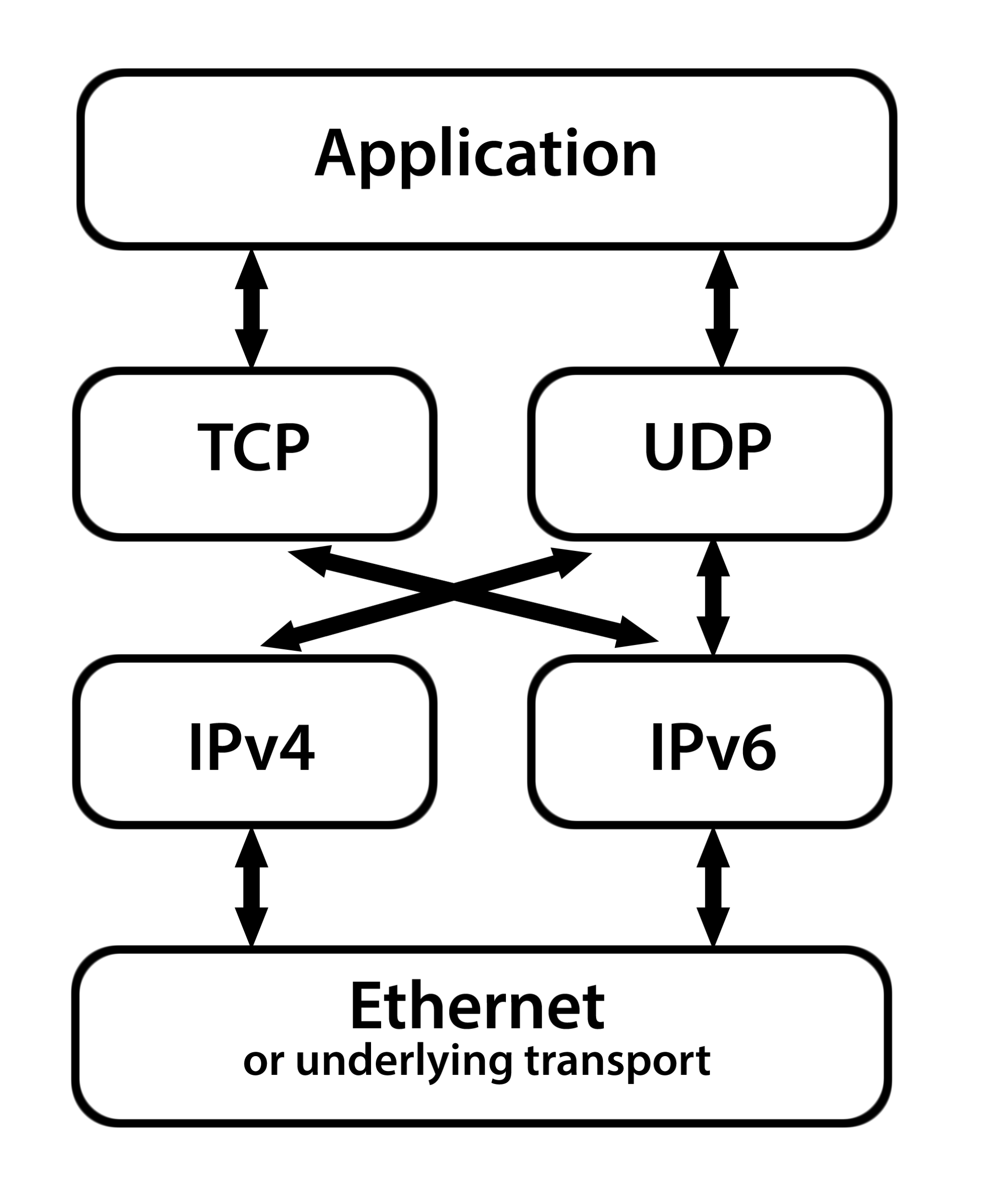
IPv4 and IPv6 Coexist
A device has software for both IPv4 and IPv6.
Packets from Ethernet are handed off to either IPv4 or IPv6.
The IP layer hands the packet to either TCP or UDP.

Slide 38
IPv6 Extension Headers
There is not enough information in the IPv6 header to route all packets.
The additional information is supplied in extension headers:
Routing
Fragmentation
Authentication
Encapsulation
Destination Options

Slide 39
TCP/IP Port Addresses
Sixteen-bit numbers, part of the TCP packet header.
Used by software to identify which application should receive the packet after it is delivered to the computer.
The first 1024 port numbers are called “well known ports” because they are standard addresses for common applications.
Example: Port 80 is commonly used for Web servers.
The rest can be user-defined.

Slide 40
Example Well-Known Port Addresses
Service | Port | Description
ftp | 20 | File transfer
ssh | 22 | Secure shell session
smtp | 25 | Server-to-server mail
http | 80 | Web servers
kerberos | 88 | Authentication
pop3 | 110 | Post office protocol
sqlserv | 118 | SQL services

Slide 41
Configuring a Network
Static Configuration
IP address
Network mask
DNS server(s)
Default gateway
Dynamic Host Configuration Protocol (DHCP)
A computer sends a broadcast asking for configuration information.
A DHCP server replies

Slide 42
Dynamic Host Configuration Protocol
Referred to as DHCP.
Manages available addresses.
Uses broadcast-response to assign addresses to nodes (computers) as they come online.
Can distribute either reserved or registered addresses.
Also configures netmask, DNS servers, default gateway, etc.

Slide 43
What Addresses to Use?
One can use a pool of “reserved” (RFC 1918) addresses
The choice is not (quite) arbitrary
A gateway must perform network address translation
One can use a pool of “registered” addresses
Assigned by regional registrar or ISP
A scarce resource.

Slide 44
RFC-1918 Reserved Addresses
Every computer attached directly to the Internet must have a unique IP address.
Not every computer that uses the IP protocol must be directly connected to the Internet.
Reserved addresses
10.0.0.0 − 10.255.255.255
172.16.0.0 − 172.31.255.255
192.168.0.0 − 192.168.255.255
These same address ranges may be used by many organizations; they are dropped by Internet routers; sometimes called “non-routable.”
Notes:
They are as “routable” as any other IP addresses; Internet routers refuse to route them by design.

Slide 45
ARP: Mapping IP Address to MAC
Nodes (computers) are configured with IP addresses, either by static config or DHCP.
DNS gives out IP addresses.
Communication on the LAN needs Ethernet MAC addresses.
Problem: I know the IP address of a node but need to find the MAC address.
Solution: ARP, the address resolution protocol.

Slide 46
How ARP Works
A node wants to communicate:
The destination IP is known, perhaps from DNS.
The destination MAC is unknown.
The node wanting to communicate sends a broadcast message containing the IP address it wants to contact.
The node with that IP address replies, giving its MAC address.
The original node saves the IP-to-MAC translation in an ARP table.

Slide 47
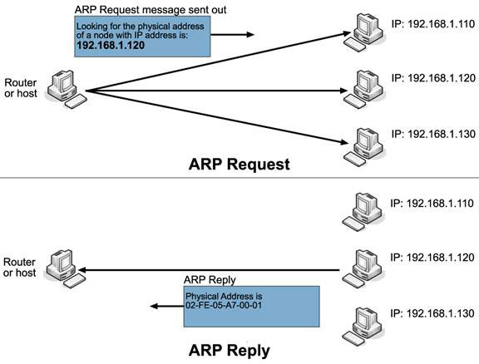
How ARP Works
http://www.louiewong.com/archives/196

Slide 48
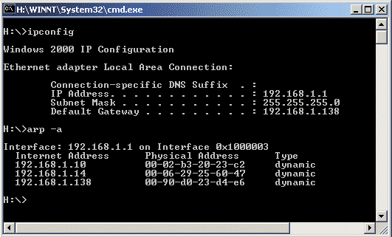
Interrogating the ARP Table

Slide 49
Network Address Translation
All IPv4 connections are characterized by four numbers:
IP address of source
Port of source
IP address of destination
Port of destination
Server
Client
168.28.176.200:80
206.2.42.6:4096
Notes:
Theport number is the part following the colon.

Slide 50
Network Address Translation
A NAT router has only one “outside” address.
But 65,000 available port numbers.
A dynamic table translates outside connections to inside connections by port number.
Source | Port (on NAT Router) | Destination
168.28.176.200:80 | 1025 | 192.168.0.32:4096
126.3.4.16:1605 | 1026 | 192.168.0.92:1250
128.197.130.200:22 | 1027 | 192.168.0.50:32700

Slide 51
Network Address Translation
Network address translation (NAT) interposes an “appliance” between a computer and the “outside world.”
The table in the NAT router translates addresses.
NAT Router
Server
Client
168.28.176.200:80
206.2.42.6:1025
192.168.0.8:4096
192.168.0.1:80

Slide 52
Port Forwarding
SMTP
NAT Router
1:25
25 → 1:25 80 → 2:80 4096 → 3:1024
Web Server
12.32.4.22:6000
2:80
206.2.42.6:4096
Desktop
.3:1024
168.28.176.200:80

Slide 53
Network Address Translation
Advantages:
Internet activity using reserved addresses.
NAT’d computers are defended from unsolicited incoming packets.
Disadvantages
Running Internet servers behind a NAT router takes special configuration.
No protection against “solicited” malicious data, e.g. email, malicious Web sites.

Slide 54
Quality of Service (QoS)
Methods to reserve and prioritize channel capacity to favor packets that require special treatment.
Service guarantees from contract carrier services that specify particular levels of throughput, delay and jitter (variation in delay from packet to packet).
Differentiated service (DiffServ)
8-bit (DS) field in IP header
Set by the application at the sender or by the first node
Diffserv capable nodes such as routers can then prioritize and route packets based on the packet class

Slide 55
Alternative Protocols to TCP/IP
MPLS (Multi-Protocol Label Switching)
Creates a virtual circuit over packet switched networks to improve forwarding speed of datagrams
ATM (Asynchronous Transfer Mode)
Partial-mesh network technology in which data passes through the network in cells (53-byte packets)
SONET (Synchronous Optical Network) and
SDH (Synchronous Digital Hierarchy)
Protocol that uses fiber optic to create wide area networks with very high bit rates over long distances
Frame Relay
Low-speed (56k), wide area network standard

Slide 56
Virtual Private Networks (VPNs)
Packet switched.
On a public network (like the Internet).
Encryption keeps data secure.
Sometimes referred to as a “tunnel” through the public network.

Slide 57
High-Speed Networking
Billions of bits per second.
Fiber optic cable.
Ethernet, ATM or SONET protocols.
Wave division multiplexing.
Notes:
Wave division multiplexing is sending light of different wavelengths (colors) on the same fiber.

Slide 58
Comparison of Networking Speeds
Connection Type | Speed | Time for 8 MB
Dial up | 56 kb | 2.4 min
DSL, cable modem | 2 mbps | 4 sec
Ethernet | 10 mbps | 0.8 sec
Fast Ethernet | 100 mbps | 0.08 sec
Gigabit Ethernet | 1,000 mbps | 0.008 sec
Ten gig Ethernet | 10,000 mbps | 0.0008 sec

Slide 59
Questions

