Slide 1

IT 3123 Hardware and Software Concepts
Intro to Data Communications Ethernet
Notice: This session is being recorded.

Slide 2
Announcements
About the exam…
The Best Practices video.
ChatGPT and careers.
Chapter 5 replaced in PDF but not ePub.
The end of regular video recordings, maybe.
Notes:
Generative pre-trained transformer

Slide 3
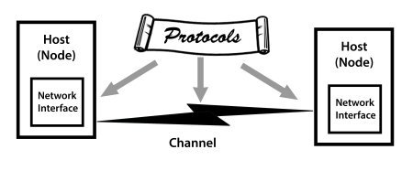
Data Communications: Simple View
Messages: data shared between sender and receiver.
Communications channels that can capably and reliably transport messages.
Protocols establish accurate and appropriate meaning to the messages that are understood by both senders and receivers.
Node: any device attached to a network.
Host: a computer attached to a network. All hosts are nodes.
Notes:
Examples
POTS - plain old telephone service
Web servers and Web browsers

Slide 4
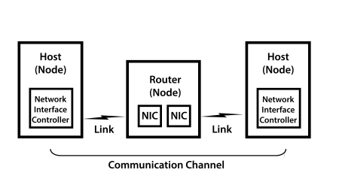
Data Communications: Physical Connections
A channel is a communication facility capable of carrying messages with signaling that represents the messages being transported. In network diagrams, a channel is often represented as a lightning bolt or a pipe.
A link is a physical connection between nodes. One link may carry several channels. Example: one Internet connection can simultaneously deliver two separate streams.
Notes:
The link can also be a lightning bolt or pipe.

Slide 5
Messages
Communication between cooperating applications at each end node.
Can take many forms such as data, a program, a file, or multimedia.
Messages are represented digitally.
Data is described as a byte stream because communications are predominantly serial.
A limitation as a communication tool is the varying message length: Long messages could tie up a communication channel indefinitely creating problems for other messages that share that channel.

Slide 6
Bandwidth, Speed, Latency
Bandwidth is the theoretical amount of information a link can carry per second, measured in Hertz.
Speed is the number of bits per second a link can carry, measured in bits per second.
Latency is the delay in transmission as signals pass through the network from source to destination often measured in milliseconds.

Slide 7
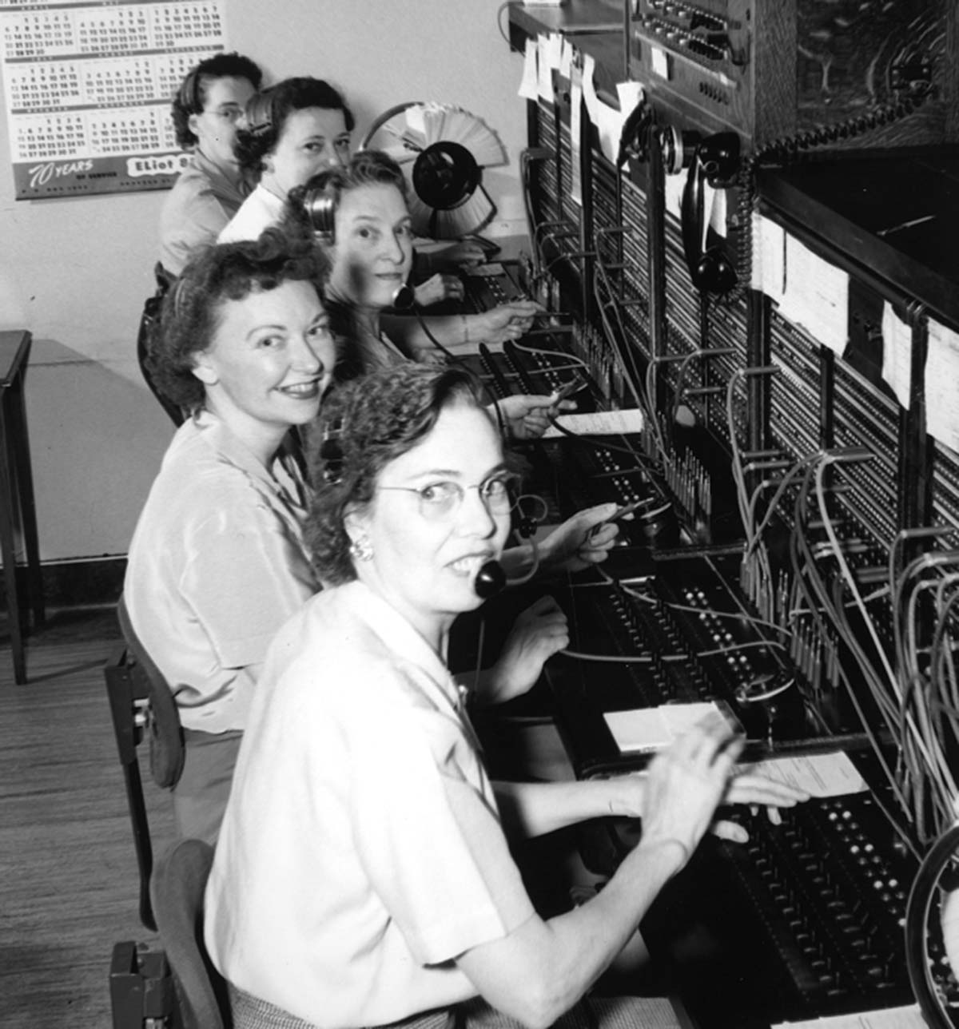
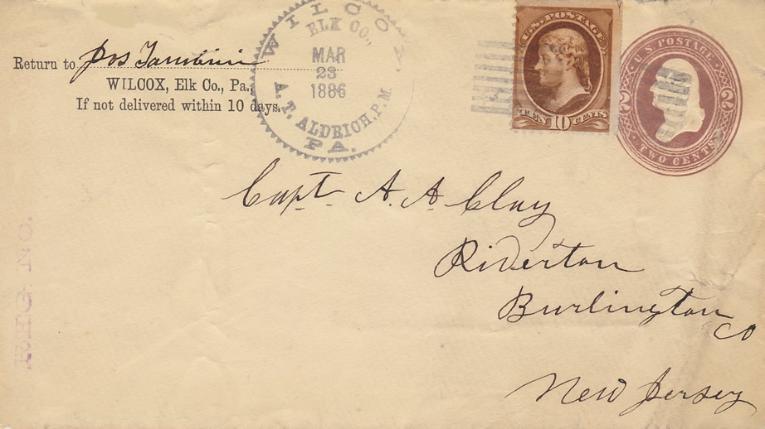
Circuit and Packet Switching
Circuit switching: dedicated channel between source and destination for duration of connection.
Packet switching (datagram switching): each packet is routed from node to node independently based on various criteria.
Notes:
A wired phone conversation is circuit-switched.
An every-day example of packet-switching would be mailing the pages of a novel, each in a separate envelope. They can be reassembled at the destination even though they may (will!) arrive out of order because the pages are numbered.

Slide 8
Packets
In packet switching, messages are segmented into packets.
A single message is often many packets.
Packets consist of data encapsulated by the packet header which contains information about the packet.
Used because of efficiency; solve problems of message length, channel availability and maximum utilization.
Equivalent to an envelope that contains pages of data.

Slide 9
Advantages of Packets
Increases channel utilization efficiency.
Reasonable unit for routing of data.
Alternative to dedicating a channel for the entire length of the message.
Packets from several sources can share a channel.
Each sender/receiver pair appears to have a channel to itself.
Receiving computer can process an entire block of data instead of a character or byte at a time.

Slide 10
Packet Routing
Routers
Specialized devices used to interconnect network and pass packets from one network to another.
Operation
When packet arrives at input port…
Processor decides where packet is to be directed…
A switch is set to direct the packet to the correct output port.
Gateways
Same as routers but connect dissimilar networks together.
Convert packet headers for the dissimilar networks if needed.

Slide 11
Reliable and Unreliable Protocols
Reliable and unreliable are used differently from their ordinary meanings in data communications.
Reliable protocols provide for acknowledgement of messages, similar to certified mail with return receipt.
Unreliable protocols do not provide for acknowledgement. (But messages almost always get through, like first-class mail.)

Slide 12
Local and Wide-Area Networks
In local area networks, the network operators own the equipment and the wires that connect it.
Local area networks span a department, building, or campus and operate at high speeds.
Wide area networks were really leased data lines connecting local networks, i.e. internets.
Now people mostly use the Internet for that.
Today we talk about local area networks, service providers, and endpoints.
Notes:
“endpoints” can include a cell phone, a wired desktop computer, or a laptop with wireless access to a local wireless access point.

Slide 13
Protocol Stacks
A protocol stack is an abstraction of the modularized hardware and software used for data communication.
Modularization is good programming and design practice.
One part of the stack can be replaced without replacing everything, e.g. replace wire with cellular radio.
Two major stacks, OSI Model and Internet Protocol Suite model.

Slide 14
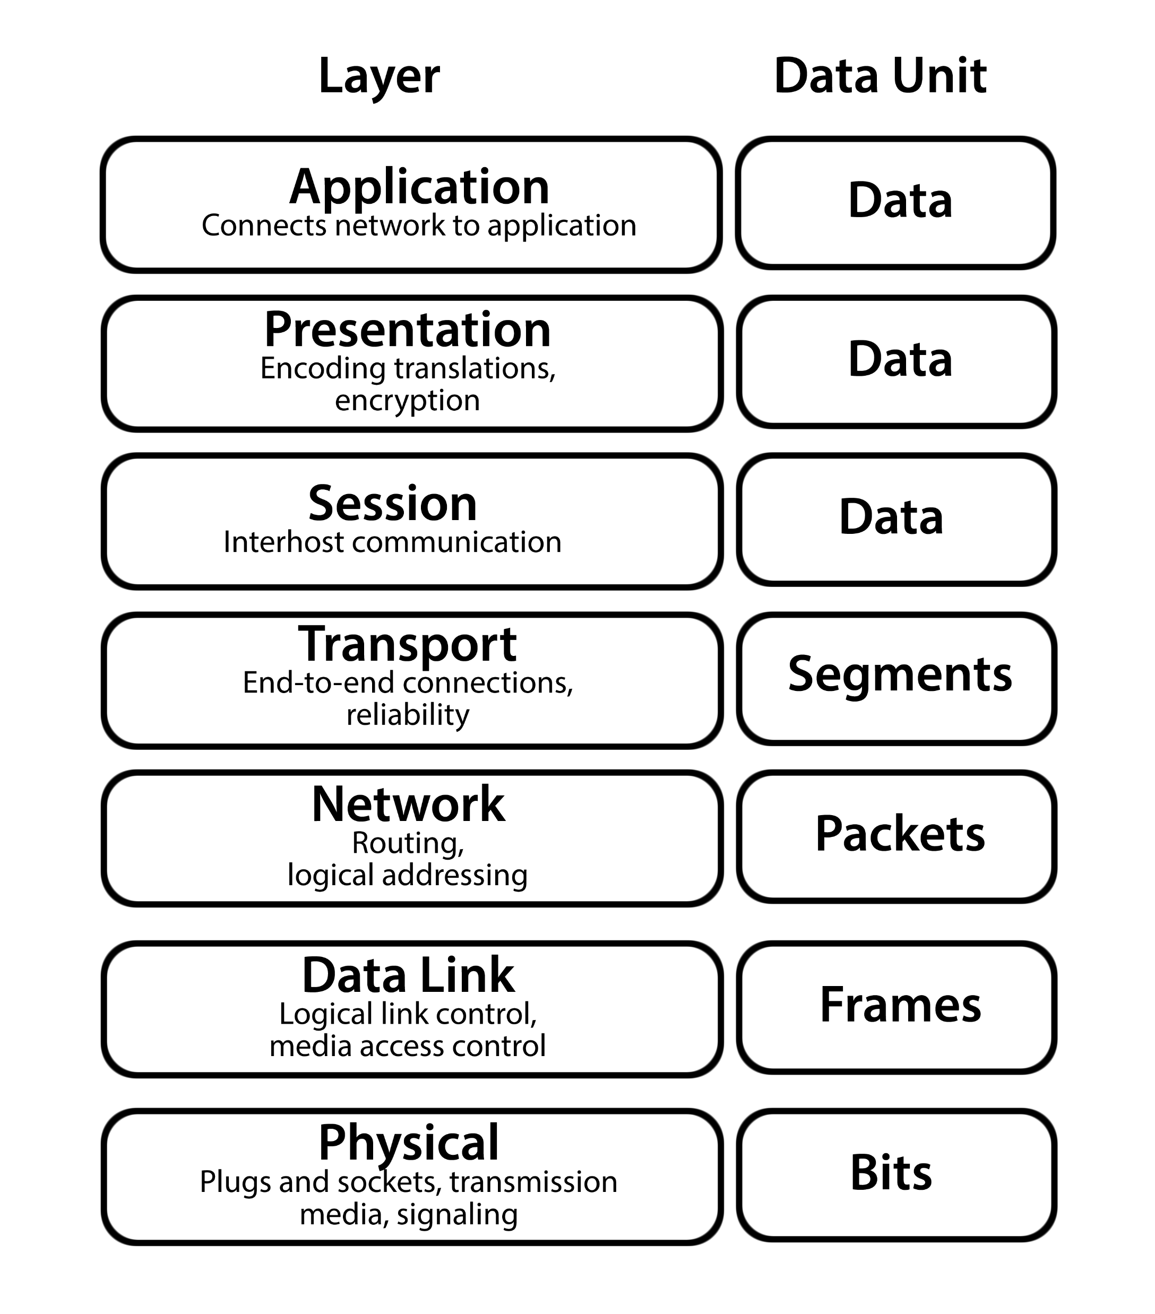
The OSI Model
The OSI (Open Systems Interconnect) model is a reference model.
Provides the cleanest separation of layers.
Includes the physical layer. (Subsumed in the data link layer in the Internet Protocol Suite model.)
Notes:
“Reference model means we don’t actually build things that way. We are interested for theoretical reasons.

Slide 15
If You Must Memorize…
This should be something you look up.
If you are required to memorize…
Away Application
Pizza Presentation
Sausage Session
Throw Transport
Not Network
Do Data link People Physical

Slide 16
Physical Layer (Layer 1)
Layer at which communication takes place, consisting of a bare stream of bits.
Primarily implemented in hardware by a network interface controller (NIC).
Physical access protocol includes:
Definition of the medium.
Signaling method, signal parameters, carrier frequencies, lengths of pulses, synchronization and timing issues.
Method used to physically connect the computer to the medium.

Slide 17
Data Link Layer (Layer 2)
Responsible for the reliable transmission and delivery of packets between two adjacent nodes.
Packets at this layer are called frames.
Sometimes divided into the following two sublayers:
Software logical link control sublayer.
Hardware medium-access control sublayer.
Notes:
Error correction, flow control, retransmission, packet reconstruction and IP datagram/frame conversions
Numbers frames and reorders received frames to recreate the original message
Medium access control: Defines procedures for access the channel and detecting errors
Responsible for services such as data encoding, collision handling, synchronization, and multiplexing

Slide 18
Network Layer (Layer 3)
Provides for logical addressing and routing.
Connectionless: it is packets that are being routed, not messages.

Slide 19
Transport Layer (Layer 4)
When sending, divides large messages into sizes suitable for packets.
Reassembles packets into messages when receiving.
Provides error control.
Provides flow control.
Notes:
Flow control means signaling a sending node to pause if data are being sent faster than they can be accepted.

Slide 20
Session Layer (Layer 5)
Maintains a virtual connection if needed.
Closes the connection at the end of the session.

Slide 21
Presentation Layer (Layer 6)
Provides data independence, like translating UCS-2 characters to UTF-8 and back.
Handles encryption and decryption.
Handles compressing and uncompressing.

Slide 22
Application Layer (Layer 7)
Provides the interface between the network stack and the application.
Interface is via an API.
The application need not know about any other part of the network stack.

Slide 23
Important Protocols
The principal protocols are:
Ethernet (local area networks)
Internet Protocol, or IP (for routed networks)
Ethernet and IP work together; Ethernet is the local area protocol and IP is the wide-area protocol.
TCP/IP has several upper-layer protocols, such as TCP and UDP.
There are other protocols.

Slide 24
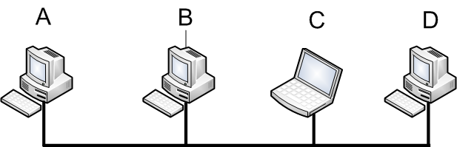
Simple LAN Communication
A sends a message to C.
B and D (potentially) “hear” the message, but do not act on it because it’s addressed to C.
C hears and processes the message.
The network is a “bus” connecting all nodes.

Slide 25
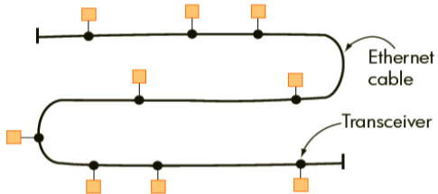
Ethernet
The prevalent local-area networking technology.
10, 100, 1000 or more mbps.
Multiple-access (more than two devices possible on the same wire.)
CSMA/CD: Carrier- sense multiple access with collision detection.

Slide 26
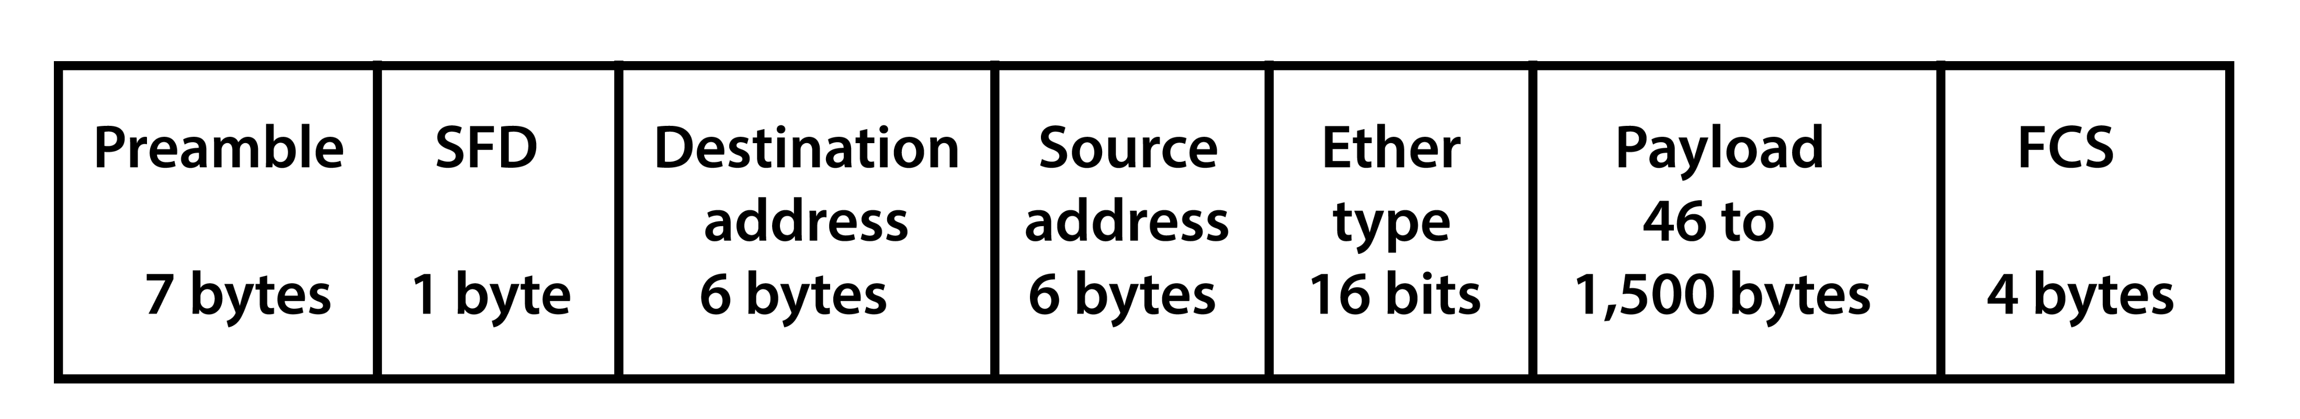
Ethernet Frame
Hardware (MAC) Addresses
Ethernet “jumbo frames” support packets of 9,000 bytes with payloads of 8,960 bytes, reducing “packet overhead.”
A 32-bit VLAN address can optionally follow the source address.
“FCS” is a cyclic redundancy check for error control.
There are 96 bit-times (12 byte times) of interpacket gap after each packet.

Slide 27
Ethernet MAC Addresses
MAC is “medium access control.”
48 bits, 6 bytes long for each of source and destination.
Globally unique.
Written as six hex pairs separated by colons 00:11:25:d3:12:77
A network interface device processes only frames with its address.
Unless in “promiscuous mode.”
An address of all ones is the broadcast address.

Slide 28
Assigning MAC Addresses
First 3 bytes identify manufacturer, but two leading bits are always zero, so 22 bits.
That’s enough for four million manufacturers.
24 bits for device, so 16 million devices.
Large manufacturers have more than one prefix.

Slide 29
Ethernet MAC Protocol
MAC: Medium Access Control
Four step procedure:
Listen; if medium is idle, transmit.
If medium is busy, listen until idle and then transmit.
If collision is detected, cease transmitting.
After a collision, wait a random amount of time before re-transmitting.

Slide 30
Ethernet Nodes “Take Turns” Sending
A:
A Sending
Idle
B:
Listen and wait
Wants to Send
B Sending
Time

Slide 31
An Ethernet Collision
A:
A Sending
Idle
B:
Collision
Both Messages Lost
Wants to Send
C:
Wants to Send
Collision
Both Send
Time

Slide 32
Recovery From a Collision
A:
A Sending
Idle
B:
Collision
Listen and wait
B Sending
R_{B}
C:
Collision
C Sending
Both Send
R_{C}
Time
B and C each wait a random time before trying again.
One of them “wins” and the collision is recovered.

Slide 33
Ethernet and Collision Domains
As the number of stations in a collision domain increases, the number of collisions increases.
Collisions harm network throughput (two or more stations waiting.)
If the network is “saturated,” almost no data gets through.
Solution: divide the network into many smaller collision domains.

Slide 34
Hub vs. Switch
Ethernets were formerly built using hubs
All devices logically connected.
Every device could “hear” every other device.
Hence, one large collision domain.
Switching:
The switch connects two ports when traffic must pass between them..
Only devices on the two ports “hear” the traffic.
Result: multiple, smaller collision domains.

Slide 35
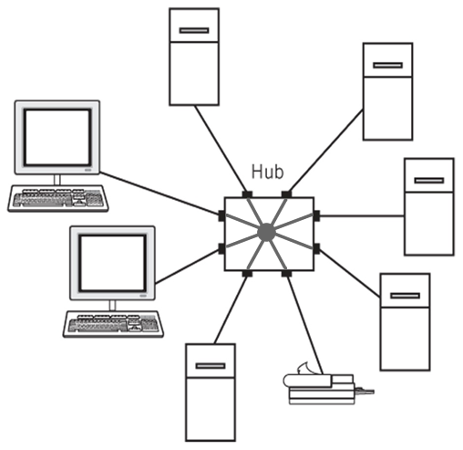
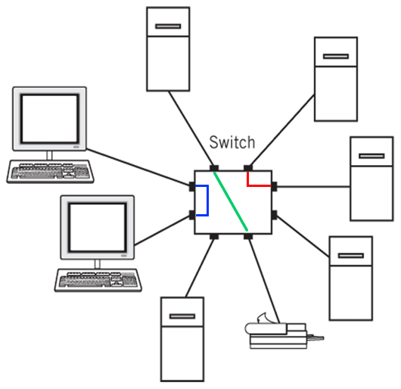
Hub vs. Switch
All ports are connected all the time.
Ports connected dynamically as needed.

Slide 36
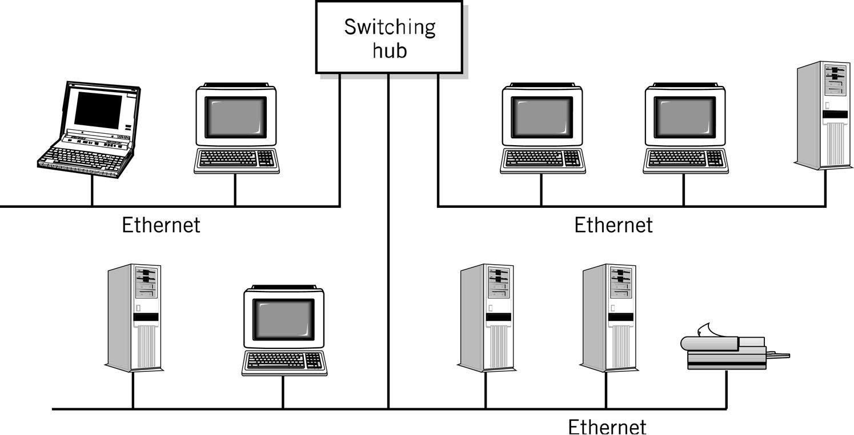
Switched Ethernet
Ethernet Switch
A
0
1
2
B
C
D
E
K
F
G
H
J

Slide 37
Switched Ethernet
Collision domains
Ethernet Switch
A
0
1
2
B
C
D
E
K
F
G
H
J

Slide 38
The Switch Learns MAC Addresses
Ethernet Switch
A
B
0
1
2
C
D
E
F
G
H
J
K
The switch “learns” which devices are on what ports.
Device | Port | Device | Port
A | 0 | F | 1
B | 0 | G | 1
C | 2 | H | 1
D | 2 | J | 1
E | 2 | K | 1

Slide 39
Switched Ethernet
The switch “port” is a device in each collision domain.
The switch learns (by listening to traffic) which devices are on what ports.
The switch identifies packets that need to go to other segments.
Packets for unknown destinations are sent to all ports except the port where it arrived. The reply will tell the switch which port has the addressed device.
Notes:
There’s no need to forward to the incoming port. If the destination device is on that port, it will respond directly.

Slide 40
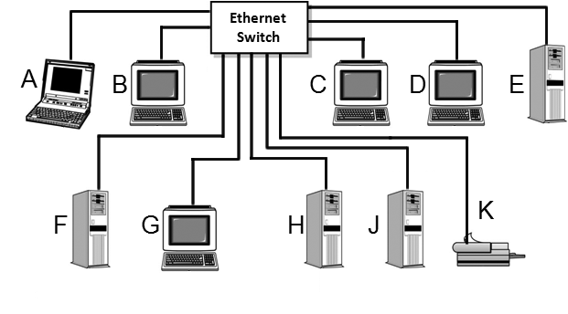
Modern Switched Ethernet
Only one device per port.
All devices talk only to the switch.
No collisions are possible.

Slide 41
Switching Loops and Broadcast Storms
If two Ethernet switch ports are connected together, possibly through another switch…
A packet with no address in the switch’s tables will be broadcast to all ports except the one on which it arrived.
The connected port will receive and broadcast the packet, including to the original port.
The result is a broadcast storm that renders the network useless.

Slide 42
Spanning Tree and Shortest Path Bridging
Switches with spanning tree protocol software will calculate a “spanning tree” and block redundant routes.
Shortest path bridging allows redundant links but prevents or mitigates loops.
SPB is found only on enterprise or carrier class equipment.
Blocked by STP.
Notes:
The invention of the spanning tree algorithm by Radia Perlman in 1985 allowed software or firmware in switches to find those paths through the network sufficient to reach every node, that is, to span the network. Switch ports unnecessary to the spanning tree are disabled and loops cannot exist. A change in the topology of the network, such as by a connection failing, causes the spanning tree to be recomputed. That makes redundant connections possible, but only one connection of a redundant set can be used at a time.
The shortest path bridging protocol, which was developed by the IEEE 802 working group beginning in 2006 and finalized in 2012. The spanning tree protocol disables redundant links; the shortest path bridging protocol allows traffic on redundant links, thereby maximizing network throughput while preventing or mitigating loops. Shortest path bridging is currently found only in enterprise
and service provider grade equipment.

Slide 43
Wireless Ethernet
Uses radio, so no switching possible.
Uses the original CSMA/CD protocol.
The radio link may optionally be reserved by sending a “request to send” (RTS) frame to the access point.
The access point replies with a “clear to send” CTS frame when the link is reserved.

Slide 44
Wireless Standards
Standardized by IEEE as 802.11 standards with letter suffixes.
Separate standards by the WiFi alliance are supposedly more consumer friendly.
Wireless Ethernet operates in the 2.4 GHz and 5 GHz bands. An allocation in the 6 GHz band has been approved by the FCC.
Higher frequencies offer higher data rates at the expanse of shorter distances.

Slide 45
Wireless Security
For any radio signal, including Wireless Ethernet and Bluetooth, anyone with a suitable radio can pick up any transmission.
Encryption is essential to maintain security.
Early WiFi encryption algorithms were flawed.
WEP and WPA are obsolete and should never be used.
Use WPA3 if available, otherwise WPA2.
Notes:
WPA3 announced in January 2018; support mandatory in devices with “WiFi Certified” logo since July 2020.

Slide 46
Questions

