Slide 1

IT 3123 Hardware and Software Concepts
Notice: This session is being recorded.
Secondary Storage Other Input and Output Devices

Slide 2
Announcements
Assignment 3 due tonight!
Review on Wednesday.
The chapter summaries are your friend.
If you don’t have Exam 1 back, see me after class.

Slide 3
Primary and Secondary Storage
Primary storage: registers, cache memory, main memory. Usually volatile.
Primary storage holds instructions and data for currently running programs.
Secondary storage: disks, optical drives, tape. Non-volatile.
Secondary storage generally holds “files” which may be data or executable machine code.

Slide 4
Storage Speed
Measured by access time and data transfer rate.
Access time: average time it takes a computer to locate data.
nanosecond = one-billionth of a second
millisecond = one-thousandth of a second
Data transfer rate: amount of data that moves per second.

Slide 5
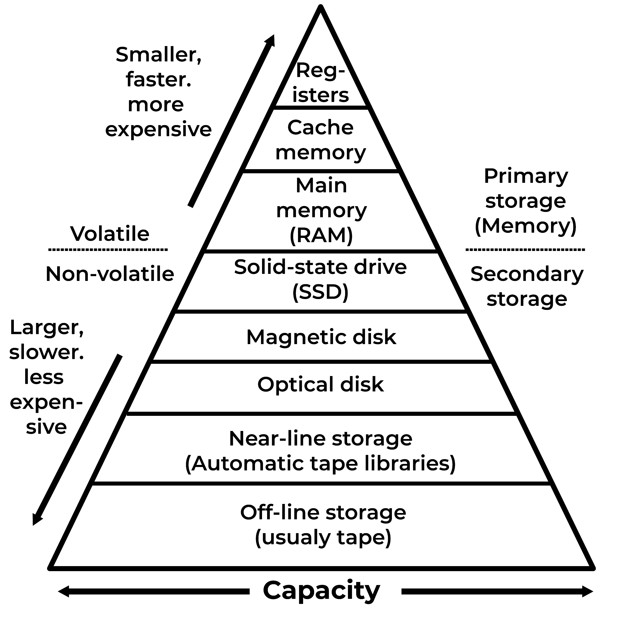
Hierarchy of Storage
Access time
½ nanosecond
1-20 nanoseconds
20-60 nanoseconds
Difference of 1,000,000 (10⁶)
0.1 millisecond
10 milliseconds
100 milliseconds
Seconds to minutes
Minutes to hours

Slide 6
Sequential and Random Access
Sequential access: A file is read or written from beginning to end, or, for reading, until specific data found.
Random access: Any block of data can be accessed directly in about the same time as any other block.
Devices that support random access also support sequential access, but not the reverse.
Notes:
The vast majority of files on personal-use computers are accessed sequentially. Random access is used only for databases and similar applications.

Slide 7

Magnetic (Hard) Disks
Magnetic disks were the principal storage medium for computers from 1956 until the first decade of the 21st century.
Magnetic disks are still important when cost or storage space are primary considerations.
Magnetic disks are random access devices.
Notes:
“Hard” disks as opposed to flexible of “floppy” disks formerly used to store small amounts of data, up to about 1.44 MB.
The image is a magnetic disk with the cover removed. A read and write head is visible on the top surface of the top platter. The edges of three other platters are visible below the top platter.
As of 2023, a 2 TB magnetic disk was available in the $30-50 price range; a similar solid-state disk cost about $100-150. Prices of solid-state disks have declined substantially since about 2020. It is reasonable to conjecture that they will drop below the prices of mechanical disks within a few years given the complexity and precision manufacturing needed for mechanical disks. Magnetic disks might be as extinct as floppy disks by 2030.

Slide 8
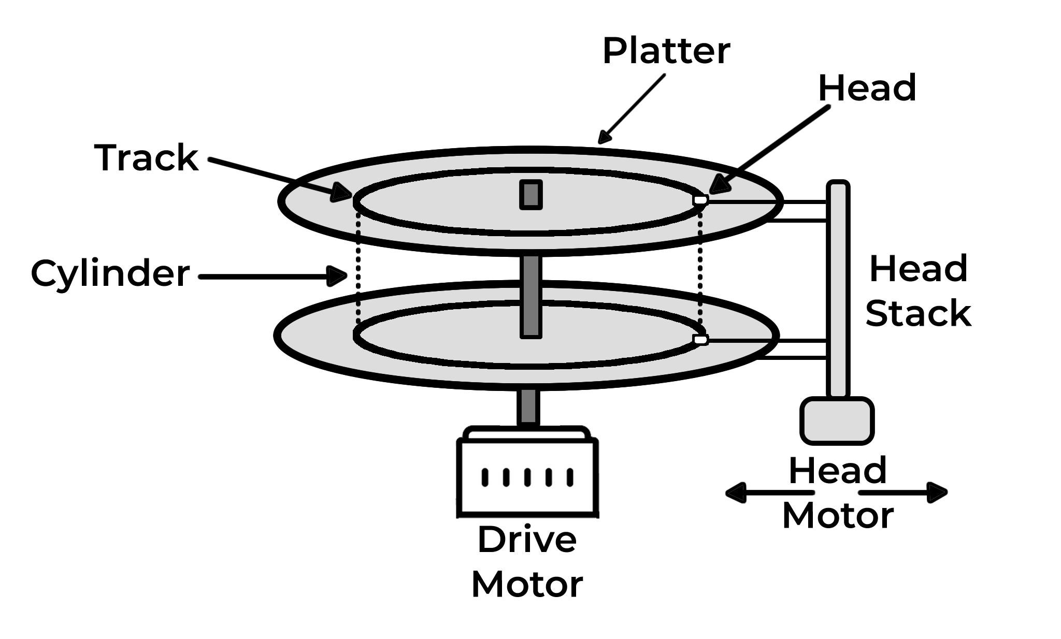
Magnetic Disk Technology
One or more platters.
Each platter has two heads, two recording surfaces.
Each surface has ≈1,000 concentric tracks.
Each track is divided into fixed size blocks of 512 or 4,906 bytes. Also erroneously called sectors.

Slide 9
Disk “Cylinders”
The set of tracks at a specific position, e.g., track 20, form a figurative cylinder.
The significance of the cylinder concept it that one cylinder is the most data that can be accessed without moving the disk heads.
Obsolete concept with logical block addressing.

Slide 10
Magnetic Disk Terminology
Platter – a circular piece of metal coated on both sides with magnetic recording material
Head – reads/writes data off the disk
Track – circle around the disk
Cylinder – collection of tracks consisting of the same track on all platters
Block – amount of data held in one sector of one track (sometimes erroneously called a sector.)
Sector – an arc (pie slice) of the tracks

Slide 11
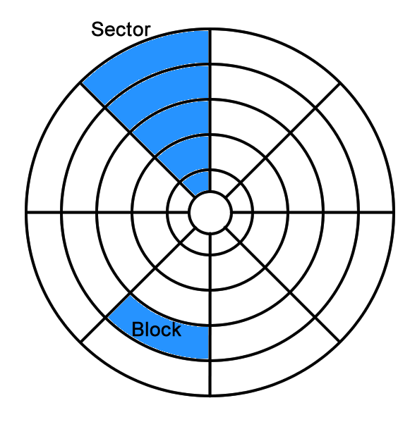
Block and Sector (Pedantic)

Slide 12
Disk Rotation
The number of bits is the same for every track, unless the disk is “zoned.”
The recording density must be greater toward the center of the disk.
Disk rotation speed is constant regardless of the position of the heads: constant angular velocity.
Rotation speeds of 3,600 to 15,000 RPM.

Slide 13
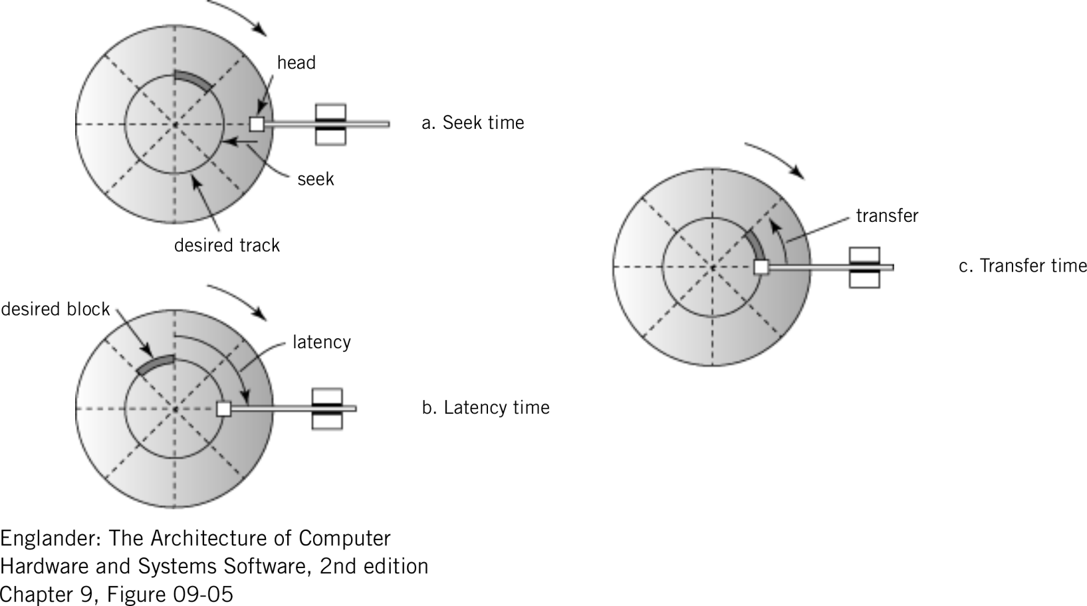
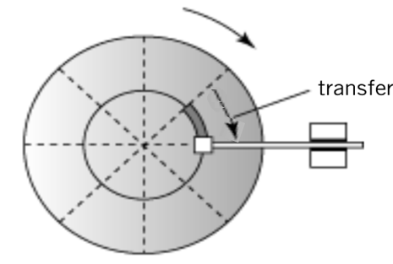
Disk Access Time
Seek time: time required to move heads to the desired track.
Rotational latency: time required for disk to rotate to beginning of correct block.
Transfer time: time required to transfer a block of data to the disk controller buffer.

Slide 14
Disk Access Time
Seek Time: time to move heads to the desired track.
Rotational Latency Time: time to rotate to the beginning of the block; average = ½ × 1/rotational speed.
Transfer Time: time to read or write a block; 1/(# of sectors × rotational speed)
Total Time to access a disk block: Seek Time + Latency Time + Transfer Time.

Slide 15
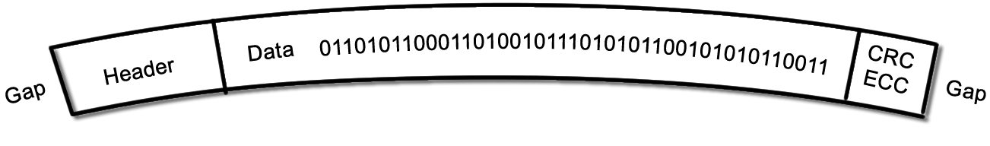
Disk Block Formats
Inter-block gap (nothing recorded)
Header (synchronization)
Data, 512 or 4,096 bytes, usually.
Error correcting code (error control)
Next gap

Slide 16

About that Inter-Block Gap
The lurker in the inter-block gap.
Formatting a disk establishes the operating system’s file structure on the disk.
A low-level format establishes the track positions, blocks, and headers needed before use of the disk. The low-level format is generally done during manufacture of the disk.

Slide 17
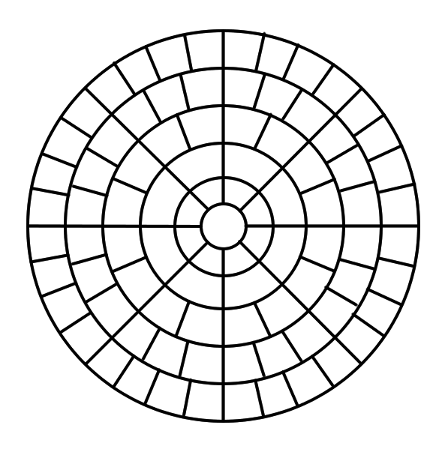
Multiple Zone Recording
Modern disks solve the recording density problem by having more blocks per track at the outer edge than near the center. A typical disk might have a dozen or so such “zones.”

Slide 18
Logical Block Addressing
Increasing disk sizes made addressing by cylinder, head, sector cumbersome.
Zoned disks made the number of blocks dependent on location.
Disk electronics now use logical block addressing (LBA) in which only the block number (starting with zero) is used to address a block.
48-bit logical block addresses introduced in 2003.

Slide 19
Shingled Magnetic Recording
Conventional magnetic disks have a small space between tracks.
A wide write-head is needed to change the magnetic properties of the disk.
The read head can be much narrower.
Shingled magnetic recording overlaps tracks, like shingles.
Any track can be read randomly.
Writes require rewriting all tracks in a zone.

Slide 20
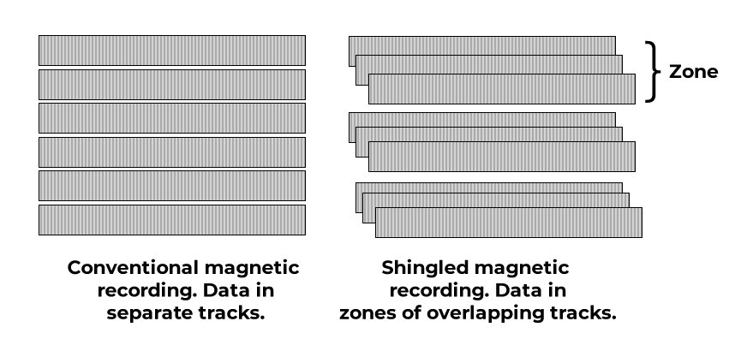
Shingled Magnetic Recording
Because writing requires rewriting an entire zone, write performance is poor.
Useful for write-few, read-many applications.
Notes:
No such thing as a free lunch. The penalty for increased capacity is poor write performance.
Western Digital confusingly calls shingled magnetic recording “zoned” magnetic recording. It is rumored that WD has sold shingled magnetic drives into the consumer market.
SMR drives come in three flavors. Drive-managed SMR drives handle the necessary updates from non-sequential writes with electronics that are part of the drive. Host-aware SMR drives use internal electronics to handle updates, but the host operating system is aware of the SMR nature of the drive and so can optimize sequences of writes. Host- managed SMR drives expect the host operating system to handle the complexity of random writes

Slide 21
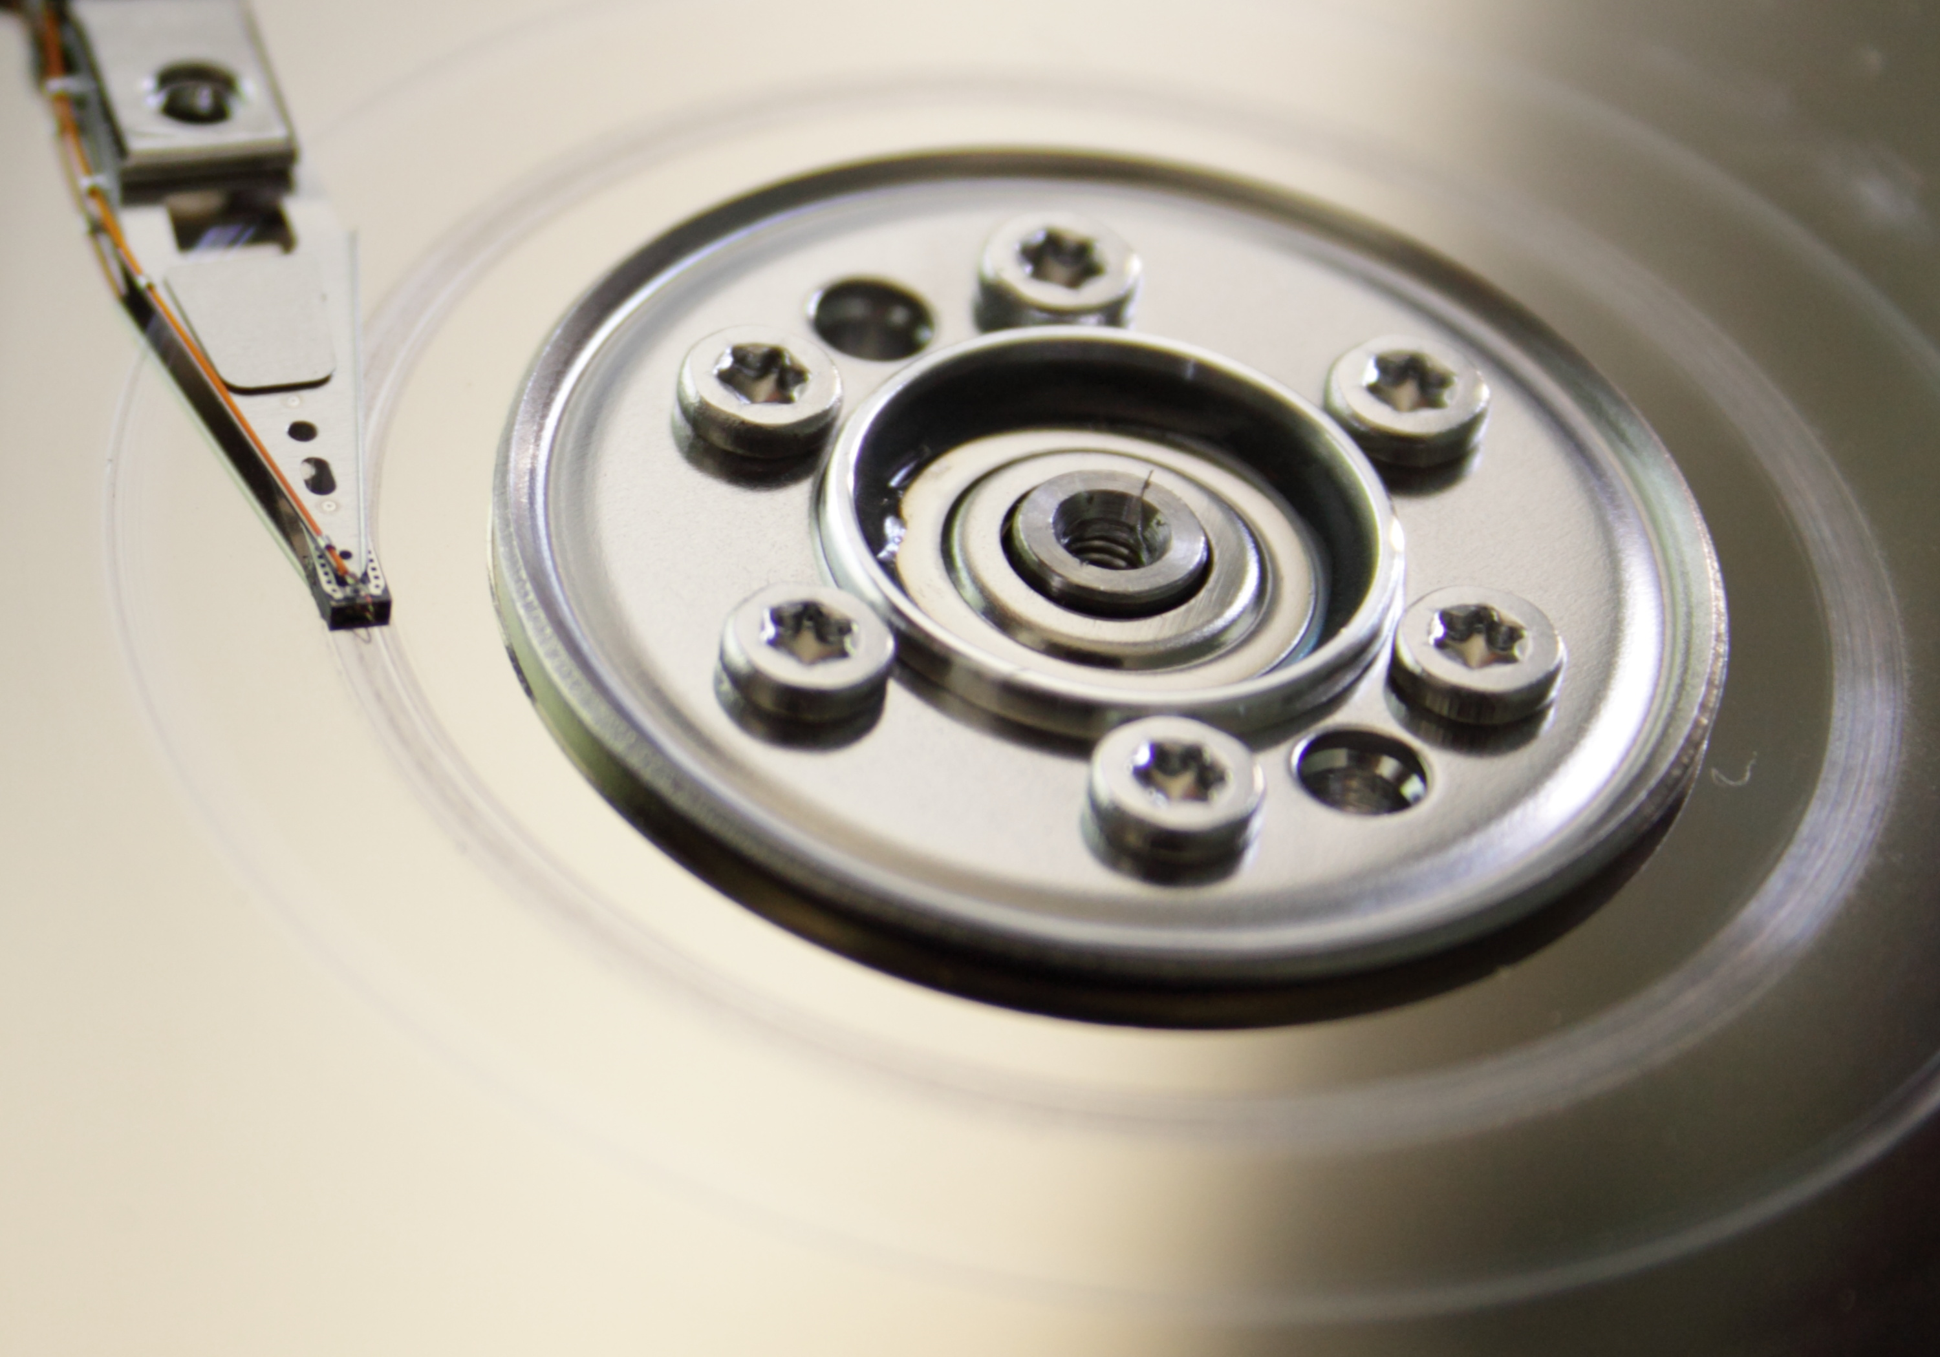
About “Head Crashes”
Disk heads “fly” a few thousandths of an inch from the disk surface on an air bearing created by the spinning disk.
The disk is moving very fast.
If the head touches the disk, it can abrade the magnetic material; this is a “head crash.”
The magnetic material is destroyed, and the debris can cause more head crashes.
Notes:
A “head crash” occurs if a head touches the disk platter outside the landing zone. It is likely that permanent damage will be done at the point of the crash and possible that material abraded from the disk or head will cause more crashes quickly resulting in catastrophic failure. Head crashes can be caused by physical or electrostatic shock, operation outside the drive’s designed temperature, operation at high altitude, or contamination of the air inside the drive.
The photograph showa an abraded area of the disk several tracks wide and completely around the platter. This disk has suffered a catastrophic failure and is unusable.

Slide 22
Stopping and Starting
When the disk is stopped, the heads are “parked” in a special area of the platter called a “landing zone.”
When the disk is started, the heads are kept in the landing zone until the disk is spinning fast enough for the heads to “fly.”
When the disk is turned off, the heads are returned to the landing zone as the platters slow down.
Alternatively, the heads can be moved to a parking ramp before removing power from the platters and removed from the ramp after the platters are spinning.
Notes:
Disk heads do not touch the disk surface in normal operation. Instead, they fly about 10 nm above the surface of the disk on an air bearing created by air friction with the spinning platters. The heads are retracted to a lubricated landing zone when power is removed from the disk. When a disk is powered up, the heads remain in the landing zone until the platters are spinning fast enough to create the air bearing. An alternative to the landing zone is an unload ramp. During power-down, the heads are moved to the outer edge of the platters where they encounter a ramp structure that lifts the heads away from the disk surface. The heads are moved off the ramp only when the platters are spinning fast enough to allow the heads to fly.

Slide 23
Silent Data Corruption
If incorrect data are sent to the hard disk, what is recorded will be incorrect.
Error-correcting codes do not help because the codes will be computed on incorrect data.
This is silent data corruption.
It can be caused by errors in the CPU, cabling, or other electronics.
Also applies to memory and solid state drives.
Notes:
Failures in the CPU, bus, or connection to the disk drive result in incorrect data being recorded. In that case, the error correcting code will be computed in incorrect data and cannot indicate an error when the block is read. This is silent data corruption, and a problem of concern to those who work with disk arrays. Silent data corruption can occur with solid-state drives or main memory as well because the cause is incorrect data delivered to the storage device or memory.

Slide 24
Solid State Drives
Can directly replace magnetic disks mechanically and electrically.
No moving parts.
Flash memory.
Data is organized in pages within blocks.
Reading is at the page level, writing at block level.
Wear-leveling used to extend life.
Controller logic used to manage memory space and provide fast reads/writes.

Slide 25
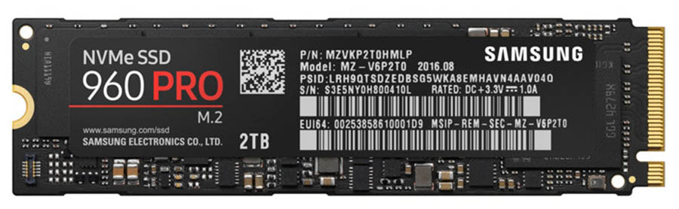

Interfaces and Form Factors
The first widely-available SSDs had form factors identical to 3-1/2” magnetic disks and had SATA interfaces.
Solid state devices did not need that much room.
The SATA interface was a bottleneck.
NVMe (non-volatile memory express) devices were available beginning in 2013.
PCIe interface, small size.
Notes:
3.15 inches long, 0.87 inches wide, and 0.09 inches thick, about the same size as a stick of chewing gum. The PCIe four lane interface gives write speeds of 2,100 MB/second and read speeds of 3,500 MB/second according to the manufacturer’s specification. Price for the 2 TB version at the end of 2022 was about $160. By comparison, a 2 TB magnetic disk would cost about $50.
Each stick of chewing gum … dimensions shall not exceed 7.62 cm (3.00 in) in length, 2.22 cm (0.87 in) in width, and 0.24 cm (0.09 in) in thickness. -- U.S. Department of Agriculture.

Slide 26
The End of Magnetic Disks?
Prices of SSDs are falling.
They have other advantages:
Much higher speed
No moving parts, so shock resistant.
SSDs seem likely to replace magnetic disks for general-purpose storage “soon.”
There still will be specialized uses for magnetic disks.

Slide 27
Redundant Data Storage
If redundant (duplicative) data are stored on two or more disks, the failure of any single disk will not cause data loss.
RAID = redundant array of inexpensive disks.
“Levels” of RAID
RAID 1: Mirrored disk volumes
RAID 5: Bits of each data word duplicated across three or more drives.
There are other levels.

Slide 28
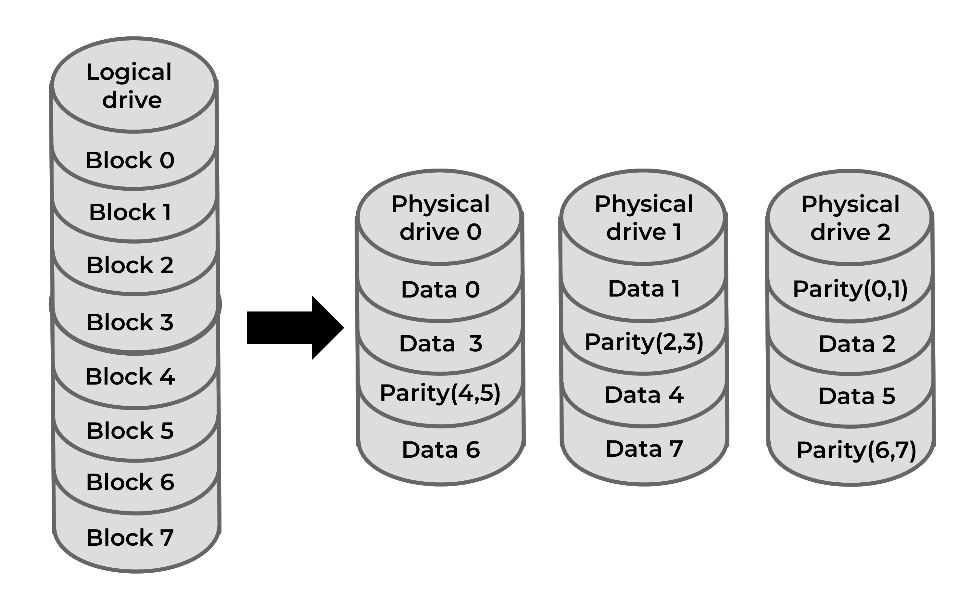
RAID 5
One logical drive mapped to three physical drives.
Notes:
RAID 5
A logical drive of eight data blocks is split across three physical drives, each with a mixture data blocks and parity blocks.
If physical drive 0 fails, data blocks 0, 3, and 6 are lost along with the parity block computed from blocks 4 and 5. However, block 0 can be regenerated from data block 1 on physical drive 1 and the parity(0,1) block on drive 2. Similarly, data blocks 3 and 6 can be recreated from the data and parity blocks on the two functional drives.
No data is lost, but the array is no longer redundant. The RAID controller can continue to respond to requests for data blocks 0, 3, and 6 by computing the values using information from the operational drives.
When drive 0 is replaced, the controller can rebuild the drive by computing the data and parity blocks from the other two drives. A second drive failure before the failed drive is rebuilt causes the loss of all data in the array.
In a real RAID array where will be many more than eight data blocks, but the principal is the same. Raid 5 arrays are possible with many more than 3 physical drives using a similar arrangement of data and parity blocks.

Slide 29
RAID Levels
RAID 0 – not true RAID, no error checking or redundancy, but data is placed across all drives for increased speed.
RAID 1 – mirrored array.
RAID 2, 3, 4 – arrays that are striped in different ways.
RAID 5 – error checking blocks are spread across all drives.

Slide 30
RAID is not ‘Backup’
RAID protects against disk hardware failure by storing redundant bits on more than one disk.
It does not protect against other causes of data loss:
File accidentally deleted.
Program error corrupts / destroys data.
Fire or other disaster.
Etc.

Slide 31
The End of RAID
When a drive in a RAID 5 array fails, the array keeps working…
… but it’s not redundant anymore!
The failed drive must be replaced, and the array re-built before any other drive failure.
Large drives make the rebuild time longer.
The longer the rebuild time, the greater the chance of a catastrophic failure.

Slide 32
Other Approaches to Redundancy
One answer: multiply-redundant arrays.
Raid 5-1: Two RAID 5 arrays, mirrored.
Multiple mirroring, e.g., three sets of disks.
Remote mirroring.
File systems designed for redundancy
Microsoft's Resilient File System (ReFS)
The ZFS file system (Oracle and open source)

Slide 33
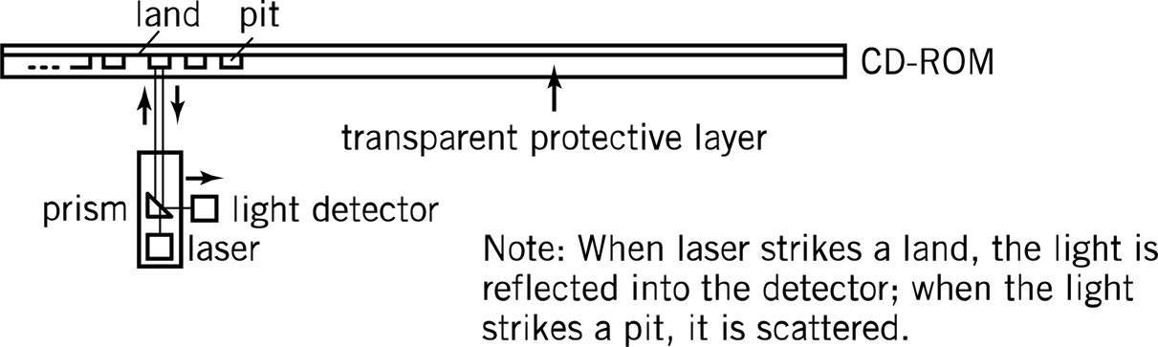
Optical Storage
Bits stored by burning “pits” in a reflective surface with a medium-power laser.
Reading is accomplished with a low-power laser. If the light is reflected, no pit is present. (The areas that are not pits are called “lands.”)

Slide 34
CD-ROM
A single, spiral track (vs. many concentric circular tracks on a disk.)
Constant linear velocity; rotational speed changes to maintain constant bit rate. (Mostly for older drives.)

Slide 35
CD and DVD
Both are optical storage.
Read-Write Modes
Read-only
Write once, read many (WORM)
Read-write
CD: 600-720 MB
DVD: 4+ GB per “layer”
Up to 2 layers per side
Total of 17 GB

Slide 36
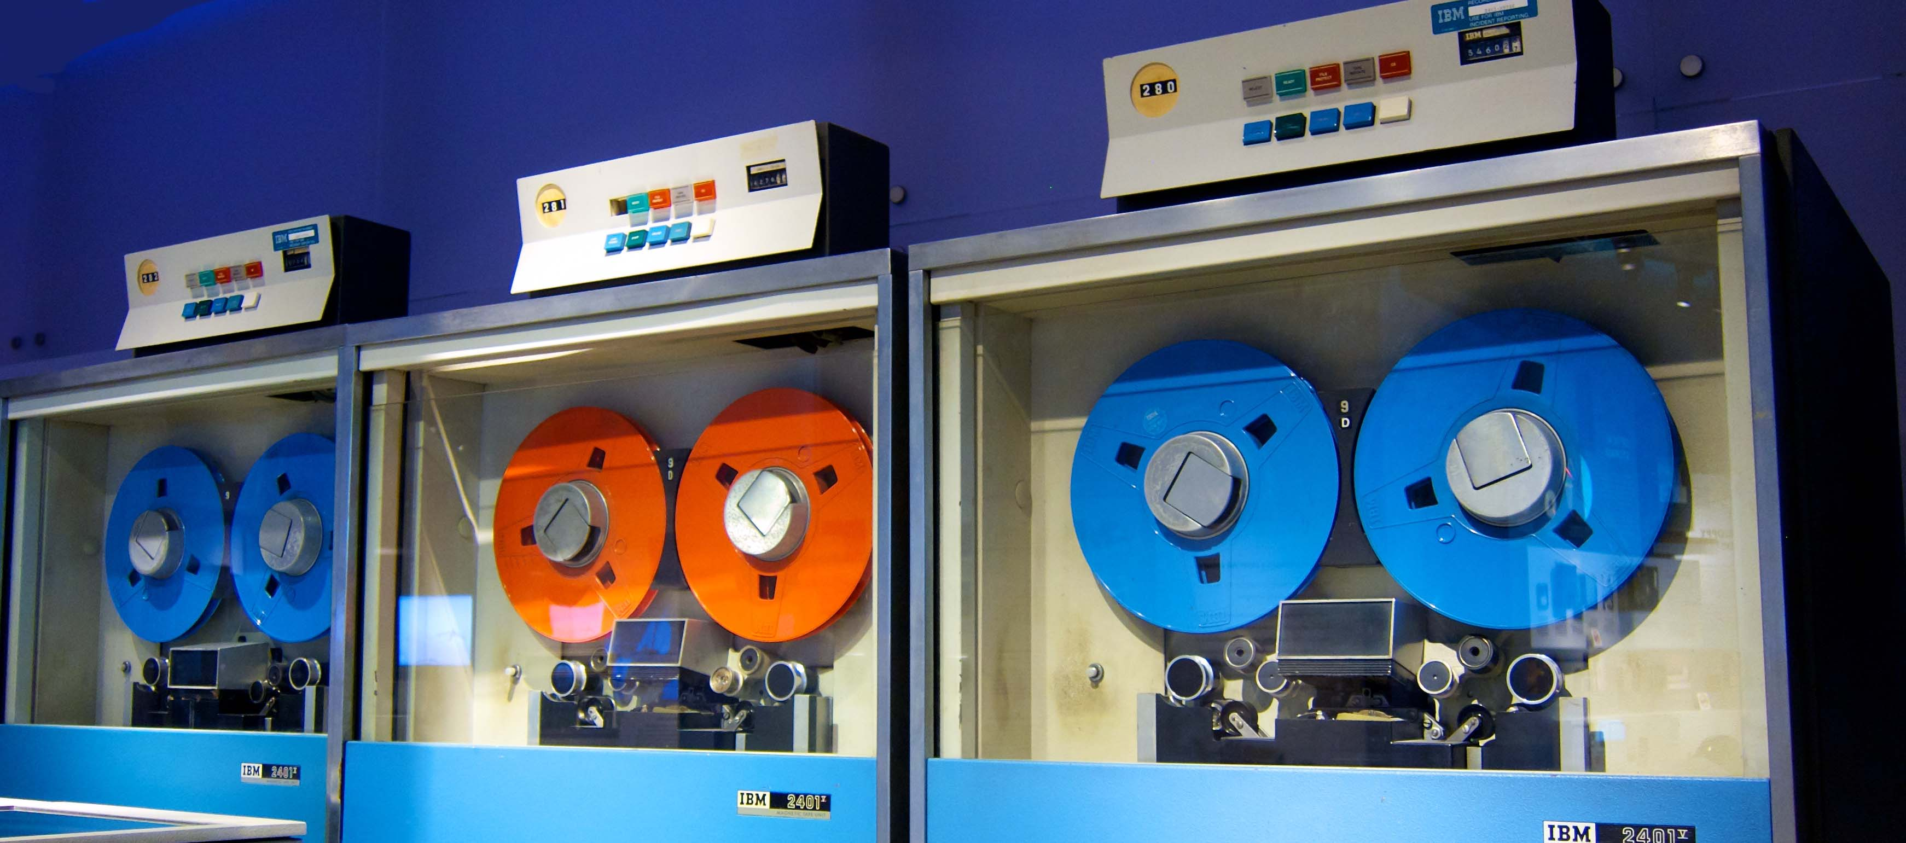
Magnetic Tape
IBM 2401 computer tape drives at the Computer History Museum. Copyright © 2011 Don DeBold Creative Commons Attribution license.

Slide 37
Magnetic Tape
Offline and “near-line” storage
Archival purposes
Disaster recovery
Tape Cartridges
20 – 144 tracks (side by side)
Read serially
DAT – digital audio tape (small size)
“Smart” tapes
Tape “libraries” and auto-loaders

Slide 38

Tape Library / Autoloader
StorageTek tape library and autoloader.. Copyright © 2008 Hannes Grobe Creative Commons Attribution license.
Notes:
https://commons.wikimedia.org/wiki/File:Storagetek-tape_drive_hg.jpg
The colorful items on the right are bar-coded tape cartridges, each holding up to 18 TB of data. There is unused cartridge storage space on the left. The robotic device in the center can select and load any tape in tens of seconds under program command. Such a library puts petabytes of data available in “near-line” storage.

Slide 39
MAID Arrays
MAID: Massive Arrays of Idle Disks.
Disks arranged to “spin down” when not in active use; reduces power consumption, heat, and wear.
Activity from CPU causes a disk to spin up.
Data available several seconds after request.

Slide 40
Displays
Pixel: A single colored dot on the screen, contraction of “picture element.” Also called “pel.”
Resolution: Pixels on the screen
640 × 480 NTSC television
HD or 1080p (1920 × 1080 progressive scan)
4K (3840×2160)
8K (7680×4320)
Many others, old and new.

Slide 41
Picture Size
How many pixels?
640 × 480 = 307,200
1920 × 1080 = 2,073,600
How many bits per pixel?
24 bits × 2,073,600 = 49,766,400
A 4K display requires a dual-link DVI connection, high speed HDMI, DispayPort, or Thunderbolt.

Slide 42
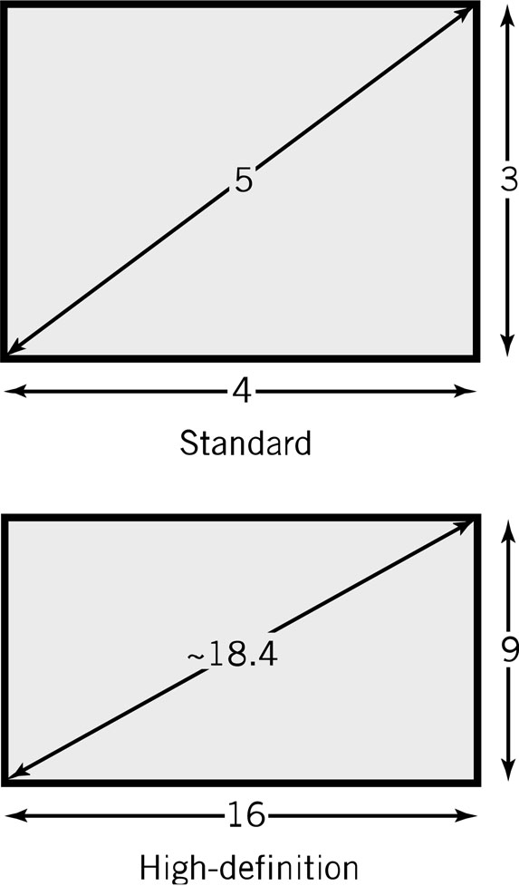
Screen Aspect Ratio
Screen size: measured diagonally
Resolution: minimum identifiable pixel size
Aspect ratio: x pixels to y pixels
16:9 on high-definition displays

Slide 43
Colors
Additive colors: red, green, blue.
Number of bits/color determines how many colors can be displayed.
4 bits/color, 12 bits/color = 16×16×16 = 4,096 colors (2¹²)
8 bits/color, 24 bits/pixel = 256×256×256 =16.7 million colors (2²⁴)
Notes:
The human eye can discern slightly more than 16 million colors, but 24 bit pixels provide near-photographic color depth.

Slide 44
LCD Displays
Fluorescent backlight panel.
3 color cells per pixel.
Operation
1st filter polarizes light in a specific direction
Electric charge rotates molecules in liquid crystal cells proportional to the strength of colors, changing polarization.
Color filters only let through red, green, and blue light.
Final filter lets through light with brightness proportional to the polarization twist.

Slide 45
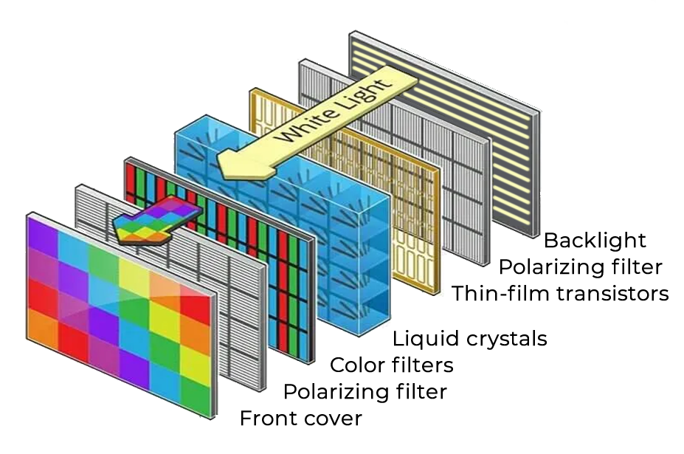
LCD Diagram

Slide 46
LCD Displays
Active matrix (current technology)
One transistor per cell
More expensive
Brighter picture
Passive matrix (older technology)
One transistor per row or column
Each cell is lit in succession
Display is dimmer since pixels are lit less frequently

Slide 47
Quantum Dot Displays
Quantum dots are nano-scale particles that emit colored light when excited by blue light.
The color of the dot depends on its composition; red, green, and blue possible.
High resolution, very fast response time.
Still very expensive: $500 to $3,000.
Notes:
Fast response time means about 1 ms.

Slide 48
Organic LED (OLED) Displays
Made with organic compounds that emit red, green, or blue light.
No backlight needed.
No mechanical change as with liquid crystals, so response time of a millisecond or less.

Slide 49
Touchscreens
Capacitive touch screens are most common, depend on the fact that the human body is a conductor of electricity.
Contact is reported as X-Y coordinates.
Single-touch and multi-touch screens are available.
Motion sensing is available.
Notes:
The alternative to a capacitive touchscreen is a resistive touchscreen, described in the textbook.

Slide 50
Printers
Dots vs. pixels
300-2400 dpi vs. 70-100 pixels per inch
Dots are on or off, pixels have intensities
Types
Inkjet – squirts heated droplets of ink
Laser – xerographic imaging
Thermal wax transfer
Dye Sublimation
Older technologies
Dot matrix, fully-formed characters
}
Color technologies

Slide 51
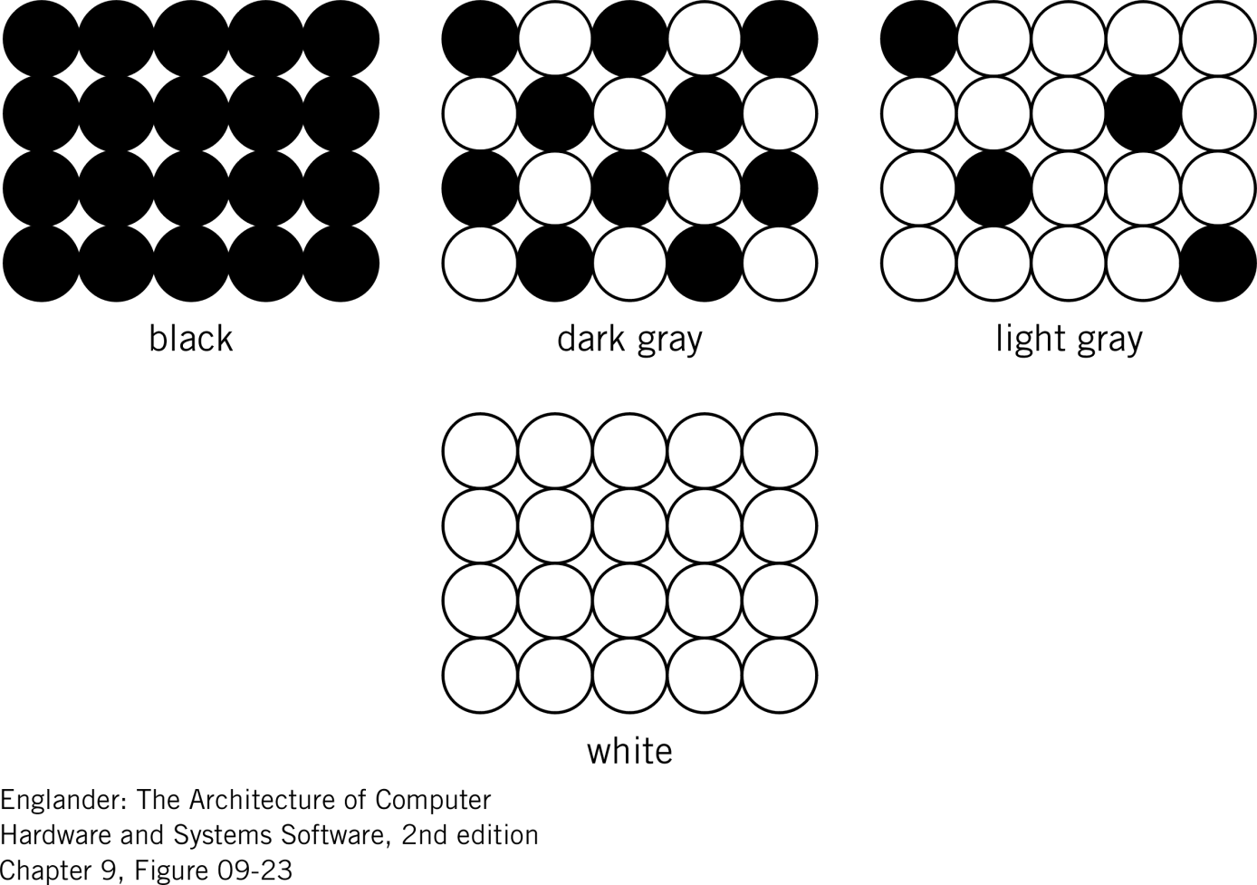
Creating a Gray Scale

Slide 52
Laser Printer Operation
A drum is electrically-charged.
Dots of laser light are beamed onto a drum to remove the charge.
Drum passes through toner which then sticks to the electrically charged places.
Electrically charged paper is fed toward the drum.
Toner is transferred from the drum to the paper.
The fusing system heats and melts the toner onto the paper.
A corona wire resets the electrical charge on the drum.

Slide 53
Keyboards
Usually connected wirelessly or via USB.
Pressing a key generates a scan code.
Releasing a key generates a different scan code.
Different codes for press/release make key “chords” and repeating keys possible.
Scan codes are translated to characters by the operating system.
Notes:
Wireless connections can be Bluetooth or operate in the WiFi bands. They could also use an infrared connection, similar to some remote controls.
Keystrokes are converted to electrical signals in several ways:
Membrane keyboard
Dome-switch keyboard
Scissor-switch keyboard
Capacitive keyboard
Mechanical-switch keyboard
Hot-swappable keyboard
Buckling-spring keyboard
Hall-effect keyboard
Internal circuitry must “debounce” the signal no matter what kind of switch is used. Keyboard circuitry also provides for “rollover,” the case where the next key in a sequence if presses before the current one is completely released. Keyboards may provide tacticle and audible feed backt to the typist.

Slide 54
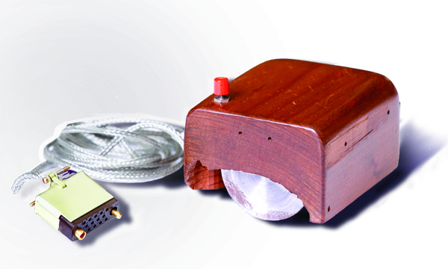
Mice and Pointers
Mice and other pointing devices translate motion in two dimensions into position of a cursor on a screen.
Translation from “increments” to cursor position is done by the operating system.
Mice may also have buttons and scroll wheels.
Connectivity is usually wireless or USB.
Doug Englebart’s mouse. Courtesy SRI International.

Slide 55
Other Peripherals
Scanners
Flatbed, sheet-fed, hand-held.
Light is reflected off the sheet of paper.
Cameras.
Voice input.
Many others.

Slide 56
What? No Networks?!?
Networks get their own chapter.

Slide 57
Questions

