Slide 1

IT 3123 Hardware and Software Concepts
Input and Output Concepts
Notice: This session is being recorded.

Slide 2
Announcements
Quiz 4 due tonight!
Read the feedback, even for those you got right.
Assignment 3 due Monday.
Attendance in class is an expectation of classroom-based courses. Do not depend on the recordings as a substitute for coming to class.
I will be away Thursday to Sunday but will check email and D2L twice a day.

Slide 3
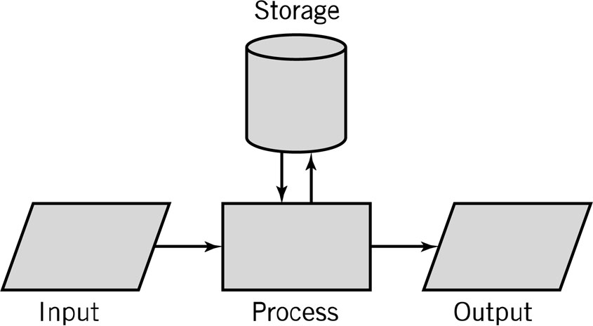
One Model of Computing
Notes:
One model of computing. This is the input output process model we have seen several times before. There is storage in the middle. At this point in this semester - you notice that there is a lot of inputting and outputting. Computers aren’t really useful without a way to get data in and results out.

Slide 4
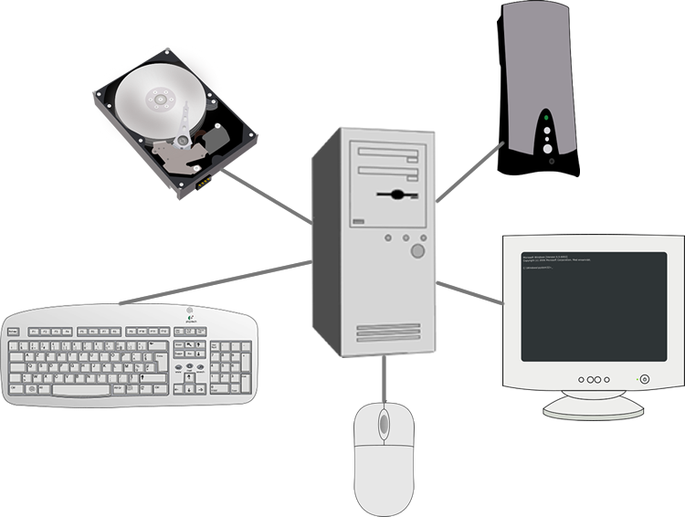
Peripheral Devices
I-O devices are sometimes called “peripheral devices.”
They can be thought of as forming the periphery (edge area)of a computer system.

Slide 5
I-O Issues
Several devices can perform I/O simultaneously.
Unexpected (asynchronous) input.
Various input formats.
Status information needed for each device.
Actual I-O is almost always performed by the operating system on behalf of applications.
Notes:
More than one device can input or output at the same time. I can have input arrive unexpectedly. The mouse is just sort of sitting there - and I can reach down and move it and generate input.
I get various input formats. We talked about that some when we talked about data formats in about the third class of the semester. For every i/o device I need some information about the status of the device.
If the printer is jammed and the buffer is full, and I send one more byte that will be lost - the CPU and the operating system need to know that so that they don’t send that one more byte that will be lost.

Slide 6
Memory Mapped I-O
Some computer architectures reserve memory locations for input and output.
No special I-O instructions needed.
“Writing to memory” sends data to an I-O device.
“Reading” from memory gets data from the device.
Memory locations are also reserved for status and command information
Notes:
In memory-mapped I/O, some of the addresses that would otherwise be part of main memory instead refer to device registers. Often these addresses are at the highest part of the logical address space, where one might not expect actual memory to be installed in any case. It is up to the address decoder to sort out which addresses are actual memory locations and which refer to device registers.

Slide 7
Port Mapped I-O
Modern computers are more likely to have a separate address space for I-O devices.
That allows the full memory address space to be used for memory,
…but requires separate I-O instructions.
Some early designs used both, with display memory addressed as part of the main memory address space. Unusual now.
Notes:
In port-mapped I/O, there is a separate address space of I/O ports. This has the advantage of allowing the full physical memory address space to be used for memory and of separating I/O devices, which are usually slower than memory, from the operation of the memory subsystem. The disadvantage is that separate instructions for input and output are needed, as with the Intel X86 IN and OUT instructions

Slide 8
Block and Character Devices
Some devices, like disk and tape, transfer data in blocks.
Blocks may be of fixed or variable size.
Only entire blocks are read and written in block mode devices.
Some, like keyboards and mice, transfer one character at a time.
Notes:
Disk blocks are fixed at 512 or 4,096 bytes. Tape blocks are variable.

Slide 9
The I-O Control Module
I-O Control Module
CPU
I-O Device
Memory
Notes:
That I/O control module - and there is going to be more than one in all but the very simplest computers - communicates with the CPU and communicates with the I/O device. So the I/O control module sits between the CPU and the I/O device. The control module is going to operate at close to CPU and the I/O device is going to usually operate at physical speeds. And we can give that I/O control module a connection to memory so the control module can communicate directly with memory independent of the CPU.

Slide 10
Functions of I-O Control Module
Provides the necessary registers and controls to perform a direct memory transfer
Physically controls the device.
Might notify the CPU with interrupts.
Notes:
The I/O control module has status registers and the information necessary to do direct memory access which we will talk about in a minute. Provides the electrical signals to control the physical I/O devices and has a mechanism for notifying the CPU of status by raising an interrupt signal.

Slide 11
Functions of I-O Control Module
Recognizes messages from device(s) addressed to it and accepts commands from the CPU.
Provides a buffer where the data from memory can be held until it can be transferred to the I-O device.
Copies data from its buffer to the device/from the CPU to its buffer.
Notes:
The I/O control module recognizes messages from devices that are address to the control module. It accepts commands from the CPU, provides a buffer - an area of memory where data can be held before it is transferred to the I/O device or for getting the data in before it is transferred to memory. And it can copy that data from the buffer to either the I/O device or to memory or to or from the CPU.

Slide 12
I-O Device Interface Issues
Different formats:
Parallel interface
Serial interface
Buffering of data.
Burst vs. stream vs. block.
Different control requirements. (electromechanical devices, like disks, printers)
Notes:
I/o devices have differing interface formats - different methods of buffering data.
We talked about bursts of data- my mouse generates data in bursts. Right now it isn’t generating data, but if I move it’s going to generate a large amount of mouse movement data.
Or stream data - data comes in a relatively constant speed or block data - data that is read from a disk or device like that.
Different devices have different control requirements. I can backspace a magnetic tape. If you try to backspace a printer it makes a big mess.

Slide 13
I-O Speed Considerations
CPU operates at speeds much faster than the fastest I-O device:
CPU: nanoseconds
I-O: milliseconds
Difference: 10⁶, CPU is about a million times faster than devices like magnetic disks.
Devices operate at different speeds.
Some devices produce bursts of data.
Block data transfer required for disks and certain other devices.
Notes:
The CPU operates faster than memory and very much faster than even the fastest I/O device.
I/O devices operate at different speeds and they may either generate or consume bursts of data. And in some cases like disk devices when I read a block off the disk I know how many blocks I am going to transfer - maybe 512 bytes - but I have to do them all in one block. Otherwise the disk will have spun out from under the read head and the remaining bytes in that block won’t be available until the next time the disk spins around.
You think about a disk spinning at 7200 or 15000 rpm and you might decide the next time is going to come pretty soon but remember that you are comparing the time for that one disk rotation with millions of CPU cycles so we dare not miss that block transfer.

Slide 14
Approaches to I-O Transfers
Programmed I-O (Controlled by the CPU.)
Interrupt-driven I-O.
Direct memory access (DMA) I-O.
Notes:
There are three approaches to I/O transfers: Programmed I/O which is totally controlled by a CPU, interrupt driven I/O and direct memory access I/O.

Slide 15
Programmed I-O with Busy Waiting
I/O data and address registers in CPU.
One-word or one byte transfers.
Address information for each I/O device.
Full instruction fetch/decode/execute cycle to start an I-O operation.
“Busy waiting” – Is it done yet? Similar to waiting on memory, but I-O is much slower.
Can be used to talk to I-O controllers.
Notes:
In every computer the CPU has I/O and data registers. If one is doing programmed I/O we transfer data between CPU and I/O device one word at a time and we are going to use an I/O address register and an I/O data register analogous to how we used the memory address register and memory data register.
So the CPU places an address in the I/O address register, places data in the I/O data register and then using some sort of status register, it commands the I/O device to start its I/O operation.
With programmed I/O, the CPU continually tests the I/O device’s status register saying are you done yet? similar to waiting for memory to complete an operations - except it is much slower.
Programmed I/O is hideously slow and the CPU isn’t getting any real work done while it is asking are you done yet?

Slide 16
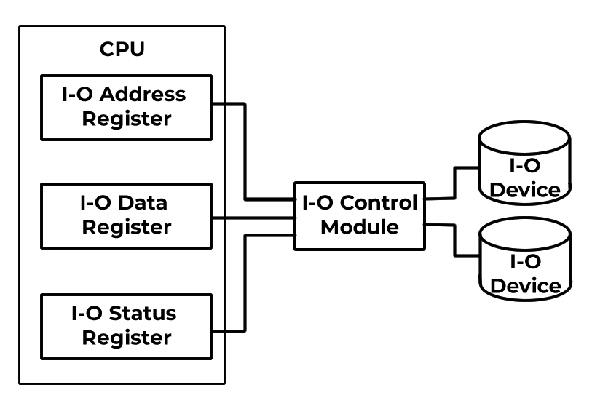
Programmed I-O
Notes:
This slide shows how the pieces fit together with programmed I/O - the CPU has an I/O data register, an I/O address register and an I-O status register.
We put the address in the address register, the data in the data register and then we put a read or write command in the status register just like we did for memory.
The data register and address register are connected to buses that are in turn connected to the I/O modules in the computer. So one I/O module will recognize an address of one its devices and it will cause data to be either sent to the I/O device or read from it.
The same principle that we had when we were reading or writing memory but much, much slower because we are often dealing with mechanical devices.

Slide 17
Flow of Programmed I-O
Send Command to Device
“Busy waiting” loop
Check Status Register
Ready
Read One Character
Not Ready
The “Busy waiting” loop, checking the status register can execute millions of times for each character.

Slide 18
Interrupts
Interrupt: an electronic signal that causes the CPU to alter its normal flow of instruction execution.
Frees CPU from waiting for events.
Provides control for external input.
Notes:
In order to go further - we need this idea of an interrupt.
An interrupt is an electronic signal that causes the CPU to alter it’s instruction flow. If I have this idea of an interrupt I can get rid of the idea of the CPU waiting for the keyboard controller to read a key - I can instead command the controller to read a key raise an interrupt signal. The CPU then can do other work while waiting for input from the controller.

Slide 19
Interrupt-Driven I-O
The CPU commands an I-O device to perform an operation.
The CPU can then execute other instructions. (No “busy waiting.”)
The I-O device “raises an interrupt” when it is finished.
The CPU switches to code that “handles the interrupt” at the end of the next instruction.
Notes:
An interrupt driven I/O - the CPU still sets up I/O address register and I/O data register and commands the device to perform an operation but it then can go do other work until that electrical signal that is the interrupt from the device notifies that it is done.
That signal causes the CPU to switch to program instructions that handle the interrupt and that happens at the end of the next instruction we don’t interrupt an instruction that is in flight. But at the end of the next instruction we will save the state of the computer and do whatever we are going to do with that keystroke that just came in from the keyboard.

Slide 20
Interrupt Terminology
Interrupt lines (hardware) Asserting a signal on an interrupt line is an interrupt request.
Interrupt handlers: (software) programs that “service” the interrupt. Also known as interrupt routines or service routines.
A running program has been interrupted the interrupt handler must save state before starting and restore state on completion.
Notes:
The slide has some terminology of interrupts. An interrupt line is a conductor - a signal or a single path within the CPU or on the printed circuit board that is the mother board.
Turning on the signal on an interrupt line is an interrupt request. I/O devices can assert the interrupt line it is connected at the other end to the CPU and the CPU can respond.
An interrupt handler is software and that is how we accomplish the requested activity. The CPU causes the interrupt handler to run.
Those interrupt handlers are also called interrupt routines.
The important thing about all of this is that the CPU started the I/O and then went off to do other work. That is why we introduced interrupt driven I/O. When that interrupt arrives - some running program... The other work.... Has been interrupted. The interrupt handler has to save the state of the computer before dealing with the interrupt, then restore the state when the interrupt has been handled.

Slide 21
Interrupts and the Instruction Cycle
Fetch
Decode
CPU Hardware
Execute
Part of the Operating System
No
Int?
Yes
Int. Handler
Notes:
Here is a picture of the instruction cycle fetch decode execute fetch decode execute fetch decode execute. Now we put a test at the bottom after the execute phase that says is any of the interrupt lines active - have any of the I/O devices caused an interrupt. If the answer is no, we go back to fetch decode execute.
If the answer is yes, then we are going to essentially do a conditional branch. The instructions to which we branch are the interrupt handling code that is part of the operating system.

Slide 22
Other Uses of Interrupts
Notify that an external event has occurred; real-time or time-sensitive.
Allocate CPU time.
Indicate abnormal event (CPU originates for notification and recovery.)
illegal instruction.
illegal address.
hardware error.
Notes:
The primary use of an interrupt in a computer is for an I/O device to notify the CPU and the operating system that something has happened.
There other uses as well - an interrupt can notify the CPU and the operating system that some external event has occurred. It can be used to allocate CPU time and we will talk about how that works when we talk about operating systems. And it can be used to indicate an abnormal event.
So - let’s go back to external event.
A computer’s power supply stores enough power for a few seconds of milliseconds of operation after the electric power has been cut off. So if you just jerk the power cord out of the socket.. There are just a few milliseconds of power stored.
The power supply generates a power condition interrupt that can tell the CPU that it has only three-thousandths of a second of power left. And the CPU can retract and park the disk heads before the disk starts to slow down.
An abnormal event might be something like an illegal operation.
If I have an eight bit operation code with 256 possible instructions and I only use 200 in my particular computer design because that is all I needed. There are 56 combinations of that op code that are not legal instructions. If the control unit sees one of those 56 combinations - it is not going to know what to do with it and will generate an interrupt that gives the operating system control. The operating system - if it happens to be windows - will put up a pop up block on your screen that says “Illegal instruction encountered at” and long hexadecimal address and then this button that says okay.
When you click that okay button it blows your program out of the water.
That is way better blowing up the CPU or trudging along as if nothing happed. It is far better to end the program with that kind of problem than let it keep running.
There is a certain kind of hardware that can be detected by the hardware and can generate an interrupt that allows the operating system to take over and try to do something about that hardware error.

Slide 23
Process Control Block (PCB)
Located in a reserved part of memory (often in the stack area.) Also called program status word (PSW.)
All registers of the interrupted program are saved here before control is transferred to the interrupt handler.
Notes:
Every program that is running has some something called a process control block. It is in main memory... Managed by the operating system and it is the place where the state of the computer can be stored when a running program has been interrupted. If you happen to be in the IBM world, that process control block is called the program status word, although it is more than one word long.

Slide 24
“Handling” an Interrupt
Save the Program Counter.
Load interrupt handling program address into program counter.
Interrupt handler runs on next fetch.
Interrupt handler saves machine state in PCB (registers, program counter.)
Interrupt handler “handles” the interrupt.
Interrupt handler restores machine state, including program counter, from PCB.
Interrupted program continues.
Notes:
In order to handle an interrupt we must first save the program counter - and in fact we have to save all the registers - load the interrupt handling program’s address into the program counter and so that on the next catch the interrupt handler is going to run. The interrupt handler is the thing that saves the machine state. And where it gets saved is in that process control block. The interrupt handler does the work necessary to deal with the interrupt then restores the machine’s state including the program counter out of that process control block and the interrupted program continues without any knowledge that it was interrupted other than that time has passed.

Slide 25
Allocation of CPU Time
A timer requests an interrupt every so often (every few hundred nanoseconds.)
The interrupt routine is part of the operating system.
It may select another program to run for a while.
Notes:
If I build into my computer a timer - not the time of day clock, just something that counts - and cause it to generate an interrupt perhaps every few hundred nanoseconds, the operating system will get control every few hundred nanoseconds and can look to see which program has been running on the CPU and possibly select some other program to run. We will talk about this in more detail when we get to operating systems.

Slide 26
Software Interrupts
Some instructions can cause interrupts
These are called “software interrupts”
Can be used to communicate with the operating system, e.g. to request I-O.
Notes:
I can have instructions in software that cause interrupts; that allows an application program to communicate with the operating system.
If you code a system call instruction, it will setup a parameter block that generates an interrupt that causes the operating system to run and provide whatever service you requested through the system call.

Slide 27
Multiple Interrupts
Two or more devices may request service at the same time.
The CPU has multiple interrupt lines.
So, there can be several interrupts “pending” at any moment.
Notes:
Since I can I have more than one I/O device and more than one can be active at one time - I can get more than interrupt at the same time.
The CPU has multiple interrupt lines. That is some number you can count on your fingers.
It is possible to have several pending interrupt including more than one interrupt on a single interrupt line. I am going to handle them and make them go away. And if say interrupt line 0 has three devices with interrupts pending, I handle the first one its interrupt goes away. I still have signals because there are still two. I handle the next one its interrupt goes away I still have an interrupt signal because of the last one. I handle that one and the interrupt signal finally goes away.

Slide 28
Interrupt Priorities
Time-sensitive events (communications buffer full.)
“Important” events, such as a hardware error.
Other events, like disk I-O completion.
Notes:
I can set interrupts in priority order to handle time sensitive events or so called important events like that power failure interrupt.

Slide 29
Interrupt Vectors
The operating system contains a list of unconditional branch (or call) instructions, one for each interrupt.
Each instruction branches to the interrupt handler for that interrupt.
Because the branches are all in one place, the operating system can select the right one easily.
Notes:
The operating system has a list of branch instructions or list of address one for every possible interrupt that can be handled by operating system. The list is called an interrupt vector.
The instructions in the interrupt vector are just branches to the interrupt handling routine for that particular interrupt. We put them all in one place so that the operating system and the hardware together can select one of them easily.
Interrupt 0 uses the branch address vector address 0, interrupt 1 uses address 1 and so on.

Slide 30
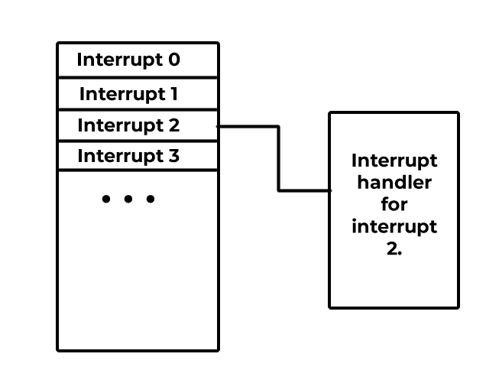
Interrupt Vectors
Interrupt “Vector”
Notes:
The slide has a picture of the interrupt vector that addresses a through k - if interrupt K occurs I count down through these addresses until I find the Kth one among them and it provides the location of the interrupt service routine for interrupt K.

Slide 31
Polled Interrupts
One operating system routine is called no matter what interrupt has occurred.
That “polling routine” determines which interrupt occurred…
And calls the correct handler.
Notes:
In the case of polled interrupts - found in simple computers like microwave ovens and anti lock brakes - there is only one interrupt line. The operating system calls one interrupt routine and the interrupt routine then starts checking the I/O devices until it finds the I/O device that determines that raised the interrupt then it call the correct interrupt handler.

Slide 32
Disabling Interrupts
Some computer operations are required to be “atomic.”
Example: Test a variable and, if zero, set it to one and take some action. No other program must be able to test while “set” is pending.
If an atomic operation requires several instruction cycles, interrupts must be disabled.
Interrupts must not be disabled for more than a few instruction times.
Notes:
Sometimes I require that two or more machine instruction to be acquired atomically - so nothing happens between the execution of each one.
An example of potentially atomic instructions - testing and setting semaphores. You will talk about semaphores when you take the operating systems course. We have to be sure that the semaphore variable - the semaphore is just a variable in the operating system - we want to be sure it isn’t changed by anyone else between the time that some particular program tests and then time that program then changes it.
In order to cause a sequence of two or more instructions to be processed atomically, we disable interrupts. We say I am not going to allow interrupts for some period of time and that period of time needs to be some number of instruction times that you can count without using your thumbs - it needs to be very short.

Slide 33
Interrupts and the Instruction Cycle
Fetch
Decode
Execute
Interrupts disabled
No
Int?
Yes
Int. Handler
Notes:
The slide has our interrupt schematic with fetch decode and execute. This one is different because there is a test for interrupts being disabled right after the execute chunk of fetch decode and execute and in the case that interrupts are disabled, we go right back to fetch without ever testing that an interrupt is present.

Slide 34
Approaches to I-O Processing
Programmed I-O with busy waiting:
Uses the CPU to control I-O
CPU cannot do anything else while I-O is in process.
Interrupt-driven I-O:
CPU commands an I-O device to do something.
Device raises an interrupt signal when done
CPU can do other work.
Direct Memory Access (DMA) I-O.
Notes:
We’ve talked about two approaches to I/O processing already - programmed I/O is busy waiting the CPU is doing all of the work and can’t do anything else while I/O is in process.
The second one that we’ve talked about is interrupt driven I/O. The CPU sets up the I/O but then the device raises an interrupt when it is done and the CPU can do other work between the time it starts the I/O operation and the time the interrupt arrives to say it is done.
The third one is almost always used for disk-like devices and maybe other direct memory access (or DMA I/O) devices.

Slide 35
Direct Memory Access
CPU can send commands to I-O module
I-O module is also connected to memory. Has its own bus connection, MAR, MDR.
Data transfers between I-O module and memory can happen independent of the CPU, which can do other work.
Notes:
The CPU sends commands to an I/O module which has a connection to memory like the connection we saw earlier. Its own BUS connection, it’s own memory address register, its own memory data register.
So the I/O control module can transfer data between itself and memory independent of the CPU.
When we did the interrupt driven I/O, it was up to the CPU to move data between the I/O device and memory.
With direct memory access I/O, I am now letting the I/O control module take over that function leaving CPU cycles available to do other work.

Slide 36
DMA Connections
I-O Control Module
CPU
I-O Device
Memory
Notes:
This is the same diagram you saw earlier. The I-O control module may have a connection to memory, and be able to read or write memory without involving the CPU.

Slide 37
A DMA Operation
The operating system uses programmed I-O to send a command to the DMA I-O module
I-O device to use
location of data on I/O device
the starting location in memory
the size of the block (amount of data)
whether to read or write.
The DMA I-O module completes the transfer.
The DMA I-O module raises an interrupt to the CPU when done.
Notes:
So, how does DMA work now that we have that background.
The operating system uses programmed I/O to send a command to that I/O module and we are doing programmed I/O and I told that you that was slow but all we are doing is sending one command to an I/O module and we can do that at electronic speeds because we are not going to wait for the I/O device.
The command has a device address, data address, a location in memory and an amount of data to move back and forth and information about whether this is a read or write.
The I/O control module the DMA controller takes over from there and completes the whole I/O operation and raises an interrupt when it is done.
Think about reading a block from the disk. If I were doing programmed I/O, I would command the disk controller to read a byte and wait for it tell me it is done before reading the next one and I would do that 512 times.
Interrupt driven I/O I would say give me a byte then send me an interrupt. Okay give me another byte and send me an interrupt. And I would do that 512 times but I can do some work between them.
With a DMA operation, I say go read a disk block and tell me when you are done. And at the end, all 500 at the end when the interrupt arrives at the CPU the whole 512 disk block has been read into memory. The CPU hasn’t had to do any work at all other than send the start command and handle the interrupt at the end.

Slide 38
Advantages and Disadvantages
Advantages
Only one CPU command to start I-O
Details of I-O handled by controller (I-O module)
Only one interrupt, when the operation is complete.
Disadvantages
I-O module “steals cycles” on the memory bus from the CPU; CPU may have to wait anyway.
The bus logic is more complex. We need bus arbitration circuits to the CPU and DMA controllers from interfering with each other.
Notes:
Advantages to DMAIO - the CPU has to send only one command to start the operation. The details are all handled by the DMA controller. There is only interrupt no matter how many bytes we transferred when the whole operating is complete. So the CPU can go off and do lots of stuff.
The disadvantage the there is no such thing as a free lunch is that DMA controller still cycles on the memory bus. It uses memory bus cycles to transfer data to and from memory. If the CPU uses memory at the same time it may have to wait. To make sure the CPU and memory don’t trip over each other, the bus logic has to be more complex, with bus arbitration circuits that prevent the CPU and the DMC controllers from interfering with one another.

Slide 39
Avoiding Conflicts
What happens if two programs want to do I-O at the same time. (Big trouble!)
Solution: only the operating system is allowed to do I-O:
A program requests an I-O operation from the operating system.
The operating system “blocks” the program.
The operating system does the I-O.
The operating system unblocks the program.
Notes:
The other condition of conflict might be two or more programs that want to do I/O at the same time.
I want you to think about a specific case of that. I have my disk head here with a disk spinning around underneath and I have positioned it carefully over the track I am about to write.
And the disk spends around and I send a write signal and just about that time some other program moves the disk head. What has happened?
Corrupted disk - my data are gone forever.
They are written to the disk - but I have no clue where they are so they might just as well be gone forever. And something that used to be on the disk is not there anymore.
The Pick operating system, which is thankfully obsolete, had that problem. The condition was called a group format error abbreviated GFE and anyone who had to work with Pick knew that meant gone forever.
The solution in modern operating system is that we don’t let programs do I/O. Only the operating system does I/O. That way the operating system can serialize those I/O operations and keep situations like the one I described from happening.
A program is going to request an I/O operation and it does that with one of those software interrupts - a system call interrupt.
So I set up a system call instruction that says I want to do I/O from this device and this memory location and it is either read or write.
Executing that instruction generates an interrupt. The operating system gets control. The operating system then blocks the program in the sense that my expectation is that the I/O will be finished when the instruction after the system call is executed. And we would like that expectation to be true by not allowing anymore instructions from that particular program to execute until the I/O is finished. So the operating system blocks the program, performs the I/O and once everything is done and the dust has settled, the operating system unblocks the program that requested
I/O and everyone is happy.

Slide 40
Privileged Instructions
How do we keep “ordinary” programs from doing their own I-O?
Answer: privileged instructions.
The CPU has a “mode bit” that has two states:
System state
Application State
Privileged instructions only work in the system state; “illegal instruction” otherwise.
Notes:
Now that leads us to the question of if we say that only the operating system can do I/O, at least several of you said in your heads, I will do my own I/O if I want to by golly Moses, I know more about this stuff than those guys in Redmond, Washington.
The answer to that is this thing called a privileged instruction. We build into the CPU a load bit that tests whether the operating system is running or an application program is running. We call those two states the system state and the application state.
Privileged instructions are wired up in the control unit so that they will not work if the system state bit is not set.
The control unit sees a physical I/O instruction, checks the system state bit and raises an illegal instruction interrupt if the operating system is not in control.
And so if you are doing your own I/O on a windows operating system you get the box that says illegal instruction. There is an okay button and you click and it blows your program out of the water. So you can’t do your own I/O if you want to.

Slide 41
Avoiding Conflicts
CPU and I-O module are both connected to the memory bus.
What happens if both need memory at the same time? (Big trouble, that’s what.)
Solution: Either the I-O module or the CPU can “take control” of the memory bus.
CPU and I-O module must test for “bus busy” before transferring data and wait if busy.
Notes:
And now a memory bus cycle by the CPU or that I/O control module is more complicated than it used to be. Now there has to be a test for bus busy before the CPU or anything else starts using the bus.
If the bus is busy when the CPU needs it, then the CPU must wait. So direct memory access I/O will let us use the CPU to work on other things while the I/O controller talks to memory. But the penalty we pay is now there are times when the CPU must wait to talk to memory.
There is no such thing as a free lunch.

Slide 42
Cache Coherence
All but the smallest computers have one or more levels of cache memory.
If the DMA controller updates an area of memory that is also cached…
…the cached value no longer matches memory.
Being sure cache and main memory match is called cache coherence.
Hardware could invalidate cache entries.
The OS is aware of DMA transfers and could invalidate cache entries.
Notes:
The problem of maintaining cache coherence can be mitigated by having the cache subsystem monitor the memory address lines and invalidate any cache entries that are written by direct memory access. This is called a snooping cache and increases hardware cost. Since DMA operations are initiated by the operating system, the OS is aware of memory locations that will be overwritten and can invalidate any cache entries for those locations. In that case, the penalty is time rather than money

Slide 43
I-O Channels
Mainframes take a different approach: the I-O channel.
An I-O channel is itself a computer, programmed to handle the details of input and output and capable of controlling many devices, extending the concept of DMA.
That is how bank and airline mainframes handle thousands of terminals and hundreds of disks.

Slide 44
I-O Buses
I-O buses are specialized buses used to connect I-O devices.
Principal characteristics are:
Signaling speed
Serial or parallel transmission
Single or multiple device connection.
Modern buses use serial transmission.
If multiple devices are connected, bus arbitration circuitry is needed.
Notes:
The reason for serial transmission is bus skew in parallel buses.

Slide 45
Bus Flavors
General purpose:
USB: universal serial bus.
SATA: serial ATA.
PCIe: PCI Express.
Buses for display connection:
HDMI: high-definition multimedia interface.
DisplayPort.
Notes:
HDMI (short for High-Definition Multimedia Interface) was introduced in 2003 by a consortium of (mainly) display manufacturers, including Sony, Philips, Panasonic, and Toshiba. These are large corporations that primarily target purely image driven applications. This is why you will find HDMI ports most commonly on appliances like television sets, gaming consoles, projectors and home computers.
A few years later (2006), another large consortium of PC and chip manufacturers worked to create DisplayPort (DP), a follow-up of the older VGA and DVI standards. The main focus was computer displays, graphics cards and professional IT equipment, so more data centered markets.
DisplayPort signals can be passively converted to HDMI, but not the other way around. HDMI supports an audio return channel; DisplayPort does not..
HDMI is now (2023) at version 2.1, DisplayPort at 2.0.

Slide 46
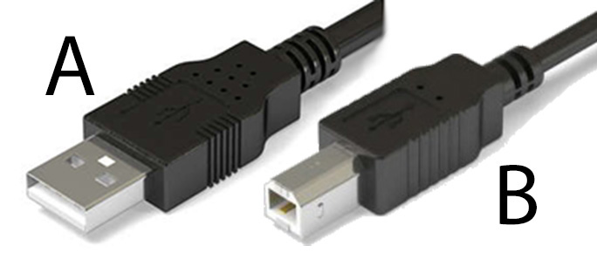
Universal Serial Bus
Initially developed (1990s) for low speed, low power devices like keyboards and mice. Could deliver 5 volts of power at low current.
A (host) and B (device) connectors.
Original design had one host, one or more peripheral devices.
USB hubs can support up to 127 devices.
Notes:
The A and B connectors are intended to prevent connecting two power sources. Power was to be supplied at the A connector and consumed at the B connector.

Slide 47
USB Development
USB 2 could provide speeds of 480 Mb/sec.
USB 3.2 up to 20 Gb/sec. with shielded and short cables.
USB4 up to 40 Gb/sec.
USB4 can “tunnel” DisplayPort and PCIe connections.
Power delivery standard (USB PD) can deliver up to 100 Watts of power, 20 volts at 5 amperes.
Notes:
USB4 (with no space) is the official designation.

Slide 48
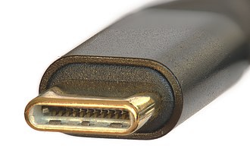
USB C
USB C is a connector type.
Connectors are rotationally symmetric.
No distinction between host and device ends.
24 pins, including four shielded data pairs.
Power negotiated by devices on cable.
Embedded E-Mark circuit identifies cable.
Compatible with Thunderbolt specification.

Slide 49
USB Dangers
100 Watts of power is a lot!
There are substandard cables that can cause equipment damage or even fires.
Look for the “USB Certified” mark to avoid substandard cables.
Be careful of adapters, particularly USB-C to USB-A.
Read the USB section of the assigned reading!

Slide 50
SATA Bus
Intended for mass storage devices lie disks, optical drives, solid-state storage.
Replaced the (parallel) ATA/IDE bus.
Compatible with ATA software, but not hardware.
Current speeds up to 600 MiB/second.
SATA Express accepts either SATA or PCIe devices, speeds up to 16 GiB/second.
Notes:
The ATA (AT attachment) or IDE (integrated drive electronics) disk technology moved
That’s 600 mebiBYTES per second.

Slide 51
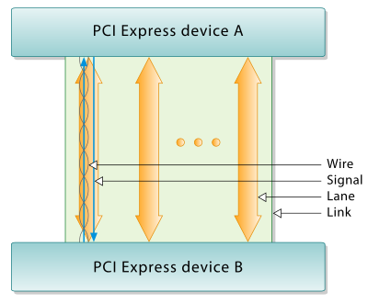
PCI Express (PCIe)
A serial/parallel computer expansion (internal) bus
Full duplex operation over two simplex paths, one each direction.
Each pair is a “lane.”
A “link” may be one to 32 lanes.
Lanes transmit byte streams
https://en.wikipedia.org/wiki/PCI_Express
Notes:
This is the same slide used in the computer organization lecture.

Slide 52
More About PCIe
PCIe is really a packet-switched protocol.
Interface circuitry hides the complexity, presents an interface similar to a parallel interface.
PCIe is much faster than SATA, suitable for connecting CPU to memory.
PCIe interfaces are available for SSDs.

Slide 53
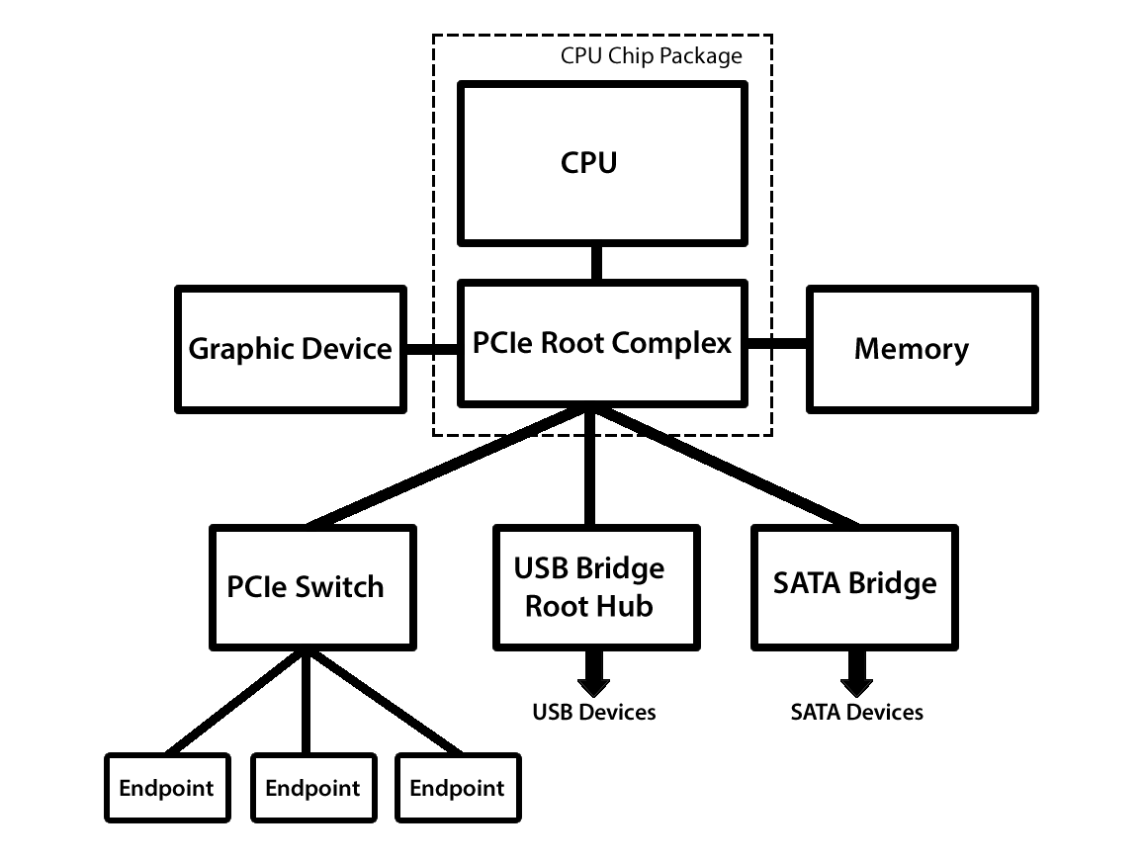
Connection to the CPU
Notes:
PCIe provides direct connection of CPU to memory and graphic devices, replacing the device formerly called a “northbridge” or system bridge.

Slide 54
Questions

