Slide 1

IT 3123 Hardware and Software Concepts
Modern Computer Architecture
Notice: This session is being recorded.

Slide 2
Announcements
Quiz 4: Released tonight, due Wednesday at 11:59 PM. Includes tonight’s material.
Read Assignment 3 before attempting the quiz.
Assignment 3: Due next Monday.
March 14 is the last day to withdraw without penalty.
I will be away Thursday to Sunday but will check email and D2L twice a day.

Slide 3
Stacks Revisited
Main Program
1024 1025 1026 CALL A 1027

Slide 4
Stacks Revisited
Main Program
1024 1025 1026 CALL A 1027
1027
The CALL instruction saves the program counter on the stack before branching to the address of method A.
Notes:
When the main program encounters CALL A, the program counter, which holds the address of the next instruction, is pushed onto the stack, then the address of A is loaded into the program counter.

Slide 5
Stacks Revisited
Main Program
1024 1025 1026 CALL A 1027
Method A
2048 2049 CALL B 2050 2051 RETURN
1027
1027
Method A executes.

Slide 6
Stacks Revisited
Main Program
1024 1025 1026 CALL A 1027
Method A
2048 2049 CALL B 2050 2051 RETURN
1027
2050
1027
The CALL instruction saves (pushes) the program counter on the stack before branching to the address of method B.

Slide 7
Stacks Revisited
Main Program
1024 1025 1026 CALL A 1027
Method A
2048 2049 CALL B 2050 2051 RETURN
Method B
4096 4097 4098 4099 RETURN
1027
2050
2050
1027
1027
Method B executes.

Slide 8
Stacks Revisited
Main Program
1024 1025 1026 CALL A 1027
Method A
2048 2049 CALL B 2050 2051 RETURN
Method B
4096 4097 4098 4099 RETURN
2050
1027
1027
1027
The RETURN instruction pops the return address from the stack and stores it in the program counter. Control returns to method A.

Slide 9
Stacks Revisited
Main Program
1024 1025 1026 CALL A 1027
Method A
2048 2049 CALL B 2050 2051 RETURN
Method B
4096 4097 4098 4099 RETURN
1027
The RETURN instruction pops the return address from the stack and stores it in the program counter. Control returns to The main program.

Slide 10
Addressing Modes
The effective address for an instruction is the address actually used to refer to an operand.
Often the effective address involves computation to get enough bits to address all of memory.
Addressing modes for data access and program flow control (branching) can be different.

Slide 11
Addressing Modes for Data
Register address: The operand is held in a register. The instruction needs enough bits to address all registers, e.g., 4 bits for 16 registers, 7 bits for 128 registers.
Direct address: The address in the instruction points to an operand in main memory. This could require 32 or more bits in the instruction.

Slide 12
Base-Displacement
Base-Displacement addressing: The effective address is formed from bits of the instruction added to the contents of a “base register.” The base register must have enough bits to address all of memory, but the number of bits in the instruction can be much smaller.

Slide 13
Indirect Addressing
Register Indirect Addressing: The address of an operand in main memory is held in a register. The instruction needs only enough bits to select the register.
Memory Indirect Addressing: The effective address is loaded from a location in main memory.
Notes:
With memory indirect addressing, some method like base-displacement addressing is used to locate the “indirect” memory location. Memory indirect addressing requires two memory accesses and so is expensive in execution time.

Slide 14
Indexed Addressing
An index value, typically in a register, is added to the effective address.
Indexed addressing is used, for example, to loop through arrays.
One of the other addressing modes is used prior to adding the index.

Slide 15
Immediate Addressing
The operand data is held in the instruction word.
It is “immediate” because the data needed is already in the instruction register.
Example:
addImmediate 127
Operation code “address” field

Slide 16
Addressing for Flow of Control
Sequence is the natural operation of a von Neumann architecture computer; instructions are executed in order.
In direct addressing the full memory address of a branch target in in the instruction’s address field.
In relative addressing, address bits are added to the program counter. Only a few address bits are needed to address “nearby” locations.

Slide 17
Indirect Addressing for Flow of Control
In register indirect addressing, the branch address is held in a register. Only enough address bits to enumerate the registers are needed in the instruction.
Stack indirect addressing uses the address at the top of the stack as the effective address.
Memory indirect addressing uses another form of addressing to fetch the branch address from main memory.
Notes:
Stack indirect addressing may need no address bits at all in the instruction. The RETURN instruction discussed earlier is an example.

Slide 18
Improving Performance
Faster clock speeds
Faster buses and circuits
Wider instruction and data paths
More and faster memory
Faster disks

Slide 19
Increasing Complexity
The earliest electronic digital computers were nearly as simple as LMC and TBC.
Moore’s Law allowed increasing complexity.
Hardware designers added instructions applicable to high-level languages.
By the 1970s, ALUs and control units became very complex.
Complex “machine instructions” were implemented internally as sequences of simpler operations.
Notes:
TBC implements “machine” instructions as sequences of data path cycles. It is the same idea.

Slide 20
Analysis
Analysis of actual compiled programs revealed:
Little or no use of many complex instructions.
Much time spent moving data to and from registers.
Conclusion: Remove complex instructions and use the transistors saved to make more registers.

Slide 21
Reduced Instruction Set Computers (RISC)
A new approach to CPU design.
David Patterson and others.
Late 1980s to early 1990s.
Limited and simple instruction sets
Fixed length, fixed format instruction words enable pipelining, parallel fetches and executions.

Slide 22
Reduced Instruction-Set Computers
A few kinds of instructions
A small number of formats
All instructions are the same length
All operation codes are the same length
High-level language statements generally require several instructions
Emphasis is on speed

Slide 23
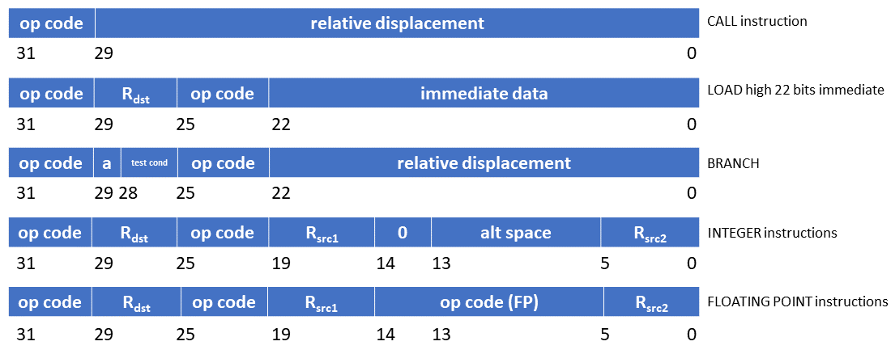
RISC Instruction Formats
SPARC RISC Instruction Formats (Complete set)

Slide 24
RISC Features
Limited addressing modes reduce complicated hardware.
Register-oriented instruction set reduces memory accesses
Large bank of registers
Reduce memory accesses
Efficient procedure calls

Slide 25
Hardware and Software
Hardware and software are logically equivalent. (But there must be some hardware someplace!)
So, computer designers have a choice of implementing with hardware or software.

Slide 26
Microprogrammed Implementation
Microcode: programs stored in ROM that replace hardwired CPU instructions
Advantages
More flexible
Easier to implement complex instructions
Can emulate other CPUs
Can be changed!
Disadvantage
Usually requires more clock cycles

Slide 27
Hardware Implementation
Hardware implementation – operations are implemented using logic gates
Advantages:
Speed
RISC designs are simple and typically implemented in hardware

Slide 28
Complex Instruction-Set Computers
Many different kinds of instructions
Many different instruction formats
Several different instruction lengths
A few different operation code lengths
Often things done in high-level languages can be performed in one instruction.
Emphasis is on flexibility

Slide 29
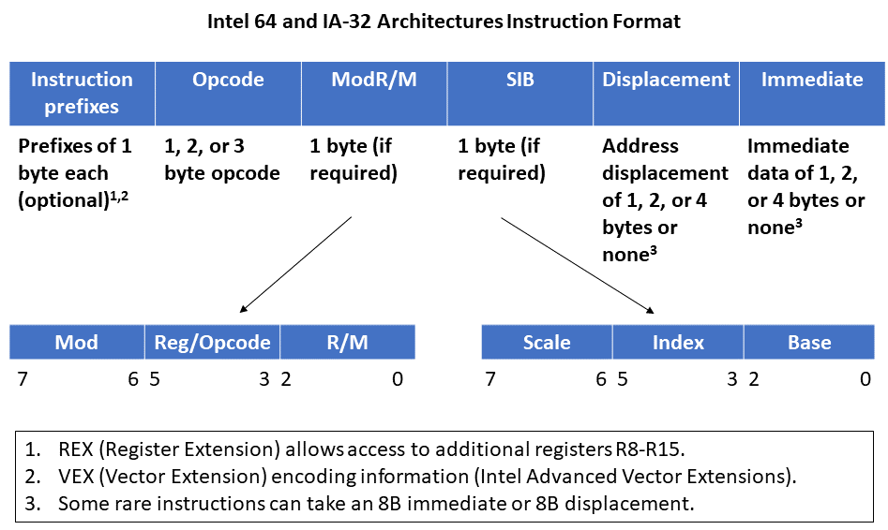
CISC Instruction Formats

Slide 30
CISC Architecture
Examples
Intel x86, IA-32, 64; IBM Z-Series Mainframes; older CPU architectures
Characteristics
Few general-purpose registers (perhaps 16)
Many addressing modes
Large number of specialized, complex instructions
Instructions are of varying sizes

Slide 31
Limitations of CISC Architecture
Some instructions are infrequently used by programmers and compilers
Only a few of the many instructions are used frequently
Memory references, loads and stores, are slow and account for a significant fraction of all instructions
Procedure and function calls are a major bottleneck
Passing arguments
Storing and retrieving values in registers
Notes:
Study by Hopkins: 10 instructions accounted for 71% of code in a sample of IBM mainframe programs.

Slide 32
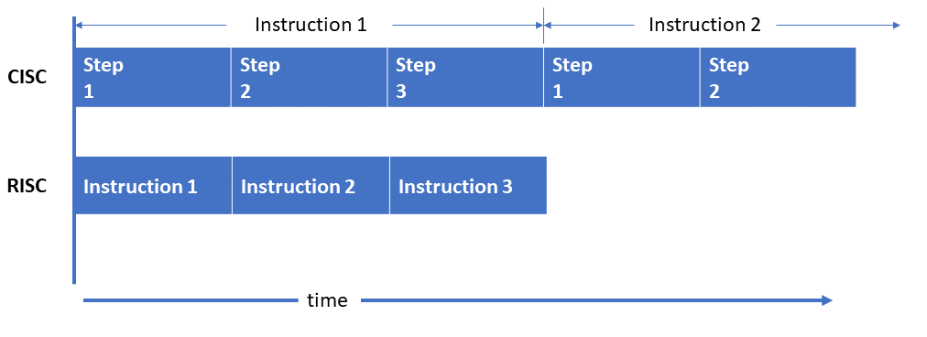
CISC vs. RISC Processing

Slide 33
Speeding Up Procedure Calls
Procedure calls help modularize programs.
They also cause major overhead at execution time:
Saving state
Setting up parameters
Call (transfer control to method or procedure)
Retrieving results
Restoring state
What if we could make procedure calls without moving data around?

Slide 34
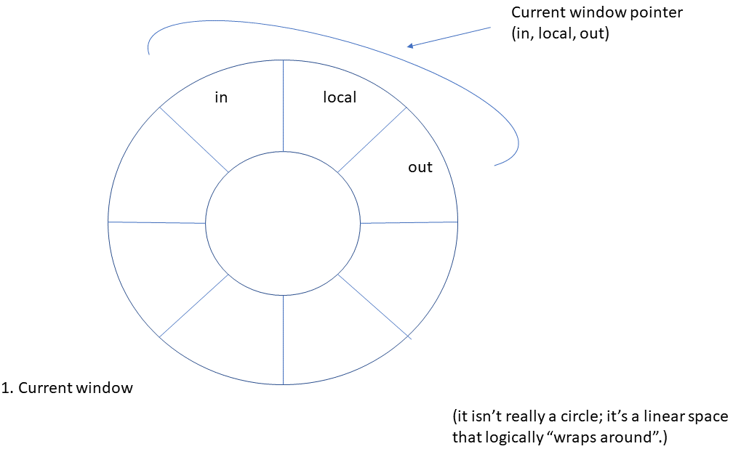
Circular Register Buffer (RISC)

Slide 35
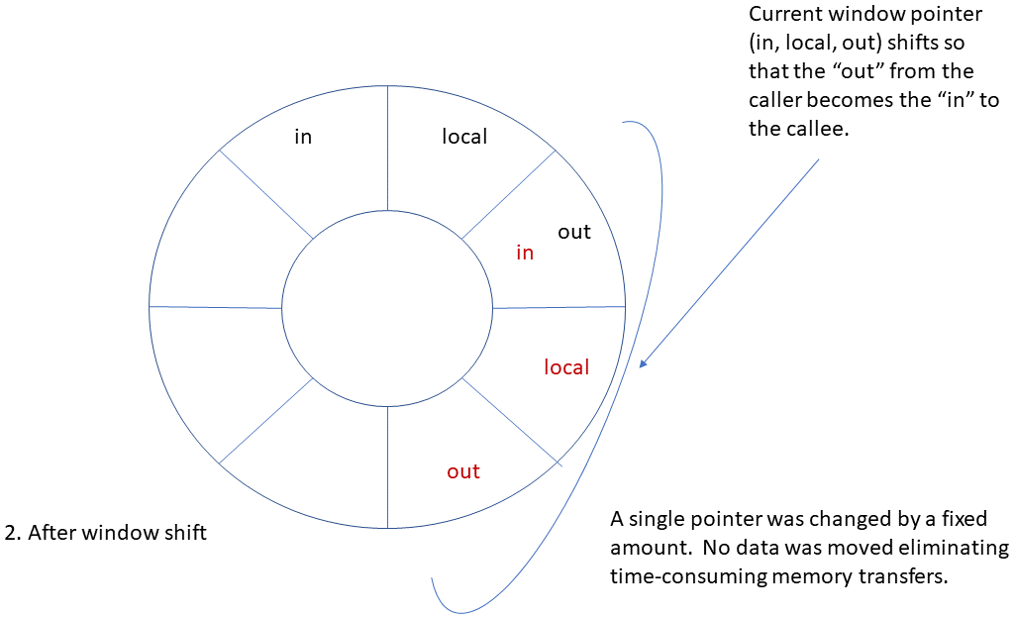
Circular Register Buffer After Procedure Call

Slide 36
CISC vs. RISC Performance Comparison
RISC → Simpler instructions
more instructions required for a program
more memory required to hold program, maybe
CISC → More memory access for data, so more bus traffic and increased cache memory misses
More registers would improve CISC performance but there was formerly no space available for them
Modern CISC and RISC architectures are becoming similar due to Moore’s Law.

Slide 37
Current and Emerging Trends
CISC and RISC are re-converging because of greater chip densities.
“Multi-core” chips: 8, 16, and even more CPUs in a single integrated circuit package.
Cluster computing: Hundreds or thousands of “commodity computers” working together. Example: the “Big Mac” at Virginia Tech
Parallel computing
Experimental architectures

Slide 38
Modern CPU Processing Methods
Separate Fetch/Execute Units
Pipelining
Scalar Processing
Superscalar Processing

Slide 39
Separate Fetch-Execute Units
Fetch Unit
Instruction fetch unit
Instruction decode unit
Determine opcode
Identify type of instruction and operands
Several instructions are fetched in parallel and held in a buffer until decoded and executed
IP – Instruction Pointer register
Execute Unit
Receives instructions from the decode unit
Appropriate execution unit services the instruction (There can be more than one, with specialization.)

Slide 40
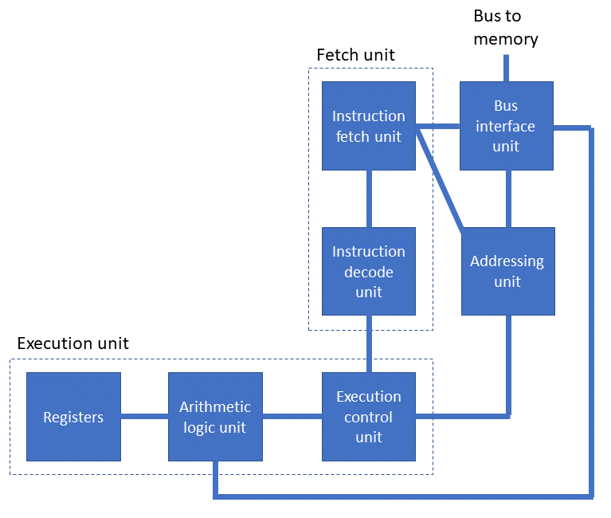
Alternative CPU Organization

Slide 41
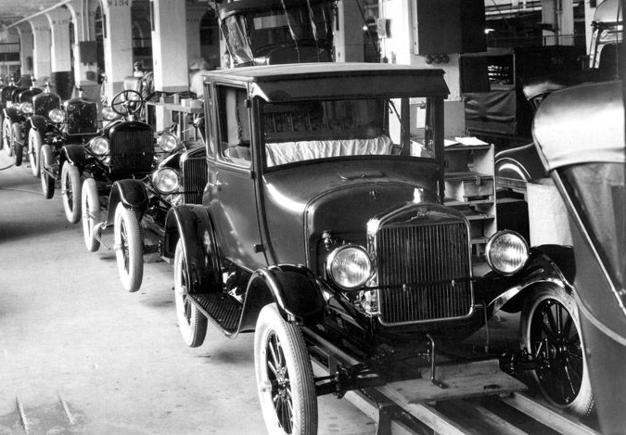
Assembly Lines
It takes 24 to 36 hours to build a modern car.
Assembly lines produce finished cars at 50 to 100 per hour.
So, an assembly line might be “30 hours long” and might start production of a car every 60 seconds.
After 30 hours, the pipeline is full, and we get a new car every minute!

Slide 42
Instruction Pipelining
Assembly-line technique to allow overlapping between fetch-execute cycles of sequences of instructions
Only one instruction is being completed at a time
Scalar processing
Average instruction execution is approximately equal to the clock speed of the CPU
Problems from stalling
Instructions have different numbers of steps
Problems of data latency
Problems from branching
Notes:
Data latency: A load instruction cannot complete in one clock cycle, so the register being loaded cannot be used by the immediately following instruction.

Slide 43
Branch Problem Solutions
Separate pipelines for both possibilities
Probabilistic approach (guess)
Requiring the following instruction to not be dependent on the branch
Instruction reordering

Slide 44
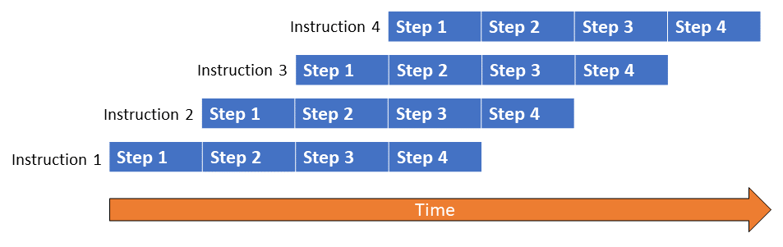
Pipelining Example

Slide 45
Superscalar Processing
Process more than one instruction per clock cycle
Separate fetch and execute cycles as much as possible
Buffers for fetch and decode phases
Parallel execution units

Slide 46
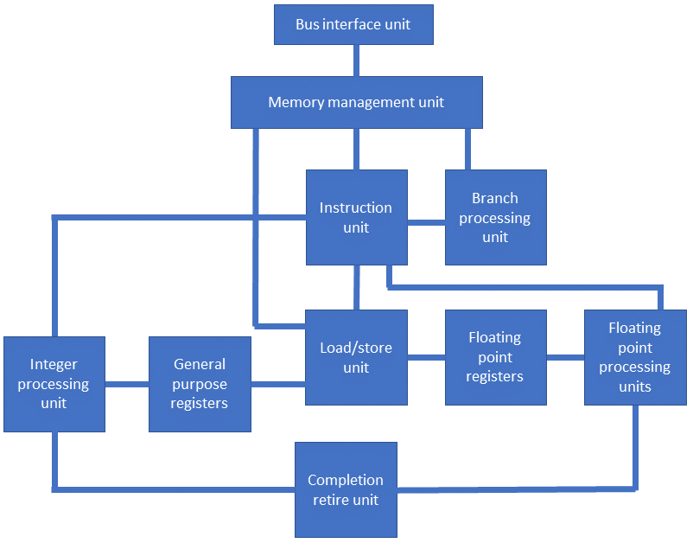
Superscalar CPU Block Diagram

Slide 47
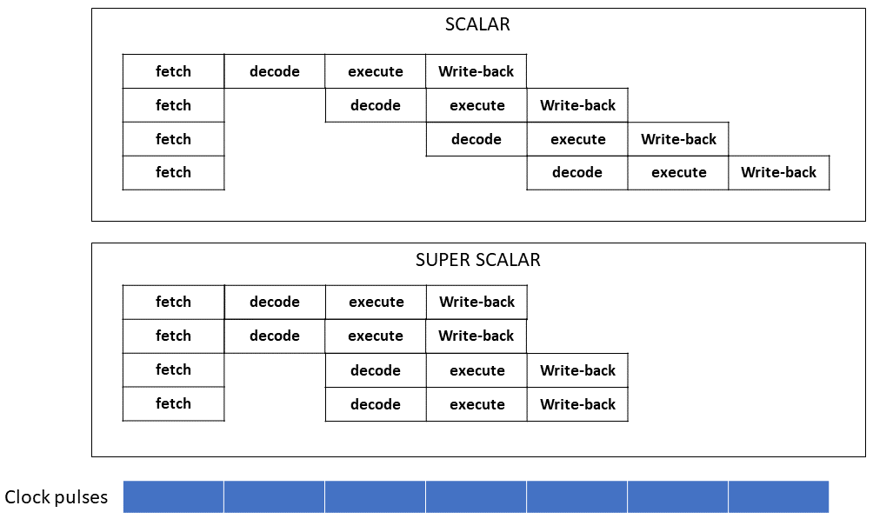
Scalar vs. Superscalar Processing

Slide 48
Superscalar Issues
Out-of-order processing – dependencies (hazards)
Data dependencies
Branch (flow) dependencies and speculative execution
Parallel speculative execution or branch prediction
Branch History Table
Register access conflicts
Logical registers (register renaming)

Slide 49
Definitions
Multiprogramming: Two or more programs running concurrently on one computer.
Multiprocessing: A computer has two or more processors (CPUs).

Slide 50
Multiprocessing
Motivation
Faster computing
More processing power
Parallel processing
Coupling of Processors
Tightly coupled
Loosely coupled

Slide 51
Tightly Coupled Systems
Shared memory and I-O
Two ways to configure:
Master-slave multiprocessing
Symmetric multiprocessing (SMP)

Slide 52
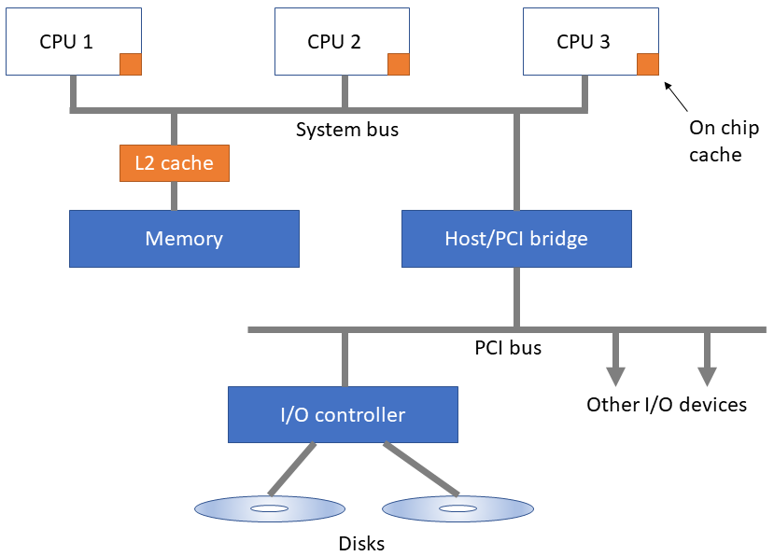
Tightly-Coupled Systems
Notes:
“Peripheral Component Interconnect"

Slide 53
Master-Slave Multiprocessing
One CPU is the “Master”
Manages the system
Controls all resources and scheduling
Assigns tasks to slave CPUs

Slide 54
Master-Slave Multiprocessing
Advantages
Simplicity
Protection of system and data
Disadvantages
Master CPU becomes a bottleneck
Reliability – if master CPU fails entire system fails

Slide 55
Symmetric Multiprocessing
Each CPU has equal access to resources
Each CPU determines what to run using a standard algorithm
Advantages
High reliability
Fault tolerant support is straightforward
Balanced workload
Disadvantages
Resource conflicts – memory, I/O, etc.
Complex implementation

Slide 56
Loosely-Coupled Systems
Clusters or multi-computer systems
Each system has its own CPU, memory, and I/O facilities
Advantages: Fault-tolerant, scalable, well balanced, distance is not (much of) an issue
Two ways to configure
Shared-nothing model
Shared-disk model

Slide 57
Shared-Nothing Model
High speed links between nodes
No sharing of resources
Partitioning of work through division of data and message-passing
Advantage
Reduced communication between nodes
Disadvantage
Can result in inefficient division of work

Slide 58
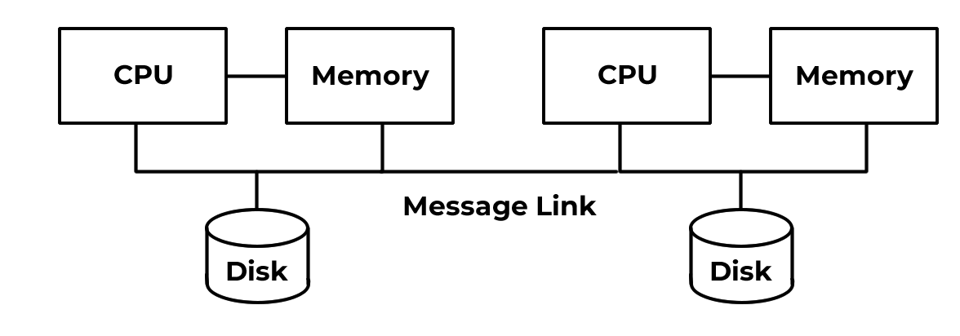
Shared Nothing Model

Slide 59
Shared Disk Model
High speed links between nodes
Disk drives are shared between nodes
Advantage
Better load balancing
Disadvantage
Complex software required for transaction processing (lock, commit phases)
Hardware complexity in the “I/O director”

Slide 60
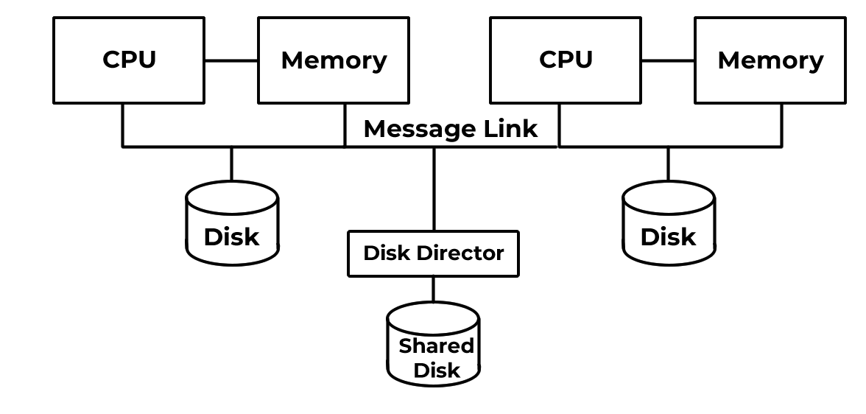
Shared Disk Model

Slide 61
Advantages of Clusters
Increased computing power by combining the power of individual computer systems
Inherently scalable
Cheaper than using a single large computer
Fault-tolerance
Failure in one node does not bring down the entire system
Failover – processing by failed node is switched to other nodes
High Availability
Load Balancing: can be attained either through software and/or through geographically distributed location of nodes

Slide 62
Beowulf Clusters
Simple and highly configurable
Low cost
Loosely Coupled
Computers connected to one another by a private Ethernet network
Connection to an external network is through a single gateway computer

Slide 63
Beowulf Clusters
A type of cluster computer defined by specialized software.
Commercial-off-the-shelf components such as inexpensive computers
Blade components – computers mounted on a motherboard that are plugged into connectors on a rack
Either shared-disk or shared-nothing model

Slide 64
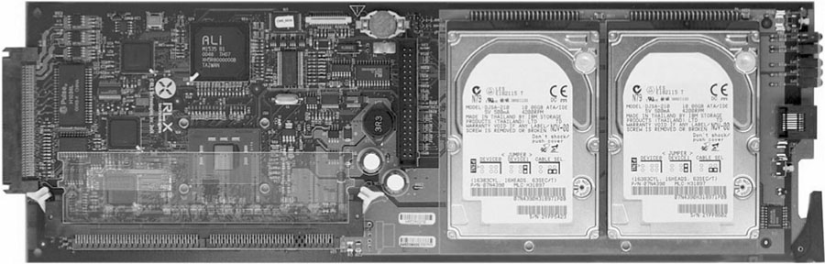
Blade Computer

Slide 65
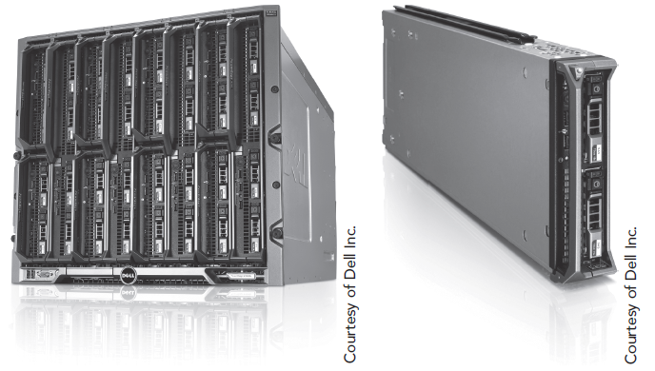
Blade and Rack Configuration

Slide 66
High Performance Computing
Massively parallel processor architectures (MPP)
Clusters of powerful machines or larger Beowulf blade clusters
Well suited for problems that can be broken into subtasks
Cloud (Grid) computing
Supercomputer performance through distributing CPU processing to computers connected to a network

Slide 67
Networks vs. Clusters
Externally, clusters appear as a single computing unit.
Network nodes are individually identifiable.
Workload on a cluster is determined by cluster administration and load-balancing software.
Network workload depends on the job mix of each node.

Slide 68
Parallel Computers
Massively parallel architectures
Hundreds to millions of CPUs
CPUs have small amounts of local memory
All CPUs have access to global shared memory
Each CPU may calculate a part of the problem independently.

Slide 69
Questions

