Slide 1

IT 3123 Hardware and Software Concepts
Computer and Memory Organization
Notice: This session is being recorded.

Slide 2
Announcements
Midterm grades posted.
About grades…
You can see a semester cumulative grade in D2L. (It’s called “final grade.)
Reduced office hours on March 13.
Assignment 3
Minor syllabus revisions.

Slide 3
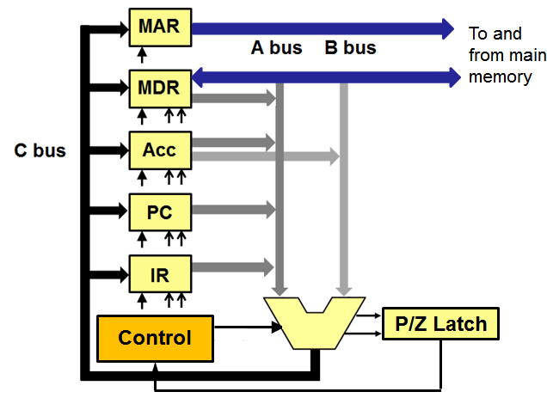
The Datapath Computes PC ← PC+1
Write
Ena A
Incr
Control
Notes:
In reality, each register has two outputs, A and B, and two Enable lines, Enable-A and Enable-B

Slide 4
Branch Instructions: BRP
Fetch
MAR ← PC (read memory)
PC ← PC+1
IR ← MDR
Decode
Determine next operation
IFP tests the P (positive) flag; the branch is only taken if P is true. Branch on zero is similar. Unconditional branch omits the test.
Execute
IFP; PC ← IR[addr]
Notes:
Natural language description and RTL

Slide 5
Instructions
Direction given to a computer
Cause electrical signals to be sent through specific circuits for processing
Instruction Set: The collection of instructions a given computer can perform. (TBC has nine instructions; the list of them is its instruction set.)

Slide 6
Instruction Set
Design defines functions performed by the processor
Differentiates computer architecture by the
Number of instructions
Complexity of operations performed by individual instructions
Data types supported
Format (layout, fixed vs. variable length)
Use of registers
Addressing (size, modes)

Slide 7
Elements of an Instruction
Operation Code (op-code): Commands the control unit and the ALU what to do
Operands: tell the location of the data to be used in the instruction.
Source operand: where to get the data
Result operand: where to put the result (Also called the destination operand.)
The operands are (usually) addresses.

Slide 8
Operand Addresses
Addresses may be explicit or implicit
Explicit: encoded in the instruction. (The TBC memory address is explicit.)
Implicit: implied by the nature of the operand. (The TBC uses the accumulator implicitly.)
Addresses may refer to memory or to registers.
Operation code 3 25 Operand

Slide 9
General Form of an Instruction
Source
Operand
Result
Operand
Op-Code
A More Specific Form
Register Operand
Memory
Operand
Op-Code
8 bits
4 bits
20 bits

Slide 10
Instruction Format
Specific to a particular family of computers (architecture).
Specifies the length of the op-code.
And the size and number of operand fields.
A single computer may have several different instruction formats.

Slide 11
Categories of Instructions
Data transfer instructions
Arithmetic instructions
Logical operations
Program control
Stack manipulation
I-O and machine control
Multiple-data instructions
Notes:
Seven categories

Slide 12
Data Transfer Instructions
Move data between registers in CPU
Transfer data from memory to a CPU register (load)
Transfer data from a CPU register to memory (store)
Size of a single transfer: generally, the size of a data register; a “word”
Words are 8, 16, 32, 64, or 128 bits
64-bit words are currently most common

Slide 13
Arithmetic Instructions
The usual suspects: + – / *
Separate instructions for integer and floating-point operands.
Shift and rotate instructions
One bit shift left multiplies by two
One bit shift right divides by two
Rotate: Bits shifted out one end are used for replacement bits at the other end.
Increment, complement, etc.

Slide 14
Logical Operations
Logical AND and OR of two operands
Sometimes others: XOR, NOR, NOT
Relational operations: > < =
Testing for zero, positive, negative

Slide 15
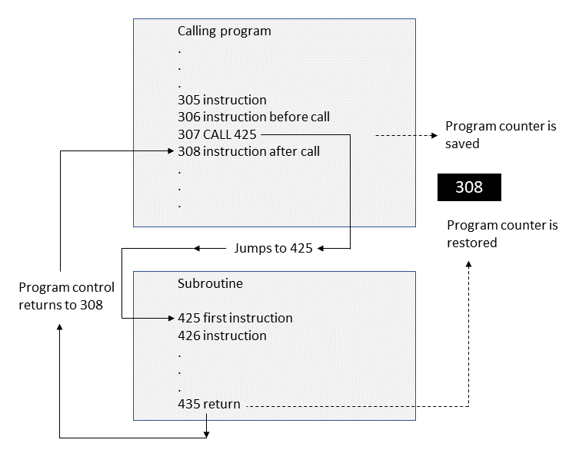
Program Control
Branch instructions; conditional and unconditional
Call instructions (save program counter someplace)

Slide 16
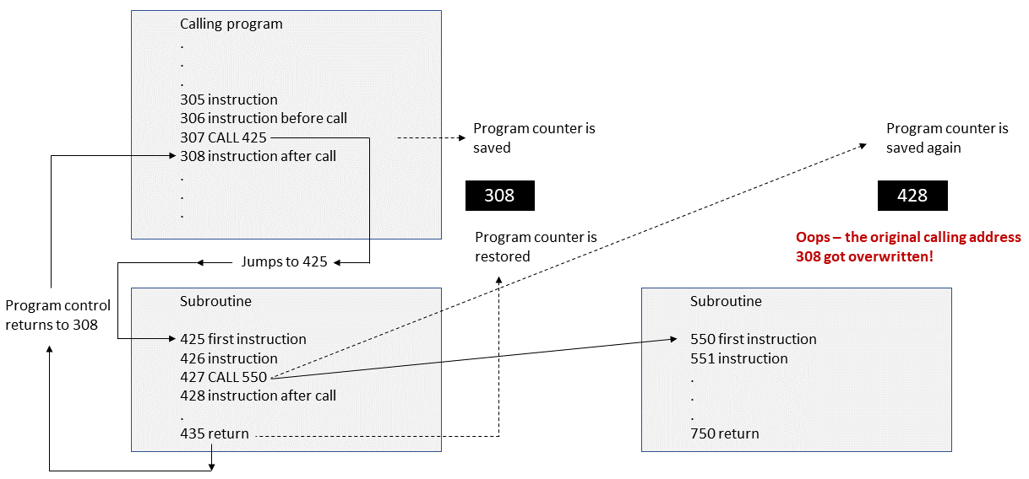
Subroutine Linkage Problem
Notes:
Calling methods (subroutines or subprograms) we have the same problem as Hansel und Gretel; getting there is no problem, but how to get back?

Slide 17
Subroutine Linkage Solution
Dynamic allocation of data…
… so that multiple return addresses can be saved.
Data structure: last-in, first-out, so that retrieving an address gets that of the most recent subprogram call.
In computer terms, that’s a stack.

Slide 18
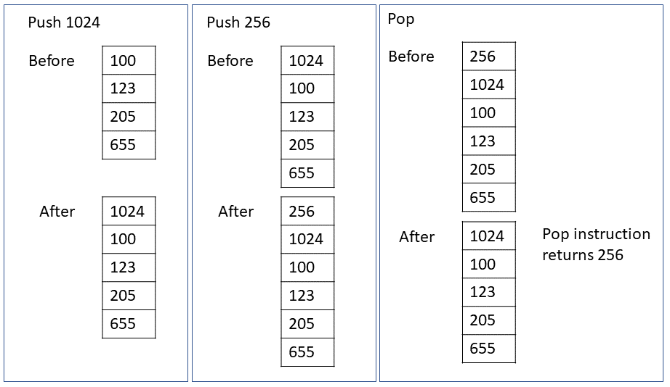
Stack Manipulation
Many architectures have special instructions for dealing with LIFO data structures (stacks)
push and pop; also call and return

Slide 19
I-O and Machine Control
Transfers from registers to I-O devices
Direct memory access (DMA) I-O The I-O device communicates with memory independent of the CPU
Machine state switching (privileged instructions)
Interrupt control
State saving
Halt

Slide 20
Multiple-Data Instructions
Perform the same operation on multiple data items simultaneously (Example: Intel MMX)
Commonly used in vector and array processing
SIMD: Single-instruction, multiple data

Slide 21
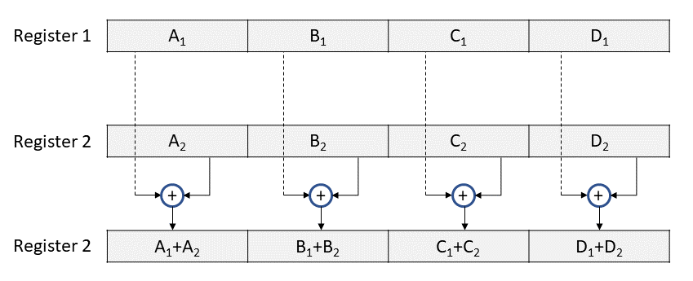
Multiple Data Instructions

Slide 22
Memory Capacity
Limited by two factors
Size of the MAR: k bits address 2^{k} cells
Size of the effective address portion of an instruction. (in LMC, it is two digits, in TLC, eight bits.)
The amount of physical memory is important for performance
Notes:
“Effective address” is the address after all address arithmetic.

Slide 23
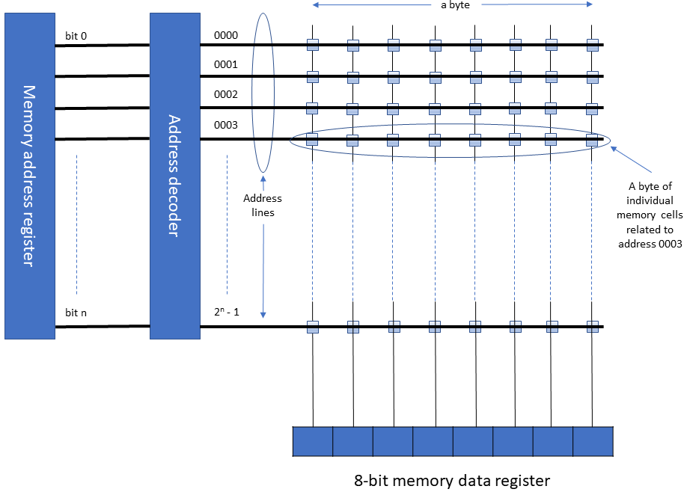
Operation of Memory

Slide 24
Decoders for Large Memories
A 32-bit MAR would need a 32 to four billion decoder; not really practical.
If the address is divided into 16 bits of “row address” and 16 bits of “column address,” each is 2¹⁶ = 65,536 lines.
Decoding is necessarily slower for very large memories.
Decoding happens within the memory chips, not in the CPU. That keeps the size of the memory address bus reasonable.

Slide 25
Volatile and Non-Volatile Memories
Volatile memories lose their contents when power is removed.
Non-volatile memories retain their contents even when powered off.

Slide 26
Random Access Memory (RAM)
Called “random access” because any cell may be addressed as fast as any other.
Dynamic RAM (DRAM)
Loses contents when power removed (volatile).
Must be refreshed thousands of times per second..
Static RAM (SRAM)
More expensive, faster, no refresh needed.
Loses contents when power removed(volatile).
SDRAM: Synchronous dynamic RAM.
Notes:
SDRAM uses a clock to synchronize the operation of the memory.

Slide 27
Flash Memory
Non-volatile semiconductor memory
Faster than magnetic disks but more expensive
Uses
BIOS: initial boot instructions and diagnostics
Solid-state drives
Digital cameras, music players, thumb drives, etc.
Slower than RAM
Limited, but fairly large, number of write cycles.

Slide 28
Read Only Memory (ROM)
Non-volatile memory to hold software that is not expected to change over the life of the system
ROM: Contents fixed when manufactured; cannot be changed.
EEPROM
Electrically Erasable Programmable ROM
Slower and less flexible than flash memory
Used when changes are infrequent

Slide 29
CMOS Memory
CMOS: Very low power read-write memory; clock and configuration info.
CMOS: Complementary metal-oxide semiconductor.

Slide 30
Boundary Alignment
Modern computers are byte-addressable, i.e. a program can request any byte.
Transfers between CPU and memory are in words. For a 64-bit CPU, that’s eight bytes.
Data items more than one byte and less than one word should be word-aligned so that only one transfer is needed.
Compilers do this automatically.

Slide 31
Byte Ordering
The most significant byte of a word can be stored:
At the lowest address or
At the highest address.
This is a choice made when the architecture is designed.
Lowest address called : Big-endian
Highest address called: Little-endian
Important for data exchange.
Notes:
The terms big endian and little endian come from Jonathan Swift’s Gulliver’s Travels, and refer to the
war over which end of an egg to open. They were applied to computer byte ordering by D. Cohen (1981).

Slide 32
Error Detection: Parity
To each byte, add one extra bit, called a parity bit.
Each time the byte is stored, set the extra bit such that the number of one-bits is even. (Even parity.)
Each time a byte is read, check the number of one bits is still even. If not, a memory error has occurred.
Could use odd parity as well.
Notes:
A parity system can detect only errors in an odd number of bits. If two bits are changed erroneously, the parity will be correct even though the contents have been corrupted. Often this is called “detecting single-bit errors.”

Slide 33
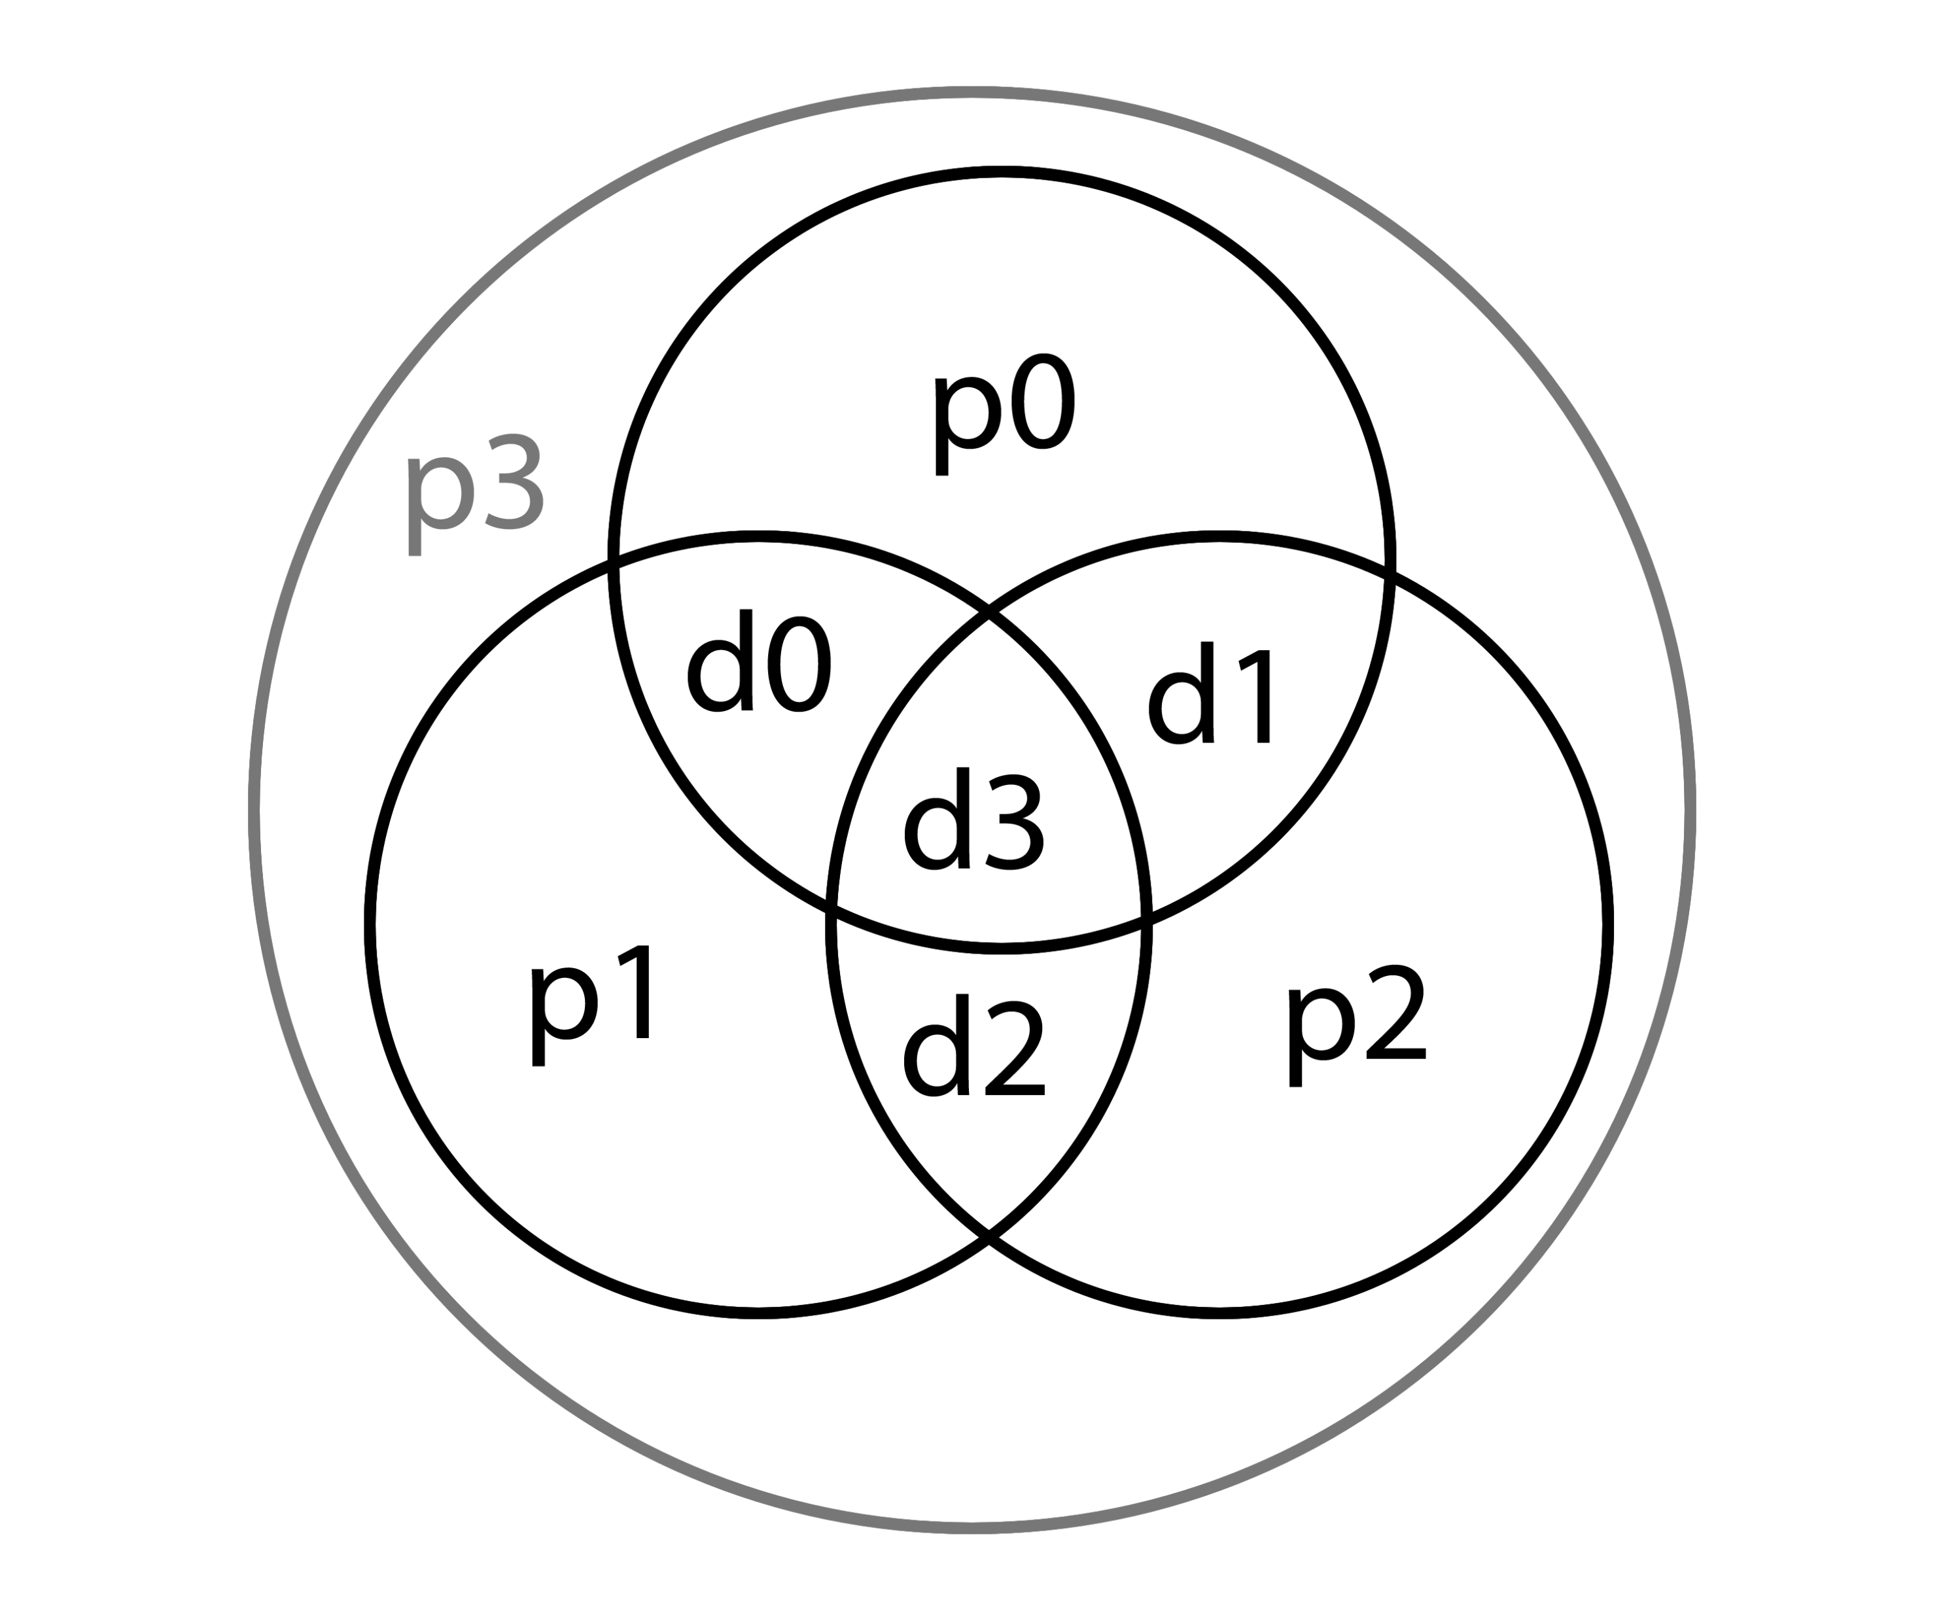
Error-Correcting Codes
Hamming code: adds extra parity bits.
Can detect double-bit errors and correct single- bit errors.
Example: d0 is checked by p0 and p1. If both are in error, then the error must be in d0.
There are other error-correcting codes.
Notes:
In 1950, Richard Hamming of Bell Laboratories devised a system to detect multi-bit errors and correct single bit errors, now called
a Hamming code. The principle of the Hamming code is that every data bit is checked by more than one parity bit.
The figure shows four data bits being checked be three parity bits. If data bit d0 were corrupted, parity bits p0 and p1 would both indicate errors. The only data bit checked by both p0 and p1 is d0. If we know which single bit is incorrect, it can be corrected by complementing it, i.e. flipping it back to the other possible value. A fourth parity bit, p3, checks the parity of all the other parity and data bits. A Hamming code like this can correct single-bit errors and detect double-bit errors. The example uses four parity bits to check four data bits, an overhead of 100%. However, the overhead diminishes as the number of data bits to be checked by a Hamming code increases. A 32-bit word can be checked with seven parity bits, six of which check individual data bits and one of which checks the overall
parity.

Slide 34
Buses
The physical connection that makes it possible to transfer data from one location in the computer system to another
Group of electrical conductors for carrying signals from one location to another
Line: each conductor in the bus

Slide 35
Bus Signals
3 kinds of signals and sometimes power, which is not a “signal”
Data (binary numbers: alphanumeric, numerical, instructions)
Addresses
Control signals
Power and ground (sometimes)

Slide 36
Bus Applications
Connect CPU and Memory
I/O peripherals: on same bus as CPU/memory or separate bus
Physical packaging commonly called backplane or motherboard
Also called system bus or external bus
Example of broadcast bus
Part of printed circuit board called motherboard that holds CPU and related components

Slide 37
Bus Hierarchy
Processor bus: on-chip
Memory bus (northbridge) Connects the memory subsystem and processor
I/O bus (southbridge)
Connects I/O to the CPU and memory
Connects all peripheral cards and connectors
Examples: SATA, Thunderbolt, and USB

Slide 38
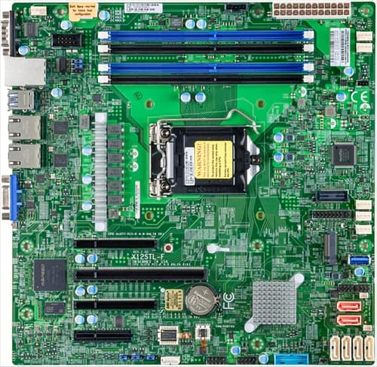
Motherboard

Slide 39
Bus Characteristics
Protocol
Documented agreement for communication
Specification that spells out the meaning of each line and each signal on each line
Throughput, i.e., data transfer rate in bits per second
Data width in bits carried simultaneously

Slide 40
Parallel Buses
High throughput because all bits of a word are transmitted simultaneously.
Expensive and require physical space
Subject to electrical interference, which limits their speed and length.
“Bus skew” is the condition that bits on some of the lines arrive before bits on other lines.
If bus skew exceeds one bit time, data are corrupted!
Generally used for short distances such as CPU buses and on computer motherboards.

Slide 41
Serial Buses
One bit transmitted at a time; so, no skew
Single data line pair and a few control lines.
For many applications, throughput is higher than for parallel because of the lack of electrical interference and absence of skew.
Consider USB (Universal Serial Bus) and SATA (Serial ATA disk attachment).

Slide 42
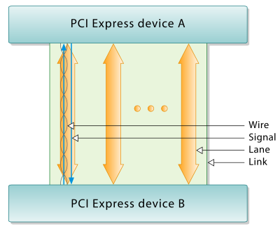
PCI Express (PCIe)
A serial/parallel computer expansion (internal) bus
Full duplex operation over two simplex paths, one each direction.
Each pair is a “lane.”
A “link” may be one to 32 lanes.
Lanes transmit byte streams
https://en.wikipedia.org/wiki/PCI_Express

Slide 43
Point to Point vs. Multipoint
cv
CPU
Computer
Printer
PCIe Root Complex
Computer
Multipoint
Point-to-point

Slide 44
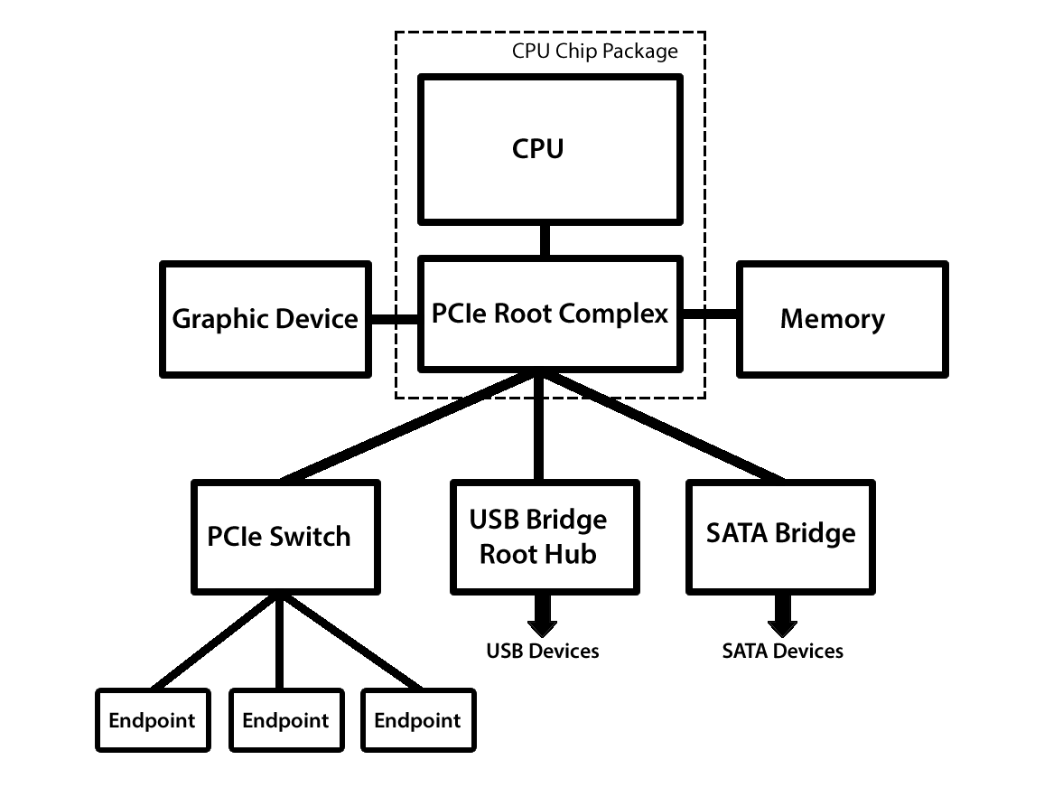
Bus Organization in Modern CPU

Slide 45
Virtual Memory
What if a program (or collection of programs) needs more memory than the computer has?
Solution: use disk as a substitute for memory
Managed by the operating system
Built into the hardware
Independent of application (transparent)

Slide 46
Memory Speed
Memory is slow compared to CPU processing speeds!
2Ghz CPU = 1 cycle in ½ of a billionth of a second
20ns DRAM = 1 access in 20 billionths of a second (40 times slower!)

Slide 47
Memory Enhancements
Methods to improve memory accesses
Wide Path Memory Access
Retrieve multiple bytes instead of one byte at a time
Memory Interleaving
Partition memory into subsections, each with its own address register and data register
Cache Memory

Slide 48
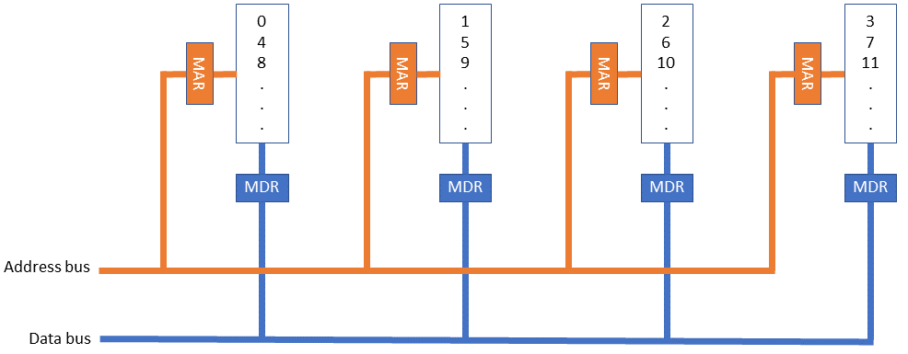
Memory Interleaving

Slide 49
Cache Memory
A small, fast memory placed between the CPU and main memory
Blocks: 8 or 16 bytes ; Unit of transfer between storage and cache memory. (Also called a cache line.)
Tags: point to a location in main memory

Slide 50
Cache Memory
Hit Ratio: ratio of hits out of total requests
Hit ratios of 90% are common.
Problem: synchronizing cache and memory
Write through
Write back

Slide 51
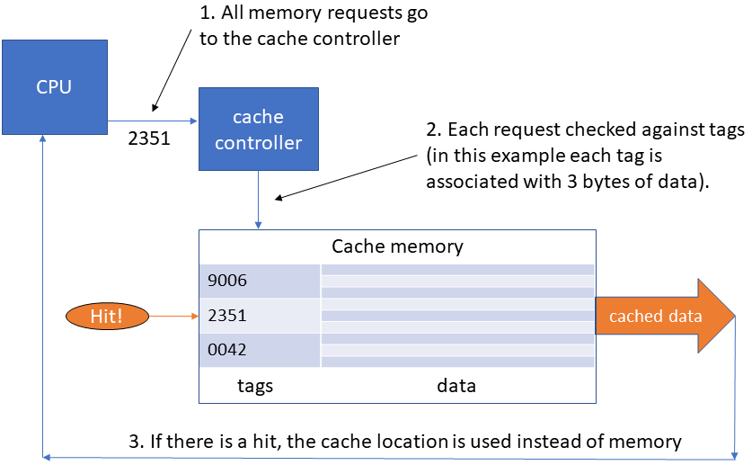
Step-by-Step Use of Cache: Hit

Slide 52
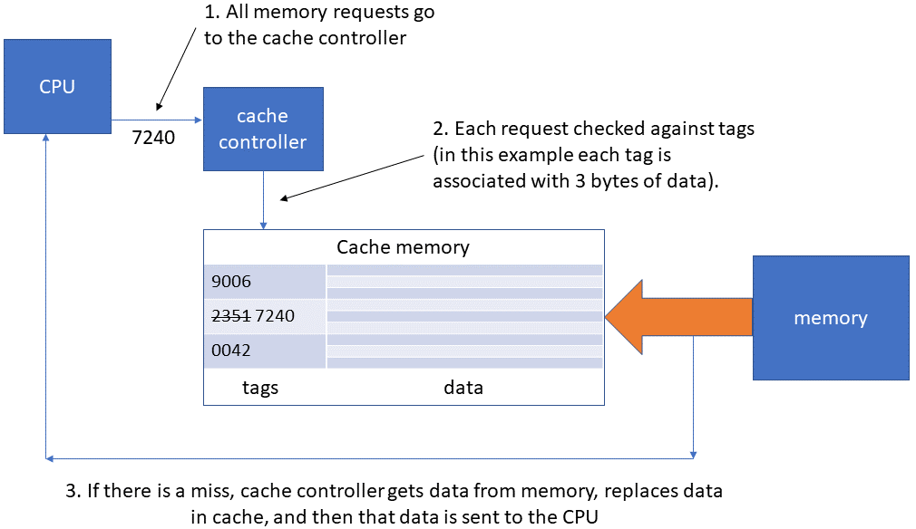
Step-by-Step Use of Cache: Miss

Slide 53
Performance Advantages
Hit ratios of 90% common
50%+ improved execution speed
Locality of reference is why caching works
Most memory references confined to small region of memory at any given time
Well-written program in small loop, procedure or function
Data likely in array
Variables stored together

Slide 54
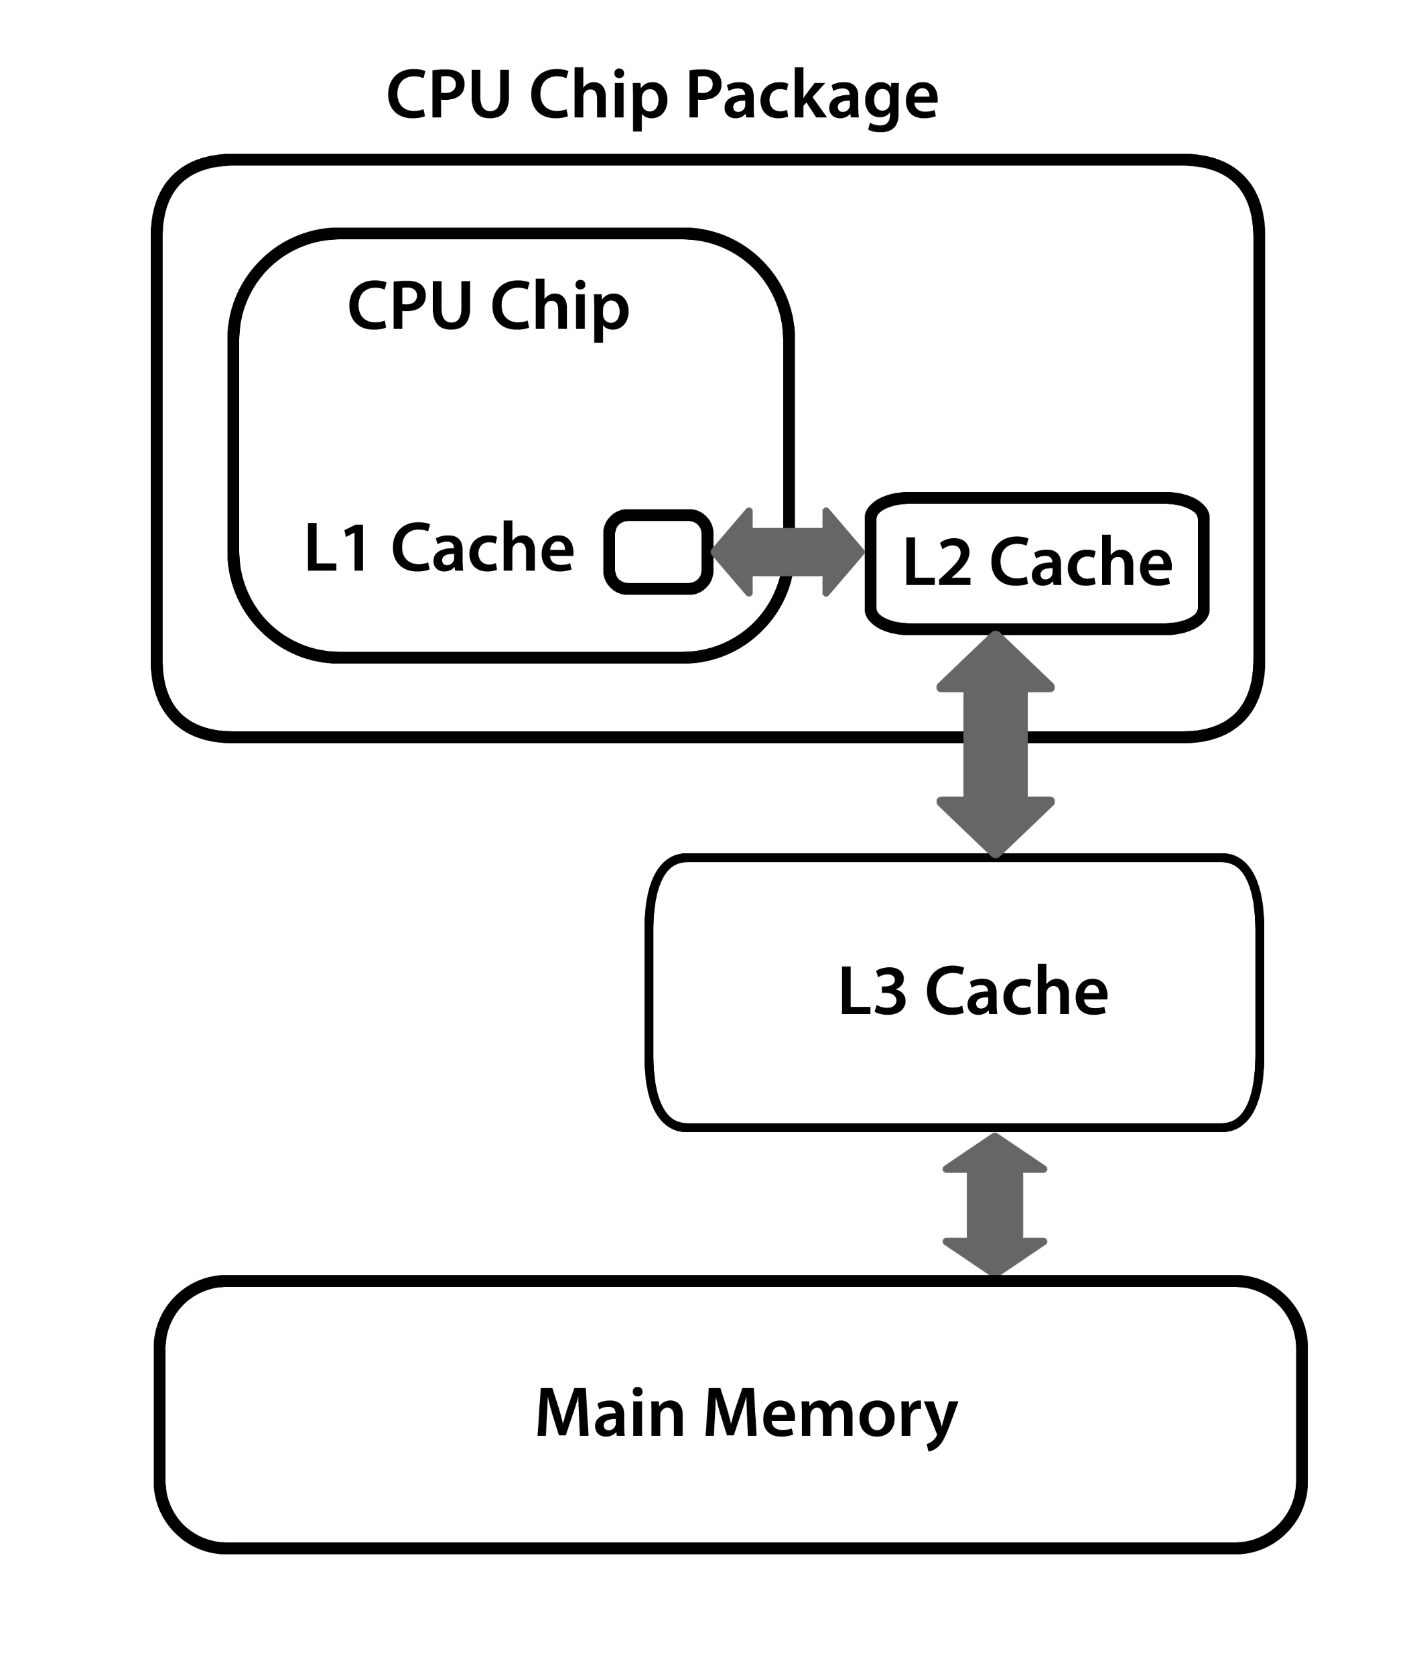
Multi-level Caches

Slide 55
Cache vs. Virtual Memory
Cache speeds up memory access
Virtual memory increases amount of perceived storage
independence from the configuration and capacity of the memory system
low cost per bit

Slide 56
Questions

