Slide 1

IT 3123 Hardware and Software Concepts
Let’s Build a Computer II Programming TBC
Notice: This session is being recorded.

Slide 2
The LMC/TBC Instruction Set
Mnemonic Op Code Meaning
HLT 0xx Halt
ADD 1xx Add
SUB 2xx Subtract
STO 3xx Store
LDA 5xx Load
BR 6xx Branch
BRZ 7xx Branch Zero
BRP 8xx Branch Positive
IN 901 Input
OUT 902 Output

Slide 3
A Pseudo-Instruction
The LMC/TBC assembler recognizes the DAT (for “data”) mnemonic.
DAT is not an instruction; it is a command to the assembler to reserve one location for data.
Such assembler commands are called pseudo-instructions
Could also be used to reserve and initialize data, e.g. DAT 001

Slide 4
Previous Semester’s Homework
Part 4: Design a program that displays the even numbers counting downward from 20 to zero using the LMC / TLC instruction set and looping. The program must halt after displaying zero. Write and turn in as the answer to this part the pseudo-code for your solution.

Slide 5
The Expected Result
20
18
16
14
12
10
8
6
4
2
0

Slide 6
Elements of the Problem
Start at 20
Count down
Even numbers only
Use a loop
Stop after displaying zero

Slide 7
Pseudo-Code for Data
Number? 20 to start
Value to subtract? 2

Slide 8
Pseudo-Code for Instructions
print print the current value
was it zero?
if yes, stop
subtract 2
go to print
Remember, data goes at the end!

Slide 9
One Way to Approach This
lda number print out brz done sub two br print done hlt
number dat 20
two dat 2

Slide 10
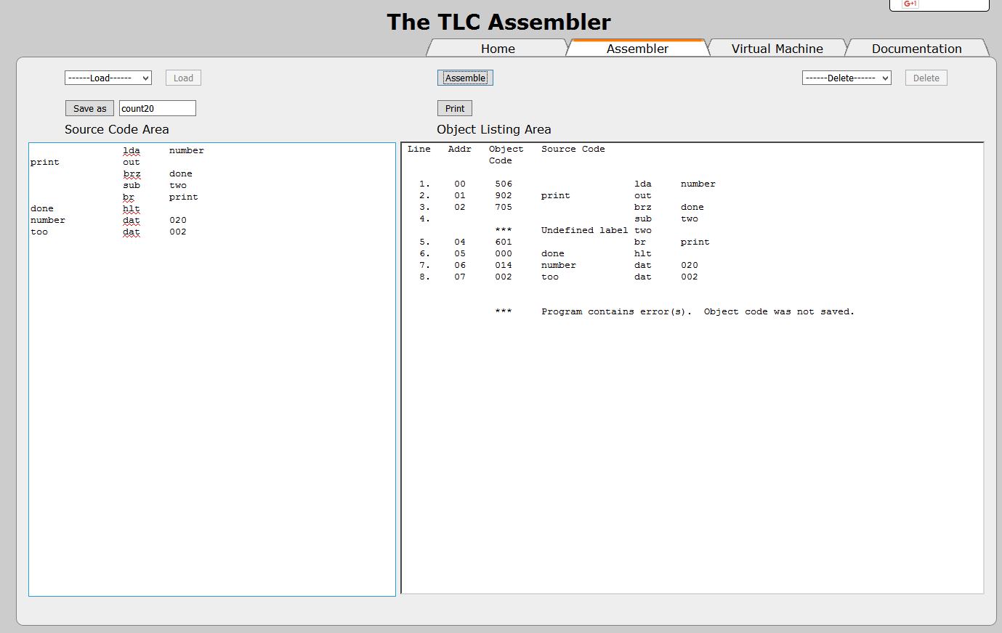
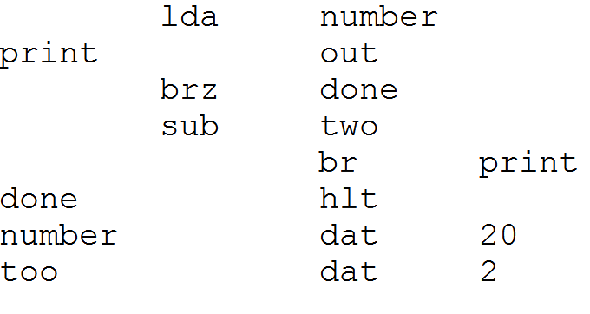
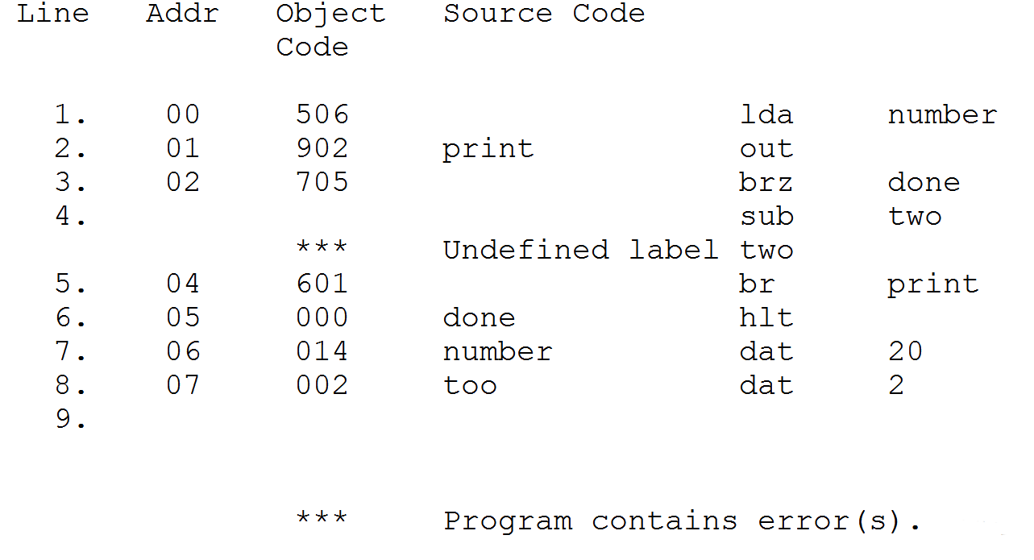
Assembling the Program (Error!)
Notes:
“two” was misspelled the first time. The error message was where “two” was used, not where we tried to define it.

Slide 11
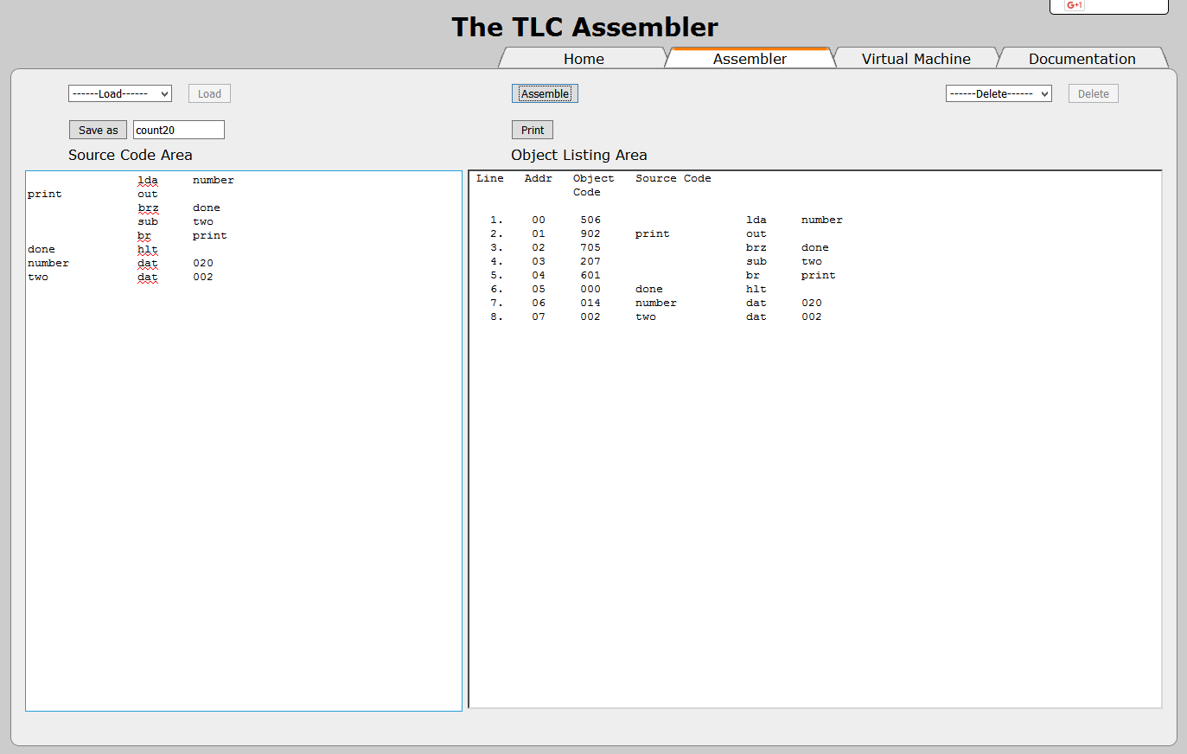
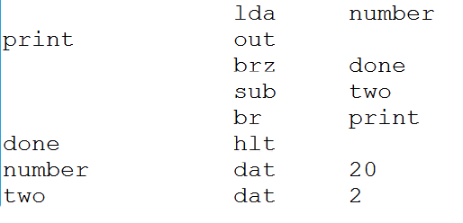
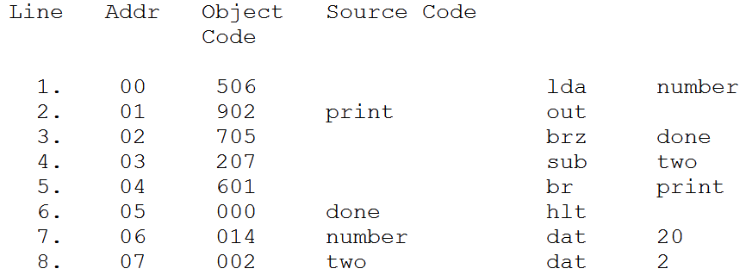
Assembling the Program

Slide 12
The Object Listing Area
Line | Address | Object Code | Source code 1 | Source code 2 | Source code 3
1 | 00 | 506 |  | lad | number
2 | 01 | 902 | print | out
3 | 02 | 705 |  | brz | done
4 | 03 | 207 |  | sub | two
5 | 04 | 601 |  | br | print
6 | 05 | 000 | done | hlt
7 | 06 | 014 | number | dat | 20
8 | 07 | 002 | two | dat | 2

Slide 13
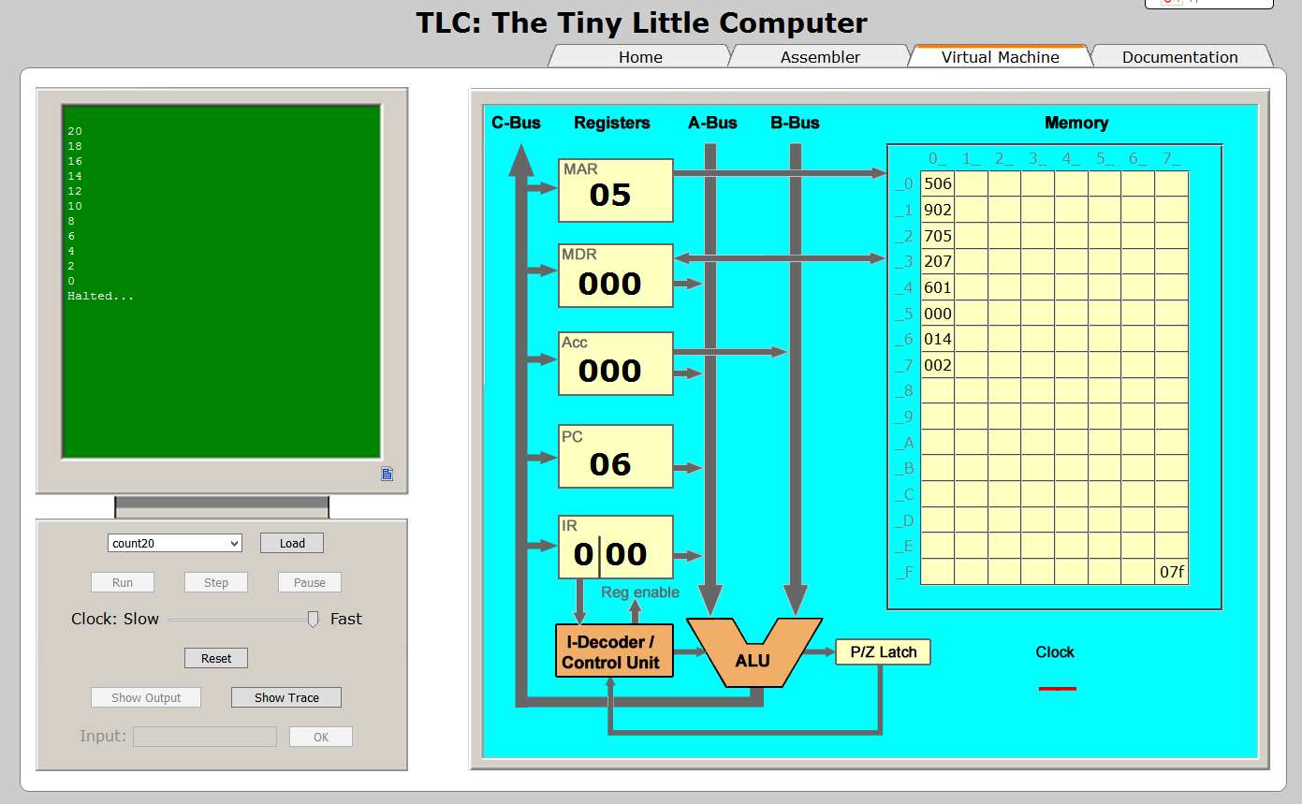
Run the Program

Slide 14
TLC’s Memory at the End
 | 0 | 1 | 2 | 3 | 4 | 5 | 6 | 7
0 | 506
1 | 902
2 | 705
3 | 207
4 | 601
5 | 000
6 | 014
7 | 002
8
9
A
B
C
D
E
F |  |  |  |  |  |  |  | 07F

Slide 15
What If…
What if we were asked to stop at a number other than zero?
We have to:
Save the current number to memory
Subtract the “stop limit” from it
Branch on zero (numbers were equal)
If not zero, restore the current number from memory

Slide 16
Why This Is Important
Three important facts…
Grace Murray Hopper helped with the invention of compilers so that we wouldn’t have to program in assembly language.
A high-level language introduces a layer of abstraction between hardware and software.
Wirth’s Law: Software is getting slower faster than hardware is getting faster.

Slide 17
Why This Is Important
Assembly language programming, even just a little bit of it, helps one understand how the CPU and memory operate.
People who understand how the CPU and memory operate are better able to evaluate new technologies.
People who understand how the CPU and memory operate are better able to write, or evaluate, efficient software.

Slide 18
Questions

