Slide 1

IT 3123 Hardware and Software Concepts
Notice: This session is being recorded.
Let’s Build a Computer

Slide 2
I’ll Be Here
almost
On time every time!
In over 21 years of teaching, this is the second time I’ve missed class because of illness.

Slide 3

Problems with LMC
LMC is a decimal computer, but all real computers are binary.
There is a certain amount of “magic” in the actions of the Little Man, but no magic in real computers.
The available simulators do not show the fetch / decode / execute cycle clearly.
So… we’ll do something else!

Slide 4
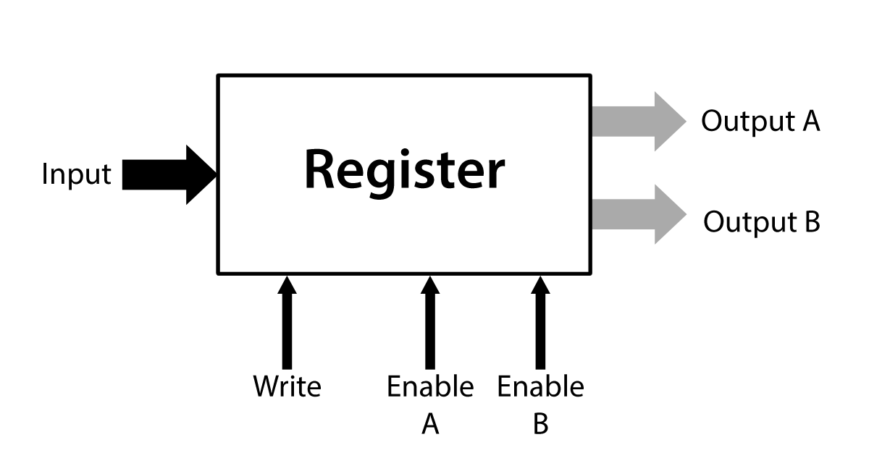
Reminder: Registers
Small, fast storage within the CPU.
From “a few” to a few hundred.
One input, one or two outputs.
Conceptually, the right number of latches.
From “a few” to 64 or more bits wide.
“Fat arrows” indicate multi-bit paths.

Slide 5
Computers Have Registers
The Little Man could remember things; in a real computer, registers do that.
The memory location to read or write: The memory address register
The data transferred to or from memory: The memory data register (also called the memory buffer register.)
Arithmetic results: The accumulator or data registers, also called general registers.
Address of the next instruction: The program counter
The current instruction read from memory: The instruction register

Slide 6
Memory Registers
The memory address register holds an address in memory:
From which to read data
To which to write data
The memory data register holds data or instruction words:
Read from memory
To be written to memory

Slide 7
Program Counter
Holds the address of the next instruction
Updated shortly after an instruction is fetched
Can be changed (by the CPU) to implement branching.

Slide 8
Instruction Register
Holds the instruction fetched from the memory location pointed by the Program Counter
The “Decode” phase examines the contents of the instruction register to decide what operation to perform
The instruction was something the Little Man remembered; a real computer uses the Instruction Register

Slide 9
About LMC’s Calculator
Does three things:
Receive data from the Little Man
Performs arithmetic operations
Holds the result of arithmetic operations
Two separate components in a real computer:
The arithmetic/logic unit performs arithmetic and logical operations.
Data registers or accumulator (if there’s only one) receive the results of arithmetic and logical operations.

Slide 10
The Arithmetic / Logic Unit
LMC performs addition and subtraction with the calculator.
We must also be able to copy data into the accumulator, i.e. enter numbers.
To do what LMC does, we need these functions:
Add
Subtract
Copy
Increment (add one)
It is also useful to generate constants like zero and one.

Slide 11
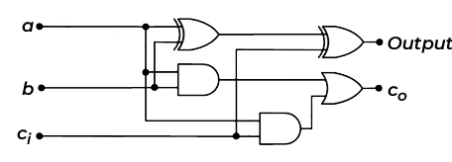
Making an ALU: Start With a Full Adder
This is the same circuit we saw in the study of digital logic, slightly rearranged.
It adds two bits, a and b, and a carry-in to produce a sum (output) and carry-out.
Notes:
“Rearranged:” It’s still exactly the same circuit in terms of gates, wiring, and logical flow; the positions of the gates have been moved slightly to make adding to the circuit easier.

Slide 12

AND as an “Enable” Control
The and gate can be used as an “enable” gate to control whether a signal passes through it or not.
When Ena (enable) is zero (false), the result f is zero.
When Ena is one (true), the result f is equal to a.
Ena | A | f
0 | 0 | 0
0 | 1 | 0
1 | 0 | 0
1 | 1 | 1
a Ena
f

Slide 13
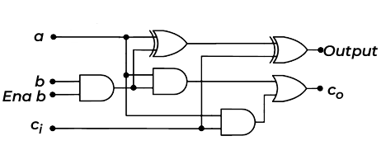

Provide “Enable-B” Input
b Ena b
If Enable b is true, the value of b is passed to the full adder.
If not, the b input of the adder is zero.
This will let us copy a from input to output without addition by “adding” zero.

Slide 14

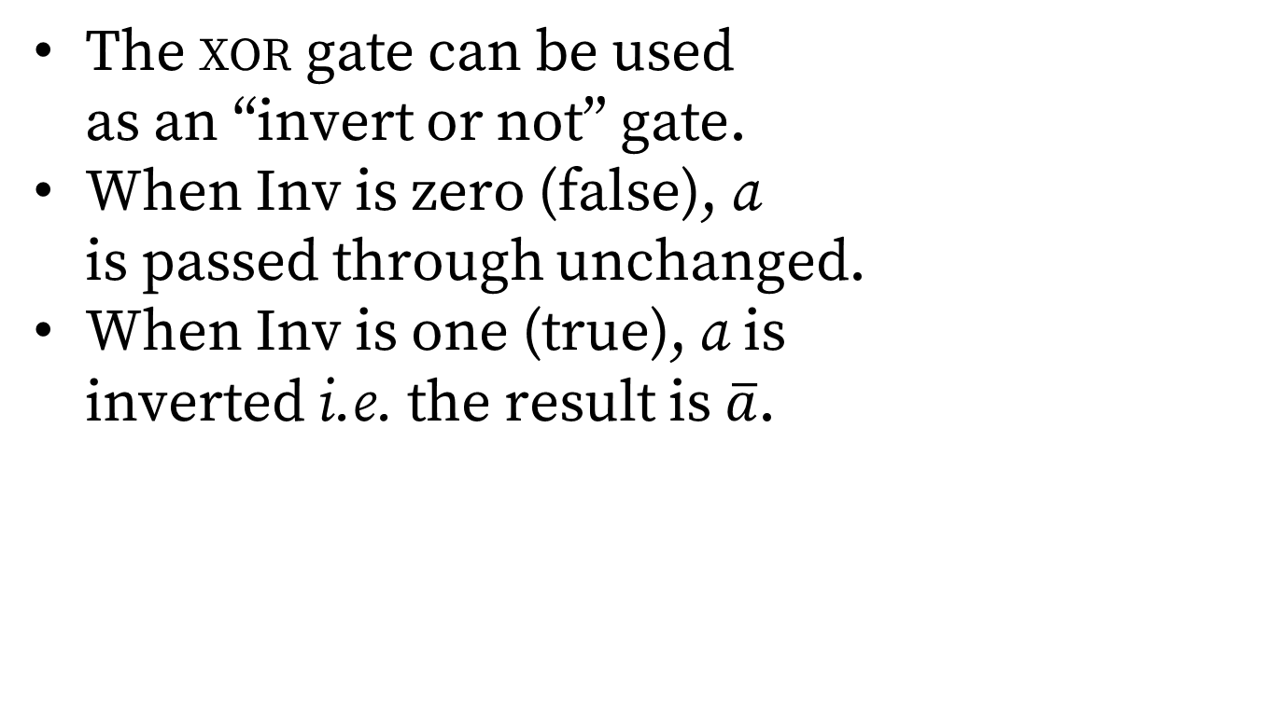
XOR as Controlled Inverter
The xor gate can be used as an “invert or not” gate.
When Inv is zero (false), a is passed through unchanged.
When Inv is one (true), a is inverted i.e. the result is $\overline{a}$.
Inv | A | f
0 | 0 | 0
0 | 1 | 1
1 | 0 | 1
1 | 1 | 0
a Inv
f

Slide 15
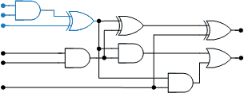
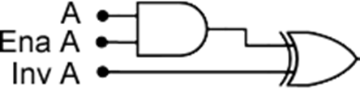
Provide Control Inputs for a
a Ena a Inv a
Two new control inputs:
Enable a passes the a value to the XOR gate that’s a controlled inverter, or sends zero.
Invert a complements (inverts) the a input; this will be used for subtraction.

Slide 16
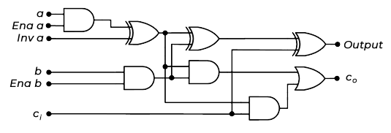
A One Bit (Bit-Slice) ALU
A full adder with three inputs: a, b, c_{i}
Three control inputs:
Enable a
Invert a
Enable b
Output and c_{o}

Slide 17
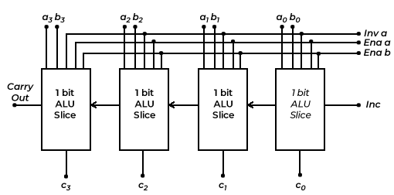
Make the Full ALU from Bit Slices
This is the same principle as the ripple-carry adder. We can have more than four bits.
A new control input, Inc (increment), can place a zero or one on the rightmost carry in.

Slide 18
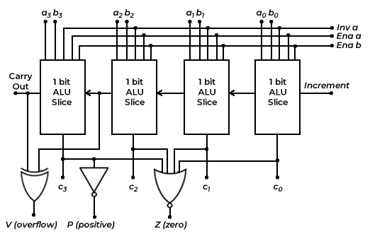
Detecting Overflow, Positive, and Zero
Overflow causes a “program check.” P and Z are stored in a latch whenever a value is stored in Acc, the Accumulator.
Notes:
P, positive, is the NOT of the leftmost output bit. The leftmost bit will be one if the result is negative, so the NOT gate will produce a one or true if the result is not negative. This means zero is positive.
Z, zero, is the NOR of all four result bits. If all are zero, Z will ve true.

Slide 19
About Detecting Overflow
Remember the overflow rule? Changed sign means overflow.
The circuit on the previous slide XORs carry in and carry out of the leftmost bit.
Case 1: 0 carried in and 1 carried out… a_{n-1} and b_{n-1} must both be 1 or negative, but the result will be positive.
Case 2: 1 carried in and 0 carried out… a_{n-1} and b_{n-1} must both be 0 or non-negative, but the result will be negative.
Notes:
The overflow rule for two’s complement addition is: overflow has occurred if two numbers of the same sign are added and the result is of the opposite sign.
A_{n-1} and B_{n-1} represent the leftmost bit, or sign bit, because we started numbering at zero.
xor computes a “not equal” function; it generates a one, or true, when the two inputs are not equal.
The xor gate on the previous slide produces a one, or true, when the carry into the leftmost bit is not equal to the carry out.
When does that happen? There are two cases.
Case 1: If the carry into the leftmost bit is zero, the only way the carry out can be one is if both A and B of the leftmost bit were one, i.e. both negative. The sum of 1+1 (plus zero for the carry in) will be zero with a carry out. The two operands were negative, but the leftmost bit of the result will be zero, or be positive, and overflow has occurred.
Case 2: If the carry into the leftmost bit is one, the only way carry out can be zero is if both A and B of the leftmost bit were zero, i.e. positive. The sum of 0+0+1 will be one. The two operands were positive, but the leftmost bit of the result will be one, or negative, and overflow has occurred.

Slide 20
What Can We Do with this ALU?
 | Ena A | Inv A | Ena B | Inc
Add (A + B) | • |  | •
Subtract (B – A) | • | • | • | •
Copy A | •
Increment A | • |  |  | •
Constant zero
Constant one |  |  |  | •
Constant minus one |  | •
Much more complex ALUs are possible. This one does everything we need using only eight gates per bit! (Plus a few for V, P, Z.)
Notes:
If Ena A and Ena B are true and Inv A is false, the circuit functions as a full adder, adding A, B, and C_{i} to produce the sum at Out and the carry out at C_{o}.
The subtract function applies the subtraction rule for two’s complement numbers, namely take the two’s complement of the subtrahend and add it to the minuend. The ALU forms the two’s complement of A by inverting the A bits using Inv A and adding one by setting Inc. The adder completes the operation.
The copy A function actually computes A+0 by turning off Ena B. A copy B function, not shown in the table, could be implemented similarly.
The Increment A operation enables A and adds one with the Inc control. An increment B function could be implemented similarly.
If Ena A, Ena B, Inv A, and Inc are false, the adder computes 0+0 and emits a constant zero. If Inc is true and Ena A and Ena B are false, the adder computes 1+0, and emits a constant one.
A constant minus one is produced when Ena A and Ena B are both false and Inv A is true. Having Ena A false sends logic zero to the xor gate that serves as a controlled inverter. Inv A changes the zero to a one. Because Ena B is false, the adder computes 1+0 for each position, and produces a string of all ones at the outputs. Recall that a string of all ones is a two’s complement minus one.

Slide 21
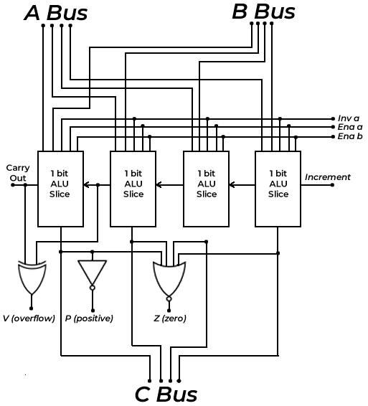
Buses
Bus: just a bunch of conductors carrying related signals.
These buses carry data only.
Other possibilities are, addresses, control and status.
Some buses carry power and ground.

Slide 22
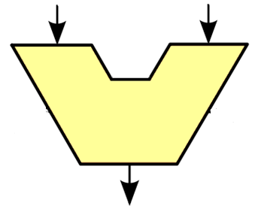
Abstraction: The ALU Symbol
A Bus
B Bus
Control
P, Z, V
C Bus

Slide 23
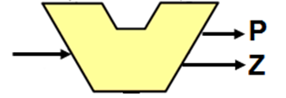
Start with an ALU

Slide 24
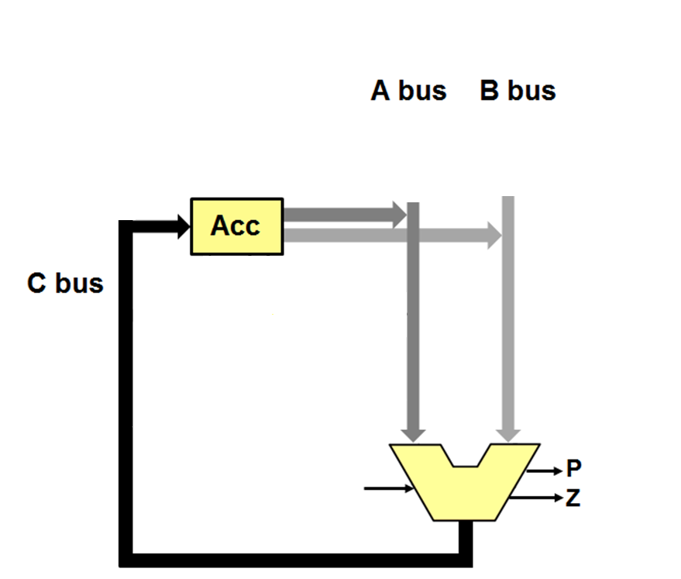
Add a Register and Buses

Slide 25
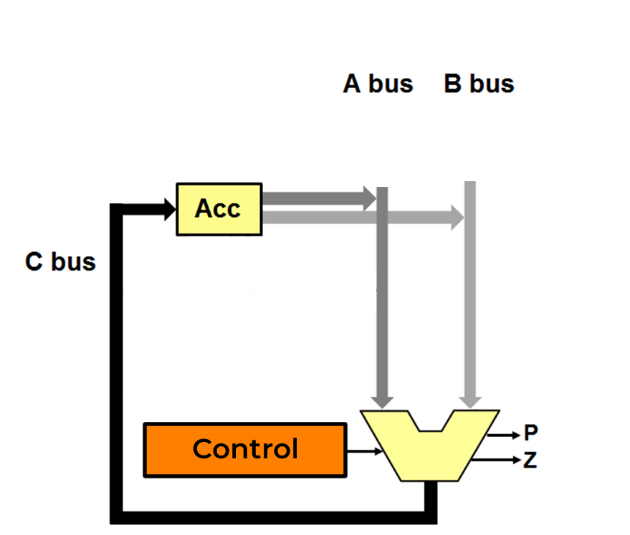
Add a Control Unit

Slide 26
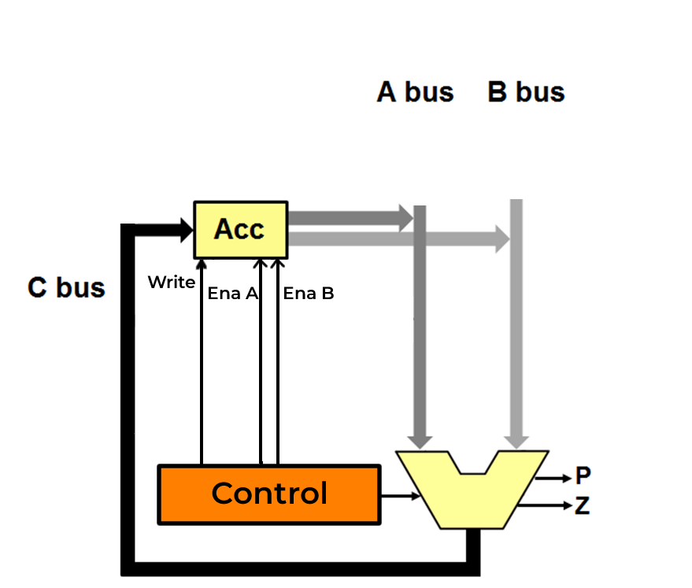
The Control Unit Generates Enable Signals for the Registers

Slide 27
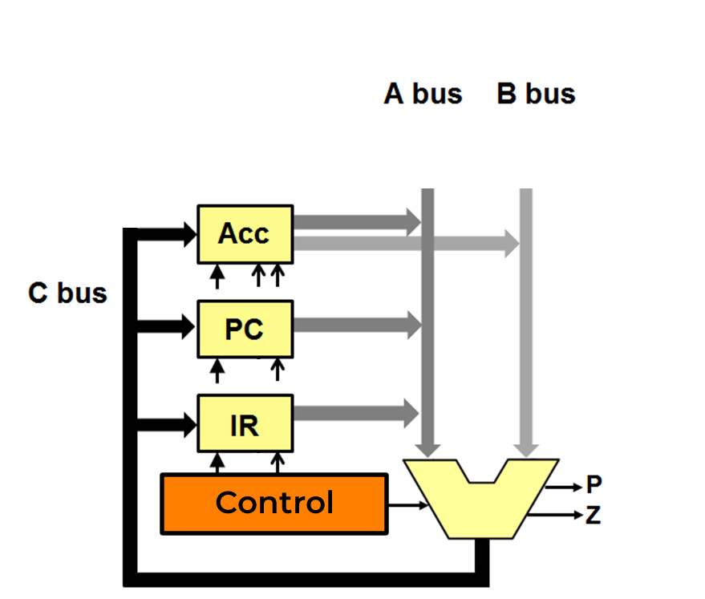
More Registers
Notes:
The “disembodied arrows” connecting to the registers and memory all come from the control unit. Arrows with closed heads indicate loading the register from C at the end of the clock cycle. The open head arrows indicate enabling the register into the A or B bus. For memory, the arrow indicates read or write.

Slide 28
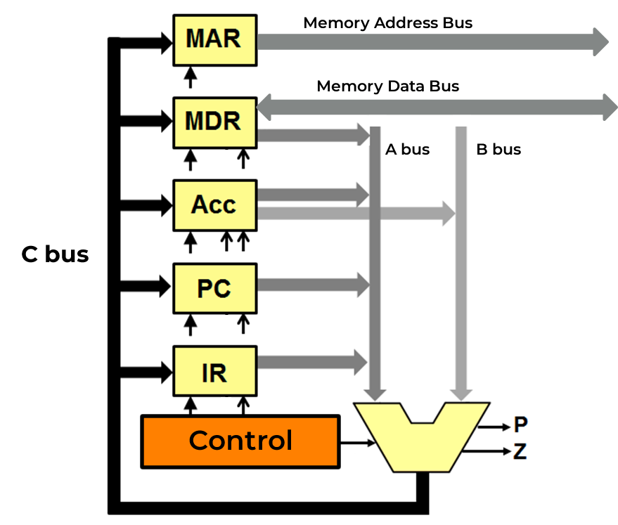
Connecting to Memory
To and from main memory

Slide 29
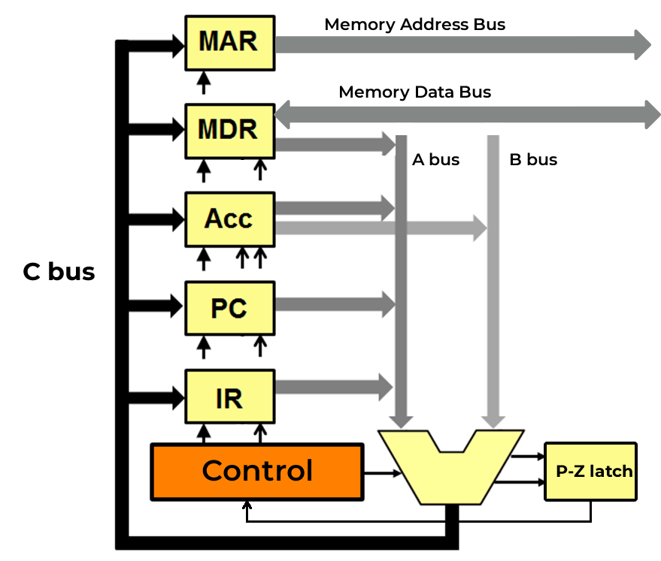
Saving the P and Z Flags
To and from main memory

Slide 30
Data Path: The ALU and Registers
To and from main memory
Notes:
The control unit is not part of the data path.

Slide 31
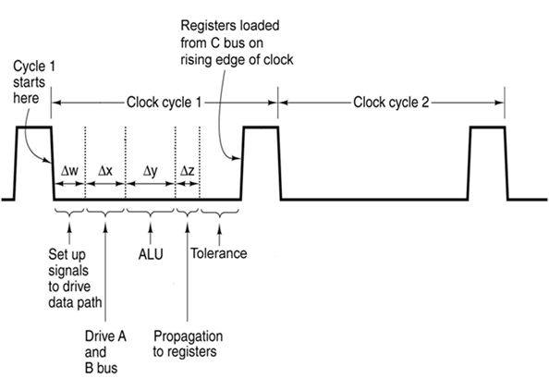
Data Path Timing (The Clock)
Adapted from Tanenbaum, Structured Computer Organization
Notes:
The processor clock in a computer doesn’t tell time, it “ticks” like a metronome, only very fast, to synchronize the internal operations of the computer.
We measure clock speeds in Hertz. “Hertz” is inverse time. So, a 2 GHz clock “ticks” every 1/2 billionth of a second, or every 1/2 of a nanosecond.
Tell about tolerance.
Discuss overclocking and how it:
Narrows the tolerance
Increases heat generation
Overclocking can destroy a chip by generating too much heat, or lead to wrong answers through removing the necessary tolerance
A student looked at this slide and exclaimed, “Oh! I finally understand what a clock is for!”

Slide 32
The Control Unit: Input
The Instruction Register (IR) holds the operation code and operand address.
The control unit receives:
4 bits of operation code from the instruction register.
The P and Z flags from the ALU, stored in a latch.
Three bits of “cycle count” (where are we in the instruction?)

Slide 33
The Control Unit: Output
The control unit generates:
4 bits of ALU control input (EnaA, InvA, EnaB, Inc).
Read, write, and presence-detect signals for memory.
Enable and write signals for the registers.
In this case, a total of 28 bits.

Slide 34
The Instruction Cycle
The von Neumann Instruction Cycle
Fetch: Get an instruction from the memory location pointed by the program counter and advance the program counter.
Decode: Determine what operation code is present, and what data to use.
Execute: Perform the commanded operation.

Slide 35
Register Transfer Language
The basic operation of the execute part of the instruction cycle: send the contents of one or two registers through the ALU.
The result is stored in a register, possibly the same as one of the sending registers.
Data are transformed according to the command (add, copy, etc.) given the ALU.
The “copy” command can move data without changing it.
Register operations are described with RTL

Slide 36
The Instruction Cycle: STORE
Fetch
MAR ← PC (read memory)
PC ← PC+1
IR ← MDR
Decode
Determine next operation
Execute
MDR ← A
MAR ← IR[addr] (write memory)
Notes:
Natural language description and RTL

Slide 37
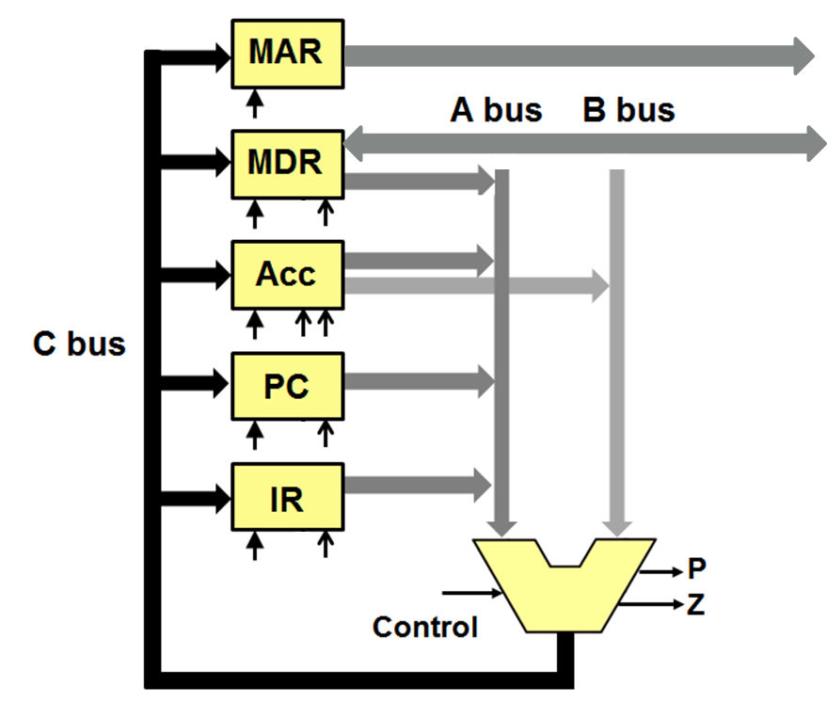
Register Transfer Example: MAR←PC
Write
Ena A
Control
Copy
P/Z Latch
Notes:
In reality, each register has two outputs, A and B, and two Enable lines, Enable-A and Enable-B

Slide 38
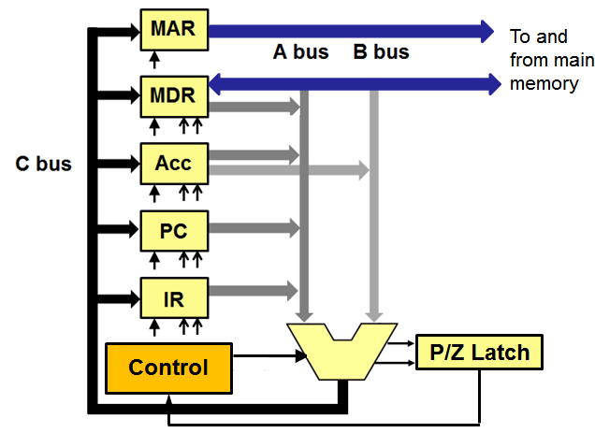
The Datapath Computes PC ← PC+1
Write
Ena A
Incr
Control
Notes:
In reality, each register has two outputs, A and B, and two Enable lines, Enable-A and Enable-B

Slide 39
Introducing TBC!
It’s a “Tiny Binary Computer.”
Starting with a full adder, we built a CPU…
That will execute the LMC instruction set.
It’s a binary computer, like real ones.
There is no “little man” and no magic; it’s all digital logic, with a bit of ROM.
(I-O remains a bit mysterious for the moment.)

Slide 40
It’s a Twelve-Bit Computer
Two’s Complement Integer
Data word
Op Code
Address
Instruction word
11
8 7
0
Four bits of op code (So, 16 combinations.)
Eight bits of address (256 words of memory, but only 128 installed.)
Integer range from –2,048 to +2,047
It will run LMC programs (if reassembled)

Slide 41
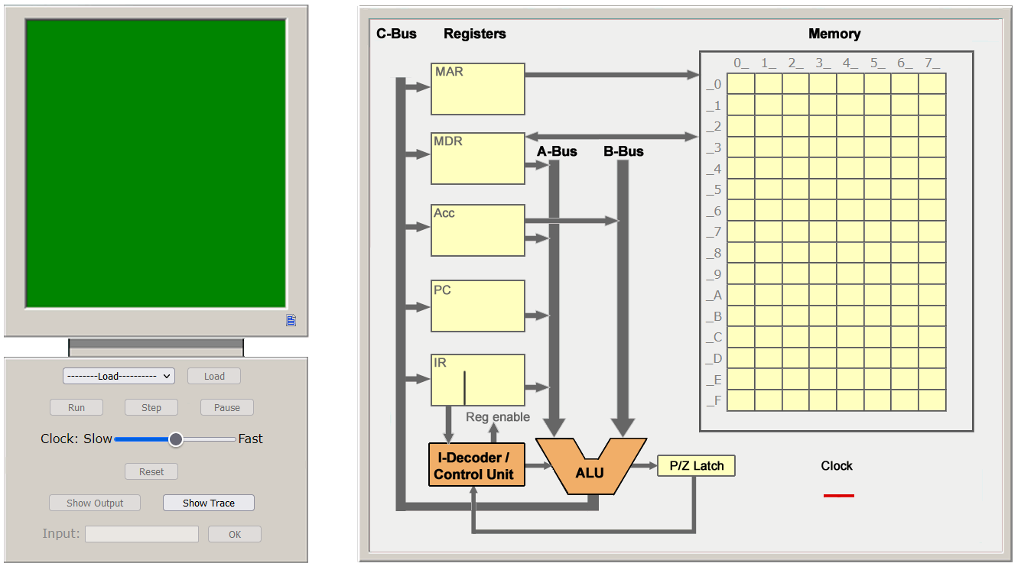
The TBC Simulator

Slide 42
Using the TBC Simulator
It’s on the Web: https://www.professorbrown.net/tbc/tbc.html
Your programs are stored in the browser’s memory.
That means you can’t easily switch computers or even switch browsers.
You can copy information out of TBC’s source code pane and save it with Notepad or another editor.

Slide 43
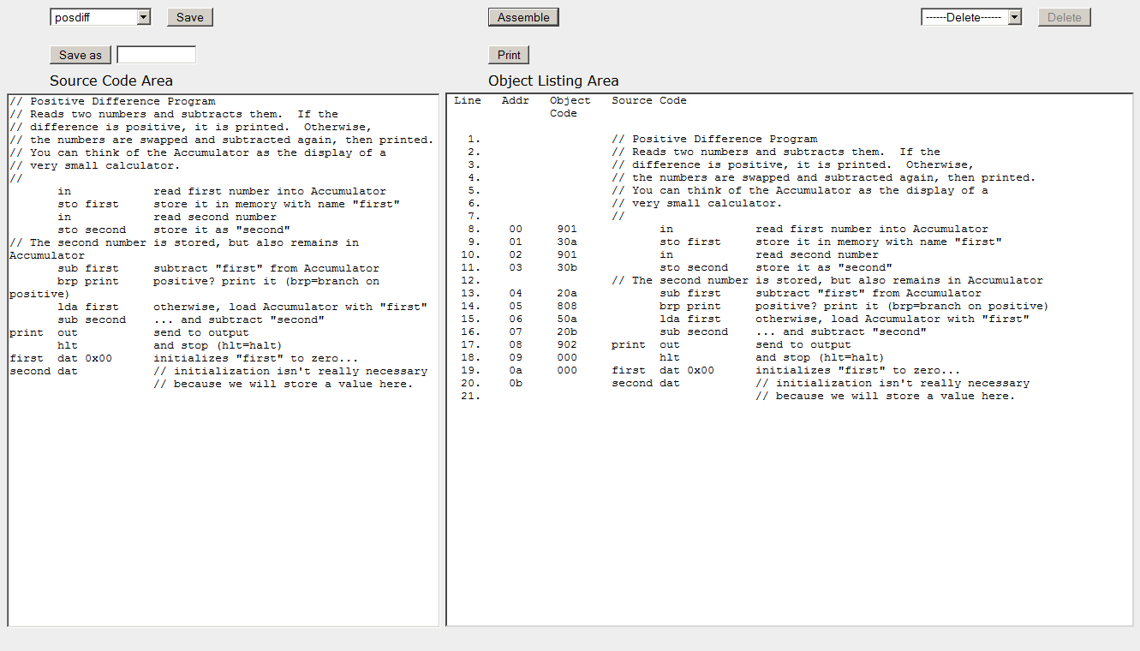
Preparing Programs
Type your source program here. Save it in the browser.
The assembled (translated) program is displayed here when you click the “Assemble” button.

Slide 44
The Assembled Program
Line Addr Object Source Code
Code
1. 00 901 in
2. 01 30a sto first
3. 02 901 in
4. 03 30b sto second
5. // The second number
6. 04 20a sub first
7. 05 808 brp print
8. 06 50a lda first
9. 07 20b sub second
10. 08 902 print out
11. 09 000 hlt
12. 0a 000 first dat 0x00
13. 0b second dat

Slide 45
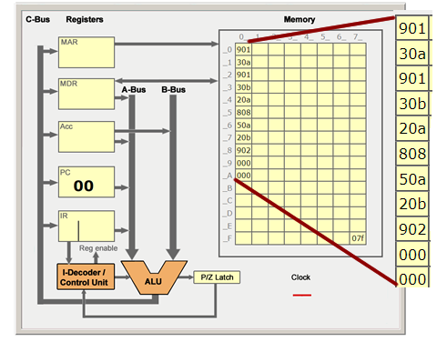
The Program in Memory

Slide 46
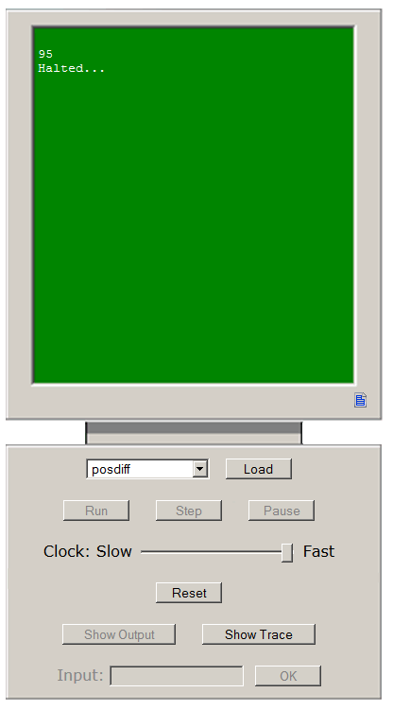
Running Programs
The “Control Panel” lets you load and run assembled programs.
Output is on the screen.
You can change the clock speed.
You can step programs one instruction at a time.

Slide 47
“As close as we can get…”
TBC is very close to a real computer design.
There is no magic
There is very little hand-waving; only in how programs are loaded. (We didn’t discuss the control unit, but it’s not magic!)
In theory, you could go to the digital logic lab and build TBC.
We’ve left out power supplies, clock generator, and some details of bus design. For this course, those are “abstract details.”

Slide 48
Is TBC Realistic?
The first widely successful mini-computer was the DEC PDP-8.
It had an instruction set of eight instructions (smaller than TBC’s).
The PDP-8 could run a complete multi-user operating system.

Slide 49
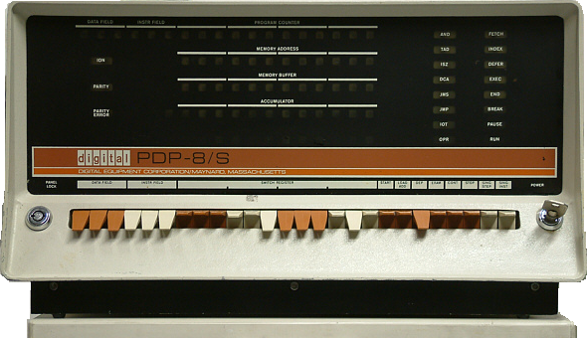
The PDP-8
Notes:
Dead link

Slide 50
Something to Think About
The PDP-8 had an add instruction, but no subtract instruction.
How do you think subtraction was performed?
Hint: the mnemonic for the add instruction was TAD for “two’s complement add.”

Slide 51
The LMC/TBC Instruction Set
Mnemonic Op Code Meaning
HLT 0xx Halt
ADD 1xx Add
SUB 2xx Subtract
STO 3xx Store
LDA 5xx Load
BR 6xx Branch
BRZ 7xx Branch Zero
BRP 8xx Branch Positive
IN 901 Input
OUT 902 Output

Slide 52
A Pseudo-Instruction
The LMC/TBC assembler recognizes the DAT (for “data”) mnemonic.
DAT is not an instruction; it is a command to the assembler to reserve one location for data.
Such assembler commands are called pseudo-instructions
Could also be used to reserve and initialize data, e.g. DAT 001

Slide 53
Previous Semester’s Homework
Part 4: Design a program that displays the even numbers counting downward from 20 to zero using the LMC / TLC instruction set and looping. The program must halt after displaying zero. Write and turn in as the answer to this part the pseudo-code for your solution.

Slide 54
The Expected Result
20
18
16
14
12
10
8
6
4
2
0

Slide 55
Elements of the Problem
Start at 20
Count down
Even numbers only
Use a loop
Stop after displaying zero

Slide 56
Pseudo-Code for Data
Number? 20 to start
Value to subtract? 2

Slide 57
Pseudo-Code for Instructions
print print the current value
was it zero?
if yes, stop
subtract 2
go to print
Remember, data goes at the end!

Slide 58
One Way to Approach This
lda number print out brz done sub two br print done hlt
number dat 20
two dat 2

Slide 59
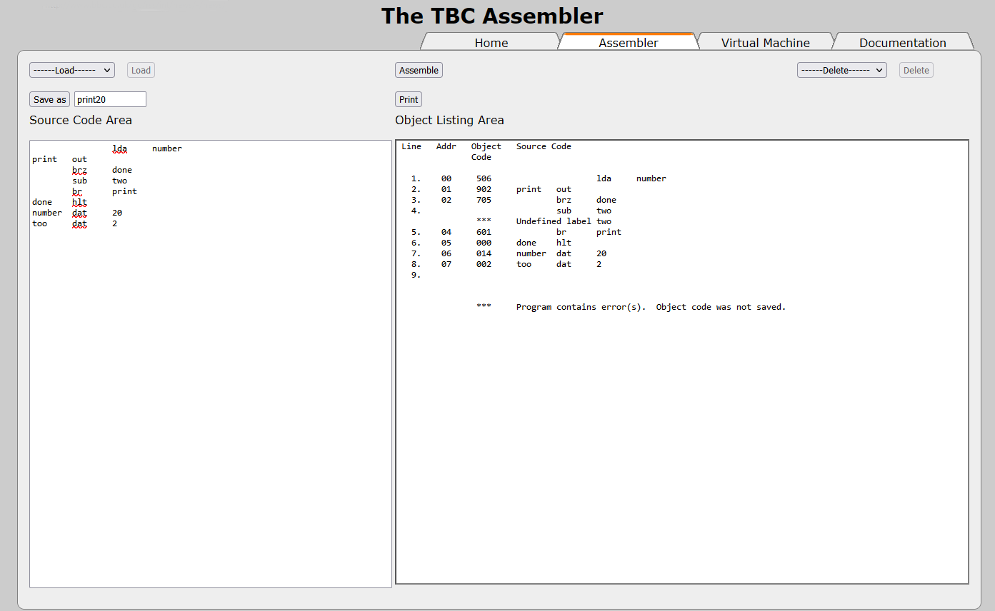
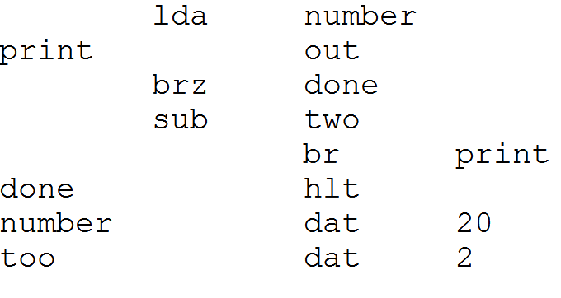
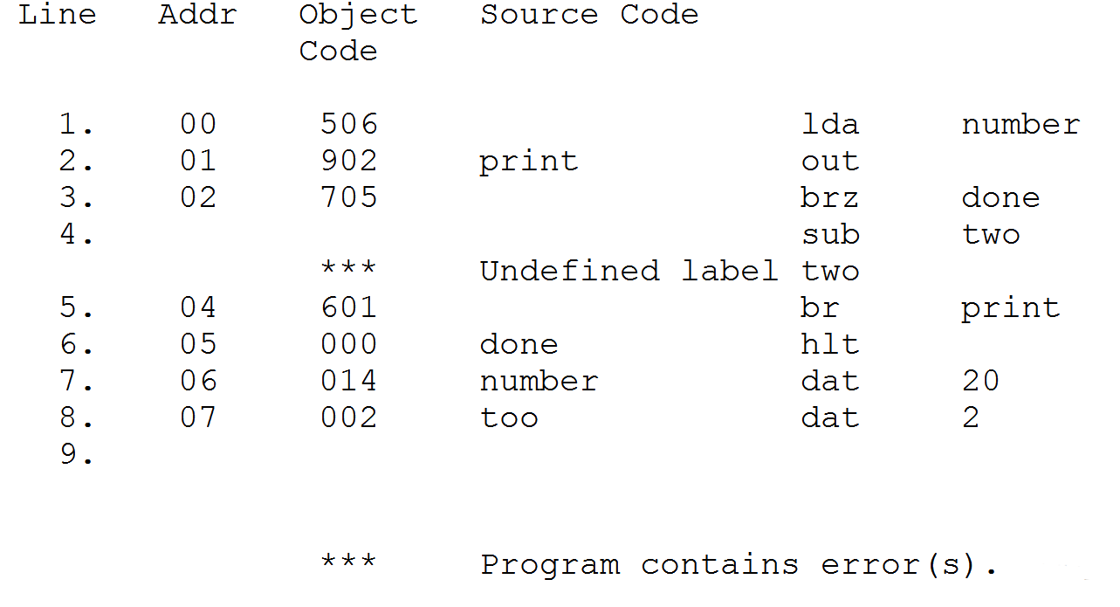
Assembling the Program (Error!)
Notes:
“two” was misspelled the first time. The error message was where “two” was used, not where we tried to define it.

Slide 60
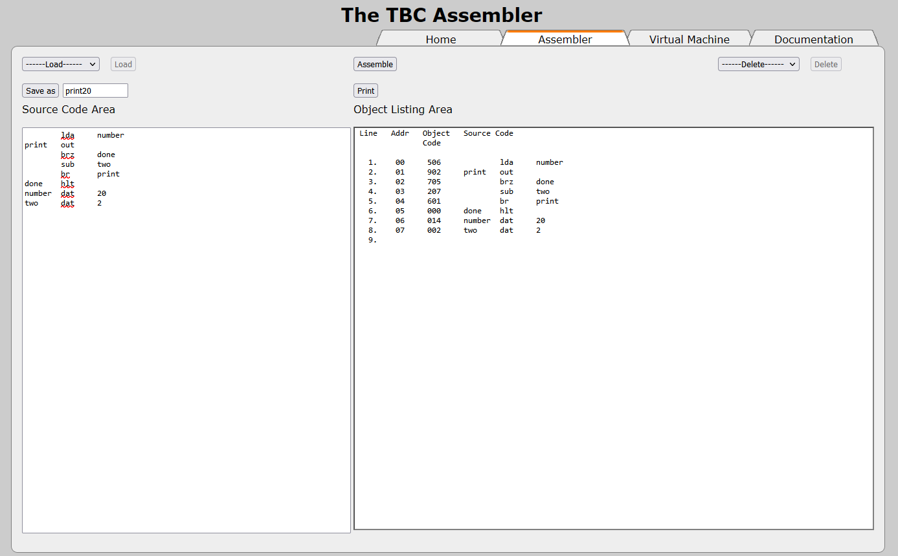
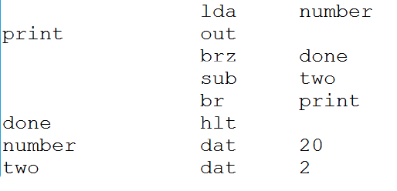
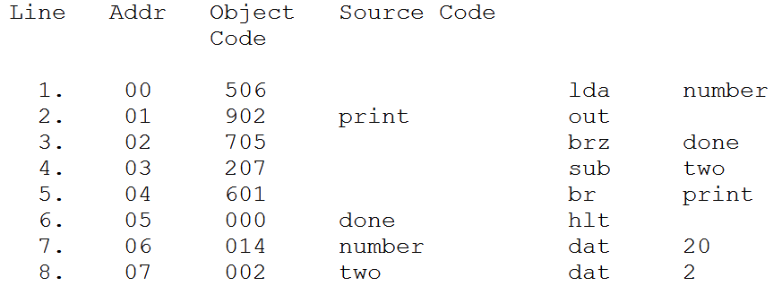
Assembling the Program

Slide 61
The Object Listing Area

Slide 62
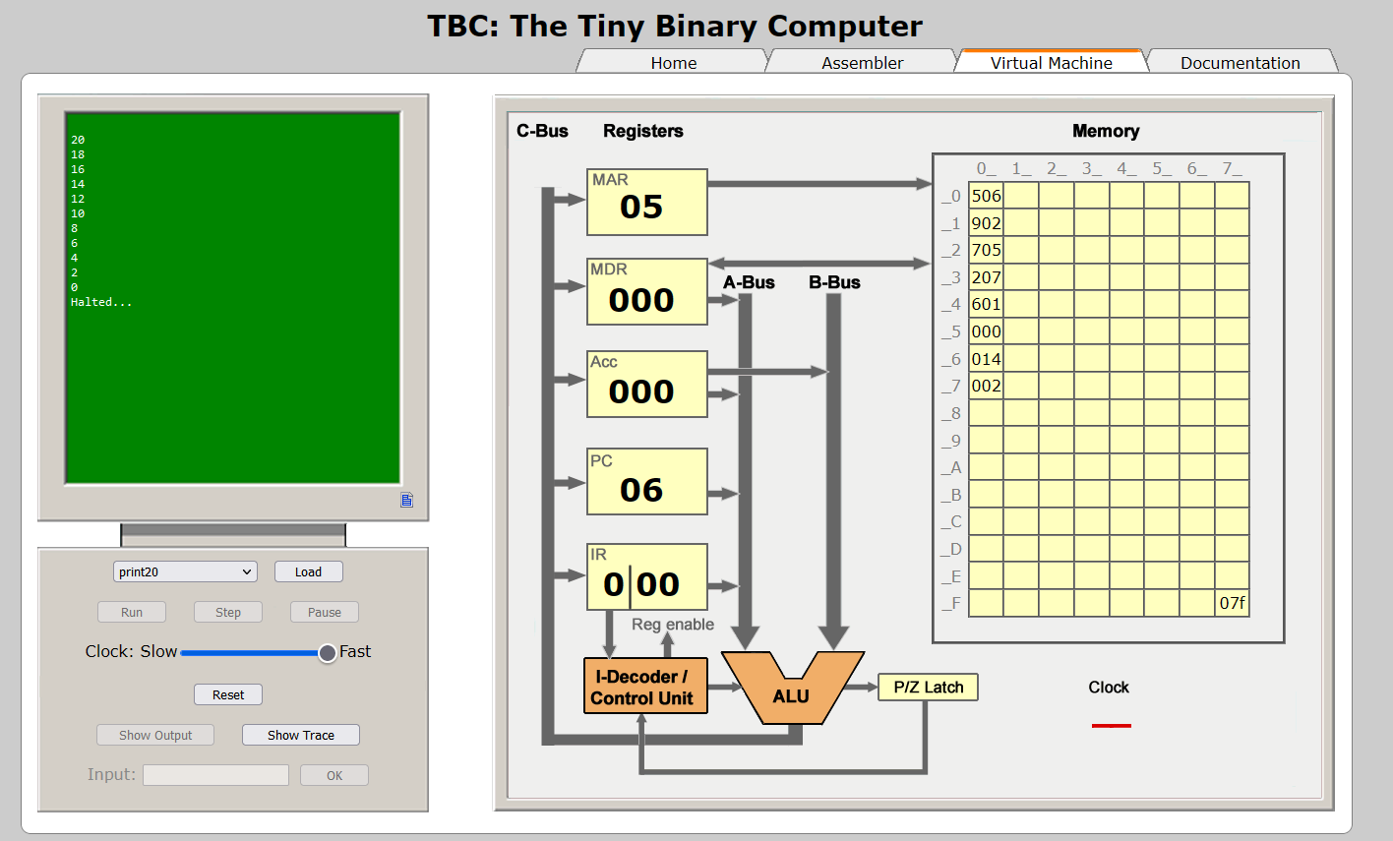
Run the Program

Slide 63
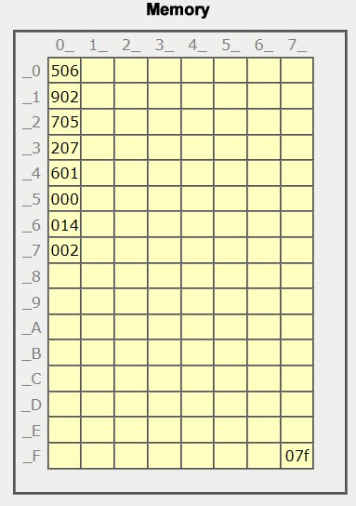
TLC’s Memory at the End

Slide 64
What If…
What if we were asked to stop at a number other than zero?
We’d have to:
Save the current number to memory
Subtract the “stop limit” from it
Branch on zero (numbers were equal)
If not zero, restore the current number from memory

Slide 65
Why This Is Important
Three important facts…
Grace Murray Hopper helped with the invention of compilers so that we wouldn’t have to program in assembly language.
A high-level language introduces a layer of abstraction between hardware and software.
Wirth’s Law: Software is getting slower faster than hardware is getting faster.

Slide 66
Why This Is Important
Assembly language programming, even just a little bit of it, helps one understand how the CPU and memory operate.
People who understand how the CPU and memory operate are better able to evaluate new technologies.
People who understand how the CPU and memory operate are better able to write, or evaluate, efficient software.

Slide 67
Questions

