Slide 1

IT 3123 Hardware and Software Concepts
The von Neumann Architecture
Notice: This session is being recorded.
Notes:
Time: 1:08

Slide 2
Quiz 3 and D2L Discussions
Available tomorrow, Valentine’s Day.
Due Wednesday, February 15 at 11:59 PM.
Includes two’s complement!
Includes today’s material!
The Instructor’s Office topic in D2L now allows anonymous posts. Please ask questions!
Beware! Although I cannot see who’s posting, the folks in UITS can.

Slide 3
That Floating-Point Problem
0 000010 ^10000
The sign is 0 if positive, 1 if negative.
The exponent value is two to the value given, 2E.
The fraction is multiplied by the exponent value.
Remember, you can resubmit until 11:59 PM today.
And… about writing…
Sign
Exponent
Fraction
Implied binary point

Slide 4
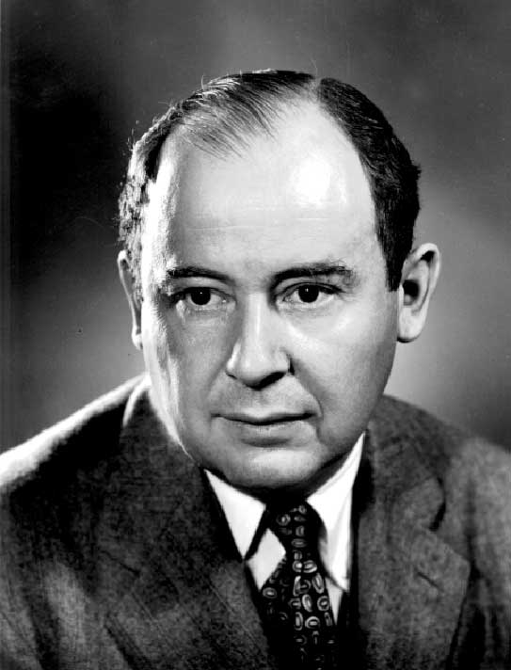
John von Neumann
Hungarian-born American mathematician and mathematical physicist.
Many contributions to mathematics, physics, and game theory.
The short book, First Draft of a Report on the edvac, describes how most computers have been designed ever since.
It is called the von Neumann Architecture.
Notes:
Von Neumann may have been the smartest person of the 20th century and is certainly in the top ten.
Von Neumann wrote “First Draft” and only his name appears on it, but it includes the ideas of many people. It is doubtful that von Neumann meant to claim credit for those ideas, given the “first draft” title. You can read “First Draft” on line or even buy a printed copy on Amazon. https://people.csail.mit.edu/brooks/idocs/VonNeumann_EDVAC.pdf
EDVAC was “Electronic Discrete Variable Automatic Computer.”

Slide 5
Complexity and Simplicity
Computers perform immensely complex tasks.
However, they can perform only a few, relatively simple operations (a few dozen to a few hundred).
Complexity is built out of these simple operations, which can be performed very fast.
The set of operations a particular computer can perform is called its instruction set.

Slide 6
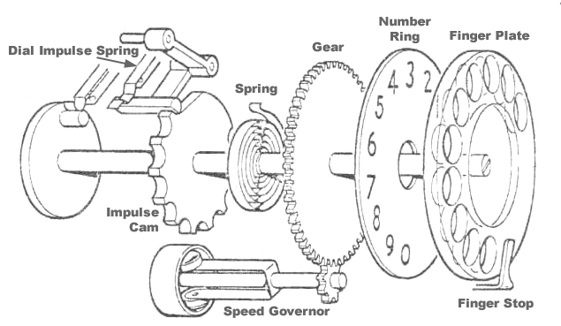
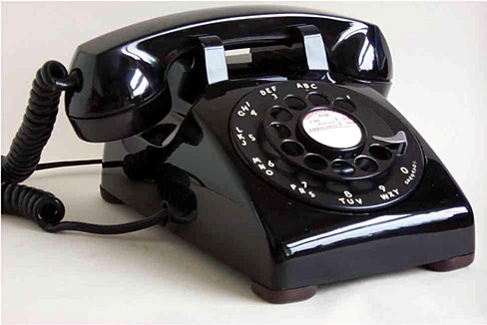
Simple Operations: Complex Results

Slide 7
One Mental Model of Computing
How the CPU processes data, including:
Instructions and data
Main memory (RAM)
Computation
Input and output
Program flow (loops and if-then-else)

Slide 8
The von Neumann Architecture
Stored program concept: Both instructions and data are stored in the same memory
Sequential execution; instructions executed in order.
Instruction cycle
Fetch instruction
Decode instruction
Execute instruction
Binary numbers
The CPU, memory, and input / output are separate.

Slide 9
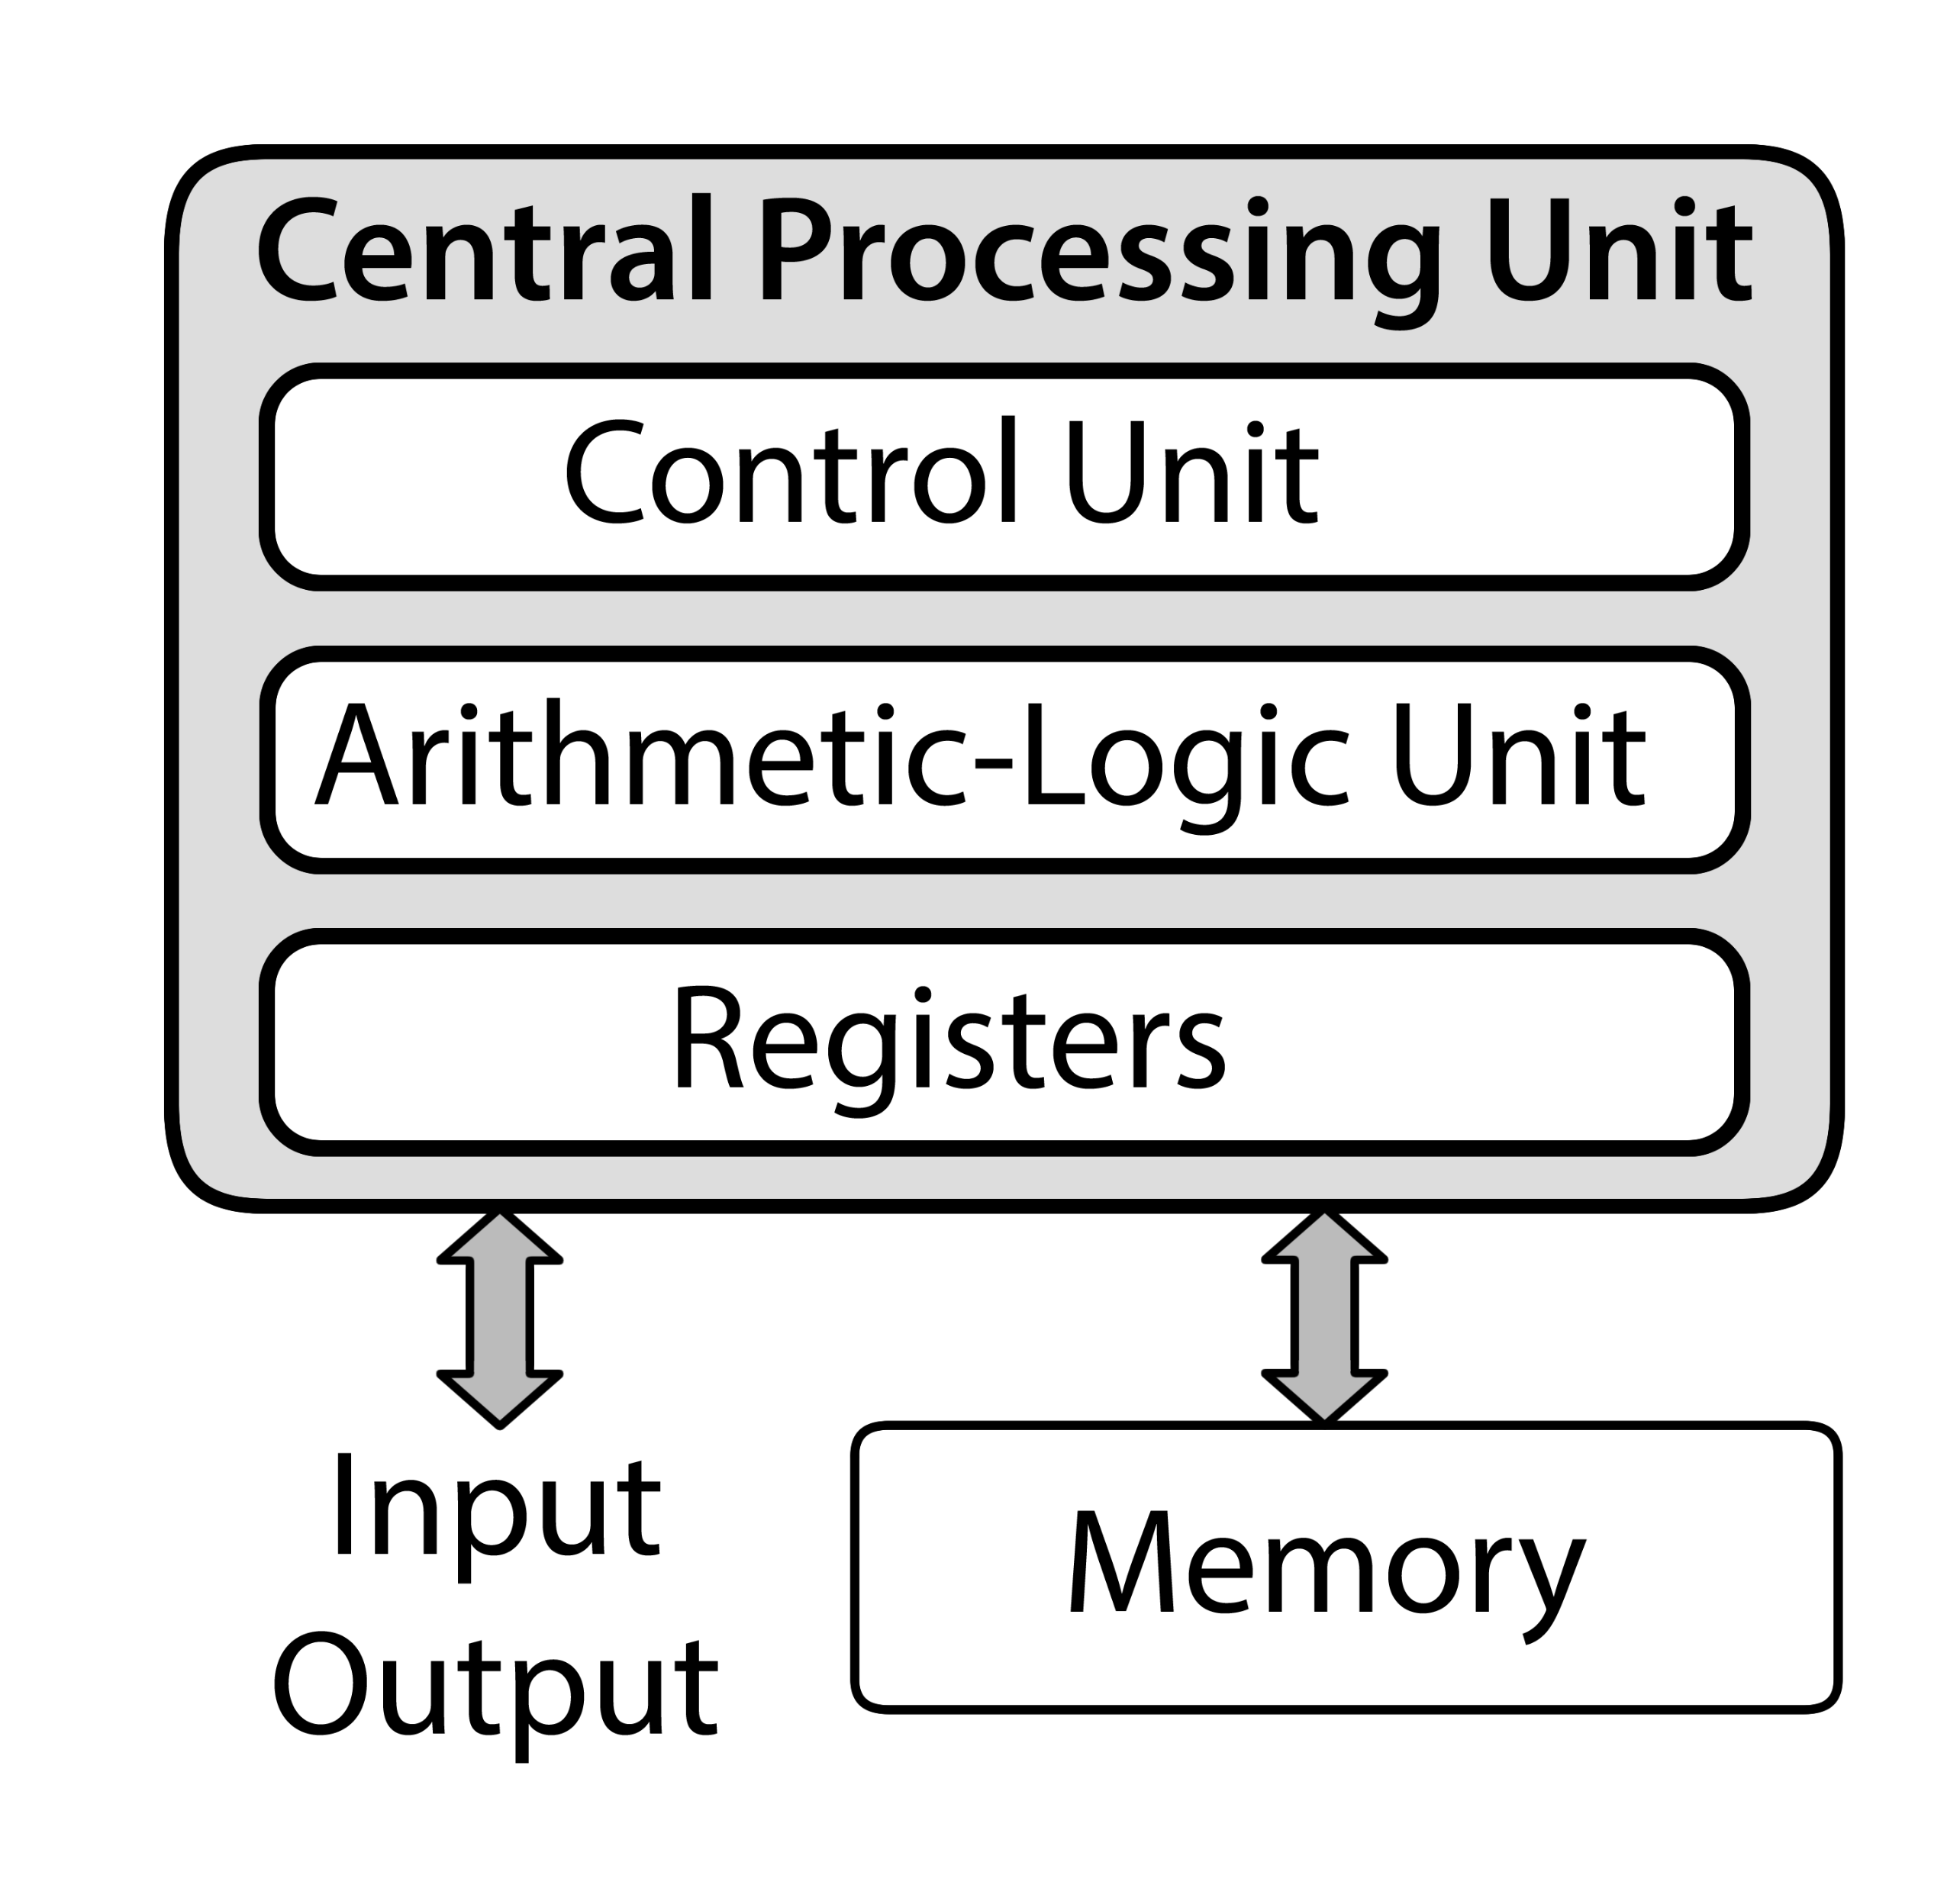
Organization of the von Neumann Architecture
The central processing unit (CPU) consists of a control unit, an arithmetic-logic unit, and registers.
Memory is separate.
Input and output are separate.

Slide 10
The von Neumann Bottleneck
The connection to memory is used for both instructions and data.
Mitigation:
Cache memory
On-chip memory
Split cache or memory.
Notes:
Having two memories, one for data and one for instructions, is called the Harvard Architecture.

Slide 11
The Instruction Cycle
Fetch an instruction from memory.
Decode the instruction.
Execute the decoded instruction.
The instruction cycle is executed repeatedly for as long as the computer is running.

Slide 12
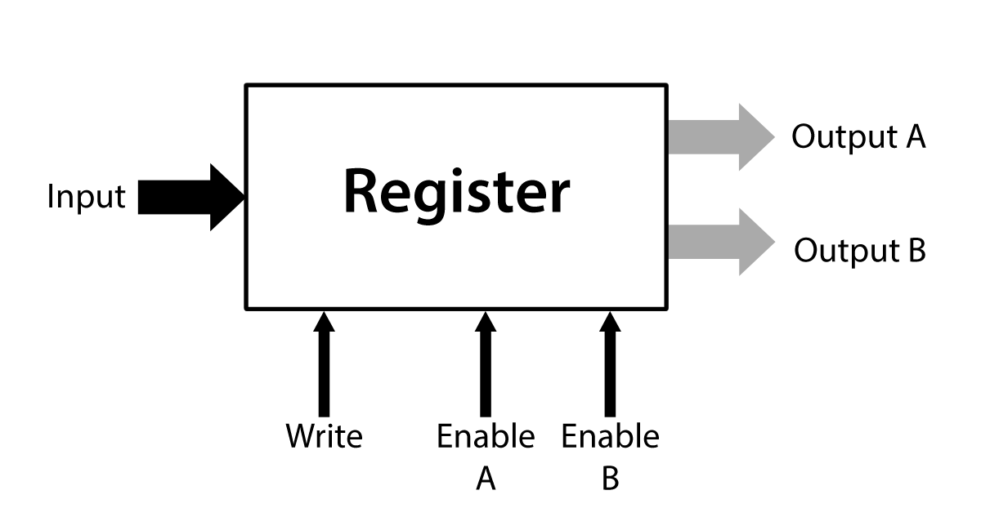
Reminder: Registers
Small, fast storage within the CPU.
From “a few” to a few hundred registers.
One input, one or two outputs.
Conceptually, the right number of latches.
From “a few” to 64 or more bits wide.
“Fat arrows” indicate multi-bit paths.

Slide 13
Registers in the von Neumann Architecture
The von Neumann Architecture needs (at least) five registers.
Memory address register.
Memory data register.
Accumulator.
Program counter.
Instruction register.

Slide 14
Memory Registers
The memory address register holds an address in memory:
From which to read data
To which to write data
The memory data register holds data or instruction words:
Read from memory
To be written to memory

Slide 15
Data Registers: Accumulator
How many: between one and around a hundred. 16 or 32 is typical. Some computers have 64 or even 128.
The original von Neumann architecture had one data register.
When a computer has only one data register, it is called an accumulator.

Slide 16
Program Counter
Holds the address of the next instruction
Updated shortly after an instruction is fetched
Can be changed (by the CPU) to implement branching.

Slide 17
Instruction Register
Holds the instruction fetched from memory and currently being executed.
Having the instruction in a CPU register allows it to be decoded…
… and provides the information necessary to execute it.

Slide 18
The Arithmetic Logic Unit (ALU)
Performs arithmetic operations, such as addition, on data
Performs logical operations (complementation, if-statements, etc.)
Can be used to transfer data
Within the CPU
From CPU to I-O

Slide 19
The Control Unit
Controls the processing of instructions by
Generating the control signals to select one operation of the ALU.
Generating control signals to send data to the ALU.
Generating control signals to store the results from the ALU.

Slide 20
Memory
Also know as:
RAM (Random Access Memory)
Main memory
Primary storage
Memory locations are of fixed size.
Words, which are composed of several
Bytes (octets)
Holds instructions (in machine language) and data for running programs

Slide 21
Size Matters
The sizes of key items establish maxima for the computer design.
A 32-bit program counter or address register can address no more than 2³² items, or 4,294,967,296.
A 16-bit signed integer can hold only −32,768 to +32,767.
You will find this kind of limit in every part of hardware and software design.

Slide 22
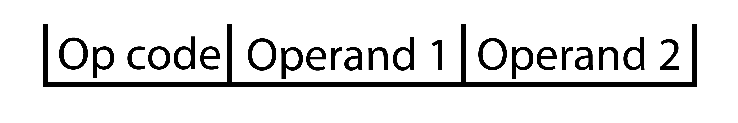
Instructions
Memory can hold both data and instructions.
Instructions consist of an operation code and one or more operands.
The operation code tells what operation the CPU is to perform.
The operands either give the location of data or contain the data.
Op code and operands are binary numbers.

Slide 23
Instruction Formats
Instructions may be fixed or variable length.
Operation code and operands are binary numbers.
The size of each part (in bits) is important.
Example: If a computer has a 6-bit operation code field, there can be no more than 2⁶ or 64 different operation codes.
Example: A 4-bit register address field means no more than 2⁴ or 16 registers.

Slide 24
Instruction Set Architecture
The instruction set architecture of a computer family describes:
The operations a computer can perform.
The format(s) of instructions available.
The formats of the data allowed.
Modern computer families are made backward compatible: new instructions may be added, but old programs still work.

Slide 25
Microarchitecture
The instruction set architecture describes what a computer can do.
The microarchitecture describes how that is accomplished.
Example: a computer may have a hardwired control unit or a microprogrammed control unit that function identically.
The hardwired control unit will be faster but more expensive.
Notes:
IBM’s System/360 took great advantage of the difference between instruction set architecture. They had a series of machines from relatively slow and relatively inexpensive to very fast and expensive, all with the same instruction set architectures, but with very different microarchitectures.

Slide 26
The “Little Man” Computer
Devised in 1965 by Stuart Madnick at MIT to teach computing.
It imagines a computer as a room with
A calculator
In and out baskets
Mailboxes for storage
A program counter.
A “Little Man” performs operations on these.

Slide 27
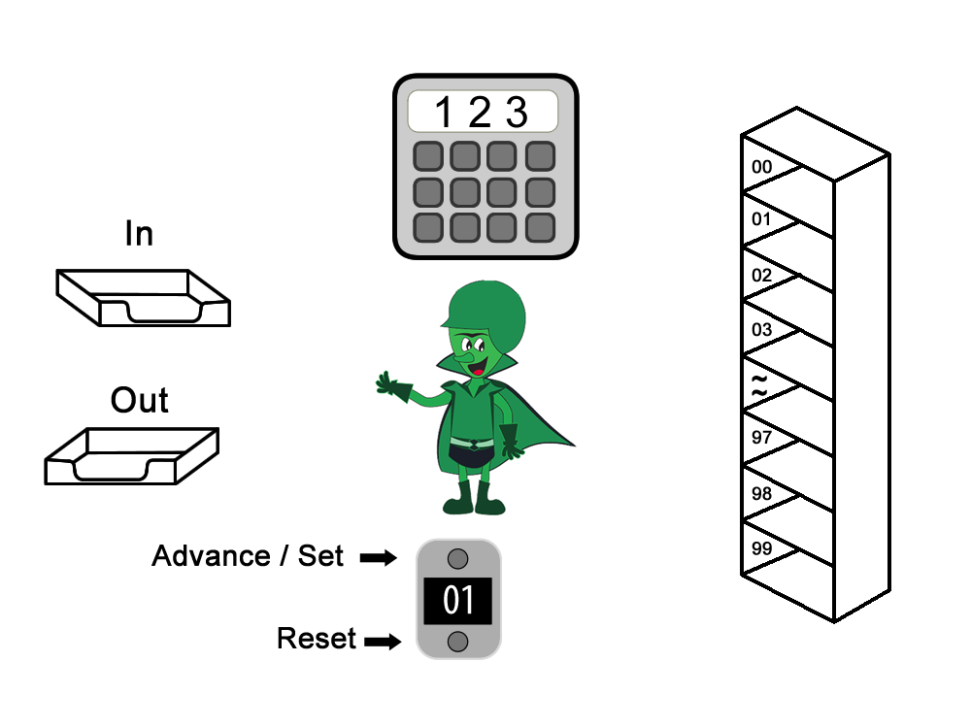
LMC is a von Neumann Computer
Arithmetic Logic Unit
Only Labels
Memory
Input and Output
Control and Interface
Program Counter

Slide 28
The Calculator (ALU)
Three digits only.
Can display a minus sign.
No provision for entering negative numbers.
No memory other than the number being displayed.

Slide 29
The Calculator (ALU)
Three operations:
Entry: a new number is typed in; it appears in the display remains there until changed, i.e. it is stored.
Add: A number is typed in and added to the number displayed; the sum replaces the number displayed.
Subtract: a number is typed in and subtracted from the number displayed. The difference replaces the number displayed.

Slide 30
Mailboxes (Memory)
Addresses are consecutive (00-99)
Each box can contain one and only one slip of paper (data word)
Data words are three decimal digits
May be either instructions or data
The memory doesn’t “know” which.
Address | Content
49 | 199
50 | 325
51 | 901

Slide 31
The Program Counter
Two digits
Can be advanced by one unit
Can be set to an arbitrary two-digit number
Can be reset to zero from outside

Slide 32
Input and Output
An input basket
An output basket
Limited to three-digit numbers
Only one three-digit number at a time

Slide 33
The “Little Man”
Performs both Control Unit and Interface functions.
Can do the following:
Operate the calculator (ALU)
Read and update memory
Get data from the input basket
Put data in the output basket
Read, advance, and set the counter
“Knows” at most ten commands

Slide 34
Memory Words as Instructions
A memory word can be thought of as:
A three-digit number, or
A one-digit number and a two-digit number
If the program counter points to a particular memory word, it is considered to be:
A one-digit operation code, and
A two-digit address
Together, the two parts are called an instruction.

Slide 35
Instruction Decoding
Interpreting (understanding) an instruction is called instruction decoding.
Suppose the program counter contains 50
And memory looks like this:
Address | Content
49 | 199
50 | 325
51 | 901

Slide 36
Instruction Decoding
325 is considered to be a one-digit operation code and a two-digit address.
The op code (3) is a command to the Little Man, or CPU
The address (25) is a mailbox number, or memory address.
The command will use the specified address when performing the operation
Operation code 3 25 Address

Slide 37
The STORE Instruction
In LMC, operation code 3 is the STORE instruction. (Because the designers of LMC selected 3 to be STORE, that’s why.)
The STORE instruction stores the contents of the calculator (ALU) in the specified memory address.
So, 3 25 means store (3) the number displayed by the calculator in mailbox 25.
Another mailbox could have been selected by using a number other than 25.

Slide 38
The Semantics of STORE
The Little Man reads the number displayed by the calculator,
writes it on a slip of paper,
and places the paper in the mailbox named by the address part of the instruction, in this case, 25.
The previous contents of mailbox 25 are destroyed (important concept!)
The number displayed by the calculator is unchanged.

Slide 39
The LMC Instruction Set
0xx Halt (stop working)
1xx Add memory content to calculator
2xx Subtract content from calculator
3xx Store calculator value at address
5xx Load calculator from address
6xx Branch Always (unconditional)
7xx Branch if zero
8xx Branch positive (zero is positive)
901 Input (In basket to calculator)
902 Output (Calculator to out basket)
Notes:
What about 4xx?

Slide 40
A Simple Program
Objective: Add two numbers, output the sum
Address Content Meaning 00 901 input a number 01 399 store number in box 99 02 901 input another number 03 199 add contents of box 99 04 902 output from calculator 05 000 halt 99 ??? data storage

Slide 41
Two Things to Notice
The Little Man need not be intelligent; all he does is:
Read memory pointed by program counter
Advance the program counter
Perform one of a very few operations as commanded by the operation code
Separate equipment (like the calculator) does the real work
The same steps are repeated for each instruction.

Slide 42
The Instruction Cycle
The Little Man does three things repeatedly
Fetch: Get an instruction from the memory location pointed by the program counter and advance the program counter.
Decode: Determine what operation code is present, and what data to use.
Execute: Perform the commanded operation.

Slide 43
Program Flow Control
Three control structures are sufficient for all correct programs (Böhm and Jacopini, 1966)
Sequence: one instruction after another
Selection: if-then-else
Iteration: loops that repeat
The program counter automatically provides sequence. (von Neumann’s idea of sequential execution.)
Notes:
Böhm and Jacopini’s proof is called the Structured Programming Theorem.

Slide 44
The Branch Instruction
The branch instruction (operation code: 6) unconditionally changes the program flow.
The address part of the instruction is loaded into the program counter. (The address digits are not used to refer to data in this case.)
There are also conditional branches.
Branches implement selection and iteration.

Slide 45
Branch Instruction Example
Location Contents 50 6 75
The instruction at location 50 says that the next instruction should be fetched from location 75
The Little Man fetches the instruction from location 50
The Little Man advances the program counter (now points to 51)
The Little Man executes the command: changes the program counter to 75

Slide 46
Advancing the Program Counter
In a real computer (and in this description) the program counter is advanced during the fetch or decode part of the instruction cycle, i.e., before the execute part.
This is because the execute part might change the program counter.
So, the program counter always points to the next instruction to be executed.
Notes:
Advancing the program counter in every instruction cycle, rather than conditionally, allows the control unit to be simpler.

Slide 47
Instruction Mnemonics
Remembering the operation codes is tedious. (It gets worse if there are a lot of them!)
The word mnemonic means “an aid to memory.”
“Instruction mnemonics” are abbreviations that take the place of numeric operation codes.

Slide 48
The LMC Instruction Mnemonics
0xx HLT Halt (stop working)
1xx ADD Add memory content to calculator
2xx SUB Subtract content from calculator
3xx STO Store calculator value at address
5xx LDA Load calculator from address
6xx BRA Branch Always (unconditional)
7xx BRZ Branch if zero
8xx BRP Branch positive (zero is positive)
901 INP Input (In basket to calculator)
902 OUT Output (Calculator to out basket)
Notes:
What about 4xx?

Slide 49
Assembler Programs
An assembler is a computer program.
It reads a computer program written in instruction mnemonics. (The source program.)
Its output is the same program but translated to numeric operation codes. (The object program.)
Assemblers also provide for giving symbolic names to memory locations.
An assembler is the simplest language translator.

Slide 50
A Pseudo-Instruction
The LMC assembler recognizes the DAT (for “data”) mnemonic.
DAT is not an instruction to the Little Man; it is a command to the assembler to reserve one location for data.
Such assembler commands are called pseudo-instructions
Could also be used to reserve and initialize data, e.g. DAT 001

Slide 51
The Addition Program
Here is the addition program in the assembly language of LMC.
Instruction Meaning INP input a number STO 99 store number in box 99 INP input another number ADD 99 add contents of box 99 OUT output from calculator HLT halt DAT data storage

Slide 52

Problems with LMC
LMC is a decimal computer, but all real computers are binary.
There is a certain amount of “magic” in the actions of the Little Man, but no magic in real computers.
The available simulators do not show the fetch / decode / execute cycle clearly.
So… we’ll do something else!

Slide 53
“Bootstrapping”
We have skimmed over how programs get into the computer in the first place
Computers (usually) have a small, built-in program that can read another program from outside, such as from a disk.
This process is called “bootstrapping” or “booting” the computer.
After the computer is bootstrapped, the externally loaded program is responsible for loading any other needed programs.

Slide 54
Questions

