Slide 1

IT 3123 Hardware and Software Concepts
Sequential Circuits and Memory
Notice: This session is being recorded.
Notes:
Time: 0:51

Slide 2
Quiz 3 and Review
Quiz 3, due Feb 15, will include two’s complement. (Because I failed to put it in Quiz 2, that’s why.)
You should already have studied this in preparation for Quiz 2.
We will have a review for Exam one of February 15 because we are ahead of the original syllabus schedule.

Slide 3
Office Hours
I’ve finally found a place.
I will be in J-353 B-C from 2:00 until 2:55 on Monday and Wednesday.
I will be in this room, J-213, a few minutes after 3:00.
I am still available by appointment at other times.

Slide 4
Why do the Reading?
No one has reported any errors in the book.
Are you reading it?
You should… here’s why.
If you do the readings before class, you will be able to identify any concepts that are unclear to you.
And then you’ll have a chance to ask questions in class!
Besides, there might be questions on the exam.

Slide 5
Combinational Circuits
A combinational circuit is a digital logic circuit the output of which is determines solely by its inputs.
Implication: combinational circuits have no memory.

Slide 6
Sequential Circuits
Sequential circuits have memory, or “maintain state.”
This is possible due to feedback; an output of the circuit is fed back to one of the inputs.
Truth tables are not applicable to sequential circuits.
Instead, a state table that has the output on both input and output sides is used.

Slide 7
Reminder: the nor Gate
a​ | b​ | f(a,b)​
0​ | 0​ | 1​
0​ | 1​ | 0​
1​ | 0​ | 0​
1​ | 1​ | 0​
a
a+b
b
The output of nor is one or true only when both inputs are zero or false.

Slide 8
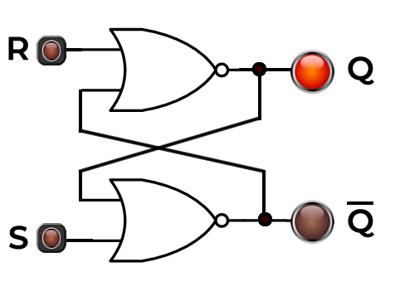



Introducing the S-R Latch
Feedback
The S-R latch has two stable states. It is bistable.

Slide 9
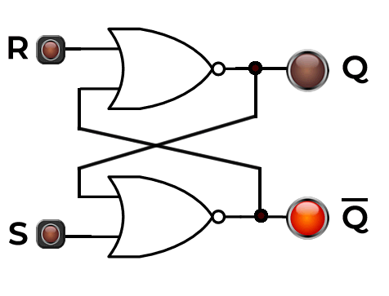
S-R Latch Sequence

Slide 10
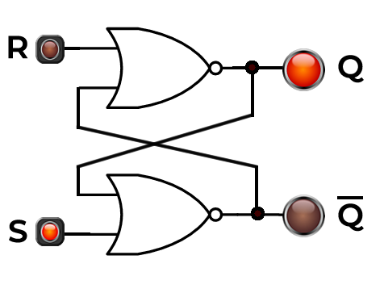
S-R Latch State Table
S | R | Q | Q'
0 | 0 | 0 | 0
0 | 0 | 1 | 1
0 | 1 | 0 | 0
0 | 1 | 1 | 0
1 | 0 | 0 | 1
1 | 0 | 1 | 1
1 | 1 | 0 | X
1 | 1 | 1 | X

Slide 11
Problems with the S-R Latch
You must have S and R; we’d really like to store a bit.
S= 1 and R = 1 not allowed, but nothing prevents that.

Slide 12
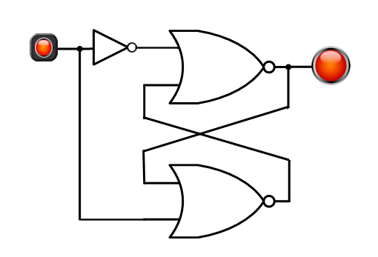

That 1-to-2 Decoder
We don’t need Q.
This fixes S=R=1, but now the output follows the input; no storage.
R
D
Q
S

Slide 13
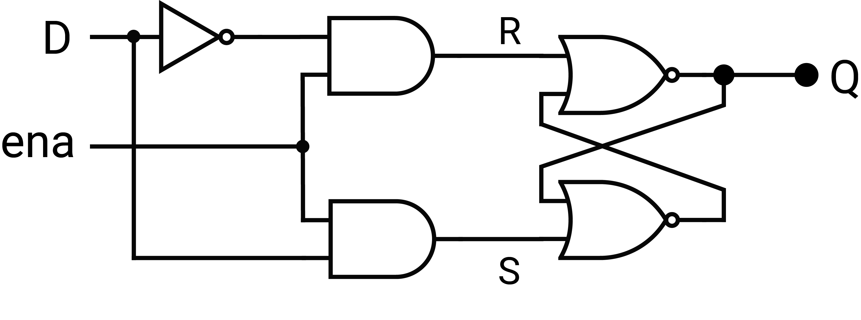
The D-Latch
D (data) is stored only when Enable is true. D is input to a decoder. Two and gates allow the signal from D to reach S or R when Enable is true.
D
Enable
Notes:
Some books call this a D flip-flop. There are many other types of flip-flops. We won’t worry about them.

Slide 14
The Tri-State Buffer
All the gates we have seen so far have an output that is either logic one or logic zero.
Sometimes we want no output at all, a “disconnected” state electrical engineers call high impedance or Hi-Z.
The tri-state buffer does that.
When Enable is logic true, input and output are connected.
When Enable is false, they are disconnected.
Enable
Input
Output

Slide 15
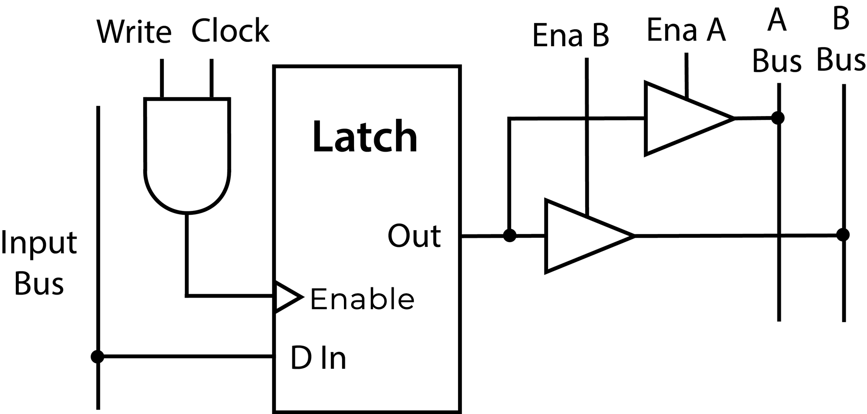
Registers
This is a one-bit register.
The input bus is connected to D In all the time.
Data will only be sampled if both Write and Clock are logic 1.
Notes:
The triangle symbol at “Enable” means this is an edge-triggered device. More on that in a moment.

Slide 16
Register Output
The output is active all the time.
Output will reach the A or B Bus only if the corresponding tri-state buffer is enabled.
Both can be enabled at the same time.
Notes:
The triangle symbol at “Enable” means this is an edge-triggered device. More on that in a moment.

Slide 17
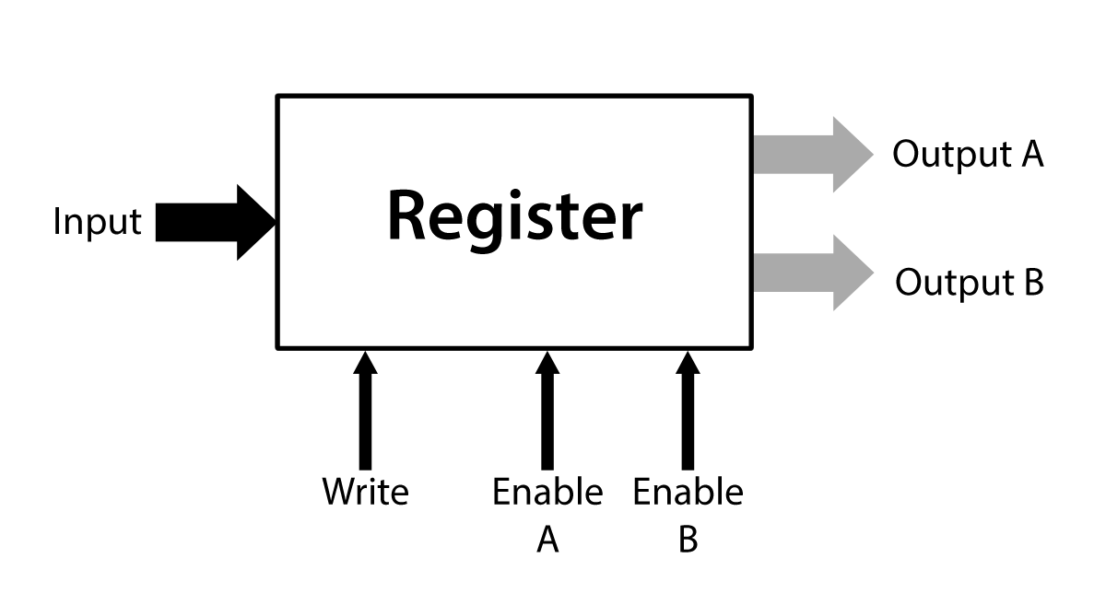
Abstract Register
This is an n-bit, two output register.
The Clock signal is not shown (abstracted away.)
Notes:
The input bus is active all the time, but data is only loaded into the register if Write is true, and only when signaled by the clock.
The two outputs are active when enable is true, high impedance (disconnected) otherwise.

Slide 18
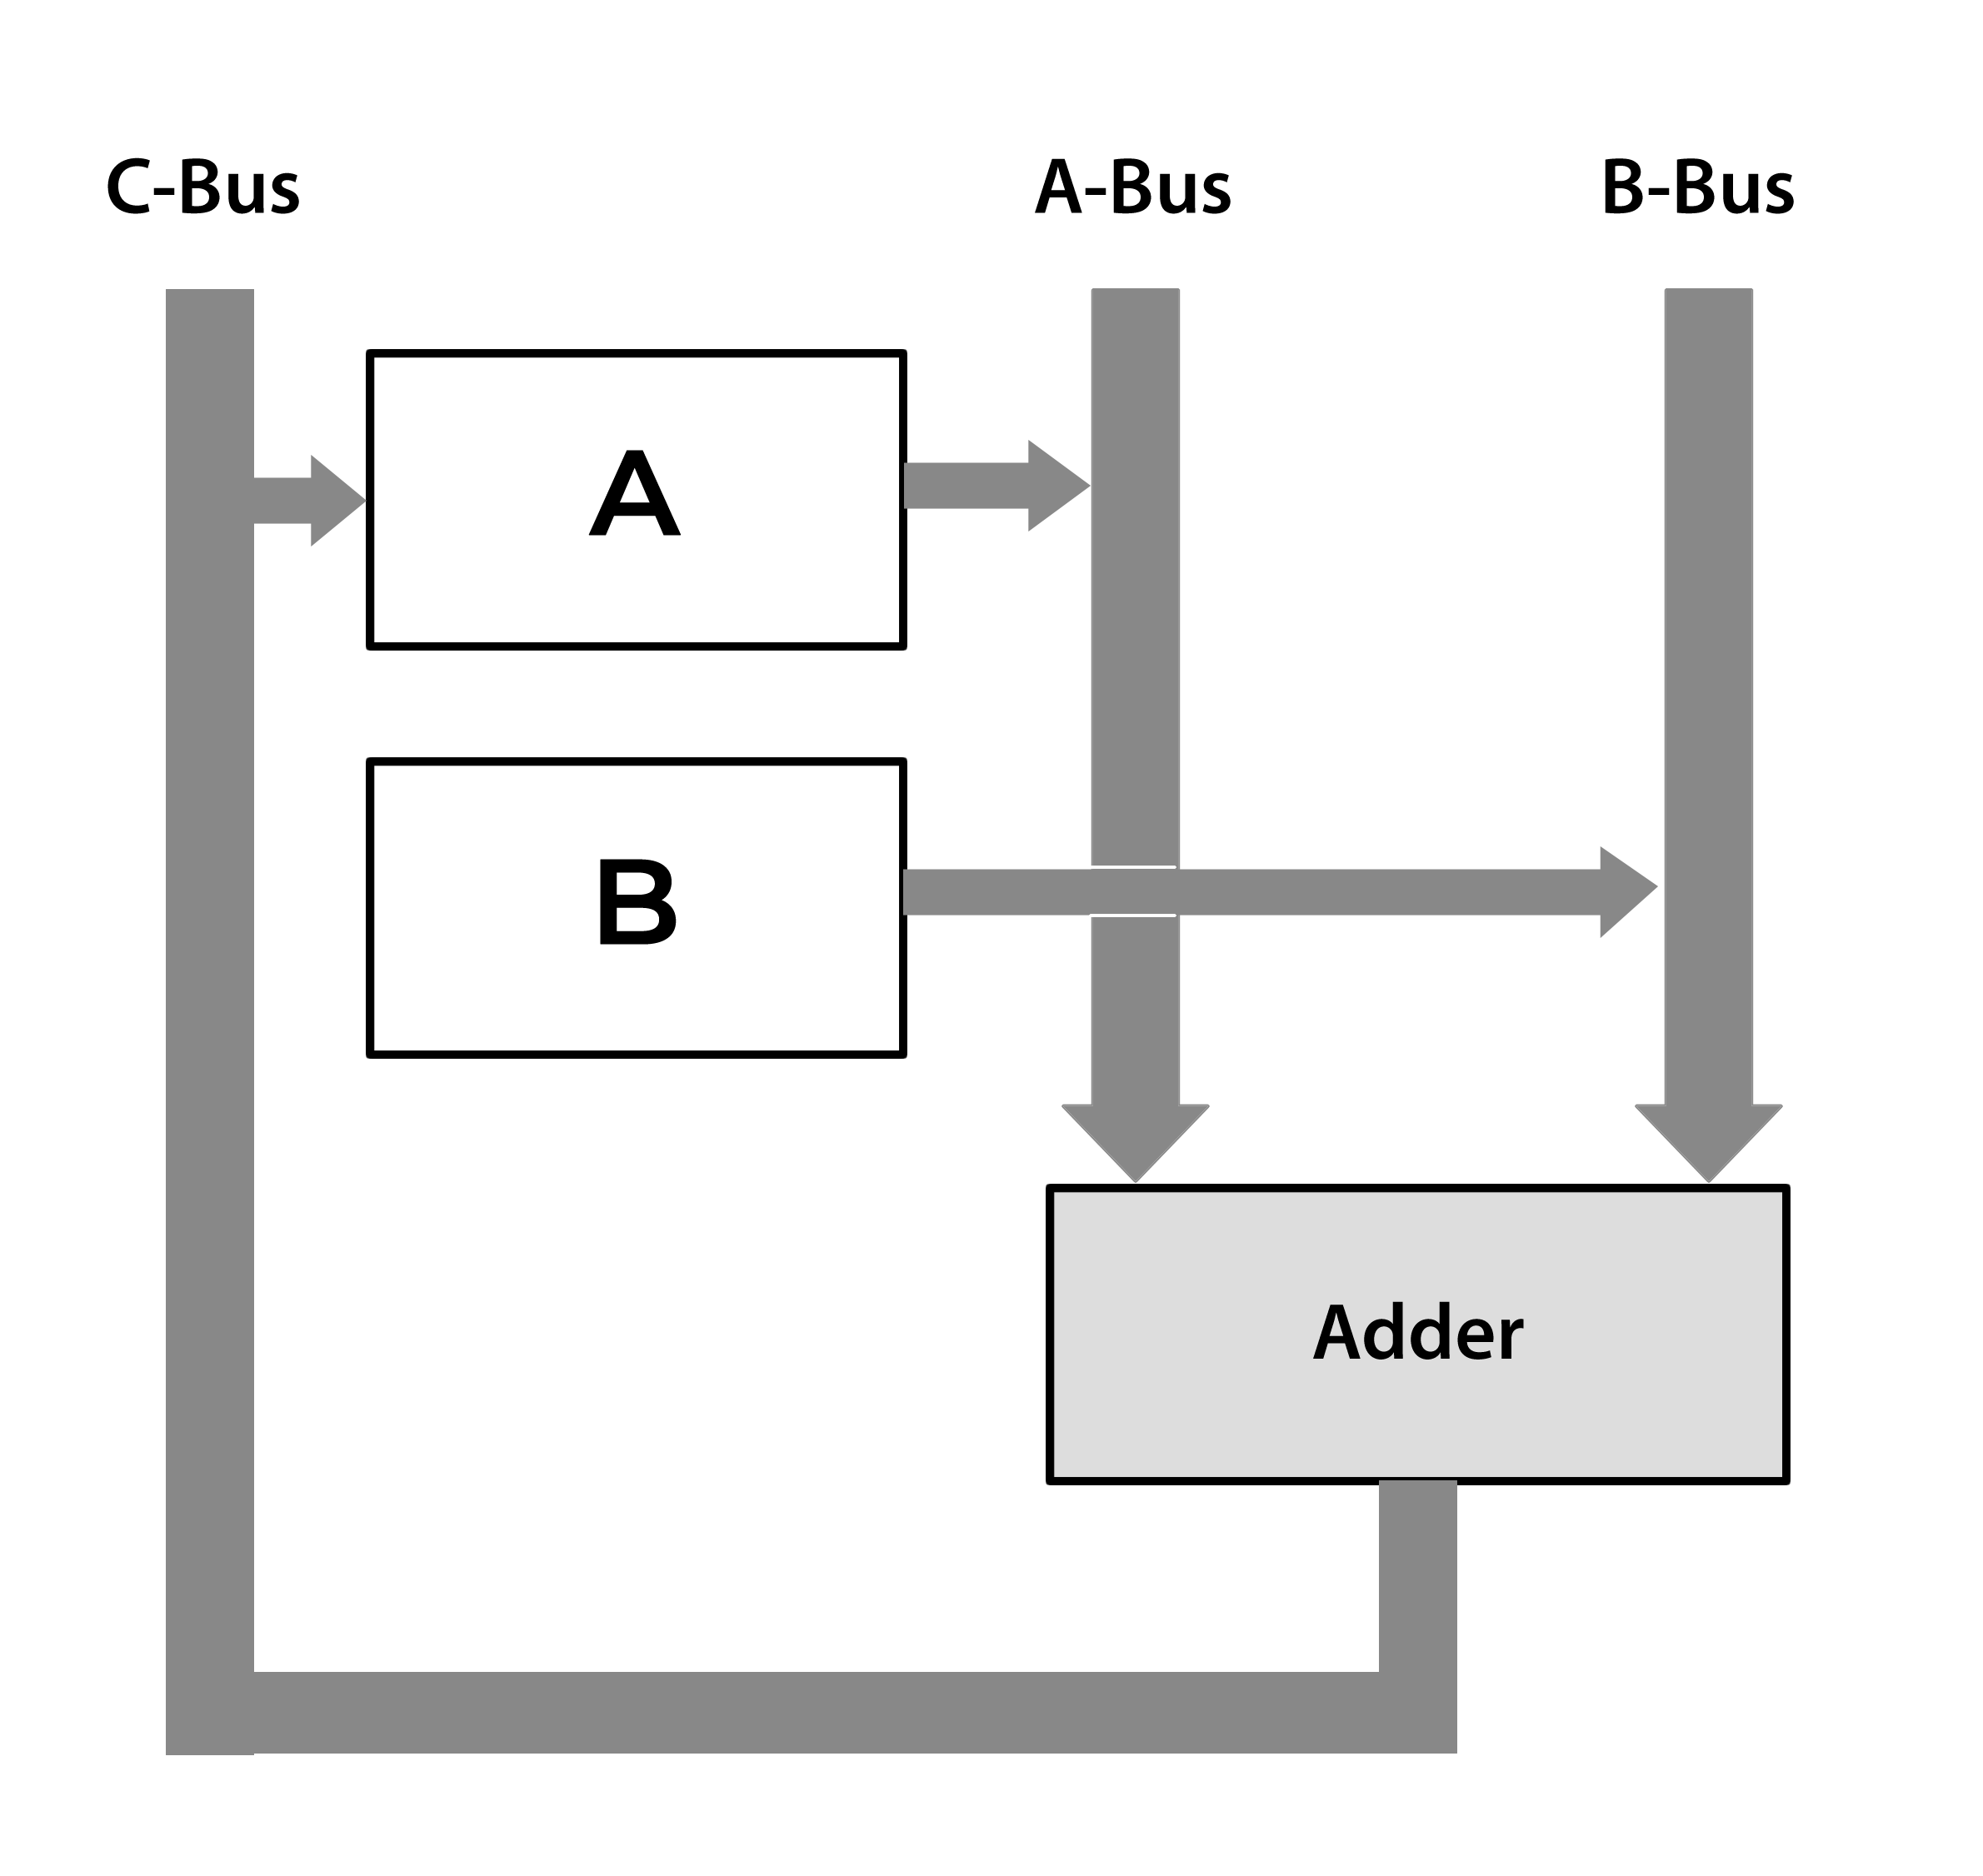
Think About Computation
Compute: A=A+B
A and B are in registers. Is there a problem?

Slide 19
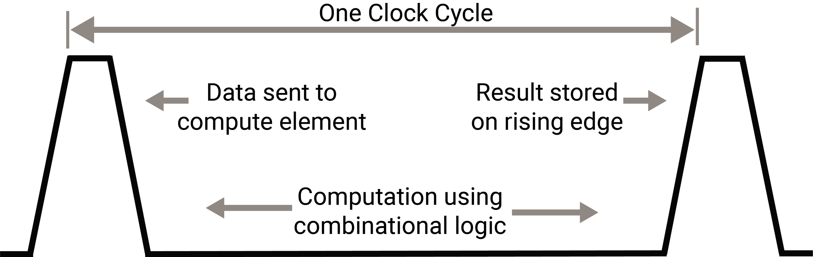
The Computer’s Clock Signal
The clock for our hypothetical computer is asymmetric.
Registers are enabled on the falling edge.
Results are stored on the rising edge.

Slide 20
Another Look at the Register
The triangle at input says this is edge-triggered.

Slide 21
How to Make an Edge-Triggered Latch?
Check a digital logic book!
The essential idea is to use the very short gate delay through a not gate to pass data from one latch to a second when the clock signal changes.
There are both rising-edge (positive) and falling-edge (negative) edge triggered devices.
Do not worry about this, OK!

Slide 22
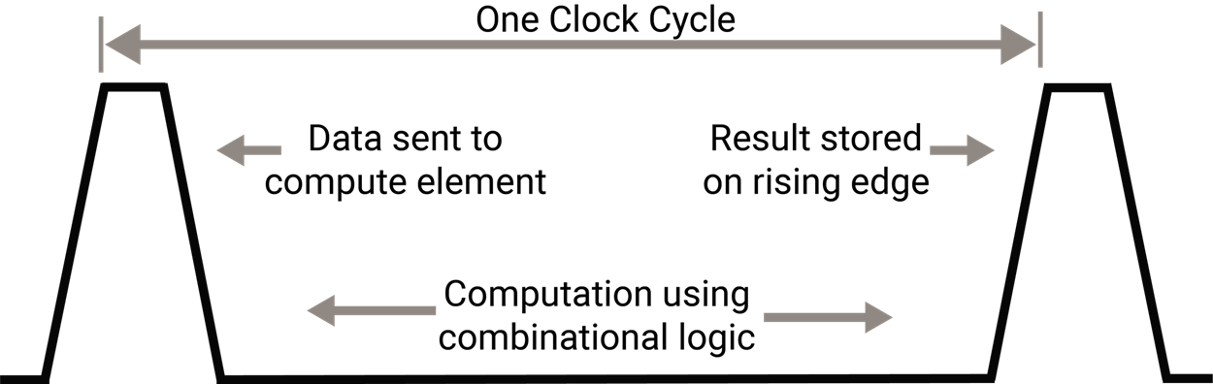
Computation and the Clock
Falling edge: Registers A and B enabled on A- and B-buses.
The adder computes the sum, and after a time, the sum is stable on the C-bus.
Rising edge: The result from the C-bus is stored in A.

Slide 23
Why that Works
A and B are still enabled (connected) to the buses when the value on the C-bus changes.
However, the value is latched (stored) in A long before a change can propagate through the adder to the C-bus.
Notes:
A and B are still enabled on the two buses; that won’t change until the control signals are set up for the next operation on the next falling edge. However, storing the value from the C-Bus in A happens very quickly on that rising edge. The value is latched long before the changed value of A can propagate through the combinational logic and be reflected on the C-Bus. So, the fact that the value on the C-Bus changes is not relevant because it happens too late to affect what is stored.

Slide 24

Out of the Weeds?
We will soon start looking at functionality and, at least mostly leave gates behind.

Slide 25
Questions

