Slide 1

IT 3123
Hardware and Software Concepts
Combinational Circuits
Notice: This session is being recorded.
Notes:
Time 1:13 including announcements.

Slide 2
Logic Diagrams
Logic diagrams are abstractions of logic circuits.
Gate symbols represent corresponding gates.
Lines represent connections: wires, traces on a printed circuit board, or conductors within a chip.
Power and ground
connections are omitted.
Connections are shown with
a heavy dot.
No dot means no connection.

Slide 3
Combinational Circuits
A combinational circuit is a digital logic circuit the output of which is determines solely by its inputs.
Implication: combinational circuits have no memory.

Slide 4
Computation with Digital Logic
Boolean algebra deals with operations on binary digits and produces binary digit results.
Arithmetic operations like addition can be expressed as truth tables.
You can build a digital logic circuit to compute any function for which you can write the truth table. We will see how shortly.

Slide 5
“A computer that cannot add is unthinkable.”
The IBM Model 1620, a scientific computer of the 1960s, could not add.
Instead, it used a table lookup to find sums.
It was said that IBM’s code name for the 1620, CADET, meant “Can’t Add, Doesn’t Even Try.”
Notes:
It was Andrew Tanenbaum who wrote “a computer that cannot add is unthinkable.”

Slide 6
Reminder: Binary Addition
0 0 1 1
0 1 0 1
0 1 1 10
a
b
s
+
+
+
+
At the moment, we are interested only in the sum, and not in the carry.

Slide 7
Binary Addition: Sum
Rewrite the sum as a truth table.
a | b | s
0 | 0 | 0
0 | 1 | 1
1 | 0 | 1
1 | 1 | 0
This is the EXCLUSIVE OR function
a
a ⊕ b
b

Slide 8
Binary Addition: Carry
Rewrite the carry as a truth table.
a​ | b​ | c₀
0​ | 0​ | 0​
0​ | 1​ | 0​
1​ | 0​ | 0​
1​ | 1​ | 1​
This is the and function
a
ab
b
Notes:
It is called c_{o} because it is the carry out.

Slide 9
A Half-Adder
a
b
sum
carry

Slide 10
Circuit Analysis
How do we know this computes sum and carry?
a | b | s
0 | 0 | 0
0 | 1 | 1
1 | 0 | 1
1 | 1 | 0
a
b
sum
carry
a​ | b​ | c₀
0​ | 0​ | 0​
0​ | 1​ | 0​
1​ | 0​ | 0​
1​ | 1​ | 1​

Slide 11
Binary Addition with Carry In
1
0 0 1 1 1
0 1 0 1 1
0 1 1 10 11
+
+
+
+
+
+
The first three of these are obvious.
The fourth one is just 1+1=2
The last one is needed when you have a carry in. It is 1+1+1=3

Slide 12
Addition with Carry In as Truth Table
a | b | c_{i} | s | c_{o}
0 | 0 | 0 | 0 | 0
0 | 0 | 1 | 1 | 0
0 | 1 | 0 | 1 | 0
0 | 1 | 1 | 0 | 1
1 | 0 | 0 | 1 | 0
1 | 0 | 1 | 0 | 1
1 | 1 | 0 | 0 | 1
1 | 1 | 1 | 1 | 1
Notes:
We now have eight rows because there are three input variables, and 2³ is 8.

Slide 13
Computation of the Sum
a | b | c_{i} | s | c_{o}
0 | 0 | 0 | 0 | 0
0 | 0 | 1 | 1 | 0
0 | 1 | 0 | 1 | 0
0 | 1 | 1 | 0 | 1
1 | 0 | 0 | 1 | 0
1 | 0 | 1 | 0 | 1
1 | 1 | 0 | 0 | 1
1 | 1 | 1 | 1 | 1
The sum is 1 when the number of input ones is odd. s=(a ⊕ b) ⊕ c_{i}

Slide 14
Circuit for the Sum
s=(a ⊕ b) ⊕ c_{i}
c_{i}
W
Sum
a
b
V
V computes a ⊕ b
W computes V ⊕ c_{i}

Slide 15
Computation of the Carry Out
a | b | c_{i} | s | c_{o}
0 | 0 | 0 | 0 | 0
0 | 0 | 1 | 1 | 0
0 | 1 | 0 | 1 | 0
0 | 1 | 1 | 0 | 1
1 | 0 | 0 | 1 | 0
1 | 0 | 1 | 0 | 1
1 | 1 | 0 | 0 | 1
1 | 1 | 1 | 1 | 1
Carry out is true when both a and b are true or when c_{i} and one of a and b is true: c_{o}=a•b+(a ⊕ b) •c_{i}

Slide 16
Add the Carry Out
c_{o}=a•b+(a ⊕ b) •c_{i}
c_{i}
W
Sum
a
b
Y
c_{o}
V
X
c_{o}
V computes a ⊕ b
X computes a•b
Y computes (a ⊕ b)• c_{i}
Notes:
The trouble with this is that there are two carry-outs, and gates X and Y.

Slide 17
The Full Adder
c_{i}
W
Sum
a
b
Y
Carry
out
V
Z
X
Z computes X + Y
Notes:
An OR gate, Z, combines the two carry-outs. If either or both is true, carry out from the addition is true or one.

Slide 18
Full Adder: Two Half Adders
Two Half-Adders and an OR gate

Slide 19
Abstraction
A
B
C_{i}
Full
Adder
C_{o}
S

Slide 20
Four Bit Ripple-Carry Adder
a₃ b₃
a₂ b₂
a₁ b₁
a₀ b₀
0
Full
Adder
Full
Adder
Full
Adder
Full
Adder
s₃
s₂
s₁
s₀
Carry
Out

Slide 21
About Digital Logic Gates
The output of a digital logic gate depends only upon its inputs; changing the inputs changes the output.
The transistors in a digital logic gate take a few nanoseconds (billionths of a second) to switch from on to off or vice-versa.
The gate delay of a digital logic gate is the time for a change in inputs to be reflected in a new output.
Notes:
There is also a propagation delay, the time for the output of one gate to reach the input of the next one. Propagation occurs at 50 to 99% of the speed of light.

Slide 22
Gate Delay in Ripple-Carry Adder
a₃ b₃
a₂ b₂
a₁ b₁
a₀ b₀
0
Full
Adder
Full
Adder
Full
Adder
Full
Adder
s₃
s₂
s₁
s₀
Carry
Out
5 ns
5 ns
5 ns
5 ns
Notes:
All four adders are computing continuously, but do not produce a correct output until the inputs have propagated all the way through the circuit. If each full adder takes 5 ns for gate delay and propagation time, then the carry in to full adder 1 isn’t accurate until about 5 ns after the inputs to full adder 0 are stable.

Slide 23
Gates with Multiple Inputs
This
Represents this

Slide 24
Sum-of-Products Method
Generate a correct circuit for any truth table.
Provide a not gate for each variable.
Provide an and gate for each row in the truth table where the result is 1. (These are the product terms.) The and gates must have an input for each variable.
Connect the and gates according to the product terms.
Connect all and gate outputs to an or gate.
Notes:
Gates with more than two inputs are possible. An abstraction for thinking about them is as a

Slide 25
Example: The Majority Function
The majority function is one
(true) when there are more ones
than zeroes in a row.
We are interested in the rows
where the result, F, is one.
That is
F = A•B•C + A•B•C + A•B•C + A•B•C
This is the minterm form; simpler expressions may be possible.
A | B | C |  | F
0 | 0 | 0 |  | 0
0 | 0 | 1 |  | 0
0 | 1 | 0 |  | 0
0 | 1 | 1 |  | 1
1 | 0 | 0 |  | 0
1 | 0 | 1 |  | 1
1 | 1 | 0 |  | 1
1 | 1 | 1 |  | 1

Slide 26
Provide not Gates

Slide 27
Provide and Wire and Gates
The first product term is A•B•C

Slide 28
Wire the Remaining and Gates
A•B•C
A•B•C
A•B•C
A•B•C

Slide 29
Provide an or gate for the Output
A | B | C |  | F
0 | 0 | 0 |  | 0
0 | 0 | 1 |  | 0
0 | 1 | 0 |  | 0
0 | 1 | 1 |  | 1
1 | 0 | 0 |  | 0
1 | 0 | 1 |  | 1
1 | 1 | 0 |  | 1
1 | 1 | 1 |  | 1
F
F = A•B•C + A•B•C + A•B•C + A•B•C

Slide 30
Digital Logic Building Blocks
As complex as digital logic is, there are a few fundamental building blocks.
These building blocks get combined in various ways to build more complex structures.
Modern computer designs depend in large part on relatively few digital logic building blocks like these in the same way that modern buildings depend on a few standard sizes for things like lumber, bricks, and doors.

Slide 31
Decoders
In Chapter 3 we will find that instructions at the machine level include an operation code, or op code, that tells what the computer should do.
This op code gets decoded into a number of signals that control the CPU.
A decoder takes an n-bit binary number and produces one of n signals.

Slide 32
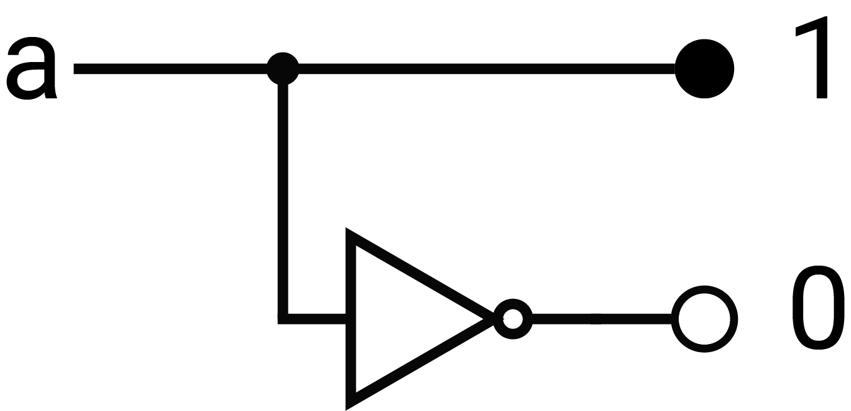
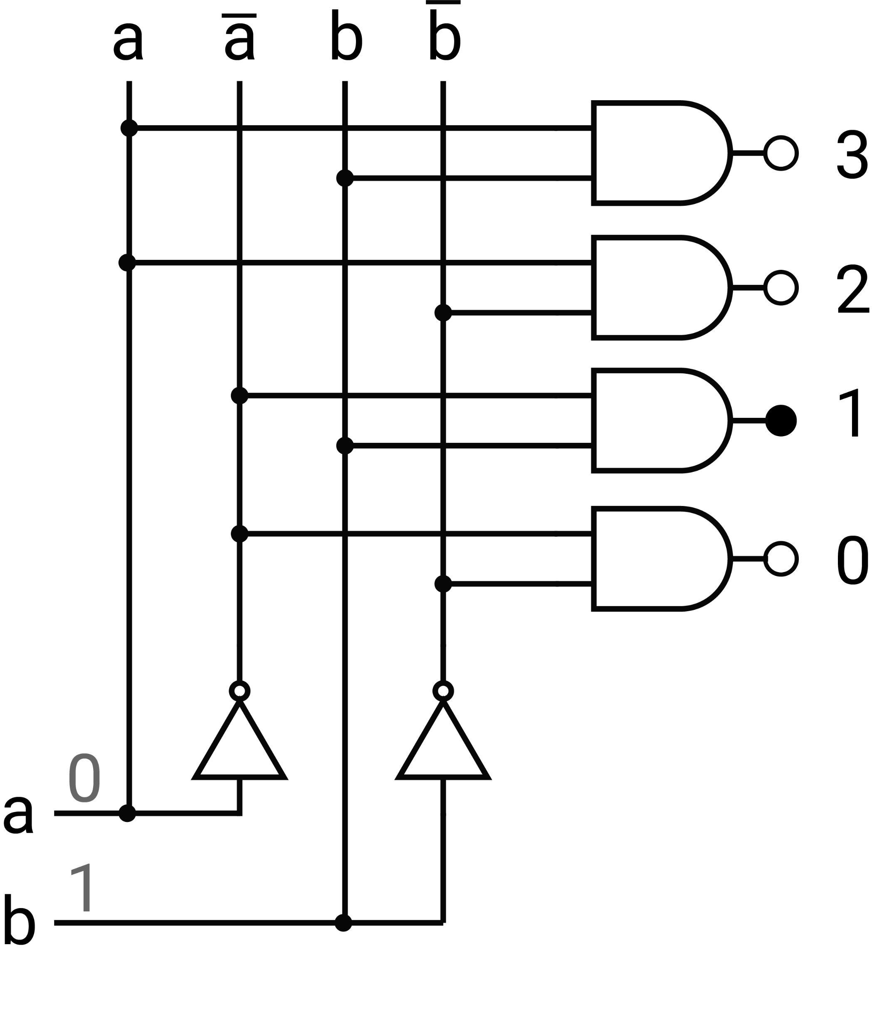
Building a Decoder
One-bit decoder
Two to Four Decoder
1
0
0
1
1
0
1

Slide 33
Multiplexers
An n-bit control signal selects one of n inputs.
The selected input is connected to the output.
I₃
I₂
Output
I₁
I₀
S₀
S₁
0 1

Slide 34
Building a Multiplexer
S₁
S₁
S₀
S₀
I₃
I₂
Output
I₁
I₀
S₁
S₀

Slide 35
Shifting
You can multiply a decimal number by 10 by adding a zero on the right, effectively shifting all the digits left one place.
You can divide by 10 by chopping off a digit on the right, shifting right. The digit chopped off is the remainder.
Binary numbers can be multiplied or divided by two in the same way.

Slide 36
Multiply or Divide by Two
This is a “wired shift.”
Left
Right

Slide 37
A Controlled Shifter

Slide 38
Arithmetic and Logical Shifts
Notes:
Arithmetic shift right preserves the sign bit, logical shift right supplies a zero on the left.

Slide 39
Other Building Blocks
There are a few other building blocks.
We’ll see some of them in the next class.
It is possible, perhaps even likely, that the existence of these standard building blocks explains why hardware designs have far few errors than software designs.

Slide 40
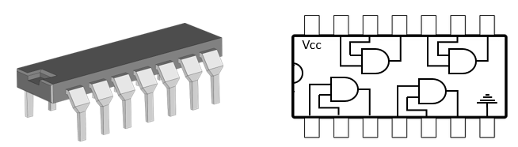
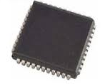
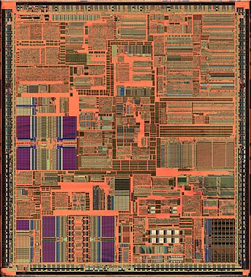
A Word About Chips
Small-scale integration packages gates.
Medium-scale integration packages simple functions.
Large-scale and Very large-scale integration packages complex functions or complete systems.

Slide 41
Questions

