Slide 1

IT 3123 Hardware and Software Concepts
Boolean Algebra Digital Logic Gates
Notice: This session is being recorded.
Notes:
Time: 0:57
Our computers seem to be capable of miracles, but literally everything that a computer does comes down to only four small logic operations: AND, OR, XOR, and NOT. How is this possible? You'll get a flavor of this over just three periods of digital logic.

Slide 2
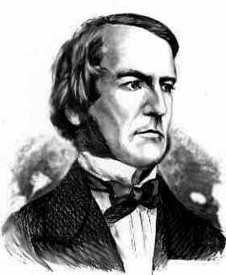
George Boole
1815 – 1864
British mathematician and philosopher
Many contributions to mathematics.
Boolean algebra: an algebra over finite sets of discrete values.
http://www-history.mcs.st-andrews.ac.uk/history/PictDisplay/Boole.html
Notes:
1854 Boole published "An investigation into the Laws of Thought, on Which are founded the Mathematical Theories of Logic and Probabilities."
Letter to William Thompson (Lord Kelvin): "I am now about to set seriously to work upon preparing for the press an account of my theory of Logic and Probabilities which in its present state I look upon as the most valuable if not the only valuable contribution that I have made or am likely to make to Science and the thing by which I would desire if at all to be remembered hereafter ... "

Slide 3
Switching Algebra
A special case of Boolean algebra.
Variables can only be one of two values, one or zero.
Zero and one can represent false and true, respectively.
So, an algebra over sets of binary digits.
Often called “Boolean algebra” by those involved in computing.

Slide 4
Boolean Functions
Functions in which the variables are 0/1 and the result is either zero or one.
Consider: f(a,b) = a•b (Remember, a and b can only be 0,1)
This is the AND function, or Boolean product
f(a,b) = 1 if and only if a=1 and b=1 For all other combinations, f(a,b) = 0
Notes:
Some books use implicit multiplication, i.e. ab.

Slide 5
Truth Tables
A more visual way to represent Boolean functions. Developed from the work of Jan Łukasiewicz.
Here is f(a,b) = a•b. Note that if you consider a and b as digits of a binary number, the values are written in ascending order.
a | b | f(a,b)
0 | 0 | 0
0 | 1 | 0
1 | 0 | 0
1 | 1 | 1

Slide 6
The “Characteristic Number”
If the left (input) side of a truth table is always written in ascending order, we don’t really need to show it.
You can think of the result of a function as a number that characterizes the function. The and function has characteristic number 0001.
a | b | f(a,b)
0 | 0 | 0
0 | 1 | 0
1 | 0 | 0
1 | 1 | 1

Slide 7
Boolean Function Combinations
There are 16 Boolean functions of two variables. Why?
a | b | f(a,b)
0 | 0 | ?
0 | 1 | ?
1 | 0 | ?
1 | 1 | ?
The result of a Boolean function of two variables is a four-bit number. How many possible combinations of four bits?
2⁴=16
Notes:
The result, or characteristic number, of the truth table for a function of two variables is a 4-bit number. There are only 16 possible values of 4 bits.

Slide 8
Categories of Boolean Functions
There are four categories of Boolean functions of two variables:
Functionally complete functions. (nand and nor. Explained later.)
Generally useful functions. (Most of our discussion is of these functions.)
Special purpose functions.
Useless functions.

Slide 9
The and Function
f(a,b) is true only when both a AND b are true.
a | b | f(a,b)
0 | 0 | 0
0 | 1 | 0
1 | 0 | 0
1 | 1 | 1
The AND function is also called the Boolean product: f(a,b) = a•b
The book uses a center dot (•) for Boolean product. Some books use ab. Classical logic: ∧
Notes:
Some books use implicit multiplication, that is, a AND b is written ab.

Slide 10
The nand Function
The nand (not and) function false when a and b are both one, true otherwise.
It’s the inverse of and.
a | b | f(a,b)
0 | 0 | 1
0 | 1 | 1
1 | 0 | 1
1 | 1 | 0
f(a,b) = a•b

Slide 11
The or Function
f(a,b) is true only when a or b (or both) are true.
a | b | f(a,b)
0 | 0 | 0
0 | 1 | 1
1 | 0 | 1
1 | 1 | 1
The or function is also called the Boolean sum: f(a,b) = a+b
The plus is not the same as arithmetic addition.

Slide 12
The nor Function
The nor function is true when neither a nor b is true, and false otherwise.
It’s the inverse of or.
a | b | f(a,b)
0 | 0 | 1
0 | 1 | 0
1 | 0 | 0
1 | 1 | 0
f(a,b) = a+b

Slide 13
The exclusive or Function
f(a,b) is true when a is true or when b is true, but not when both are true.
a | b | f(a,b)
0 | 0 | 0
0 | 1 | 1
1 | 0 | 1
1 | 1 | 0
The EXCLUSIVE OR (XOR) function is: f(a,b) = a ⊕ b

Slide 14
The equivalence Function
f(a,b) is true when a is equal to b and false when they are not equal
a | b | f(a,b)
0 | 0 | 1
0 | 1 | 0
1 | 0 | 0
1 | 1 | 1
The equivalence function is: f(a,b) = a ⇔ b
Sometimes called xnor.

Slide 15
Two Useless Functions
The NEVER Function
The ALWAYS Function
a | b | f(a,b)
0 | 0 | 0
0 | 1 | 0
1 | 0 | 0
1 | 1 | 0
a | b | f(a,b)
0 | 0 | 1
0 | 1 | 1
1 | 0 | 1
1 | 1 | 1
These names are made up, but the reasons for them are obvious.
The correct names are false and true.

Slide 16
Two More Useless Functions
identity(a)
identity(b)
a | b | f(a,b)
0 | 0 | 0
0 | 1 | 0
1 | 0 | 1
1 | 1 | 1
a | b | f(a,b)
0 | 0 | 0
0 | 1 | 1
1 | 0 | 0
1 | 1 | 1
The result of the function is the same as a.
The result of the function is the same as b.

Slide 17
The not Function
f(a) is true when a is false and false when a is true.
a | f(a)
0 | 1
1 | 0
The NOT function is also called the Boolean inverse: f(a) = a
Notes:
NOT is a function of one variable.

Slide 18

Claude Shannon
It was Shannon who developed switching algebra from Boolean algebra.
Shannon showed (1937) that switching circuits can compute any result that can be computed using switching algebra.

Slide 19
Electric Circuits Can Compute Boolean Functions
Circuits that can compute digital logic functions are called digital logic gates, or just gates.
This circuit computes the and function.
Current can only flow when switches A and B are closed.

Slide 20
Computing the or Function
This circuit computes the or function.
Current can flow when either switch A or switch B is closed, or both.

Slide 21
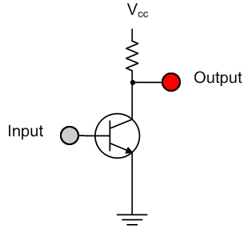
Transistors as Switches
Transistors can function as fast electrical switches. Digital logic gates are made from transistors.
This circuit computes the not function. The output is on when the input is off, and vice-versa.
Notes:
The striped triangle is the electrical symbol for “ground” or zero voltage. Vcc is the supply voltage. When the input is off, the transistor is an open circuit and the output is at the same potential as Vcc, that is, “on.” However, when the input is on, the transistor is a closed switch, and connects the output to ground potential. The sawtooth line is a resistor. It prevents high current from flowing from Vcc to ground and “burning out” the transistor. Such a resistor is called a current-limiting resistor.
No, you don’t have to learn this stuff for exams!

Slide 22
Abstraction
We use special symbols to represent the electronic circuits that make up digital logic gates.

Slide 23




The not Gate
Computes the inverse, or not function.
a | f(a)
0 | 1
1 | 0
a
$$\overline{a}$$
Negation bar
Negation bubble.
f(a) =
$$\overline{a}$$
Notes:
Be sure to point out negation bar and negation bubble.

Slide 24

The and Gate
Computes the and function, or Boolean product.
a | b | f(a,b)
0 | 0 | 0
0 | 1 | 0
1 | 0 | 0
1 | 1 | 1
a
a•b
b
f(a,b) = a•b

Slide 25


The or Gate
Computes the or function, or Boolean sum
a | b | f(a,b)
0 | 0 | 0
0 | 1 | 1
1 | 0 | 1
1 | 1 | 1
a
a+b
b
f(a,b) = a+b

Slide 26


The exclusive or Gate
Computes the exclusive or (xor), or not equal, or odd function.
a | b | f(a,b)
0 | 0 | 0
0 | 1 | 1
1 | 0 | 1
1 | 1 | 0
a
a ⊕ b
b
f(a,b) = a ⊕ b

Slide 27


The nand Gate
Computes the NAND function.
a | b | f(a,b)
0 | 0 | 1
0 | 1 | 1
1 | 0 | 1
1 | 1 | 0
a
a•b
b
Negation bar
Negation bubble.
f(a,b) = a•b

Slide 28


The nor Gate
Computes the nor function.
a | b | f(a,b)
0 | 0 | 1
0 | 1 | 0
1 | 0 | 0
1 | 1 | 0
a
a+b
b
Negation bubble.
Negation bar
f(a,b) = a+b

Slide 29
Functional Completeness
NAND and NOR are functionally complete.
Functionally complete: Any digital logic function can be computed using only one type of functionally complete gate.
Any function can be computed using only NAND gates.
Any function can be computed using only NOR gates.

Slide 30
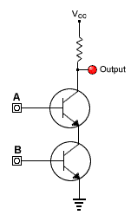
Abstraction: The nand Gate
This:
Represents this:

Slide 31

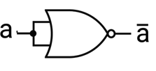
Compute not with nand or nor
nand
a | b | f(a,b)
0 | 0 | 1
0 | 1 | 1
1 | 0 | 1
1 | 1 | 0
nor
a | b | f(a,b)
0 | 0 | 1
0 | 1 | 0
1 | 0 | 0
1 | 1 | 0

Slide 32
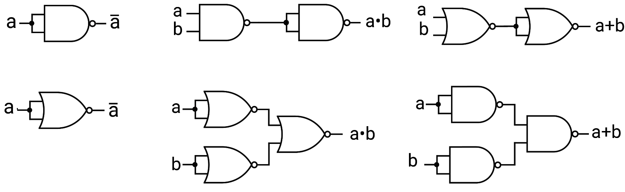
Circuit Equivalence
not and or
Either nand or nor can compute not.
Either nand or nor can compute and, or, or any of the other functions in suitable arrangements.

Slide 33
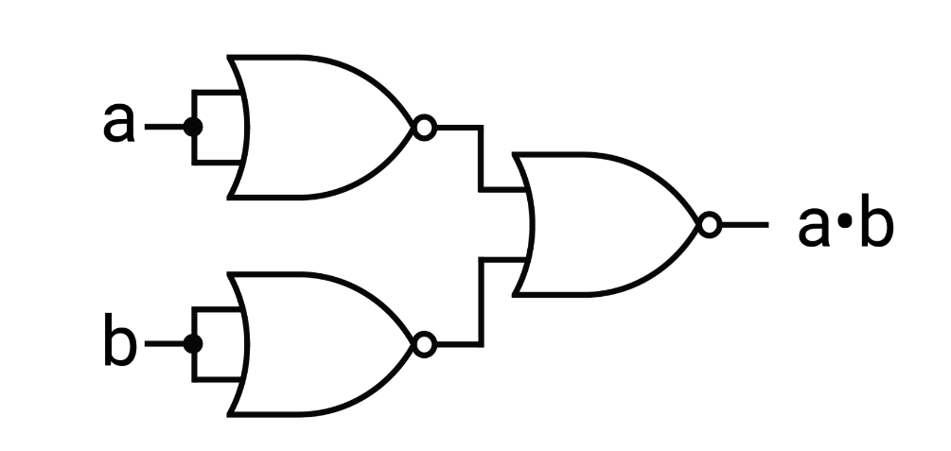
Showing Equivalence
Does this really compute and?
a
a
b
a | b |  |  | f
0 | 0 | 1 | 1 | 0
0 | 1 | 1 | 0 | 0
1 | 0 | 0 | 1 | 0
1 | 1 | 0 | 0 | 1
b

Slide 34
Why So Many Gates?
Question: If any Boolean function can be computed using only NAND or NOR, why do we bother with the other gates?
Answer: Abstraction! We want our designs to be clear, so we use the gate symbols that indicate the logical function of a gate, not its internal structure.
When a circuit is to be fabricated, engineers use the principle of circuit equivalence to convert the logic diagram to the gates that are physically needed.

Slide 35
Another Class Motto There is no magic!
Everything that computers do is performed by hardware and software designed by engineers and computer scientists.

Slide 36
Questions

