Slide 1

IT 3123 Hardware and Software Concepts
Representing Symbols, Sounds and Pictures
Notice: This session is being recorded.
Notes:
Time: 1:10

Slide 2
Announcements
Small Syllabus changes: the syllabus has been updated to reflect what we have actually covered.
No due dates have been changed.
Please read section 2.7 (in addition to the rest) for Wednesday. It’s short.
More about office hours.
About “Due means due.”

Slide 3
Binary Numbers
How many unique combinations of n bits?
How high can we count in n bits?
2^{n}
0 to 2^{n} −1

Slide 4
The Difference Between 1 and One
Symbols represent numbers
The idea of “one” is a mathematical abstraction: unity
The symbol “1” represents that abstraction.
To the computer they need not be, and generally are not, the same.
Other number symbols also represent abstractions.
The symbols and abstractions are not the same.
Notes:
The map is not the territory.

Slide 5
Encoding Schemes
Numbers can represent letters and other symbols:
A=1 B=2 C=3 … Z=26.
(This isn’t really good enough, but we’ll see some that are.)

Slide 6
Encoding Schemes
Numbers can also represent pictures, sounds, and other human data.
The data are encoded for use with a computer.
Often the representation is approximate. However, as with fractions, we can be arbitrarily precise in the approximation, within the limitations of word sizes, etc.
Notes:
For example, it would be difficult to accomplish 70 bits of precision on a 64-bit computer.

Slide 7
Encoding Symbol Sets
Many kinds of human-form expression are represented using symbols, called graphemes.
In western languages:
52 letter symbols (about): A-Z, a-z
10 digit symbols: 0-9
Punctuation
Accent marks (diacritical marks)
These are “alphanumeric” symbol sets
It really is almost as simple as A=1, B=2
Notes:
In linguistics, a grapheme is the smallest functional unit of a writing system https://en.wikipedia.org/wiki/Grapheme
Graphemes are expressed as glyphs.
In typography, a glyph /ˈɡlɪf/ is an elemental symbol within an agreed set of symbols, intended to represent a readable character for the purposes of writing and thereby expressing thoughts, ideas and concepts. As such, glyphs are considered to be unique marks that collectively add up to the spelling of a word, or otherwise contribute to a specific meaning of what is written, with that meaning dependent on cultural and social usage.
https://en.wikipedia.org/wiki/Glyph

Slide 8
Characteristics of an Encoding Scheme
Collating Sequence (Sort Order)
An ordering over the code set: B > A
One way is to choose a binary code for B that is larger than the code for A. (They’re both just numbers, remember.)
Size of the character set (How many different combinations are possible with n bits?)

Slide 9
ASCII
Pronounced “ass-key”
American Standard Code for Information Interchange: 1963.
Originally 7 bits, now stored as 8 bits. (Why?)
Still around as the first 128 code points of UNICODE.
Notes:
ASCII had its origins in teletypewriter codes used to send telegrams and cablegrams. The original telegraphy code was invented by Émile Baudot in about 1870. Baudot's code became known as the International Telegraph Alphabet No. 1 (ITA1). ITA1 was a five-bit code with “letters-shift” and “figures-shift” keys (similar to the modern caps lock key) to get about 60 symbols from five bits. The first printing telegraph machine was invented in 1901 by Donald Murray. It used a five-bit code rearranged to minimize wear on the machine. With only five bits, Murray’s code continued to use shift codes.
Codes with shift characters have the drawback that if a shift code is garbled (that is, one or more bits changed) the entire rest of the message is garbled.
Work on ASCII, a seven-bit code began in 1960 or 1961, with the first standard published in 1963. Computers used a number of different code schemes between the late 1950s and 1963. After the publication of the ASCII standard, most computer manufacturers transitioned to ASCII. IBM continued to use EBCDIC for many years, but had ASCII options because of a Federal mandate effective in 1969 that computers bought by the Federal government be ASCII-compatible.

Slide 10
ASCII
How many possible combinations in 7 bits?
So, how many possible symbols in ASCII?

Slide 11
ASCII
33 “non-printing” characters
Used for controls, like “new line”
26 upper case Latin letters (A-Z)
26 lower case Latin letters (a-z)
10 Decimal digits (0-9)
33 symbols and punctuation marks
128 total symbols (2⁷)

Slide 12
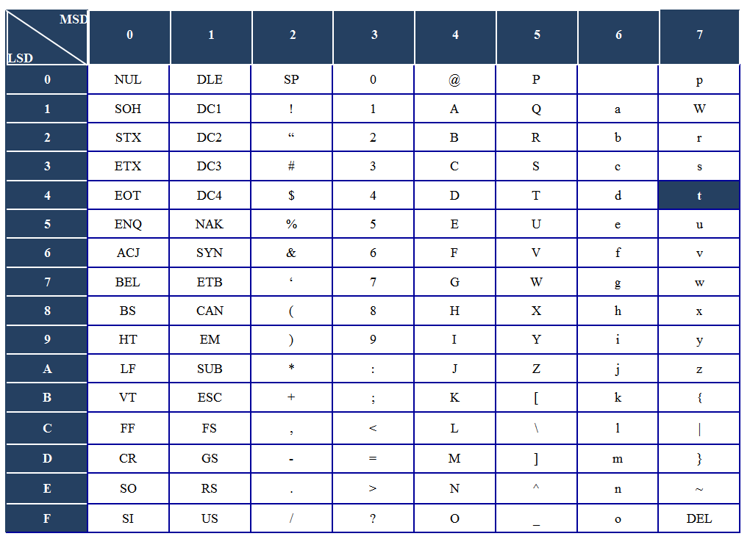
ASCII Reference Table
“t” is hex 74
Notes:
Explain that one reads the first hex digit from the column and the second from the row.

Slide 13
The Difference Between 1 and One
The binary number one (in 8 bits) is: 0000 0001
The ASCII code for the grapheme “1” is 011 0001
They are not the same!
“One” is an integer “1” is a code for a printable symbol, or grapheme.

Slide 14
What About the Other Bit?
ASCII is a 7-bit code. (128 combinations) …stored in 8-bit bytes (octets)
How many combinations in 8 bits?
In the U.S., the remaining 128 combinations are used for line-drawing characters, smiley faces, etc.
This is a convention, not a standard. (7-bit ASCII is a standard.)
Could be used for other symbols; ISO-8859 uses these for diacritical marks, etc.

Slide 15
Another Encoding Scheme
There are many possible schemes (A=1?)
EBCDIC (EB-sih-DIK): Extended Binary Coded Decimal Interchange Code
Invented by IBM, independent of ASCII
Used in mainframe computers
Translation to and from ASCII is possible but not easy.

Slide 16
Problem: Other Languages
There are many non-Latin alphabets (Cyrillic, Greek, Hebrew, etc.)
Non-alphabetic languages like Chinese use a large set of symbols for words and ideas. These symbols are called ideographs.

Slide 17
Possible Solution: More Bits
7 bits: 128 symbols
8 bits: 256 symbols
16 bits: 65,536 symbols
But we need over 200,000 symbols for all the world’s languages!

Slide 18
“Code Pages”
“ASCII with line drawing and smiley faces” is fine in the United States; doesn’t work for western European languages. (Or anywhere else!)
Idea: dump the line drawings and smiley faces. Make the first 128 characters the same as ASCII. Use the remainder for things like ö and á and Å and ñ. That covers a lot of European languages.
Each mapping defines a “code page.”

Slide 19
Problems with Code Pages
Text created with one code page and displayed under another is garbled (mojibake).
Programs must “know” which code page to use.
Data might not be tagged with the code page used to create it.
With 8-bit code pages, we’re still limited to 256 characters; not enough for some languages.
Notes:
MOE-jee-BAH-kee, with a bit more stress on the BAH than the MOE

Slide 20
One Code to Rule Them All!
Idea: A single coding scheme that represents all the possible characters in all the world’s languages. (Over 200,000 symbols are required.)
And be able to represent dead languages… things like cuneiform (Sumero-Akkadian) and medieval languages, and… and… everything!
That would take about 18 bits per character; a distinctly odd number for byte-oriented computers.
Compromise is needed!

Slide 21
16-Bit UNICODE (UCS-2)
16 bits per character; 65,536 symbols (2¹⁶)
Many alphabets
Many of the ideographs from non-alphabetic languages (but not all)
First 128 symbols correspond to ASCII
First 256 symbols correspond to ISO-8859
The symbols are called “code points”
Still not enough symbols to cover fully the world’s languages!
And we need two bytes for every character.
Notes:
The 200,000 number comes from Tanenbaum’s SCO 6th ed.

Slide 22
UCS-2: Nobody’s Happy
Actually, Americans (North and South) and most Europeans are pretty OK with UCS-2 because it handles their (living) languages easily.
Places like India and China; not so much.
So, we invent “planes:”
Basic Multilingual Plane (the original 16 bits)
Supplemental Multilingual Plane
And 14 more!
Sounds like code pages, but each character has a distinct code (20 bits needed.)

Slide 23
Implementing UNICODE: UTF-8
Idea: I can encode ASCII (the first 128 characters of UNICODE) in seven bits.
In an 8-bit byte, I can use that extra bit to say, “more is coming” and get a variable length code with “leading bytes” and “continuation bytes.”
Bits | Last code point | Leading Byte | Byte 2 | Byte 3 | Byte 4
7 | U+007F | 0xxxxxxx
11 | U+07FF | 110xxxxx | 10xxxxxx
16 | U+FFFF | 1110xxxx | 10xxxxxx | 10xxxxxx
21 | U+10FFFF | 11110xxx | 10xxxxxx | 10xxxxxx | 10xxxxxx
Notes:
UTF-8 originally allowed for 6 bytes and 31 bits; restricted in 2003 to match the 16 planes of UNICODE.

Slide 24
Advantages of UTF-8
All 2²⁰ (over a million) UNICODE characters can be represented.
Frequently used characters take one or two bytes.
Self-synchronizing:
The leading byte starts with zero or 110, 1110, 11110 where the number of ones indicates the total number of bytes.
Continuation bytes always start with 10; leading bytes never do.
It is easy to recognize UTF-8 strings.
Multiple alphabets in one document? Easy!

Slide 25
Problems with UTF-8
It’s hard to find the nth character in a string.
Microsoft standardized on UCS-2 (double byte UNICODE) early on. (UTF-8 options were available beginning with Windows XP.)
The Indians and Chinese are still not happy. (And there are a lot of Indians and Chinese.)

Slide 26
How Does The Computer Know?
Using ASCII, the letter A is 01000001
Also, 65₁₀ = 01000001₂
How does the computer know whether it’s an A or a 65?
Context! The programmer must keep track of whether the binary data represent letters, numbers, or something else.

Slide 27
Context
This is not as hard as it sounds.
Keyboard data: Encoded symbols
Scanner data: Images
Microphone data: Sounds And so on...
In languages like Java the programmer establishes context by declaring the data type of each data item.

Slide 28
Data Input
Human Form
Computer Form
Input Device
1011010
Input devices convert external (human-form) data into internal (computer) format.

Slide 29
Digital Devices
Human Form
Computer Form
“The quick brown fox…”
01010100
Digital devices generate binary data directly. Example: typing on a keyboard produces binary codes for key presses.
Notes:
0101 0100 is an ASCII “T”

Slide 30
Keyboard Input
“The quick brown fox…”
01010100
Pressing a key generates a digital signal...
…equivalent to a binary number…
…called a “scan code.”
Releasing the key generates another scan code.
This makes “key chords” and repeats possible.
Translation to UNICODE (or something else) comes later.

Slide 31
Other Alphanumeric Input
Optical Character Recognition (OCR)
Bar codes
Magnetic stripe devices
In a sense, these are “storage”

Slide 32

Analog Devices
Analog devices produce analog signals; continuously-varying data in which an electrical signal is analogous to another physical quantity, like a sound.

Slide 33
Analog Input
Human Form
Computer Form
Encoder
1011010
Analog input requires special hardware to convert the analog electrical signal to a digital signal of zeros and ones. Conversion is approximate.

Slide 34
Pictures
Photographs, printed pictures, and computer pictures are composed of many small dots.
In photographs, the dots (film grain) may be too small to distinguish individually without a microscope.
Generally, you can see the dots in printed pictures and computer pictures. (If you look closely.)

Slide 35
Encoding Pictures
Each dot is called a Picture Element, or pixel.
The number of pixels per inch (or millimeter) determines the resolution or fineness of the picture. More is better.
The number of bits per pixel determines the color depth; again, more is better.
Each pixel is one or more binary numbers.
Notes:
Pixels are sometimes called pels.

Slide 36
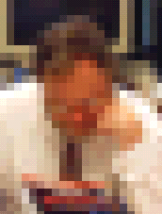
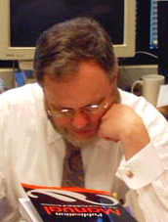
Resolution
Low resolution
Higher resolution
For photo-realistic images, the pixels must be too small for the eye to distinguish easily.

Slide 37
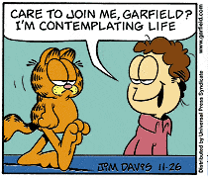

Color Depth
8 bits
24 bits
How many different colors with 8 bits? With 24 bits?
Photograph courtesy of Dr. Phillip Greenspun

Slide 38
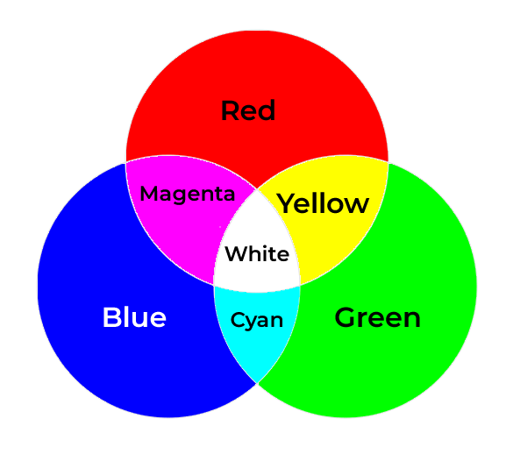
Additive Colors – The RGB Model
Computer displays emit light; we use the concept of additive colors to make many colors from the three primary colors, red, green and blue.

Slide 39
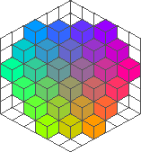
Displaying Many Colors
24 bits/pixel = 16.7 million colors (2²⁴) 8 bits each for R, G, B all off = black, all on = white
Other colors: proportional amounts of R, G, B
Color cube courtesy of William T. Johnson

Slide 40
Printing Color Pictures
Computer displays are illuminated; the colors are additive.
Printed colors are reflected. Printing uses the secondary colors cyan, magenta and yellow, plus black. (CMYK)
Printed colors are subtractive.

Slide 41
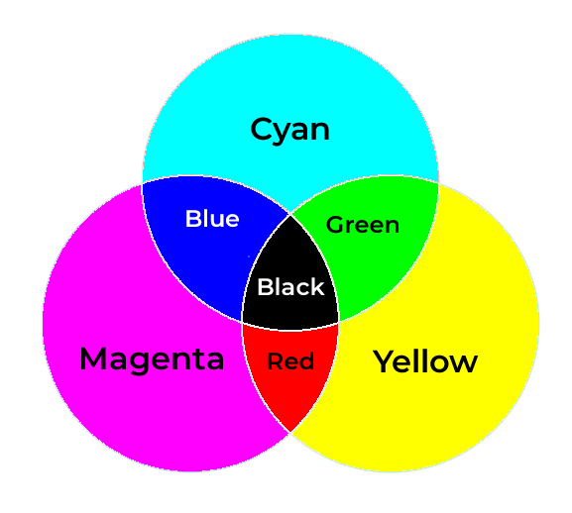
Subtractive Colors – CMYK Model
Cyan reflects blue and green, absorbs red. Magenta reflects red and blue, absorbs green. Yellow reflects red and green, absorbs blue.
Black is needed because CMY together are sort-of muddy brown.
Notes:
A fourth ink, black, is necessary because cyan, magenta, and yellow together make a sort-of muddy brown.

Slide 42
High Quality Images = Big Files
Better color depth: more bits per pixel.
Higher resolution: more pixels per inch.
Better pictures: Lots more bits.
High-resolution, photo-realistic images are big.

Slide 43
Image Formats
GIF (“jiff”) Graphics Interchange Format
Invented by Compuserve, 1987
8-bit color
Good for line drawings, large areas of color
JPEG (Joint Photographic Experts Group)
Good for photographs
“Compression artifacts” in large areas of a single color
PNG (Portable Network Graphics)
Aims to replace both GIF and JPEG

Slide 44
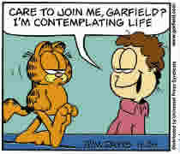
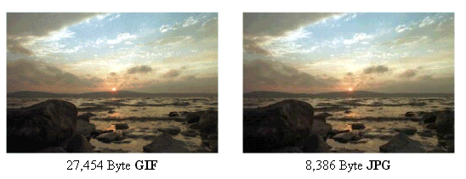
Image Formats
GIF: 14k
JPEG: 5k
http://www.onesnzeros.com/jpgvsgif/
Notes:
The JPEG format compresses very effectively. However, when there are large areas of the same color, the JPEG format produces compression artifacts, such as those below the speech balloon at the top right.

Slide 45
Raster Images
GIF, JPEG, and PNG are raster image formats, also called bitmap images.
They are composed of rows of pixels.
There are other bitmap formats.

Slide 46
Vector Images
Geometric objects can be described mathematically.
Circle: Center, radius, line width.
Much more compact storage than a bitmap.
Needs more computation.
Converted to bitmap for display.

Slide 47
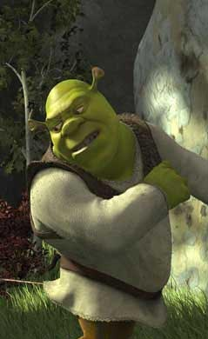
Object Images
Extends the idea of vector images
Images are mathematical models; never exist in “real life.”
So, not photographs, paintings, etc.
Shrek and Toy Story were made entirely from object images.
Shrek Copyright © 2001 DreamWorks SKG

Slide 48
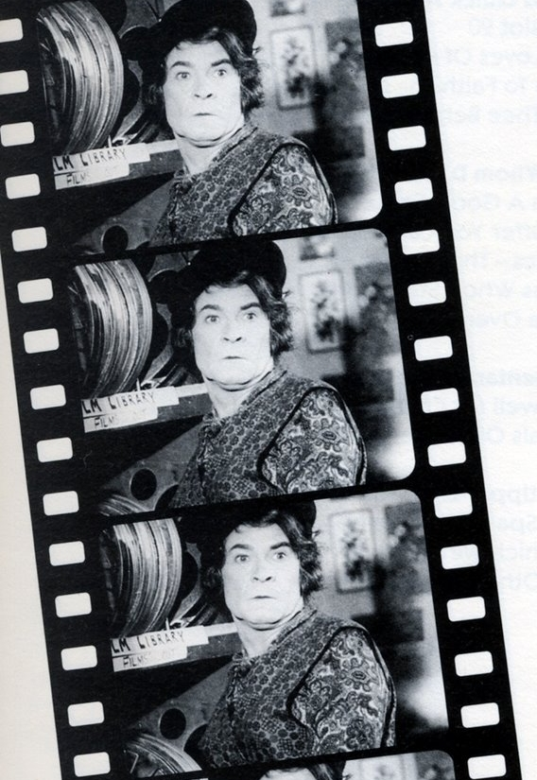
Moving Pictures
Changing an image 15-30 times per second can trick the eye into seeing motion.
Motion picture films used 24 frames per second, about 41 ms. per frame.
Notes:
The person in the images is Sir Stanley Baker

Slide 49
Digital Video
Each “frame” is just a raster image.
But they’re big! And we need up to 30 of them each second.
So, 27 MB of data every second!
Data can be compressed; we trade less data for the need for more computing power to de-compress the data.

Slide 50
Sounds
Sound is inherently analog (continuous)
Two dimensions
Amplitude (loudness)
Frequency (pitch)
Each can vary independently of the other
Amplitude
Frequency

Slide 51
Encoding Sounds
Audio is encoded as a series of integer samples. (Digital values, to get digital signals.)
The integer value determines the amplitude.
The sampling rate determines the maximum frequency.

Slide 52
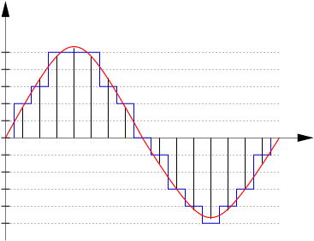
Encoding Sounds
Sample: -32 (small amplitude value)
Sample: 255 (large amplitude value)
Neither samples nor interpolation between samples is exact. The samples are integers.
http://musikality.net/wp-content/uploads/2009/01/quantised_waveform.png

Slide 53
How Many Samples?
Nyquist’s sampling theorem: Sample at twice the maximum frequency you want to reproduce. (This is a theoretical minimum sampling rate.)
Frequencies are expressed in Hertz (cycles per second.) A = 440 Hz.
To reproduce 20,000 Hz, sample at 40,000 Hz. or more.
Notes:
The 440 A is A above middle C.

Slide 54
How Big Are Samples?
More bits provide better discrimination among amplitudes and less noise.
Telephone: 8-bit samples (0-255)
CD: 16 bits for each of two stereo channels So, 0-65,535 and 32 bits per sample, 16 bits per channel.

Slide 55
Sample Size and Quality
Telephone: 8,000 8-bit samples/second Good enough to recognize voices 64,000 bits per second
CD: 44,100 samples/second One sample per channel; stereo=32 bits So, 44,100 × 32 = 1,411,200 bits/second
Trade-off: better sound = more data

Slide 56
Compression
High quality means big files; pictures, sound, video
What about large areas of the same color in pictures, or periods of silence in audio?
Compression recodes data to take less space.
Lossless compression: original signal can be recovered exactly.
Lossy compression: original signal is approximated when decompressed.

Slide 57
Compressing Audio
Both lossy and lossless compression.
Discard frequencies the human ear can’t hear (lossy).
Compress what’s left using Huffman coding (lossless).

Slide 58
Getting Data In
Images
Scanners
Digital cameras
Sounds
Microphone and CODEC: Coder/Decoder
Video
Camera or other image generation, video CODECs

Slide 59
Questions

