Slide 1

IT 3123
Hardware and Software Concepts
Number Systems
Binary Numbers
Notice: This session is being recorded.
Notes:
Time: 1:02

Slide 2
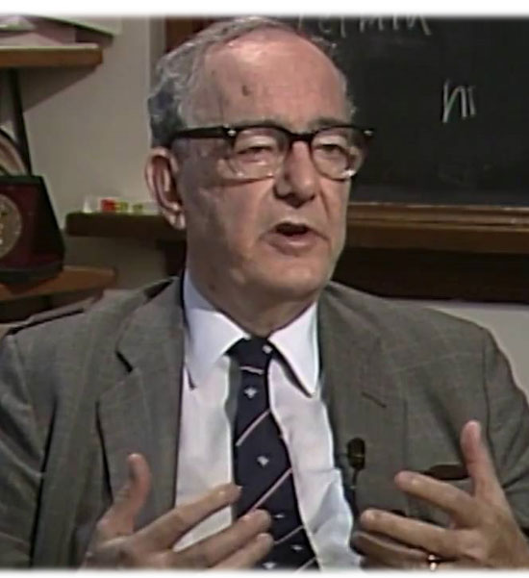
It’s All About You
“Learning results from what the student does and thinks
and only from what the student does and thinks.
The teacher can advance learning only by influencing what the student does to learn.”
–Herbert A. Simon
Notes:
In other words, your professors can help you and guide you, but learning is entirely up to you.
What can you do to enhance your learning?
Herbert A. Simon (1916 – 2001) was an American political scientist, with a Ph.D. in political science, whose work also influenced the fields of computer science, economics, and cognitive psychology.

Slide 3
A Note for the Math Averse
If you can do 1+1+1=3 …
… and you can multiply by 2
You can do all the math required for this course.
Do not let the notation put you off !

Slide 4
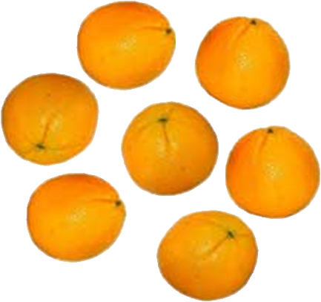

Numbers as Abstractions
Numbers can abstract physical quantities.
“Number systems” use sets of symbols to represent physical quantities.
Cave dweller: llll ll
Roman:
Arabic-Indic: 7 (۷)
Notes:
The Roman number looks suspiciously like tally marks.

Slide 5
Symbols Represent Values
0: none 5: five
1: one 6: six
2: two 7: seven
3: three 8: eight
4: four 9: nine

Slide 6
Positional Number Systems
For the cave dweller and the Roman, the symbols alone convey all the information
llll ll
The decimal number system we use every day is a positional number system. The value of a symbol depends upon:
  The symbol itself
  Its position within the number.
So, 700 is very different from 007
Notes:
The Romans were developing the idea of positional notation, but never quite got there.

Slide 7
The Decimal Number System
Also called base 10 or radix 10 numbers
Ten symbols: 0,1,2,3,4,5,6,7,8,9
Positions
  Ones place (on the right)
  Tens place
  Hundreds place
  Etc.

Slide 8
The Decimal Number System *
Also called base 10 or radix 10 numbers
Ten symbols: 0,1,2,3,4,5,6,7,8,9
Positions
  Ones place (on the right)
  Tens place
  Hundreds place, etc.
  1,037 = 1×1000 + 0×100 + 3 ×10 + 7×1

Slide 9
Powers of 10
Rule: Any number to the power zero is one Rule: Any number to the first power is itself
10⁰ = 1
10¹ = 10
10² = 100
10³ = 1000
... etc.
1,037 = 1× 10³ + 0 × 10² + 3 × 10¹ + 7× 10⁰

Slide 10
The Importance of Zero
Rule: Any number times zero is zero
1,037 = 1× 10³ + 0× 10² + 3 × 10¹ + 7× 10⁰
0× 10² = 0
The zero in 1,037 does not contribute to the value of the number
It is important as a placeholder
1,037 is not the same as 137 !
The zero puts the one in the thousands place (instead of in the hundreds place)

Slide 11
We Can Express Any Integer
Using just the digits 0 to 9, we can express any non-negative number, however large.
Form of an n-digit number:
a_{n-1}×10^{n-1}+ a_{n-2}×10^{n-2} + … + a₁×10¹+ a₀×10⁰
A more compact form:
Σ
n−1
a_{i}×10^{i}
i=0

Slide 12
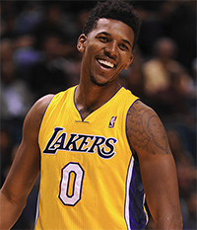
Counting and Enumerating
With one decimal digit, we can count to nine.
We can enumerate (number)
ten things because it is
possible to start numbering
at zero.
In base 10, with n digits,
we can count to 10^{n} –1.
We can enumerate 10^{n} things.
This extends to other bases as we will see.
Notes:
Nicholas Aaron (Nick) Young, LA Lakers. Later Golden State Warriors and Denver Nuggets.
https://en.wikipedia.org/wiki/Nick_Young_%28basketball%29

Slide 13
Negative Numbers
Adding a minus sign lets us express negative numbers:
± a_{n-1}×10^{n-1}+ a_{n-2}×10^{n-2} + … + a₁×10¹+ a₀×10⁰
n−1
Σ
±
a_{i}×10^{i}
i=0

Slide 14
Decimal Fractions
We use a “decimal point” to represent fractions.
0.1 = 1/10 = 10⁻¹
0.01 = 1/100 = 10⁻²
Decimal fractions are based on negative powers of 10
Unlike integers, not all fractions can be represented, e.g. 1/3
But, we can be arbitrarily precise: 0.3 or 0.33 or 0.3333, or 0.3333333333333, etc.
Notes:
Arbitrarily precise applies only to pen-and-paper arithmetic. Computers work with fixed size numbers and perform finite-precision arithmetic. In that case, the precision of a fraction, or any other number, is limited to the precision of the data type being used.

Slide 15
Other Bases
Decimal numbers are “base 10” numbers
Based on the sum of a power series in powers of 10.
There is nothing magic about base 10.
For numbers in base B
  B symbols (to represent digits)
  Powers of B
n−1
Σ
±
a_{i}×B^{i}
i=0

Slide 16
Base 8 Numbers
8 digits, 0, 1, 2, 3, 4, 5, 6, 7
Powers of 8:
624₈
Base shown by subscript when not clear from the context
Notes:
1, 8, 64 (***2), 512 (8**3)
64*6=384
8*2=16
384+16+4=402

Slide 17
Base 8 Numbers *
8 digits, 0, 1, 2, 3, 4, 5, 6, 7
Powers of 8:
624₈
624₈ = 6 × 8² + 2 × 8¹ + 4 × 8⁰
624₈ = 6 × 64 + 2 × 8 + 4 × 1
624₈ = 384 + 16 + 4 = 404₁₀
Base shown by subscript when not clear from the context
Notes:
1, 8, 64 (***2), 512 (8**3)
64*6=384
8*2=16
384+16+4=402

Slide 18
What Base Shall I Choose?
A base n number system needs n symbols for the digits
The digits enumerate the values 0 to n−1
e.g. 0, 1, 2, 3, 4, 5, 6, 7, 8, 9 for base 10
Trade-offs:
  a smaller base means fewer symbols are needed
  a larger base means numbers are more compact

Slide 19
Binary (Base 2) Numbers
2 digits: 0, 1
Powers of 2
1 0 1 1 1₂
Notes:
http://mathscitech.org/articles/zero-to-zero-power

Slide 20
Powers of Two
2⁰ = 1 2⁷ = 128
2¹ = 2 2⁸ = 256
2² = 4 2⁹ = 512
2³ = 8 2¹⁰ = 1024
2⁴ = 16 2¹¹ = 2048
2⁵ = 32 2¹² = 4096
2⁶ = 64 2¹³ = 8192
Each successive power is twice the one before it. You can do this in your head!
Remember to start at zero!

Slide 21
Powers of 2 to Memorize
2⁴ = 16 For hexadecimal
2⁸ = 256 Size of one octet
2¹⁰ = 1,024 One “K”
2²⁰ = 1,048,576 One “meg”
2³⁰ = 1,073,741,824 One “gig”
2³² = 4,294,967,296 Four gigs
2³² is the most of anything (memory, disk, etc.) you can address (i.e. number) with a 32-bit word.

Slide 22
How High Can We Count
However, counting starts with zero, so
2⁴ = 0 to 15
2⁸ = 0 to 255
2¹⁰ = 0 to 1,023 etc. …
More in this later.

Slide 23
Converting Binary to to Decimal
1 0 1 1 1 ₂
2⁴ 2³ 2² 2¹ 2⁰
16 8 4 2 1
16 + 4 +2 + 1 = 23₁₀
Write down the powers of two below the digits, from right to left. Remember to start at 2⁰ = 1 !
Write the decimal values of those powers of two.
Add up the powers of two for which the binary number bits are one.
Notes:
Write down the powers of two for each place, starting with two-to-the-zero power on the right.
Write down the decimal values of those powers of two.
Add up the decimal values for each position where the binary digit is a one,

Slide 24
Converting Decimal to Binary (1)
Divide the decimal number repeatedly by two
Carry the quotient down; write the remainder on the right.
Example: 23 ÷ 2 = 11, remainder 1
23 1
11
2

Slide 25
Converting Decimal to Binary (2)
11 ÷ 2 = 5, remainder 1
23 1
11 1
5
2

Slide 26
Converting Decimal to Binary (3)
5 ÷ 2 = 2, remainder 1
23 1
11 1
5 1
2
2

Slide 27
Converting Decimal to Binary (4)
2 ÷ 2 = 1, remainder 0
23 1
11 1
5 1
2 0
1
2

Slide 28
Converting Decimal to Binary (5)
1 ÷ 2 = 0 , remainder 1
Nothing left to divide, so we are done
23 1
11 1
5 1
2 0
1 1
0
10111₂
2
Leftmost digit

Slide 29
Why This Works
Dividing by two tells us how many twos there are in the number: 11. The remainder is how many ones, 1. It’s the top number of the column, but the rightmost digit of the result, the ones place.
Hint: the rightmost bit of a binary number tells you whether the number is odd or even. Why?

Slide 30
Why This Works (1)
Divide 11 by two again to find the number of fours: 5. The remainder is how many twos are not accounted for in the fours, one.
That will be the second digit from the right in the result, the twos place.

Slide 31
Why This Works (2)
Divide 5 by two to find the number of eights: 2
The remainder is the number of fours unaccounted for in the eights, one.
That’s the fours place.

Slide 32
Why This Works (3)
Divide two by two to find the number of sixteens. There is one sixteen, and no “left over” eights. We are done.
1 0 1 1 1 ₂
16 8 4 2 1
16 + 4 + 2 + 1 = 23₁₀

Slide 33
How High Can We Count?
One bit: 0 or 1 0 to 1
Two bits: 00, 01, 10, 11 0 to 3
Three bits: 000, 001, 010, 011 0 to 7
100, 101, 110, 111
Four bits: 0000 to 1111 0 to 15
Five bits: 00000 to 11111 0 to 31
In general: n bits can count: 0 to 2^{n}−1
We can enumerate 2^{n} things, starting at zero.

Slide 34
Why this is Important
An octet (byte) is eight bits.
What is the biggest number you can store in eight bits?
2⁸ = 256 2⁸−1 = 255
We can count from zero to 255, and no higher, in one octet!
In 32 bits, 2³² −1 or about four billion.
… what if we need more than four billion?

Slide 35
What is 2⁶⁴ ?
18,446,744,073,709,551,616
Or, 1.8 × 10¹⁹
Notes:
Hundred thousand million billion trillion quadrillion quintillion (quintillion is “exa”
Also sextillion septillion

Slide 36
Why Binary?
Why do all computers use binary devices internally? Reliability.
Consider a decimal computer: zero volts=0, one volt=1, seven volts = 7, etc.
We are representing digits, not quantities.

Slide 37
Why Binary? *
Why do all computers use binary devices internally? Reliability.
Electronic components are not perfect; a tolerance of ±10% or so when they leave the factory…
… and they get worse with age.
What do we do with 7.2 volts? 7
How about 7.8 volts? 8
A 10% error causes an undetectable mistake!

Slide 38
Why Binary ? Reliability!
10% error
9
Desired value
8
10% error
10% error
7
Desired value
1
6
10% error
5
49% error
4
3
2
0
1
0
0
Decimal Representation
Binary Representation

Slide 39
Binary Devices for Reliability
The ENIAC electronic
computer used ten
vacuum tubes operating
in on/off (binary) mode
to represent one
decimal digit.
This was called a “ring
counter” because turning one tube off turned the next one on.
0
9
1
Ring counter representing value seven.
8
2
7
3
6
4
5

Slide 40
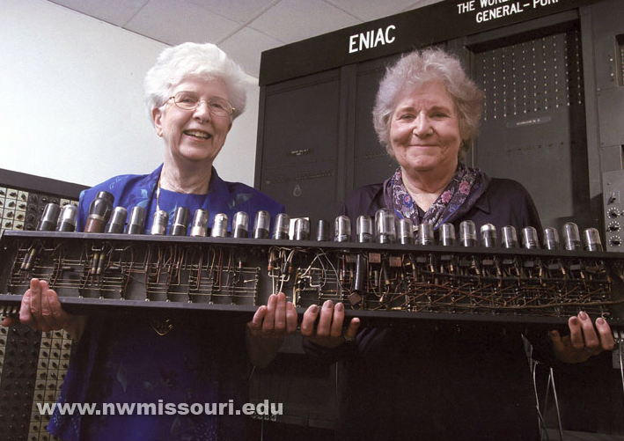
A Ring Counter from ENIAC
Notes:
https://www.flickr.com/photos/nwmostate/5556128350/
Jean Jennings Bartik and the ENIAC
Kay McNulty Mauchly and Jean Jennings Bartik hold an ENIAC Decade Ring Counter, which is on display in the Jennings Bartik Computing Museum on loan from the Smithsonian Institution.
McNulty Mauchly, is the widow of John Mauchly who helped design the computer. (Photo by Darren Whitley/Northwest Missouri State University & the Jean Jennings Bartik Computing Museum).

Slide 41
Binary Addition
1
0 0 1 1 1
0 1 0 1 1
0 1 1 10 11
+
+
+
+
+
+
The first three of these are obvious.
The fourth one is just 1+1=2
The last one is needed when you have a carry in. It is 1+1+1=3

Slide 42
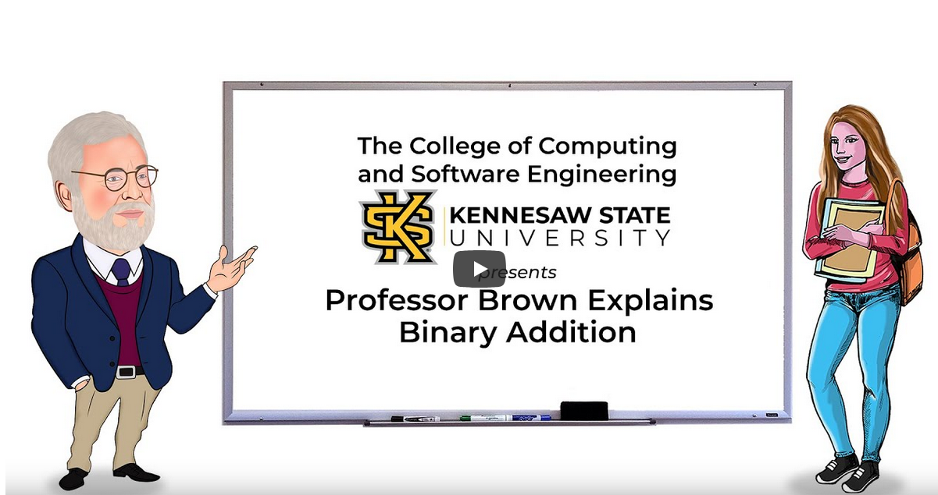
Want to Hear that Again?
https://www.youtube.com/watch?v=Fle0A8CbApQ

Slide 43
Binary Addition *
1
1
1
1
1
1
1
0
1
1
0
1
+
1
0
1
1
0
1
0
0
0
0
0
1
1

Slide 44
Binary Multiplication
1
1
0
1
Multiplicand
1
0
1
Multiplier
1
1
0
1
1’s place
0
2’s place
1
1
0
1
4’s place (bits shifted)
1
0
0
0
0
0
1
Product
If the multiplier digit is a one, the partial product is a copy of the multiplicand, shifted to align with the multiplier.
If the multiplier digit is zero, the partial product is zero
There is no actual multiplication.

Slide 45
Finite-Precision Arithmetic
Precision: The number of significant digits in a number.
Pencil and paper: if you need more digits, just write them down. Precision is effectively unlimited.
Computer: Fixed number of bits, 8, 16, 32, 64, or more, but always fixed!
Computer hardware works with finite-precision numbers.

Slide 46
Finite-Precision Arithmetic 2
Finite Precision Arithmetic: Arithmetic on numbers for which the number of digits (precision) is fixed.

Slide 47
Finite-Precision Arithmetic 3
It is important to remember that computers work with finite-precision arithmetic…
… because forgetting that can lead to wrong answers:
  Big numbers
  Very small numbers
  Complex numerical problems

Slide 48
Overflow
Numbers can become too large to fit in the (fixed) number of digits available.
Overflow: The condition that the result of an arithmetic operation is too large to fit in the space available.

Slide 49
Binary Devices to Binary Numbers
A ten-element ring counter can count from zero to nine.
John von Neumann realized, and told his colleagues, that if the same ten binary elements were used to represent a binary number, one could count from zero to 1023.
We use binary devices for reliability.
We use binary numbers because it takes significantly fewer devices to represent a given value; use of binary numbers is economical because it maximizes the expressive power of binary devices.
Notes:
http://en.wikipedia.org/wiki/Binary_number
The modern binary number system was discovered by Gottfried Leibniz in 1679 and appears in his article Explication de l'Arithmétique Binaire. However, systems related to binary numbers have appeared earlier in multiple cultures including ancient Egypt, China, and India. Leibniz was specifically inspired by the Chinese I Ching.

Slide 50
Questions

