Slide 1
IT 3123 Hardware and Software Concepts
Where we are,
How we got here
Notes:
Time: 1:10

Slide 2
About Note Taking and Studying
Read the assigned material before class.
In class, you should mostly be listening.
Make short notes on paper of anything you think is important, especially if it’s not on the slide.
Merge your notes onto the slides the following day.
Each class day, review the slides and notes from the class one week ago.
Notes:
The Pen Is Mightier Than the Keyboard: Advantages of Longhand Over Laptop Note Taking
Pam A. Mueller (Princeton) and Daniel M. Oppenheimer (UCLA)
https://linguistics.ucla.edu/people/hayes/Teaching/papers/MuellerAndOppenheimer2014OnTakingNotesByHand.pdf

Slide 3
Computing in the 21st Century
Ubiquitous computers called “smart phones.”
Huge data centers with thousands of pizza-box size computers
Mainframe computers in about 2/3 of Fortune 100 businesses.
Supercomputers for modeling and other tasks.
Embedded computers.
And nearly all of them interconnected.
Notes:
In the twenty-first century, digital computers are everywhere. You almost certainly have one with you now, although you may call it a “phone.” You are more likely to be reading this book on a digital device than on paper.
An electronic digital computer is a machine. It has mechanisms for receiving input of information, for processing and storing information, and for producing and communicating results. You will find computers in all kinds of specialized devices, but the computer itself is one of the most general-purpose machines ever devised. The more general a technology, the more and more varied the uses to which it will be put. We use computers for everything from preparing tax returns and processing them to landing airplanes, generating medical images, and displaying pictures of cats.

Slide 4
Computer Components
Hardware
Executes instructions
Provides paths for input and output
Provides temporary and long-term storage
Software
Computer programs; instructions in machine language
Data
Representation of facts, measurements, observations, in a form that can be used by the computer.
Notes:
Every computer has hardware, software and data. You have to be really bold when you say “every.”
How about the computer that costs four cents to produce and goes inside one of those annoying greeting cards that does something when you open it up?
Hardware? Well yeah, there’s a little chip in there. Software? Yeah. Something happens to make that chip go. Data? Yeah. Sings “Happy Birthday to You.” So for the very simplest computer I can think of, we’ve got hardware, software, and data.
How about the Internal Revenue Service? A big computer somewhere in suburban Washington DC, out in McClean Virginia, somewhere maybe?
Hardware, software, data.
The hardware executes instructions and we will talk you know a fair amount of detail about what an instructions is and that mechanism for input and output and mechanism for both temporary and long term storage.
Software - that’s computer programs and by the time a program is actually being executed on computer it is in binary form in the language of the machine and we will talk about that in a certain amount of detail.
Data are representations of facts, measurements observations, information in a form that can be used by the computer and what we are going to find out is that form is binary numbers.

Slide 5
Computer Systems
All computer systems, no matter how complex, consists of the following:
At least one CPU
Memory to hold programs and data
I/O devices, including communications
Long-term storage
Notes:
All computer systems all have at least one central processing unit - some sort of memory for programs and data; some sort of input and output and some mechanism for long term storage.
Now, let me say that if you bought a microwave oven any time since about 1980 ... If you have one older than that please pitch it... It is going to microwave you! It has a computer in it because it is cheaper to build a computer control for a microwave oven than it is to build all of the switches, springs, gears, and dials that it would take to do the same thing.
So we have your in your microwave oven these four things. Yes?
We have a CPU in there. Yes. Memory? Yes, because the program is still there when you turn the thing back on.
How about memory for data? Sure - how long do I want to nuke this in order to set off all the fire alarms in the building?
Every now and then somebody comes in with a bag of popcorn. Right? And they punch up 27 minutes and then they head for the men’s room or something. I don’t know where they go. And what happens? Fire alarm goes off. Right because you have burned down an entire bag of popcorn.
I/O? Do we have I/O in a microwave oven?
Yes. Beep. Beep. Beep. 27 minutes. Start. That’s the ‘I’ in the I/O. What’s the ‘O’?
Output - we’ve got a little countdown timer going on telling us how many seconds are left. And we have got something controlling the magnetron that is generating those microwaves. So we have got some internal output as it were.
Even a simple little computer system has all four of those properties.

Slide 6
Computer Systems
A computing system is more than just hardware and software.
Hardware
Several layers of software
Communications
Data
Purpose: to solve specific problems or perform specific functions.
Notes:
We need to consider that a computing system is not just hardware and software. We have got the hardware all right. And we are going to have several layers of software, probably at least two and usually more than that.
Communications, information, and the purpose of all of this is we have some specific problem that we have in mind to solve whether it is mapping the human genome or playing solitaire. We are solving some specific problem.

Slide 7
“Virtual” Components
Virtual (American Heritage Dictionary)
Existing or result in essence or effect though not in actual fact, form or name (You can see it, but it’s not really there.)
Created, simulated, or carried on by means of a computer or computer network
Computer systems examples:
Virtual memory
Virtual computer
Java Virtual Machine
Notes:
Now we are going to talk about virtualization in a couple of different senses, so I am going to be using the same word to mean two different things. That is kind of unfortunate but that is the way computing works.
The American Heritage dictionary says virtual is existing in result or essence. Okay - my definition -- this didn’t come from American Heritage’s - you can see it, but it is not really there.
That’s virtual, okay?
Created, simulated, or carried on by means of a computer or a network. So, we talk about virtual memory, we will talk about virtual networks. Everybody has taken a programming course before you got here so you already know about the job of virtual machines

Slide 8
The Virtual Machine Concept
Virtual machine:
A combination of hardware and software
Which presents specific interfaces to application software
That are not supported by the hardware alone
Hardware and an operating system together define a virtual machine.
Later we will find that a single hardware platform can run more than one virtual machine at the same time.
Notes:
A virtual machine in the most general sense is a combination of hardware and software. That combination provides specific services, presents specific interfaces to application software and it provides both services and interfaces that are not supported by the hardware alone.
So hardware and operating system together define a virtual machine. So there is a computer under the desk here and it is running Windows 7 and so I have a Windows 7 virtual machine. I can come in here with a handful of CDs, format the discs, load Red Hat Linux on there and the same piece of hardware would suddenly become a Linux virtual machine because the virtual machine-ness is a combination of hardware and software.
Questions? That is kind of a subtle distinction?
I could take a similar set of Red Hat discs, load them on an IBM z-series mainframe and have a Linux virtual machine. This time I have changed the hardware instead of changing the software.

Slide 9
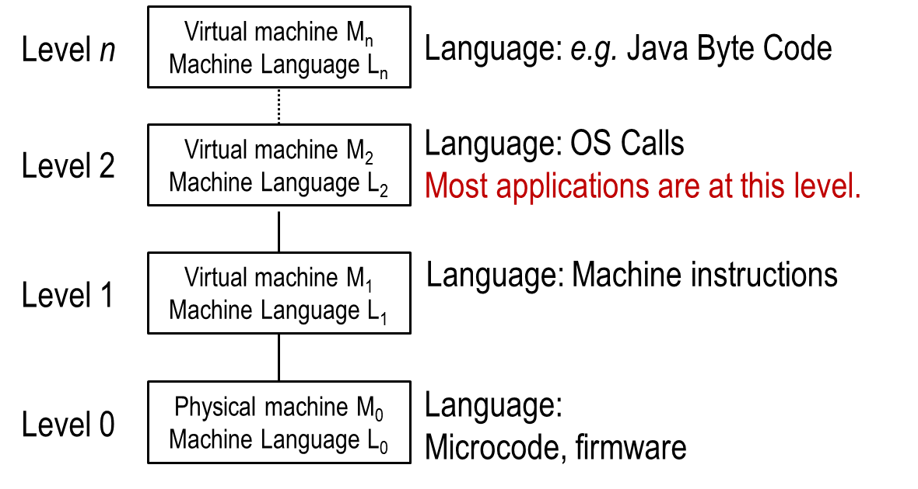
Languages, Levels, Virtual Machines
A multilevel machine
Notes:
Down at the bottom, there is some actual computer machinery. And that computer has some machine language L₀. That is the bare metal of the computer.
One level up - I have got a virtual machine M₁ with some machine language L₁. In this case I might have a Windows 11 virtual machine sitting under the desk. And then I can go up above that and say some other virtual machine M₂ ... This is a smart board virtual machine. Right? So I am doing Power Point on smart board. With different languages being interpreted by the machine below.
And I can layer that as deeply as necessary to accomplish what I am trying to accomplish.

Slide 10
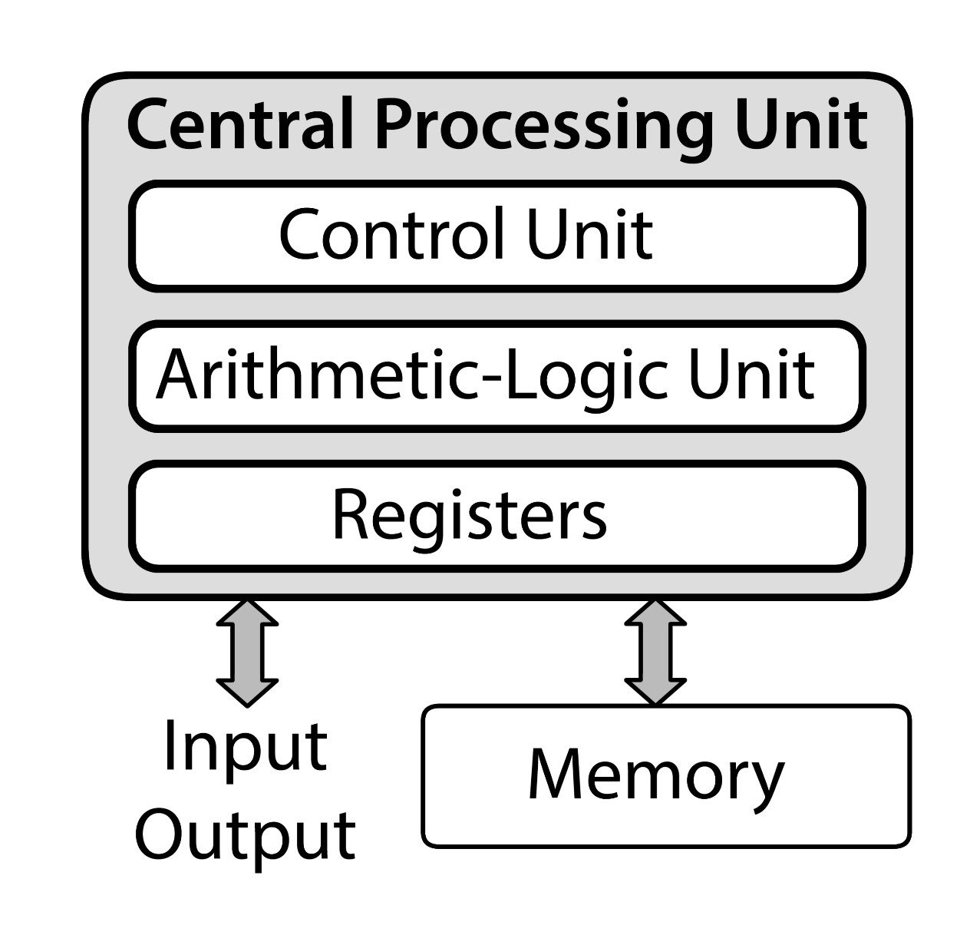
The von Neumann Architecture
Notes:
You are going to see this 27 times this semester.
I made 27 up - but you are going to see it up in the double digits probably ... What does it mean when the professor shows you the same thing half a dozen times?
It is important! And once you realize something is important what do you infer from that?
You should know it because it is going to be on the test.
Okay - this is the von Neumann computer architecture. I have a central processing unit or a CPU.
The components of that CPU are a control unit and an arithmetic logic unit. They are connected together. Registers are small fast memory that's part of the CPU. The registers hold data or control information being used at the moment by the CPU.
The fat arrow on the diagram says that I can send more than one bit of data at a time across this path and the double ended fat arrow says that it is a two directional path.
Then that central processing unit is connected to a memory and to the outside world with some sort of input and output facility.
This basic architecture is left over from the 1940s. So it is seventy years old. It is almost as old as I am! It is still the way computers are designed in 2013.

Slide 11
The Arithmetic Logic Unit (ALU)
Performs arithmetic operations on data
Performs logical operations (if-statements, etc.)
Can be used to transfer data
Within the CPU
From CPU to I-O
Notes:
The arithmetic logic unit does exactly what you think it does. It provides arithmetic and logical operations. This is not hard stuff. And it can also be used to transfer data both within the CPU and between the CPU and the input and output facility.

Slide 12
The Control Unit
Controls the processing of instructions
Controls movement of data within the CPU.
Program counter: A small area of memory within the CPU that holds the address of the next instruction.
Notes:
The arithmetic and logic unit is the thing that does the processing. The control unit controls the processing. Part of the control unit is this thing called the program counter.
The program counter and we will see the importance of this about February 1 - although we will talk about it before then.
The program counter holds the address of the next instruction.
That is going to be the class chant.
The program counter holds the address of the next instruction.
Are you with me?
The program counter holds the address of the next instruction.
About a third of you are going to get it right on the exam.
The rest of you are going to make something up because you were not with me, and there is only one right answer.

Slide 13
Registers
Registers are small, fast storage that’s a part of the CPU.
The number of registers ranges from a few to perhaps 128; there aren’t thousands of them.
The size of a register is generally the word size of the computer architecture, so a 64-bit computer is likely to have 64-bit registers except those used for special purposes.

Slide 14
The Interface Unit
Moves data and instructions between the CPU and the rest of the computer.
Bus: A bundle of wires that carry data and power between parts of a computer. (Or traces on a wiring board, or within a chip.)
Notes:
The interface unit is responsible for moving data among the parts of the computer.
And a large part of interfacing is this thing called a bus.
The slide says a bus is a bundle of wires - that is kind of old, just as I am. But it is a collection of electrical conductors. It might be a bundle of wires. It might be traces on a printed wiring board or it might be conductive traces inside a chip.
But in every case it is a collection electrical conductors and the job of that bus is to carry data and sometimes power among the parts of the computer.

Slide 15
Memory
Also know as:
RAM (Random Access Memory)
Main memory
Primary storage
Holds instructions (in machine language) and data for running programs.
Notes:
The computer’s memory is also known as RAM or random access memory, main memory or primary storage. This is where programs and data live while the program is running.
So, as the slide says, memory holds instructions, and those instructions are in machine language, for programs that are running at the moment.
The stored program concept, something else invented by John von Neumann in the 1940s... There was this great ‘Aha!’ experience when von Neumann said you know, if I represent a program as a series of binary numbers, instead of as of as a collection of wires, I can store those binary numbers in the same memory that holds the data. And instead of having to rewire the computer when I have a new problem, all I have to do is load a new program into the computer’s memory.
This is obvious to us... But it was a great ‘Aha!’ about 1946 or 1947.
That program counter (which holds the address of the next instruction) is what keeps track of the those instructions in main memory.

Slide 16
Units of Memory
The smallest unit of storage is one bit; can hold only zero or one.
Bit: binary digit
Bits are organized into larger units.
A byte (or octet) is eight bits.
A word may be 16, 32, 64, or more bits, depending on the architecture of the computer.
Computers (usually) perform arithmetic one word at a time; bigger words = faster computer.
Notes:
The smallest unit of storage is one bit. “Bit” is a contraction of the words binary digit. We will talk about binary next time. A bit can hold only a zero or a one. A bit has only two possible values. We organize those bits into larger units. There’s no chance you have gotten this far as students in computing without hearing the word byte.
And “octet” is a synonym for byte; the two words mean the same thing.
That is a collection of eight bits - and you have talked about computers with 32 bit and 64 bit words. A computer “word” is the number of bits on which we do arithmetic so it could be eight or sixteen or 32 or 64 or even more. In general we perform arithmetic one word at a time... So bigger words in general imply faster computation. I can crunch more digits more bits in one operation if I have a 64 bit word than if I have a 32 bit word.

Slide 17
Stored Program Concept
Stored program concept: The same memory can be used to hold instructions and data. (The program counter keeps track of the instructions.)
Invented by John von Neumann and (probably) independently by others.
It’s software! Everything we do with software today depends upon the stored program concept.
Notes:
The computer’s memory is also known as RAM or random access memory, main memory or primary storage. This is where programs and data live while the program is running.
So, as the slide says, memory holds instructions, and those instructions are in machine language, for programs that are running at the moment.
The stored program concept, something else invented by John von Neumann in the 1940s... There was this great ‘Aha!’ experience when von Neumann said you know, if I represent a program as a series of binary numbers, instead of as of as a collection of wires, I can store those binary numbers in the same memory that holds the data. And instead of having to rewire the computer when I have a new problem, all I have to do is load a new program into the computer’s memory.
This is obvious to us... But it was a great ‘Aha!’ about 1946 or 1947.
That program counter (which holds the address of the next instruction) is what keeps track of those instructions in main memory.

Slide 18
Application Software
Application software: software that fulfills the purpose of the computer system.
Payroll
Word processing
Web server
Notes:
Application software is what computers are all about. Application software fulfills the purpose of the computer.
So I might want a computer to do payroll or I might want it do word processing or to be a web server or to play solitaire... Actually solitaire is boring, but Freecell is kind of fun.
All of these are applications. They are the things that we buy the computers for.
Almost nobody buys a computer to run Windows 11 When we do that we can run Windows 11 all right but that isn’t why we bought the computer. The operating system whether it is MAC OS or Windows 11 or whatever supports those application programs.

Slide 19
Operating System
Operating system: software that supports the application by providing user and hardware interfaces
Graphical user interface
File management
Input and output
Memory management
Resource scheduling
Security
Notes:
And it does that by providing interfaces for the user and also interfaces to the hardware.
If a computer system has a graphical user interface, and they don’t all necessarily have to do that, that is part of the operating system.
Managing files stored on the disk is part of the operating system. Dealing with input and output, managing memory, scheduling the computers resources and if you are thinking about your own desktop computer you might at first think that there are not many resources to schedule but what happens if you print a spreadsheet and while it is printing you try to try to print a word processing document?
It just works! Right? The spreadsheet finishes and the word processing document starts and nothing gets intermixed and everything is fine.
The operating system was doing the resource scheduling that let that happen for you.
In so far as there is security in computing, the operating system is responsible for that.

Slide 20
Communications Hardware
Communication channels
Physical connections between computer systems
Examples: wire cable, phone lines, fiber optic cable, infrared light, radio waves
Interface hardware
Handles communication between the computer and the communication channel
Modem or network interface controller (NIC)
Notes:
A big part of computing in 2013 is communication. And so we have hardware that is devoted to communicating.
We are going to talk about communication channels as the physical connections between computing machines whether that is an Ethernet cable or fiber optic cable or Wi-Fi radio or something else and we will talk about interface hardware that is the connection between that communication channel and the computing machine itself.
And we have software that is involved in communications for establishing connections, controlling the flow of data, and we have to control the flow because we might have a sending computer be much faster than the receiving computer so we have to be able to put some back pressure on that data.
And also to direct data to the correct application.

Slide 21
Communications Software
Establish connections
Control flow of data
Directs data to the proper applications for use
It’s that “TCP stack” you’ve heard about.
Protocols are the standards that make communication hardware and software work.
Notes:
A big part of computing in 2013 is communication. And so we have hardware that is devoted to communicating.
We are going to talk about communication channels as the physical connections between computing machines whether that is an Ethernet cable or fiber optic cable or Wi-Fi radio or something else and we will talk about interface hardware that is the connection between that communication channel and the computing machine itself.
And we have software that is involved in communications for establishing connections, controlling the flow of data, and we have to control the flow because we might have a sending computer be much faster than the receiving computer so we have to be able to put some back pressure on that data.
And also to direct data to the correct application.

Slide 22
How We Got Here: Early Ideas
1642: Blaise Pascal invents a calculating machine
1801: Joseph Jacquard invents a loom that uses punched cards to control the pattern. Punched cards were used for automation through the 1970s.
1854: George Boole invents Boolean logic and Boolean algebra. This algebra of true and false can be used as an algebra of binary numbers.
Notes:
So - history - I love it! 1642 - remember it well - Pascal invents this calculating machine - add subtract... I think all did was add and subtract. I don’t remember whether it multiplied and divided or not.
People didn’t trust it -- they were sure that Pascal had built this thing to somehow flim-flam them and they insisted on doing the arithmetic the hard way anyway.
Two hundred years pass - almost - and a Frenchman by the name of Joseph Jacquard invents a loom, a weaving machine that uses that punch cards to control the way the threads are woven and to control the pattern.
If you go to K-Mart and buy the 19.95 oriental rug it was woven on a Jacquard loom. If you buy a real Oriental rug, it was woven by a little old man sitting cross-legged in the sand, right? It is the Jacquard loom that gets you something for 20 bucks that has that complexity.
George Boole invented an algebra over “finite sets of discrete values” in the 1850s. Claude Shannon developed the switching algebra, used to analyze digital logic, from that in the 1930s.

Slide 23
Charles Babbage and Ada King
Charles Babbage builds a difference engine for mechanical calculation.
Babbage attempts to build an analytical engine (mechanical computer). Important because it presented the idea of a general-purpose computing engine.
Augusta Ada King, Countess Lovelace develops fundamental concepts of programming
Notes:
Also in the 1800s, a Britisher by the name of Charles Babbage built a mechanical computer called the Difference Engine (because is used the method of finite differences for computation… look it up!) that was used to compute the navigation tables that British sailors used.
A navigational table like that is a star chart – it’s called an ephemeris - and Babbage was so successful with that he decided that is should be possible to build a general-purpose mechanical computer which he called the analytical engine.
He didn’t succeed but it is mostly because the technology for making sufficiently precise gears didn’t exist. There are modern copies of the analytical engine that work.
Augusta Ada King, Countess Lovelace, Lord Byron’s daughter, knew Babbage and developed some of the fundamental concepts of programming.

Slide 24
The World War II Era
1937: Mark I is built (Aiken, Harvard University, IBM). A computer built using relays.
1939: The Atanasoff-Berry Computer (ABC) is built. First fully electronic digital computer. Used vacuum tubes.
1943-46: ENIAC (Mauchly, Eckert, University of Pennsylvania). First general-purpose digital computer.
Notes:
A huge number of advances in competing came out of World War II -in 1937 the Harvard Mark 1 calculator made from telephone relays.
1939 is the ABC computer - the first fully electronic digital computer.
1943-46 - Electronic Numerical Integrator and Calculator (ENIAC), also built for military use - Babbage was doing ephemeri for the British Navy, and Eckert and Mauchly were doing firing tables for the US Army.

Slide 25
The World War II Era (2)
Alan Turing, father of Computer Science
Code breaking for British military
Colossus computer
1945: Von Neumann architecture proposed.
Still the standard for present day computers.
Stored program concept: instructions and data
Instruction cycle
Binary numbers
Notes:
Allen Turing invents computer science at Bletchley Park in England ... Something that he described as a place as ugly as its name.
And in 1945 John von Neumann was at the Los Alamos National Laboratory in New Mexico trying to solve the hydrodynamic equations of an H Bomb. The A Bomb was already taken care of by Oppenheimer and Feynman, right?
So von Neumann is trying to figure out the hydrodynamics of the hydrogen bomb with a pencil. And being one of the smartest people of the last century he quickly figured out that he could not do that. So - he hunted around for people who were working on electronic computing, went there, told them how to build a computer, and then disappeared back to Los Alamos and waited until they finished.
It was von Neumann who invented the stored program concept and invented the instruction cycle which we will talk about a little later in the semester, and the use of binary numbers with computing.

Slide 26
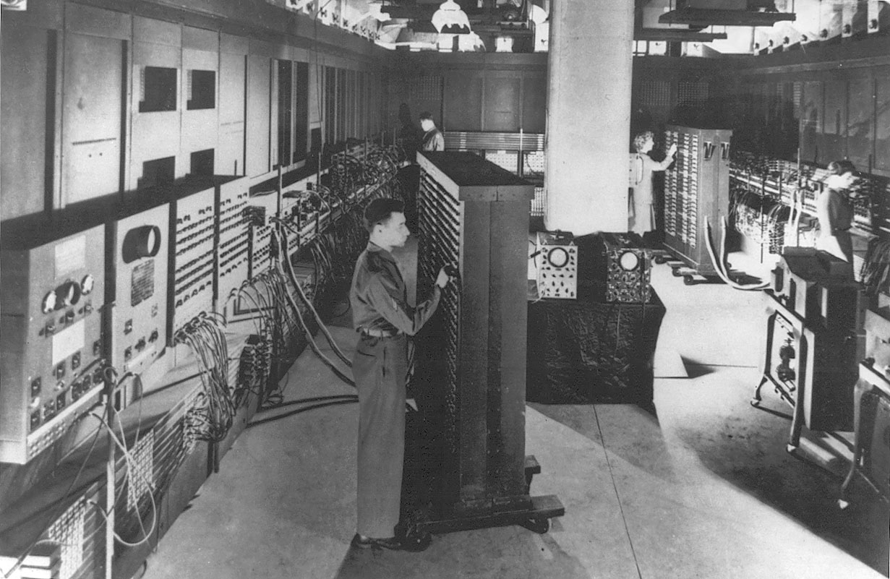
The ENIAC
Electronic Numerical Integrator and Calculator
Built to compute firing tables
18,000 vacuum tubes
Notes:
This is a picture of ENIAC - the ABC computer was a kind of specialized computer so it was the first electronic computer, but ENIAC was the first general purpose electronic computer.
It is kind of hard to see with the lights on in here but there is a guy standing up right there in front of the cabinet that is two feet taller than he is in a room full of cabinets that are about two feet taller than he is.
It is said, probably with a certain amount of exaggeration, that the lights dimmed all over Philadelphia when they turned that thing on.
18,000 vacuum tubes - and the reason it only had 18,000 is that a vacuum tube has a heater in it that heats up the two active components and allows electrons to flow which they would not do if they were at room temperature. Those heaters burn out just like an incandescent light bulb burns out... 18,000 was about as many as you could have before they burned out faster than you could replace them. So - the folks who designed and built ENIAC were up against a physical limit that was later solved by using transistors.

Slide 27
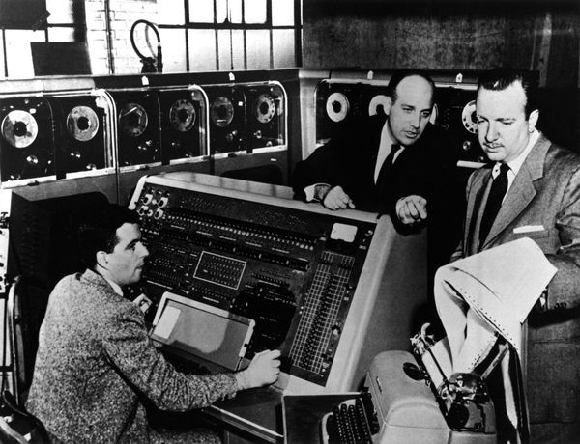
The Post-War Era
1947: Invention of the transistor
(Bardeen, Shockley, Brattain at Bell Labs).
1951: UNIVAC. First commercially available computer. Used to predict 1952 presidential election.
IBM enters the computer business
1957: Russia launches Sputnik
1958: Integrated circuits
Walter Cronkite (right), J. Presper Eckert (center) and Harold Sweeney of the U.S. Census Bureau.
Notes:
Transistors were invented in 1947. The transistor provides for switching of electronic signals without that heat. So I no longer have a heating element in my transistors. Transistors don’t burn out although you can burn out an entire chip. And we are way past that 18,000 active element limit.
The UNIVAC Corporation - Universal Automatic Computer - had for sale the first computer you could actually buy, in 1951. A program run on the UNIVAC correctly predicted the outcome of the 1952 U.S. presidential election, but the CBS network did not trust the prediction and
Also in 1951 Jay F. Forrester invented magnetic core memory.
IBM got into the computer business in the 1950s.
In 1957, Russia, then the USSR --launched the first artificial satellite and scared everybody in the US witless because we figured the Russians were about to take over everything.
A year later integrated circuits are invented in the U.S. and the U.S. and got a big jump on the rest of the world in computing. Jack Kilby of Texas Instruments , , Kurt Lehovec of Sprague Electric Company, and Robert Noyce of Fairchild Semiconductor made slightly different breakthroughs that together allowed production of modern integrated circuits.

Slide 28
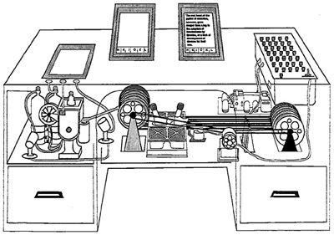
Vannevar Bush and the Memex
Bush described something very like a smart phone in an article in Atlantic Monthly.
But using the technology of 1945.
So, it was about the size of an office desk.
Notes:
Bush wrote, “...a device in which an individual stores all his books, records, and communications, and which...may be consulted with exceeding speed and flexibility.” Sounds a lot like a smart phone, eh?
Document storage was on microfilm, communication was telephone, and the other parts were all based on the technology of 1945.
The importance of the Memex is not the technology but the idea.

Slide 29
Moore’s Law
1965: Gordon Moore, director of R&D at Fairchild Semiconductor wrote a magazine article.
Moore observed that the density of devices (transistors) on integrated circuit chips doubled about every two years.
The cost of a chip is proportional to the area.
If the density doubles, either the performance doubles or the cost is halved.
Notes:
Moore’s Law isn’t really a physical law; it was an empirical observation that has been proven correct with minor differences for 60 years or more.

Slide 30
1960’s and 1970’s
Minicomputers (DEC PDP-1)
Industrial robotics
IBM System 360
ARPA starts Internet research
9 Internet hosts by 1970, 188 by 1980
Development of UNIX
Pocket calculators
The Mythical Man-Month (Brooks)
Personal Computers
Microsoft and Apple are founded
Notes:
Mini computers from the late 1960s and early 1970s - industrial robotics in the late 1960s. So for the nasty, dangerous, drudgerous jobs, people get replaced by machines.
IBM invented, developed and sold the System 360 mainframe beginning in the mid-1960s and it was revolutionary for an interesting reason. It used to be that each new line of computers was different from all that came before it. And so if you bought the newest, greatest computer you threw away all of your programs and started over. Which was kind of a painful thing to do.
IBM made their customers a promise that if you will throw away all of your programs one more time and buy the System 360 computer from us you will never have to do that again. That was 1965 or so. In 2023 you can buy an IBM z-series mainframe that will run programs written for the IBM System 360. They have absolutely kept that promise.
The Defense Department’s advance research projects agency started Internet research in the late 1960s. By 1970 there were nine computers on the Internet.
By 1980 there were 188 of them.
The UNIX operating system gets developed at AT&T/Bell Laboratories.
Gordon Moore at Intel makes what is called Moore’s Law but it is really an empirical observation that the density of transistors on integrated circuits doubles about every 18 months... About every 18 months I can get twice as many transistors.
That means I can make a computer that is twice as powerful or I can make one that is equally as powerful but costs half as much cause it uses half the integrated circuit area.
Pocket calculators are invented in the 1970s.
Fred Brooks writes The Mythical Man Month - A collection of essays about computing. It is in the library and it is a delightful book to read. It is fun to read.
Personal computers beginning with the MITS Altair in 1976 and both Microsoft and Apple get founded.
Lots of stuff happened during this time

Slide 31
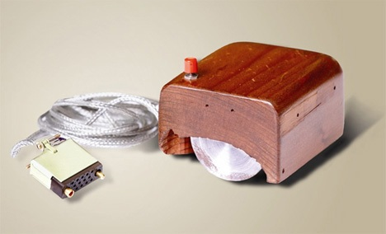
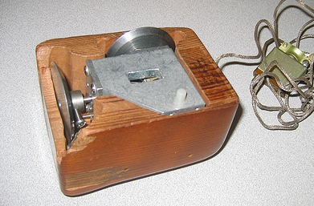
1980’s and 1990’s
IBM Personal Computer
Graphical user interfaces
Commercial email service
Software engineering
Viruses and worms
Commercial Internet service
313,000 Internet hosts in 1990
56,000,000 by 1999
NCSA Mosaic: April, 1993
Java
Widespread Internet use
Toy Story
Doug Engelbart’s mouse.
Notes:
GUI research started in the 1960s by Doug Engelbart at SRI.
Software engineering, the idea that we can engineer software the same way we engineer bridges
-- malicious software –
--commercial Internet service.
NCSA Mosaic - that was the first graphical web browser. Before 1993 browsers were text based - no pictures.
Java - lots of Internet use - and Toy Story -- why is Toy Story in my computer list? Computer generated figures - kind of creepy looking. Well - they are almost but not quite realistic.

Slide 32
2000’s
U.S. Naval Observatory reports the year as 19100 on January 1, 2000. (Oops.)
Wide availability of broadband connections
Wireless standards
Multi-gigahertz processors
285,000,000 hosts connected to the Internet
2005 – 100,000,000 Web sites. YouTube is launched.
2007 – one billion iTunes downloads
Blackberry, OS X, and Windows XP.
Notes:
Okay - so January 1, 2000. The US Naval Observatory which is the arbitrer of what time it is for the US reports the year is 19100. Oops! How embarrassing!
By the 2000s broadband connections are widely available. There are standards for wireless communication. It used to be in the 1990s if you bought wireless stuff from Symbolics it would work only with only wireless stuff from Symbolics because there were no standards.
Multigigahertz processors - 285 million Internet connected hosts and 100 million websites and YouTube.
YouTube; as far as I can tell is a vast wasteland but never mind about that.
A billion iTunes downloads by 2007.
So things have come a long way since 1642 and I watched every bit of it and yes, it was uphill both ways, in the snow!

Slide 33
2010’s
iPad and iPhone
Tri-gate transistors commercialized
Over a billion internet hosts.
Windows 10 – OS as a service
Xbox One, Playstation 4
Multi-terabyte hard drives
Early development of autonomous (self-driving) cars

Slide 34
2020’s
Windows 11 – OS as a service.
Experimental autonomous cars
New applications of machine learning
Ubiquitous high-speed connectivity
“Big data” and analytics

Slide 35
The Internet and the World Wide Web
The Internet started with the Defense Advanced Research Projects Agency in 1966.
Beginning of NSFnet from the National Science Foundation in 1986.
World Wide Web invented by Berners-Lee, 1989.
Commercial Internet operation in 1995.
The Web and the Internet changed things fundamentally.

Slide 36
How the Internet Changed Things
Metcalf’s Law: the value of a network to a user is proportional to the number of people one can contact: n × (n−1) / 2, connections.
Today you can reach nearly anyone you may know.
Effect on commerce:
Airline city ticket offices cease to exist.
Amazon sells everything!
Notes:
In 1985 there were over 20 city ticket offices, that is offices not at the airport, in Atlanta alone. Today there is one in the entire United States. It’s in Manhattan.

Slide 37
Standards
Standards are created to assure compatibility of data formats and protocols
May be created by committee or may become a de facto standard through popular use
Allow computers and computer systems to interoperate
Languages, display standards, number formats, communication protocols, etc.
Notes:
An important thing about modern computing is this idea of standards. What standards buy us is compatibility of either hardware or data or sometimes both.
Those standards might come from a committee like the American National Standards Institute, the International Standards organization, or the Institute for Electrical and electronic Engineers or a standard might be adopted from popular use - a De Facto standard rather than one that went through some sort of formal process.
It is the existence of standards that let computer systems inter-operate.
You go off and buy, I don’t know, it is a Gateway people still making computers? Nobody is saying anything so maybe not. You go off and buy somebody’s computer and you go over to microcenter and you buy a router made by somebody else and you expect to be able to plug them into one another and have them just work. That is the result of standardization.
In the 1960s if you bought a computer from IBM you bought everything else from IBM, too. Because nobody else’s equipment would work.
If you bought a computer from the Burroughs boys, you bought everything else from the Burroughs boys because nothing else would work with that Burroughs computer.
The development of standardization has moved us a huge way forward in computing.

Slide 38
The Internet and Standards
Thousands of standards from basic protocols to applications like email.
Interoperability of hardware and software from different manufacturers.
Notes:
The Internet runs on standards, and there are thousands of them, called RFCs (Requests for Comment.) In addition to the standards for the Internet protocols, there are thousands more standards necessary for the interoperability of hardware and software. The Internet could not exist without standards.

Slide 39
The Importance of Standards
We want to connect things and have them “just work.”
That is a relatively new phenomenon.
Things “just work” because of standards, from screw threads to complex communication protocols.
Notes:
Before the 802.11 Wi-Fi standards, you couldn’t depend on two radio devices from different manufacturers to work together.
We want things to “just work,” and that is a new phenomenon, and one driven by standards.

Slide 40
Where Standards Come From
Dozens of standards-making bodies:
Official groups
Industry interest groups
Official groups (examples)
ANSI
ISO
Industry interest groups
Wi-Fi Alliance
World Wide Web Consortium
Notes:
Official standards-making bodies are either governmental offices or sanctioned by the government. The American National Standards Institute, ANSI is the officially sanctioned standards group for the United States. ISO, the International Organization for Standardization, is an international standards-setting body sanctioned by multiple governments. There are many others.
Industry groups also set standards. The Wi-Fi alliance exists to certify interoperability if a class of radio communication devices, although the standards are actually set by IEEE, the Institute of Electrical and Electronics Engineers.
The World Wide Web Consortium publishes standards for everything associated with the Web.

Slide 41
Convergence
By 1990 almost all phone switching in the U.S. was electronic and traffic was digital except for the “first mile.”
But computers and phones were separate.
Now almost all information is transmitted using Internet protocols, including phone conversations.
Combining voice and other information on one medium is called convergence.
Notes:
And then there's the phone company. By 1990, almost all phone traffic in the United States was electronic and digital, except for what the slide calls the first mile, that is the wire between the subscriber and the central office. Everything else electronic and computer controlled.
Well, we now have wires that carry data instead of voice. Phones and computers were separate, but now almost all information is transmitted using those Internet protocols, which we will study in Chapter five, including phone conversations.
This business of taking the telecommunications network, which was a big deal in 1990 and merging it with information processing is called convergence. So, when you hear the word convergence, it just means we're going to use computers for both
phones and computing and other kinds of communication.

Slide 42
No Free Lunch
From Robert Heinlein’s The Moon is a Harsh Mistress: TANSTAAFL (There ain’t no such thing as a free lunch.)
Computing and information technology is a study in trade-offs.
Standards are important but cost money
A hardware control unit is faster but more expensive than software.
Some fast algorithms need large memory
Notes:
Robert Heinlein’s, The moon is a Harsh Mistress. Science fiction novel, 1966 . A recurring theme is this thing that Heinlein called TANSTAAFL: There ain't no such thing as a free lunch. You remember that the program counter holds the address of the next instruction and remember that there ain't no such thing as a free lunch, no matter what somebody tells you, somebody is paying.
But that is particularly applicable in computing and information Technology because almost everything we do is a study in trade-offs, standards, standards are important, but they cost money. Somebody has to pay the people who are working on all those standards setting committees. A hardware control unit. We mentioned the control unit, arithmetic logic unit, registers. A hardware control unit is faster than a micro programmed control unit, but it's also more expensive. You can get speed, but you pay for it. There are some fast algorithms that need very large amounts of memory. There are slower algorithms that'll work with less memory and there's a trade-off between speed and cost.

Slide 43
Systems and Architecture
We routinely talk about systems
Computer system
Operating system
Security system
Sound system
A major part of information technology is systems integration – making multiple systems work together.
Notes:
I've used the word system probably maybe 25 or 30 times tonight already. Computer systems, operating systems, security systems, sound systems. I have a friend who is a Hi-Fi nut. If it makes music, he has to have one.
A major part of what you will do as information technology professionals is this thing called systems integration, making things work together. Standards will help you do that, but there's still plenty of work to be done.

Slide 44
System Defined
A system is a collection of components…
linked together to perform specific functions, and
recognizable from the outside as a unit.
Everything outside the system is its environment, and
systems communicate with their environments through interfaces.
Notes:
System: Here's the definition. A collection of components linked together to perform specific functions and recognizable from the outside as a unit. Everything outside the system is its environment. So, the self-driving car, that's the system. Everything outside is the environment. And systems communicate with the environment through interfaces.

Slide 45
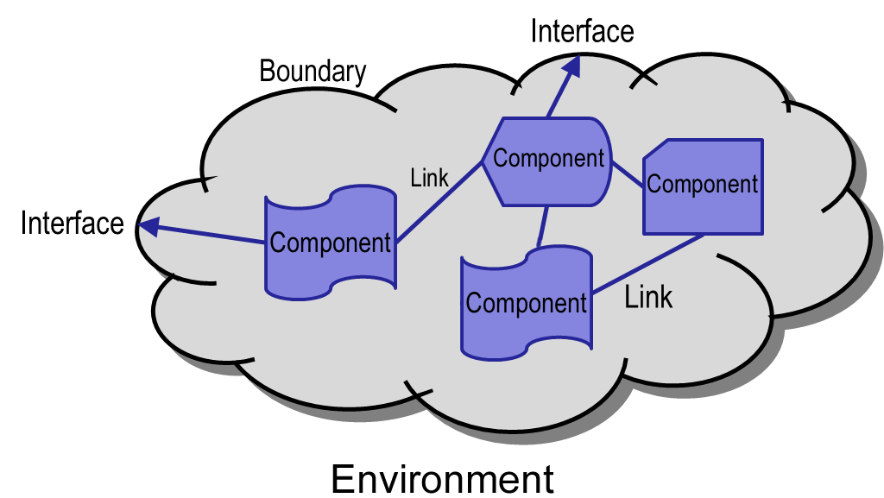
Abstract System
Notes:
An abstract look at a system might look something like this. The cloud symbol In PowerPoint is kinda nice. I've got component, component, component, component inside the system. They are connected with links inside the system. And they can talk to the outside world through interfaces. So there's an abstraction of the definition that I just gave you, a picture that is an abstraction of that definition.

Slide 46
Information Technology Systems
Hardware
At least two layers of software
Operating system
Application software
Interfaces
Keyboard and screen
Printer
Network
etc.
Notes:
An information technology systems involve hardware, at least two layers of software, that operating system and application software. And all the interfaces that were used to keyboard, screen printer network, et cetera, et cetera.

Slide 47
IT System Architectures
Monolithic computing: Mainframe
Distributed processing systems:
Client-Server Computing
2-tier architecture
3-tier architecture
N-tier architecture
Web-based computing
Peer-to-peer computing
Notes:
I.T. systems architectures can be classified in several different ways. There's the monolithic computing system, the main frame. Everything happens in one box.
There are several kinds of distributed processing, which we'll look at in a second. And then down at the bottom it says peer to peer computing. This is where you tap your phone to somebody else's and exchange business cards electronically. I've never figured out how to do that. Somebody who knowscould tell me. Then I'll act like I know what I'm doing.

Slide 48
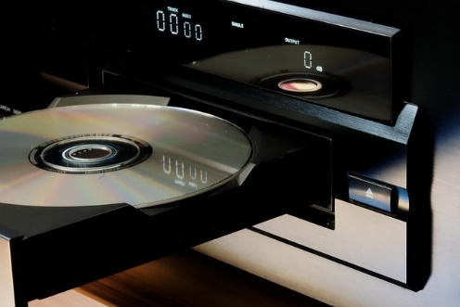
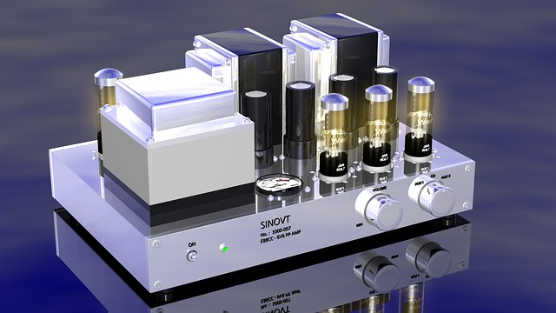
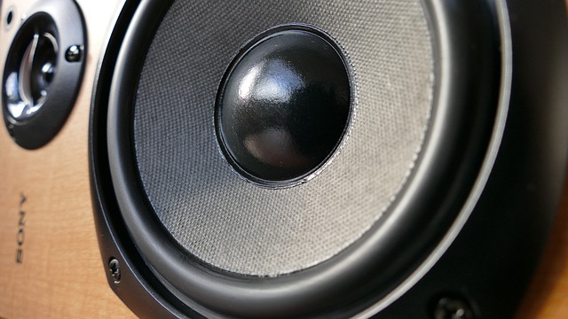
Example: Sound System
System
Interface (input)
Interface (output)
Notes:
Here's an example of a system. This is the vacuum tube sound system. And by the way, those little things with a silvery tops, those are vacuum tubes, glass envelopes, vacuum inside, which is where the name comes from. And then that electric heater inside. So they're fairly delicate. And that sound system has an input interface and an output interface. We had an abstract example. Now we have a concrete example.
How expensive or vacuum tubes. A couple of bucks back in, back a long time ago. Now the vacuum tube amplifier that's going to set you back, there's gonna be a comma in the price of that these days. But the vacuum tubes themselves were not expensive. They're probably proportionally more expensive now because they are not made by the tens and hundreds of thousands anymore. I don't have anything that needs vacuum tubes, so I don't know.

Slide 49
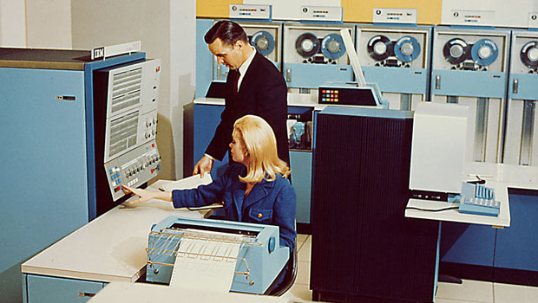
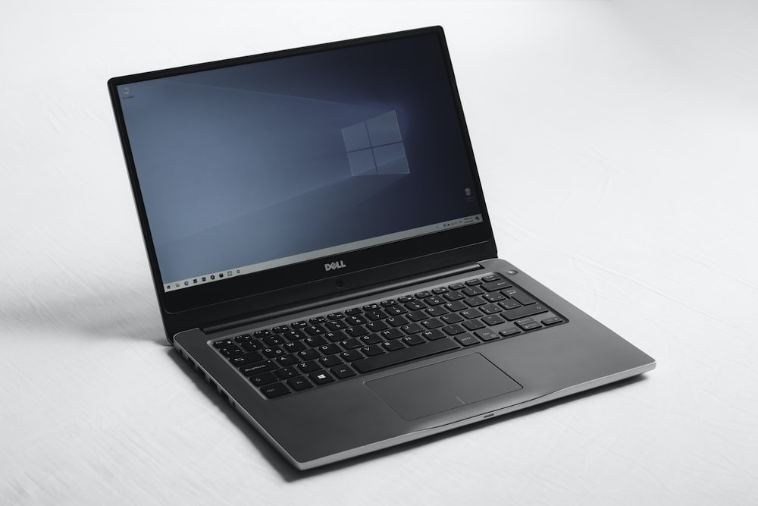
Monolithic Architecture
Everything happens within a single system.
Notes:
The mainframe computer is the archetypal monolithic architecture, but a desktop or laptop computer of the 21st century running a stand-alone application is also an example of monolithic architecture.

Slide 50
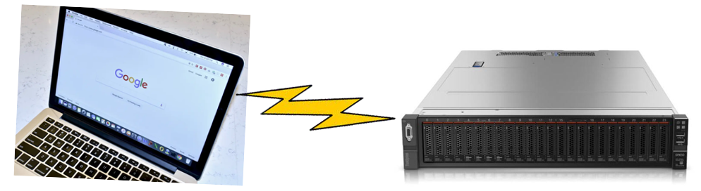
Client-Server Architecture
In a client-server architecture, a client device is the consumer of a service provided by another device.
The World Wide Web is an example of a client-server architecture.
Notes:
Client server: the web server is the example of that. The client is the web browser. The server is someplace else, almost always on a separate computer.

Slide 51
Web-Based Computing
Something of a misnomer, really.
What is actually meant is a web interface to some computing platform.
Examples:
Banner: A hideously complex database-driven system with a (relatively) simple web interface for certain tasks.
Home routers and other “appliances:” A web interface eliminates the need for command-line configuration. (There are several lightweight web server programs.)

Slide 52
Intranets
Web services accessible only to a cohesive class of people, e.g. employees.
Often implemented as a web server on an internal corporate network, and so not generally accessible from outside.
Outside access could be provided through VPN or login.
Paid web sites are not “intranets.”

Slide 53
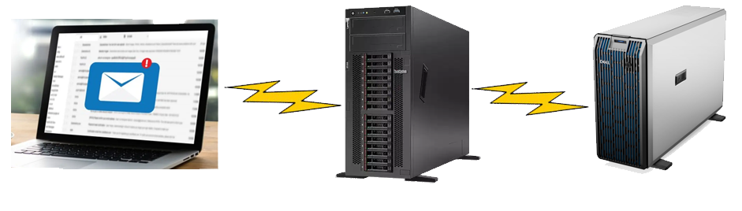
Multi-tier Architecture
In a multi-tier architecture , there is one consumer but two or more layers of servers.
Example: Web mail.
Client
Web Server
Mail Server
Notes:
Web mail. Is an example of a multi-tier architecture. There's a mail server somewhere speaking, the SMTP protocol, simple Mail Transport Protocol. And the mail server has to talk to a web server and then the web server talks to the web mail client. So that's the multi-tier architecture and you can get more than three tiers, but it'll start making your hair hurt.

Slide 54
Cloud Computing
Concept: computing resources are available on demand, similar to the electric grid or a municipal water system. (And formerly called “grid computing.”)
The “cloud” in drawings and descriptions is an abstraction.
“as a service”
Software as a service (SaaS)
Platform as a service (PaaS)
Infrastructure as a service (IaaS)
Notes:
Platform as a service (PaaS) extends cloud services to the software facilities that one
would expect to find on a developer’s computer: Web and programming development tools,
facilities, aWebserver, and operating system application program interface (API). This provides
everything a developer would need to create and run application software on a cloud platform,
without the hardware and software investments needed to support local development.
Finally, Infrastructure as a service (IaaS) offers cloud-based hardware emulation in the
form of virtual machines, networking, and the like. The user/developer interacts with the
virtual machine using a client application, or more commonly, a Web browser. Users can
add additional virtual machines for testing with different system configurations, for example,
providing considerable flexibility. Essentially, the user’s computer has been moved in its entirety
to the cloud, and can be configured as a different computer at will.

Slide 55
There is no Cloud
“There is no cloud; there’s only a bunch of disks you don’t own operated by a bunch of people you don’t know.”
– NinjaNerd56 on Ars Technica.

Slide 56
“Information Technology”
Term first used in the Harvard Business Review in 1958.
The practice of information technology: the integration, operation, and maintenance of computing hardware, software, communi-cation facilities, services, and infrastructure to receive, transform, store, and retrieve information of all types in an efficient, effective, and secure manner.
Whew!
Notes:
The term information technology was first used in 1958 in the Harvard Business Review.
And this is my definition. And man, it's a lot of words and it would get a D minus from an English teacher. The practice of information technology is the Integration, operation and maintenance of computing hardware, software, communications facilities, services, and infrastructure to receive, transform, store, and retrieve information of all types in an efficient and secure manner. That definition captures the whole thing there, I think. I hope so.

Slide 57
The Role of the Systems Architect
It is the job of the systems architect to:
Assess needs
Describe functionality
Select systems
Make the pieces work together.
Sometimes called “systems integration.”
This is:
a) A lot of fun!
b) A lot of work!
Notes:
The systems architect, which some of you will become, assesses a corporation's needs, describes the functionality, that is, after, I know what you need, here are the functions that you need. I'm going to describe the functionality. Usually, we select systems and buy them rather than making our own. Sometimes you make your own. Describe the functionality, select systems, and then make the pieces work together. That is sometimes called systems integration. And it is a lot of fun. It is an enormous amount of fun. It's a lot of work too, but it's an enormous amount of fun.

Slide 58
The Academic Discipline
“Information Technology is the study of systemic approaches to select, develop, apply, integrate, and administer secure computing technologies to enable users to accomplish their personal, organizational, and societal goals.” (ACM)
Of the computing disciplines, information technology requires the most breadth of knowledge.
That’s why information technology is so much fun.
Notes:
This is the definition of the academic discipline that is information technology, from the Association for Computing Machinery. Information technology is the study of systemic and I think they meant systematic, but their publications say systemic. It would be nice if people still took English classes. Systemic and systematic or very different words with very different ideas behind them. Anyway, the ACM says, “Systemic approaches to select, develop, apply, integrate, administers secure computing technologies to enable users to do all of this stuff. So that's what I'm supposed to be teaching.
And one of you asked me last time to talk a little bit about computer science, information technology, the cybersecurity discipline. Of all the disciplines, Information Technology requires the greatest breadth of knowledge. Now some of this stuff we're going to do is going to be a mile wide and an inch deep. But we've got to touch everything. Computer scientists are focused on algorithms and their implementations, just a little bit of it, we're going to touch everything. And that's why this is so much fun.

Slide 59
Professionalism
Information technology is:
Strategic
Customer-facing
No longer a “back office” function.
Practitioners must work within the organization. Must have:
Excellent communication skills
Excellent teamwork skills
Knowledge of the organization’s business.
Notes:
Information technology is strategic. Strategic means that the business can't do without it. My favorite example of that is Amazon. If there were no information technology, Amazon could not exist, just couldn't happen.
And it's customer-facing. When somebody's website doesn't work, you know, it used to be there. There's an association, the Association of Information Technology Professionals that you could join as a student.. Oh, but it used to be called the Data Processing Management Association and before that, back in my day, it was the National Machine Accountants Association. So things have changed. It used to be that all this stuff happened in the backroom with the accountants and that doesn't happen anymore. It is no longer a back-office function. You must work within the organization. You can't say, I'm the computer guy and I'm going to go back here in my cave and I'll come out in a year or so. You have to work within the organization. You're going to need excellent communication skills. You're going to have to learn to write. If you haven't already learned that, there's just no way around it. You have to work with other people. You're going to have to do teamwork. Used to be the programmer could lock himself in the garage and do work. Some of them still do lock themselves in the garage. That does not happen with information technology. And you have to know the business. So my career in industry was all within health care because that's the business I knew.

Slide 60
Questions

