Slide 1
IT 3123 Hardware and Software Concepts
Introductions and Overview

Slide 2
What You Will Learn
Basic principles that will help you succeed in information technology
A server is “thrashing”
A database with base and index files performs poorly
Both redundant storage and backups are needed for critical data.
Computers on a particular network segment are slow

Slide 3
Syllabus
The syllabus is in printable electronic format.
See “Start Here” in the D2L section for this course. (Updated about 10:40 this morning.)

Slide 4

Textbook
Computing Concepts for Information Technology
The book is in nearly-final draft form. You will find errors.
Please tell the author about them.
There is no extra credit for reporting errors, but you will convince me that you’ve done the reading.
Please read the Foreword and Preface, too.
Notes:
Read the front matter!

Slide 5
Expectations of University Students
Critical thinking: The ability to analyze a situation, impose order on it, and extract facts and probabilities.
Writing: organization, spelling and grammar, proper use of others’ work.
Work outside class: Two outside hours for each class hour. For this class, that’s about 15 hours per week, five in class and ten outside.
Notes:
Bob Brown: Okay. So… All of you are upper division university students who should be able to actually think about this stuff rather than just listen to the lectures, read the book and memorize and give back.
So a little bit synthesis, analytics, imposing of order... You are going to do a fair amount of writing for this course. Writing is good for you because when you are out in the world, the most important ideas you have would be communicated in writing. You do not stand up before the board of directors and say I need 10 million dollars for a new computer system. You produce a report that explains the whats, the whys, and the wherefores. And if it is not persuasive and doesn’t look like it was written by somebody with a university education, it probably is not going to get you anywhere.
So writing is good for you. As a rule of thumb, you should plan on spending two hours outside of class for every hour in class. We’ve got two and a half hours of class sessions for this course so you should expect to spend about five hours a week outside of class doing reading and homework and studying and figuring out. For some of you it won’t take that long because this class will be easy for you. For others it might take a little longer than that. But in general for university classes that is a pretty good rule of thumb.

Slide 6

Expectation for this Class
You will be in your seats at the start of the class period.
You will remain in class for the full period.
You will keep cell phones and other gear quiet
Only one person will talk at a time
If you bring food, bring enough for everyone!
Notes:
What are these about?
---------------------------

Slide 7
Expectation for this Class *
You will be in your seats at the start of the class period.
You will remain in class for the full period.
You will keep cell phones and other gear quiet
Only one person will talk at a time
If you bring food, bring enough for everyone!
These are all about being courteous to your classmates!
Notes:
What are these about?
---------------------------

Slide 8
Some More Expectations
You will come to class prepared by having done the assigned reading.
You will do your own work. There are severe penalties for cheating. You will complete your work on time.
Notes:
Please do the assigned reading. Your life will be easier if you read this stuff before class. Reading assignments are in the syllabus. For the online class your reading assignments will be but are not yet in the course calendar.
Here’s the scoop. If you don’t read the stuff before you come to class you are never going to read it. You come to class, you haven’t read it. You say I’ll get to that on the weekend. Today’s Monday right? And, I will do Wednesday’s reading on the weekend too.
Then the weekend shows up and it has pizza and football and age appropriate beverages and that kind of stuff. “I’ll read it before the exam.” Well the exam comes and goes. “I will read the before the final.” The final comes and goes. You paid 125 dollars for that book and you never even opened the cover! So please read it before class. Stuff will make more sense to you and you will earn a better grade.
Unhappily for me last semester, a small number of people turned in work other than their own. One of them is suspended for a semester. He had to take this semester off. The others got their course grades reduced by a letter grade. Please don’t do that, because it used to be that dealing with academic misconduct was hard for professors.
It isn’t hard anymore because SPSU now has an Honor Council with students on it and I can just turn the whole mess over to them. And I promise you, a group of students will be far harder on cheaters than I ever thought of being. I absolutely promise you!
And of that group from Fall, one of them said “You know I am applying for a job with the government. What are you going tell a background investigator?” And it was hard for me to say it but I said that I am going to tell a background investigator you are a cheater. So that stuff follows you long beyond the end of one class.
Some of you might think I don’t pay close enough attention to catch you and some of you are probably right. I am sure I don’t catch all of the cheating that there is. You want to bet that you are the lucky one? That is a sucker bet. Don’t do it!

Slide 9
What You Can Expect of Me
I will be in class on time, every time.
I will be prepared to cover the scheduled material thoroughly.
Your work will be graded and returned promptly; generally, within a week.
I will listen respectfully to your opinions.
I will answer your questions promptly and carefully; if I do not know an answer, I’ll try to find out.
I will help you succeed.
Notes:
Okay! I will be in class at least close to on time every time.
I will come prepared. I will try harder than I have in the past to grade and return your work promptly.
If you have questions or opinions I will listen to you respectfully. I will answer your questions if I know the answer. If I don’t know the answer, I’ll find out, often by assigning one of you to look it up. That counts as finding out.
I look really good when almost everyone in the class earns grades of A or B ... I love it! That is the right answer. And so it is to my benefit to help you succeed in the class. And I will do that.

Slide 10
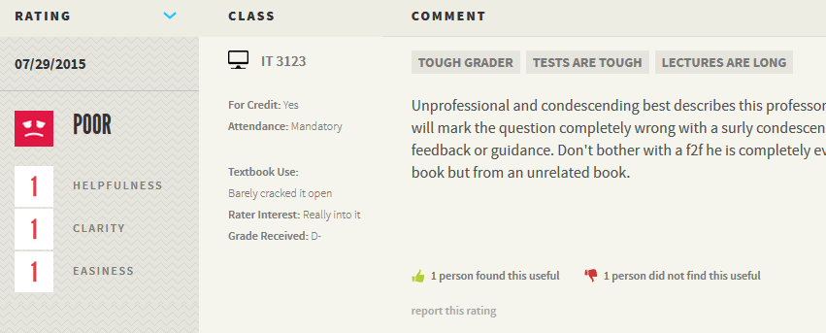
A Student Rating
Textbook use: Barely cracked it open.
Grade received: D-
Moral: You are going to have to study to earn a satisfactory grade.

Slide 11
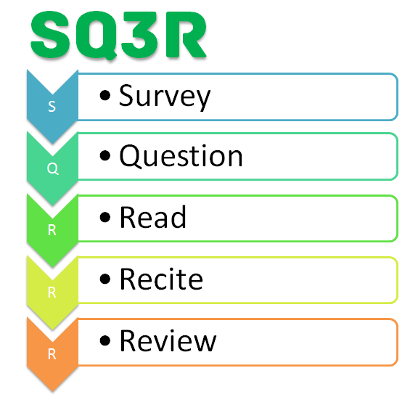
How To Succeed in this Class
Read the syllabus
Read the textbook An effective reading technique: SQ3R Survey • Question • Read • Recite • Review
Come to class and pay attention!
Take notes (the pen is mightier than the laptop)
Do the homework
Allow enough time
Notes:
So, you read the syllabus which I handed out to you. We’ve already talked about reading the text book.
Please come to class for those of you who are in the classroom based section. You are going to find out and I guess might just as well tell you now that the recording that I am making will be available to you as well as to the online class as a podcast so if you do miss a class because you got stuck on I-75 or something like that it is not fatal. You can listen to the recording. The slides that you are looking at will be available online as well.
Survey: Skim the assigned reading, looking at headings diagrams, etc. to get an idea where the author is taking you.
Question: Try to turn the main ideas from the survey into questions.
Read: Do what it says, and add more questions; do not limit your questions to the initial survey.
Recite: Go back and answer the questions you set for yourself. Refer to the book as necessary.
Review: Work through problems and any end-of-chapter questions.
An experiment by Pam Mueller at Princeton and Daniel Oppenheimer at UCLA has shown that students retain more when they take notes on paper. http://pss.sagepub.com/content/25/6/1159
That stuff is not a substitute for coming to class. The folks who are taking the online class have a much harder job than you do for a couple of reasons.
One of them is for those of you who are sitting in front of me I can see the “what are you talking about?” looks.
If I left you in the weeds, I can see that I have done that. The other one is that you have the opportunity to ask me questions right then and there instead of having to ask those questions using the online facility of Desire2Learn, with which, even if you ask a question instantly you might not get an answer until the following morning.

Slide 12
A Word About Workload
You are in class 2-1/2 hours per week. You should expect to spend about twice that (or five hours) outside class on reading, preparation, study, and homework.
That’s 7-1/2 hours per week total, about one working day.
If you are not ready for that, you have some deciding to do!

Slide 13
Syllabus Review
Textbook: Computing Concepts for Information Technology by Bob Brown
Appointments
Class schedule
Exam Schedule: exams will happen as scheduled. Be there!
Final exam will happen as scheduled.
Notes:
Office hours are in the syllabus. If you need me and you can't show up during those times, send e‑mail or give me a call and we'll make a time when you can show up.
The exams are going to happen according to the schedule that is in the syllabus. The final exam is scheduled not by me but by the registrar. Do not schedule travel for dates before the exam. If you’ve already scheduled travel, you will need to drop the class or switch to a fully online section.
Question: Is getting the textbook mandatory?
Professor: If you want a good grade- yes, the textbook is mandatory. There is material in the textbook that will not be in the lectures and vice versa. The best news is that the book is FREE!

Slide 14
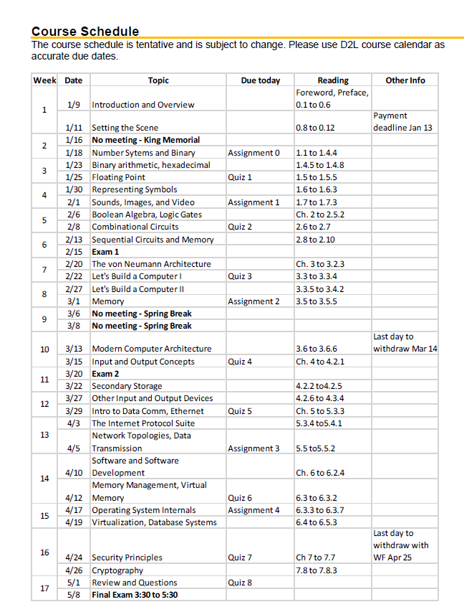
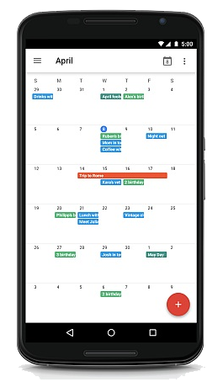
Keeping Track of Due Dates
Course Syllabus
Your Gear
Notes:
D2L will help you keep track of dates if you log in every day. If not, consider copying key dates into your own calendar.

Slide 15
Objectives
Develop a mental model for computing
Recognize and use computer terminology
Manipulate binary numbers
Explain the characteristics of digital logic
Describe the von Neumann architecture
Evaluate hardware and software systems
Describe the functions of an operating system
Detailed objectives are in the syllabus
Notes:
So what are we trying to do in this class?
We are trying to develop a mental model of computing. A way of thinking about computing. Trying to recognize and use computer terminology.
Some of you have been using computers since you were old enough to hold one. So there is probably some differences in level there. You will manipulate binary numbers. Which if you haven’t already taken discrete math please stop putting it off. You need to get that behind you.
Talk about digital logic. Describe the Von Neumann computer architecture. Learn to evaluate hardware and software systems. Describe what an operating system does. The syllabus has a detailed list of objectives.

Slide 16
Goal: Mastery of the Material
Your job: master this material. “Own” it so that you can use it in your profession.
My job: help you to do that.
Another job for me: measure your mastery. That means grades. Grades are not the objective of this class; they are a measure of how well you achieved the objectives!
Take care of mastery and the grade will take care of itself.
Notes:
Your job is not to earn grades. It is to master this material. If you master the material, you'll get a good grade. If you don't master the material, you might not. The thing to do is keep your eye on the real objective which is mastering the material, and not get distracted by that sad fact that I have to issue grades

Slide 17
Grading
25 % Homework
20% Quizzes
30 % Exams (two @ 15%)
25% Final exam
You cannot earn a satisfactory grade without doing the homework
Notes:
25% of your grade is homework. Two exams roughly one every month. So we have one about a month from now, one about a month longer after that, and then the final exam at the end. So two exams during the term, 15% each. Participation grade for both online and classroom based students, 5%. It's hard to get a good participation grade if you're not here. And then a 25% final exam. Note that there’s a different plan for summer term; see the slide.

Slide 18
Midterm Grades
I will post midterm grades by the end of the day on March 7.
The last day to withdraw without penalty is March 14.
The purpose of a midterm grade is to help you assess your progress…
Midterm grades “disappear” at the end of the semester and never appear on a transcript.

Slide 19
About Exams
Exams will be given on the dates shown in the syllabus.
If you miss an exam without making arrangements with me in advance, you will earn a grade of zero.
“Making arrangements” does not mean leaving voice mail or sending email; it means we have had a two-way discussion and agreed on when you will take the exam.
Notes:
This nails one or two people every semester so please listen. If you do not show up for an exam, you will get a zero. If you're lying in the hospital in a body cast, too bad. If there is some reason why you can't take the exam, you must get in touch with me. “Get in touch with me and make arrangements” does not mean send me e‑mail and forget about it or leave me a voicemail and forget about it. It means there's some kind of a two‑way conversation going on in which we agree when you will take the exam. If you simply don't show up or you just leave me a message, "I'm sick", you're going to be sicker when you get that zero. Please, I'll work with you if you're ill, if you're having family problems, if there's stuff going on. I will work with you. But you've got to do the other half of that and if you don't, I didn't have a chance to work with you, did I?

Slide 20
When People Submit Homework
1-2 days before deadline: 5% (These are the people who earn grades of A.)
3-24 hours before: 10%
1-2 hours: 10%
less than 1 hour: 65%
emails in distress after the deadline has expired: 10% (or nothing at all)
Most unsatisfactory grades are from this group
Notes:
https://academia.stackexchange.com/questions/50035/knowing-that-most-students-submit-assignments-right-around-the-deadline-is-it-a

Slide 21
“Due” Means Due
Late homework will not be graded (and you’ll get a zero)
Submitted to D2L only
No email, no paper, no excuses!
Notes:
Homework is due on the date in the syllabus. No excuses. Period. I know that “stuff happens.” The way you prevent that from getting you a zero on your homework is to do the homework early and turn it in early.

Slide 22
Submitting Homework
All homework will be submitted using Desire2Learn. No other method is acceptable.
Homework is due by 11:59 PM on the date given in the syllabus.
You must prepare your homework in a form that I can read with Microsoft Word 365.
Notes:
Homework is submitted using "Desire 2 Learn." It's due at 11:59 p.m. Please prepare your homework in a form that I can open with Microsoft Word. There are three programs, including both Open Office and Libre Office that will do that. You do not have to go buy Microsoft Word.
Although, if there's any software that you want to buy, the time to get it is while you're a student, because you can get huge discounts.

Slide 23
Handwritten Work
In a few cases, I will allow handwritten or hand drawn work. (For example, “long” arithmetic.)
You may still type this work if you like.
If you choose handwriting, you must scan your handwritten work. (Scanner software is available for your phone.)
You must paste the scanned image into the proper place in your Word document. Multiple documents will not be accepted.
Notes:
Sometimes I will allow you to do handwritten work. You're going do some “long” arithmetic. That's a pain in the side to try to do with Microsoft Word'. You can do it with a pen. The goal here is do you understand the arithmetic. If you hand write your work, please scan your handwritten stuff and paste it into the appropriate place in that Microsoft Word document. Just paste the image in there and I will be happy.
I’m not going to combine work for you; you’d have to do it once and I’d have to do it 30 or so times. I think I can force D2L to allow only one uploaded document. Even if you figure out a way to make it take two or more, I’m going to look only at the first one.

Slide 24
More About the Homework
The teacher knows the answers (usually.)
There are two purposes to homework:
To allow you to practice what you’ve learned
To allow you to demonstrate that you’ve learned it.
Cut-and-paste homework will not do.
And it might get an academic misconduct penalty!
Notes:
Usually, if I assign a homework question, I already know the answer. I have messed up in the past, but not very often. So the purpose of homework is for you to practice what you've learned and then to show me that you have learned it. The purpose is not to give me an answer. I already know what the answer is. What that means to you is that cut and paste homework will not do and might get you an academic misconduct penalty which would be kind of a bad thing.

Slide 25
Still More about Homework
Many of the assignments contain short writing exercises. (A few paragraphs to a page or so.)
Nearly all the important ideas you will have in your career will be communicated in writing.
So, learning to write is important; use the assignments to practice doing the best job you can.

Slide 26
Quizzes
We will have several quizzes this term.
Quizzes will be administered using D2L.
They are closed-book, closed-notes, and closed-Google.

Slide 27
Lecture Slides and Recordings
Lecture slides will be posted to D2L in the appropriate module as PDF files a day or so after each lecture.
There is information about printing the slides in D2L.
The lectures are recorded and will be available as videos.
These are not a substitute for coming to class!

Slide 28

Let’s Get Started…

Slide 29
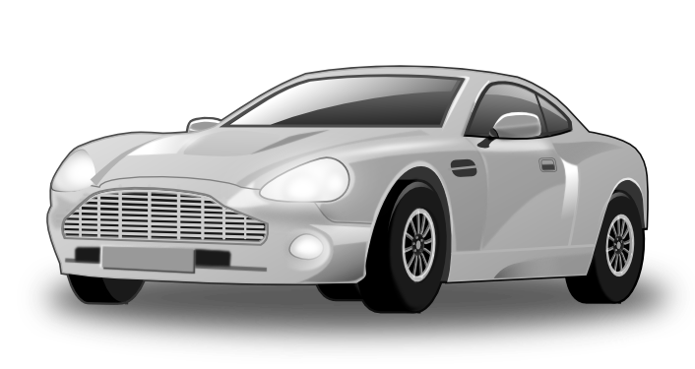
Mental Model of a Car
Electrical System
Engine
Transmission
Brakes
Steering
Who has had car trouble?
How did you apply your mental model?
Notes:
Everyone here either drives or has ridden around in somebody’s car and particularly if you drive you have developed a mental model of that automobile so you know about engines and electrical systems and steering and brakes and transmission and all of that stuff.
Did anybody in here ever have car trouble?
What happened when you had car trouble?
The car just quit. What did you think was wrong with it?
Something electrical? Were you right? Yep!
How did you know that? Mental model.

Slide 30
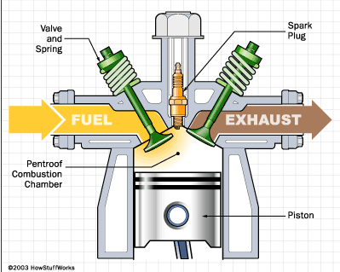
How Much Detail?
Probably about this much: Not enough detail to build one; but enough to understand one.
Notes:
How much detail do we need in that mental model?
Probably for a car about that much. Maybe when you were in the eighth grade you learned about the internal combustion engine and the four stroke cycle. Is that when you got that stuff?
Eighth or ninth grade? Everybody’s looking at me with what’ya talking about look!
This should have been in your general science course way before you hit the tenth grade.
There’s a few people nodding their heads up and down. They have seen this before.
Okay - in this diagram there is enough detail to understand how the four stroke cycle internal combustion engine works provided this explanation that goes with the diagram.
This is certainly not enough detail to design and build such an engine.
This is the level of detail that we are after in this course. Understand how it works, not necessarily be able to design it and build.

Slide 31

Mental Model of a Computer
System Unit, Monitor, Keyboard?
CPU, RAM, I-O?
Applications?
Storage?
Networking?
Without a well-focused mental model, it is hard to use something effectively.
Notes:
So, our mental model of the computer. We have a number of choices. We can think about it as the physical pieces the system unit, the monitor, the keyboard... Or we could think about the logical components... The CPU , the memory and the input and output. We might think about the applications. Yes indeed. The government issued me a three thousand dollar thinkpad laptop so I could play solitaire.
Would I think about computing as storage?
I try not to let paper come into my office. I want things electronically and I store them electronically because I can find them.
We might think of computing as networking and communication. Back in the 1980s another professor here and I used a computer in Cambridge, Massachusetts to send e-mail from one hotel room to another in Washington DC. Essentially 25 feet down the hall.
People don’t worry about where the computers are anymore. But we certainly worry about networking and the use of computing for communications.
No matter what kind of tool you are using, if it is more than trivially complex, you need that mental model. You can probably use a hammer without an effective mental model, okay, but for a tool that is more than trivially complex, you need that well focused mental model to use the tool effectively.

Slide 32
Learning About Technology
Technology has advanced very quickly
But the basic ideas have changed very little in half a century.
We will learn the basic ideas…
Then relate them to current technology.
Notes:
The good news for us is that although technology and computing advances very quickly, we will talk about Gordon Moore and Moore’s Law a little a bit later... The basic ideas for computing have changed almost not at all during my lifetime.
And so we can learn those basic ideas and relate those to current technologies. This is good news for us.

Slide 33
Who Can Benefit? (Why You Care!)
User of a computer system
Understand system capabilities and limitations
Make informed decisions
Improve communications with information technology professionals
Systems analyst
Conduct surveys, determine feasibility and define and document user requirements
Specify computer systems to meet application requirements
Notes:
Who benefits from this? Well you do ... If you are using a computing system and you understand its capabilities and limitations, you make good decisions.
If you are doing information technology you specify computer systems and, one hopes, specify and buy systems that actually get the job done.
If you mess that one up you need an offsite copy of your resume. Okay? Spend a few hundred thousand dollars on a computer and it doesn’t work -- that is a career limiting move.

Slide 34
Who Can Benefit?
Programmer
Create efficient application software for specific processing needs
System administrator / manager
Install, configure, maintain, and upgrade computer systems
Maximize system availability
Optimize system performance
Ensure system security
Notes:
If you go into programming as most of you will not -- understanding what is going on will help you create efficient application software.
Many of you are going to be doing systems administration or management so you will be installing, configuring, maintaining, upgrading, tuning, maximizing, and securing computer systems.

Slide 35
Who Else Can Benefit?
Web designer
Optimize customer accessibility to Web services
System administration of Web servers
Select appropriate data formats
Design efficient Web pages
Almost everyone!
We come into contact with computers everywhere.
Notes:
Some of you will take a web course- that is everybody if you are IT majors because you can’t get out of it - and you will want to optimize customer accessibility. You will be administering web servers, deciding how data are going to be stored, designing efficient web applications.
In other words, almost anybody who does anything with computers can benefit from that well developed mental model.

Slide 36
Abstraction
A mental model that removes unneeded complexity.
Different mental models are at different levels of abstraction.
We will select different models (different levels of abstraction) for different purposes.
Abstraction and the construction of mental models is a superpower!
Notes:
One of the tools that we use for developing mental models is this thing called abstraction.
Abstraction is removing unnecessary complexity and unnecessary and unneeded is bold and underlined because it is the key part of the definition.
Removes unnecessary complexity from the mental model.
So we can have different mental models at different levels of abstraction and we are going to do that. We will select mental models at different levels of abstraction as we work through the course this semester.

Slide 37
One Model of Computing
Storage
Input
Process
Output
This is the Input-Process-Output, or IPO, model; it is an example of abstraction.
Notes:
Here is one mental model of computing. This is the input process output or IPO model.
And there is nothing in there that looks like a computer very much. What we are focused on with this mental model is transformations.
Time cards go in, pay checks come out.
Test scores go in - course grades come out.
So we have an input, some sort of defined process, and a desired result.
And we can think about computing that way and all of the details about CPU and RAM and Gigahertz and all of that stuff is abstracted away. It is not important to this mental model. The mental model does include storage.

Slide 38
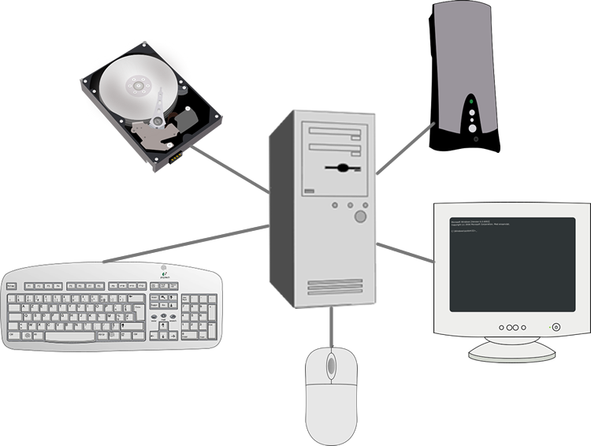
Another Model
Notes:
Here is another mental model, also an example of abstraction, but very different..
In this case it is a mental model of the physical parts of the computer. So I’ve got communications and keyboards and monitors and disks and printers and speakers.

Slide 39
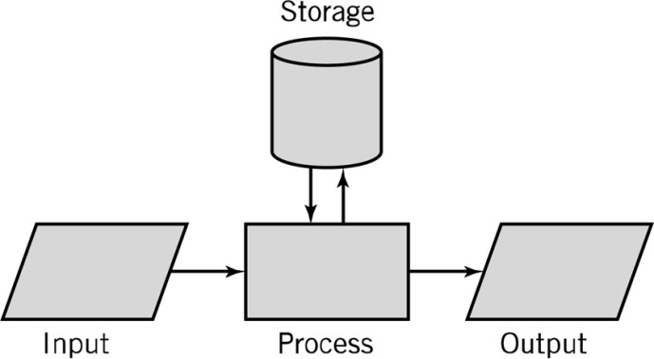
How are these alike? Different?
Notes:
Here are both of those mental models.
How are they alike?
Got storage represented explicitly in both places. I’ve got input and output represented in both places. Lots of detail in one of them... Very little detail in the other. But input and output are both there.
There is at least one other similarity. Come on y’all I’ve been doing all the work so far.
Processing! Absolutely. We’ve got our central processing unit with memory and its I/O interface in both places.
More detail and a focus on the physical on the second diagram there. In the first diagram - the one in the upper left -- we are thinking almost entirely about the logical capabilities of the computing system. In the other one, we’ve got detail ... It is detail that focuses on the physical ... The parts of the computer system.
So, the one on the upper left is a functional abstraction and on the lower right is a physical abstraction

Slide 40
Abstraction Mechanisms
Pattern recognition to enable…
Classification
Generalization
System components may be
Irreducible: A bolt can’t be further reduced
Subsystems that may be decomposed.
Notes:
Classification involves identifying something as an instance of a specific type. “A Chevrolet is a car.”
Generalization is identifying something as a subtype. "A car is a type of vehicle."
Generalization is transitive; classification is not.

Slide 41
Decomposition
Decomposition
The division of a system into its components and linkages
Functional: decompose by function
Hierarchical; decompose until all components are irreducible.

Slide 42
An Interesting Book
9 Algorithms That Changed the Future –John MacCormick
Search engine indexing
PageRank
Public-key cryptography
Forward error correction
Pattern recognition
Data compression
Database
Digital signature
https://galileo-kennesaw.primo.exlibrisgroup.com/discovery/search?vid=01GALI_KENNESAW:KSU_V1&tab=LibraryCatalog
Notes:
This book is available in the Sturgis Library on the K campus. You can request that it be sent to the Johnson Library using GIL Express

Slide 43
Questions

