Slide 1
IT-1113, Lecture Slides 13: GUI Programming
Mr. Donald Privitera, Course Coordinator
Kennesaw State University
Marietta Campus
College of Computing and Software Engineering
IT Department
dprivit2@kennesaw.edu

Slide 2
Table of Contents
Graphical User Interface (GUI) programming
Using tkinter in Python
Display text with label Widgets
Organizing Widgets with Frames
Button Widgets and Info Dialog Boxes
Getting Input with the Entry Widget
Using Labels as Output Fields
Radio Buttons and Check Buttons

Slide 3
User Interfaces
A user interface is the paradigm or method of how the user interacts with the computer program (or the computer).
A Command Line Interface (CLI), aka a text-based environment, displays a prompt and expects the user to type a command. In this paradigm, programs determine the order in which things happen. The user responds to the program in the order in which the program was coded to gather input.
A Graphical User Interface (GUI) allows users to interact with a program through graphical elements on the screen. In this paradigm the user determines the order in which things happen and the program responds to the user.

Slide 4
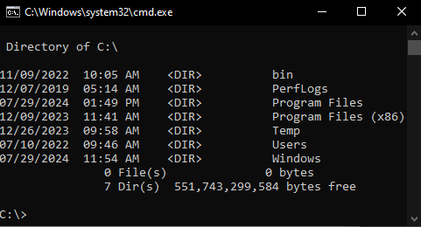
CLI
Example

Slide 5
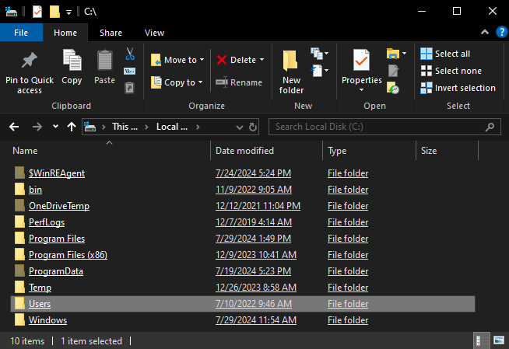
GUI
Example

Slide 6
GUI Basics
Dialog boxes are small windows that display information and allow the user to perform actions.
Dialog boxes handle most user interaction.
Users interact with graphical elements such as buttons, sliders, icons, and text boxes.
GUI’s are event driven where the user determines the order in which things happen. In other words, the user drives events and the program responds to relevant events. NOTE: progams may also need to respond to other events generated by the Operating System.
See https://en.wikipedia.org/wiki/Graphical_user_interface

Slide 7
GUI in Python
Python only provides a CLI natively.
The tkinter module (included with Python) was developed to allow a program access to GUI features. tkinter is combined from “tk” an abbreviation for toolkit and “inter” short for interface.
Within the tkinter module, Widgets are graphical elements that the user can interact with.
See https://en.wikipedia.org/wiki/Tkinter
See https://tkdocs.com/shipman/

Slide 8
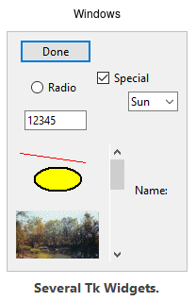
tkinter Widgets
Core widgets:
The containers: frame, labelframe, toplevel, paned window.
The buttons: button, radiobutton, checkbutton (checkbox), and menubutton.
The text widgets: label, message, text.
The entry widgets: scale, scrollbar, listbox, slider, spinbox, entry (singleline), optionmenu, text (multiline), and canvas (vector and pixel graphics).
Tkinter provides three modules that allow pop-up dialogs to be displayed:
tk.messagebox (confirmation, information, warning and error dialogs)
tk.filedialog (single file, multiple file and directory selection dialogs)
tk.colorchooser (color picker).
Python 2.7 and Python 3.1 incorporate the "themed Tk" ("ttk") functionality of Tk 8.5. This allows Tk widgets to be easily themed to look like the native desktop environment in which the application is running, thereby addressing a long-standing criticism of Tk (and hence of Tkinter). Some widgets are exclusive to ttk, such as the combobox, progressbar, treeview, notebook, separator and sizegrip.
https://en.wikipedia.org/wiki/Tkinter
https://tkdocs.com/tutorial/concepts.html

Slide 9
Using tkinter
When Widgets are created, a parent-child relationship is created. For example, if you place a text label inside a frame, the frame is the parent of the label.
Programs that use tkinter may not run reliably under IDLE; therefore, it’s best to run them from the CLI.
It is good practice to take an object oriented approach when writing GUI programs. __init__ method builds the GUI. When an instance is created, the GUI appears on the screen.
Per tkdocs.com the following imports are recommended…
from tkinter import *
from tkinter import ttk

Slide 10
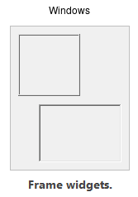
Frames
Frames are Widgets that display rectangles in your window and are often used for organizing the look of your GUI program.
Syntax:
frame = ttk.Frame(parent)
https://tkdocs.com/tutorial/widgets.html#frame

Slide 11
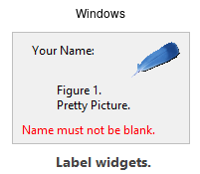
Label Widgets
Label Widget displays a single line of text in a window.
Create an instance of tkinter’s Lablel class.
Syntax: tkinter.Label(self.main_window, text = ‘my text’)
The first argument references the root widget, second argument shows text that should appear.
https://tkdocs.com/tutorial/widgets.html

Slide 12
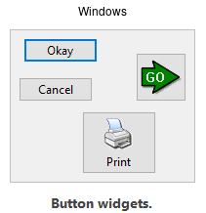
Button Widgets
Button is a Widget the user can click to trigger a callback function to take an action when the user clicks.
The callback function, aka an event handler, gets executed as long as it is passed to the Widget when it is first created.
Syntax:
button = ttk.Button(parent, text='Okay', command=submitForm)
https://tkdocs.com/tutorial/widgets.html#button

Slide 13
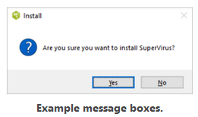
Dialog Boxes
A dialog box is a special window that pops up and reflects a message intended for the user.
Be sure to import tkinter.messagebox
Syntax:
tkinter.messagebox.showinfo(title, message)
https://tkdocs.com/tutorial/windows.html

Slide 14
Creating a Quit Button
exit_button = Button(root, text="Exit", command=root.destroy)

Slide 15
Using Labels as Output Fields
Labels can be used instead of a dialog box to dynamically display output.
Create an empty label in your main window and write code that displays data in the label upon some event such as a button click.
You could even make a custom keyboard handler and respond to keyboard keys being pressed.
If you use StringVar class and associate it with the label object, any time a string value is stored in the StringVar object, the label will be automatically updated.

Slide 16
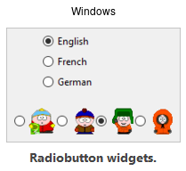
Radio Buttons
Radio Buttons are small circles where only one at a time may be selected.
Syntax:
phone = StringVar()
home = ttk.Radiobutton(parent, text='Home', variable=phone, value='home')
office = ttk.Radiobutton(parent, text='Office', variable=phone, value='office')
cell = ttk.Radiobutton(parent, text='Mobile', variable=phone, value='cell')
https://tkdocs.com/tutorial/widgets.html#radiobutton

Slide 17
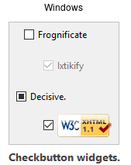
Check Button
Check buttons are small square boxes that can all be selected independently allowing combinations of settings to be selected by the user.
Syntax:
measureSystem = StringVar()
check = ttk.Checkbutton(parent, text='Use Metric',
command=metricChanged, variable=measureSystem,
onvalue='metric', offvalue='imperial’)
# variable types that can be used to store CheckButton values:
s = StringVar(value="abc") # default value is ''
b = BooleanVar(value=True) # default is False
i = IntVar(value=10) # default is 0
d = DoubleVar(value=10.5) # default is 0.0
https://tkdocs.com/tutorial/widgets.html#checkbutton

