Slide 1
IT-1113, Lecture Slides 12:
Recursion
Mr. Donald Privitera, Course Coordinator
Kennesaw State University
Marietta Campus
College of Computing and Software Engineering
IT Department
dprivit2@kennesaw.edu

Slide 2
Table of Contents
Recursion
Problem solving
Examples

Slide 3
Definition
Recursion is a method of programming where a function calls itself to repeatedly execute until some stopping point, called an anchor, is reached.
When the function calls return, the work is accomplished.
This technique uses many function calls which consumes significant CPU and memory overhead. Thus, recursion needs to be cautiously used. Often, more thoughtful design can reveal a method of using loops to accomplish the same result more efficiently.
See https://en.wikipedia.org/wiki/Recursion_%28computer_science%29

Slide 4
Recursion
A recursive function is a function that calls itself.
A recursive function must have a way to control the number of times it calls itself (otherwise the program will exhaust available resources and result in a non-trappable run-time error). Stopping is typically accomplished with an if-else logic structure which defines when the function should return a value and when it should call itself.
Depth of recursion is the number of times a function calls itself. Again, this is ultimately limited by available compute resources.

Slide 5

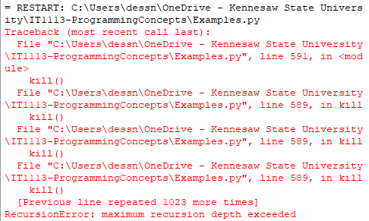
Bad Logic
This code generates a run time error:

Slide 6
Example
def factorial (num):
  if num < 0: # check for error
  print(“Error”)
  return 0
  if num == 0: # this is the anchor
  return 1
  else:
  return num * factorial(num - 1) # note: (num - 1) is logic that will allow the anchor to trigger eventually

Slide 7
Problem Solving
Though recursion can be a powerful method for elegantly solving a problem with little code, it is never required to solve a problem.
Any problem that can be solved with recursion can be solved with loops.
Unless the use of recursion will be guaranteed to be trivial in relation to available compute resources, problems should be solved using other means.

Slide 8
Solving Problems with Recursion
Some repetitive problems are solved with less code using recursion.
Recursion algorithm:
    If the problem can be solved now without recursion, solve and return (this is known as the base case or anchor);
    Otherwise, reduce the problem to a smaller problem of the same structure and call the function again to solve the smaller problem (this is known as the recursive case).
Since each call to the recursive function reduces the problem, eventually it will get to the anchor which does not require require recursion and the recursion will stop.
Usually, the problem is reduced by making one or more arguments smaller at each function call.

Slide 9
Types of Recursion
Direct recursion is when a function directly calls only itself of which there are two types:
  Recursion that contains only a single self-reference is known as single recursion.
  Recursion that contains multiple self-references is known as multiple recursion.
Indirect recursion is when function A calls function B which in turns calls function A.

Slide 10
Examples
Repetitive mathematical functions such as factorial, summing, Fibonacci series, GCD, etcetera.
Repetitive graphing functions such as fractals.
Games such as Chess, Towers of Hanoi

Slide 11
Using Lists with Recursion
def list_sum(list, start, end):
if start > end:
return 0
else:
return list[start] + list_sum(list, start + 1, end)

Slide 12
Recursion with 2 Base Cases
# Fibonacci function returns n-th number in Fibonacci series
def fib(n):
if n == 0:
return 0
elif n == 1
return 1
else:
return fib(n - 1) + fib(n - 2)

Slide 13
Recursion with 2 Parameters
# Greatest Common Divisor
def gcd(a, b)
if a == 0:
return b
else:
return gcd(b % a, a)

Slide 14
Recursion with 4 parameters
# Towers of Hanoi
def move_discs(num_discs_to_move, from_peg, to_peg, temp_peg)
  if num > 0:
  move_discs(num _discs_to_move -1, from_peg, temp_peg, to_peg)
  print(“Move a disc from peg”, from_peg, “to peg”, to_peg)
  move_discs(num _discs_to_move – 1, temp_peg, to_peg, from_peg)
move_discs(3, 1, 3, 2)

