Slide 1
IT-1113, Lecture Slides 10: Object Classes
Mr. Donald Privitera, Course Coordinator
Kennesaw State University
Marietta Campus
College of Computing and Software Engineering
IT Department
dprivit2@kennesaw.edu

Slide 2
Table of Contents
Programming paradigms
Object classes
Instances
Design Good Practices

Slide 3
Programming Paradigms
Procedural programming – a focus on writing programs made of functions that perform specific tasks and operate on data.
Procedures operate on data items that exist independently of the procedures. Often global variables are used.
Good practice dictates data items can be passed from one procedure to another.
Functions and data were 2 distinct categories of program design.
In programming architecture, it became apparent that a tighter relationship between functions and data was less error prone and fostered greater reusability.
Programming languages evolved to facilitate an object model to encompass this tighter relationship.
Object-oriented design and programming resulted.

Slide 4
Object-Oriented Design (OOD)
Object oriented design is a way of thinking and looking at problems.
Humans naturally look at everyday objects.
For example, when you look at a lamp, it has a switch that turns it on and off. It also has a state of being on or off. This way of thinking is object oriented.
In the example, in terms of looking at it in an object-oriented programming language, the switch is a method, and the state is a data variable.
The same is true for designing object-oriented programs; however, a programming language needs to support object-oriented features.
Python is an object-oriented programming language.

Slide 5
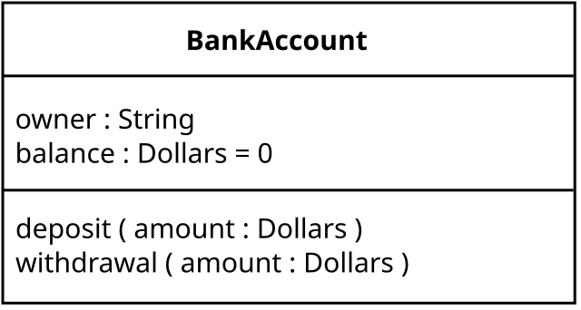
Unified Modeling Language (UML)
A UML diagram is a standard for graphically depicting object-oriented systems.
A typical UML diagram is a box divided into three sections from top to bottom.
Top section is the name of the class
Middle section is the list of attributes
Bottom section is the list of methods
See https://en.wikipedia.org/wiki/Unified_Modeling_Language
https://en.wikipedia.org/wiki/File:BankAccount1.svg

Slide 6
OOD Approach
Identify the classes
Identify real world objects that are in the problem domain.
Get or write a description of the problem domain.
Identify all nouns in the description, each of which is a possible class.
Refine the list to include only classes that are relevant to the problem.
Focus on things the classes need to know and how changes will need to be made to them.

Slide 7
Written Description
Get or write the problem domain description. A business analyst is an expert in this area. As a developer, you should be familiar with this process also. Include the following:
Physical objects simulated by the program.
The role played by a person.
The result of a business event.
Record keeping items.

Slide 8
Identifying Possible Classes
Identify all nouns in the description which are candidates for possible classes.
Include noun phrases and pronouns.
Some nouns may appear twice.

Slide 9
Refine
Pare the list to include only classes that are vital to the problem.
Distill redundant nouns to just one.
Remove nouns that represent items the program will not need to address.
Remove nouns that represent objects, not classes.
Remove nouns that represent simple values that can be assigned to a variable.

Slide 10
Final Analysis
A class’s responsibilities are the things the class is a responsible for knowing (these are candidates for data attributes). The actions the class is responsible for doing (these are candidates for methods).
To find out a class’s responsibilities, look at the problem domain and deduce the required information and actions.
See https://en.wikipedia.org/wiki/Object-oriented_analysis_and_design#Object-oriented_design

Slide 11
Object-Oriented Programming (OOP)
OOP is focused on creating objects.
An object is an entity that contains or encapsulates both data and the procedures that operate on them.
Data are known as attributes and procedures are known as methods.
Data hiding is a good practice that makes attributes inaccessible from outside the object. This forces the use of methods to modify an object’s state(s). The design idea here is that no outside code needs to know the internal workings of an object. This also protects from accidental corruption (a type of programming error).
Ideally, an object can be used in different programs (object reusability). For example, a graphics drawing object can be used by many different programs from business to architecture to games.
See https://en.wikipedia.org/wiki/Object-oriented_programming

Slide 12
Another OOP Example
ALARM CLOCK OBJECT:
Data attributes define the state – time which includes hour, minute, and seconds.
Public methods – allow external code to manipulate the object:
set_time(), set_alarm_time(), snooze()
Private methods – are used for the objects internal workings:
increment_time(), trigger_alarm(), stop_alarm()

Slide 13
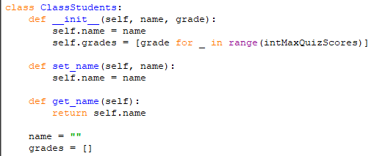
Object Classes
Class: code that specifies the data attributes and methods of an object. Like a blueprint of a house or a cookie cutter.
Instance: an object created from a class similar to a specific house built according to the blueprint or a specific cooke made from a cookie cutter.
There can be many instances of a class.

Slide 14
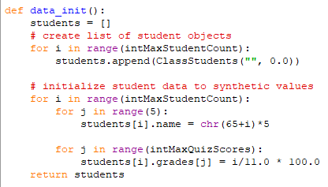
Example: Creating a Class Instance

Slide 15
Creating Object Classes
The __init__ method (initializer) is vital to the proper creation of a class instance.
Self refers to the object itself and must appear in the method definition; however, when instantiating the object instance by referencing it, you do not pass self because it’s automatically passed.
For example, the statement below will create an object. Note: self is not passed here. The required arguments are passed.
x = ClassStudents(“”,0.0)

Slide 16
Hiding Attributes, Using Modules, str
Good OOP practice is to make an object’s data attributes private and provide access to public data only through methods.
In Python, use two consecutive underscores __ in front of a name attribute to make it private to the object class.
Classes can be stored in .py modules and brought in through the import statement making them easy to use in other Python programs.
The objects state reflects its values at any given moment. A special method __str__ displays the object’s state. It is automatically called when the object is passed as an argument to functions print() and str().

Slide 17
Instances
It’s important to have a good mental model of how objects work.
An instance is a creation of one object. You can create multiple objects.
An instance attribute belongs to a specific instance of a class.
An object is created when first referenced. At that moment, the __init__ method is called and memory is allocated for the object.
If many instances are created, each instance is completely independent of one another with each having it’s own set of attributes.

Slide 18
Accessor and Mutator Methods
Methods that allow an attribute value to be returned are called accessor methods. This is considered a safe way to access from code outside the class.
Methods that allow an attribute value to be changed are called mutator methods.
Methods and functions typically need to accept objects as arguments.
CAUTION: when passing an object, you are actually passing a reference to the object. Thus, a receiving method or function has access to the actual object. Methods may be called and attributes changed by the receiving function.

