Slide 1
IT-1113, Lecture Slides 07: Lists and Tuples
Mr. Donald Privitera, Course Coordinator
Kennesaw State University
Marietta Campus
College of Computing and Software Engineering
IT Department
dprivit2@kennesaw.edu

Slide 2
Table of Contents
Arrays and Lists
Tuples
Useful Operators and Methods
Multidimensional Lists
Classes and Objects

Slide 3
Arrays and Lists
Many programming languages implement a data structure called an array.
Python implements a data structure consisting of objects of multiple items of data, called a sequence.
Python provides 2 sequence data structures that behave almost identically: lists (changeable/mutable) and tuples (unchangeable/immutable but process faster).
Python also provides a Dictionary data type that also can manage multiple items.
An IndexError exception is raised if an invalid index is used.

Slide 4
Lists
Lists are objects used to store multiple items in a single variable.
List items (aka elements) are ordered, changeable, allow duplicate values, and allow different data types.
The print function has the ability to print objects and lists are no exception.
List elements are indexed which means they start from 0 versus some other programming languages which use subscripts which start from 1.
len function provides the number of elements is a list.
list function converts certain objects to lists

Slide 5
Creating and Manipulating Lists
The first element of the list is referenced by using the list name followed by a bracket with an index number format.
listname[0]
Python is somewhat unusual in that it lets you specify not only ways to directly reference elements, but also ways to reference element ranges and ways to specify references relative to the start and end of the list.
For example, listname[-1] refers to the last element in the list called listname.
You can refer to a range of elements by using a colon.

Slide 6
Special Index References (Slicing)
Syntax: start:end:increment
listname[1:4] refers to the sublist from the 2nd element through 5th element in the list but does not include the 5th item. Always remember, indexes start from 0 representing the first element and the right most number references up to but not including that element.
listname[:4] refers to the sublist from the beginning of the list up through but not including the fifth element.
listname[2:] refers to the sublist starting at the 3rd element up to the end of the list.
listname[6] is the same as listname[6:7]
listname is the same as listname[0:len(listname)]
listname[::2] references every other element
listname[::-1] orders the list backwards

Slide 7
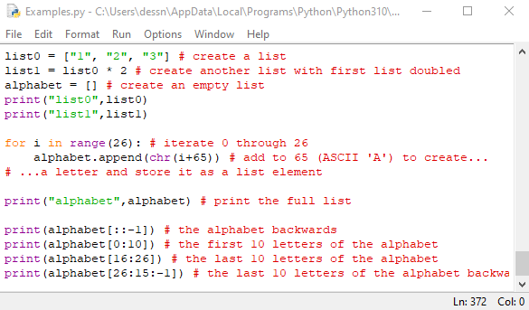
Examples

Slide 8
List Operations
2 lists of the same type can be concatenated together with + or +=.
Use in or not in operators to test whether an item is or is not within a list. Example, if item in mylist:
del can delete a specific element. Example, del mylist[i]
min and max can be used as appropriate.

Slide 9
List Methods
append() - adds an element at the end of the list
clear() – removes all elements from the list
count() – returns the number of elements with the specified value
index() – returns the index of the element with the specified value
remove() – Removes element with the specified value
sort() – sorts the list
reverse() – reverses the order of the list
See https://www.w3schools.com/python/python_lists_methods.asp

Slide 10
Important! Copying lists
If you create a list variable and then set another variable equal to it, then both variables point to the exact same list in memory. If either variable is used to change the list, both variables will reflect that change.
Copying lists can only be accomplished one of 2 ways:
Create a new list and copy list data one character at a time.
Create a new empty list and concatenate the source list to the new empty list.

Slide 11
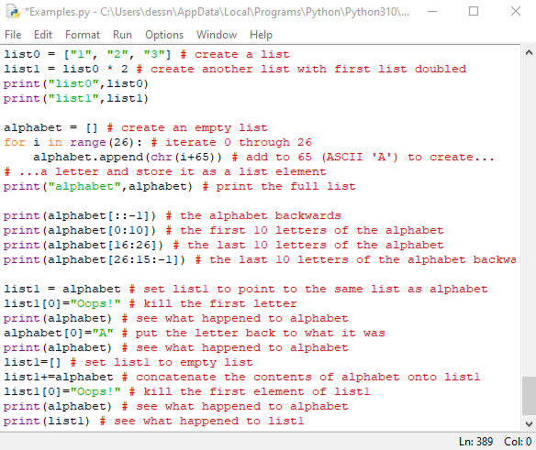
Example

Slide 12
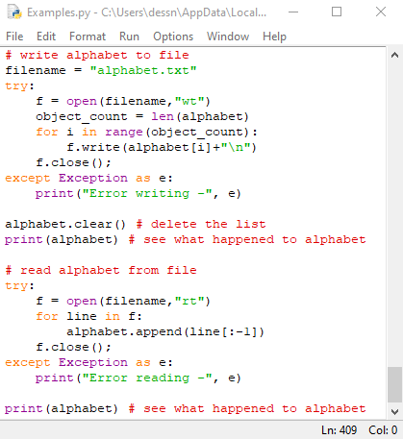
Example

Slide 13
Multidimensional lists
Python’s lists are not true arrays, so therefore, they behave slightly differently.
You can, however, simulate multidimensional arrays just like you would a real array.
You can think of a 2-dimensional list as a list of lists.
You need to use nested loops to process multidimensional lists.

Slide 14
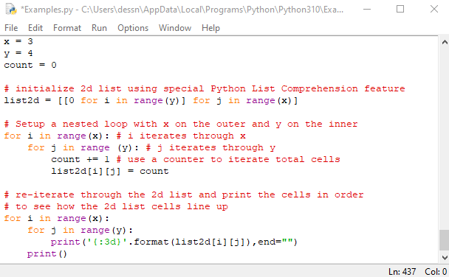
Example

Slide 15
Tuples
Syntax: tuple_variable = (element1, element2…)
Nearly identical to a list but once created it cannot be changed.
List methods not supported (append, remove, insert, reverse, sort).
Tuples can be processed more quickly than lists. More efficient.
Tuples keep data safe.
Some Python operations require Tuples.
tuple() function converts list to tuple.
list() function converts tuple to list.

