Slide 1
IT-1113, Lecture Slides 06:
Data Files Input/Output and Exceptions
Mr. Donald Privitera, Course Coordinator
Kennesaw State University
Marietta Campus
College of Computing and Software Engineering
IT Department
dprivit2@kennesaw.edu

Slide 2
Table of Contents
Intro
Files and File Types
Processing Data
Error Handling

Slide 3
Intro to Files
A data centric view is required in order to understand the value of computer hardware and software.
Being able to input, store, process, and output data is vital.
Files enable data to be stored typically on a secondary storage medium for permanence.
Programming languages typically have libraries that facilitate I/O.
Python has file I/O capabilities built in.

Slide 4
I/O Concepts
Computer memory is cleared when a computer program stops running. Memory contents are also lost when a computer is turned off.
Secondary storage (generally regarded as disk) gives data permanence. To save your program data, you must follow steps in whatever programming language you use.
Data is stored as either text or binary. Text data is human readable. Binary is a direct image of what was in memory and is not human readable.
For example, if you have a variable defined as x = 500, the binary value is 00000000000000000000000011110100 which is 4 bytes in size.
You can store it to disk in binary or text. If you store it in binary, 4 bytes would be used. If you store it in text, 3 bytes would be used as in the string “500”.
Binary I/O is generally faster than text I/O because text I/O has to be reconverted back into binary. However, due to today’s fast computers and storage, the speed difference is likely indiscernible for smaller amounts of data.
For storing and retrieving text, text I/O is more efficient.

Slide 5
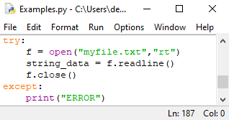
I/O Methods
In your program, you will open a file, read or write to it, and then close it.
In Python, I/O is managed using objects. Methods are functions embedded within an object.
You first “open” a file in either binary or text mode. You also need to indicate whether you are opening the file for writing, reading, or appending. If opening for writing, any existing file will be destroyed and overwritten. Use append mode to add more data to an existing file.
You always need to check for and handle errors when performing any I/O operations because you can never be sure if the disk, operating system, or other hardware is operating as expected due to the possibility that the disk can be full, the file could be locked by another application, the disk could be removed, etcetera.
After successfully opening a file, an object is created. You can then call the appropriate write or read method.
When finished, it is good practice to always close the file.

Slide 6
Open modes
Character | Meaning
'r' | open for reading (default)
'w' | open for writing, truncating the file first
'x' | open for exclusive creation, failing if the file already exists
'a' | open for writing, appending to the end of file if it exists
'b' | binary mode
't' | text mode (default)
'+' | open for updating (reading and writing)
https://docs.python.org/3/library/functions.html#open

Slide 7
Using a Python List
Python has a datatype called List which is like arrays in other languages.
A List is defined by usage.
Assigning a variable to a series of items enclosed in brackets creates a list.
mylist = [“apple”, “orange”, “banana”]
In this example, a list is created with 3 string elements.
mylist.append(“grape”) # would add the string “grape” to mylist and len(mylist) would return 4.
You can reference a specific element with an index, so mylist[0] refers to the 1st element in the list, mylist[1] the 2nd, and so on.
A special read-only list, called a Tuple, is created with parenthesis instead of brackets.
mylist = (“apple”, “orange”, “banana”)

Slide 8
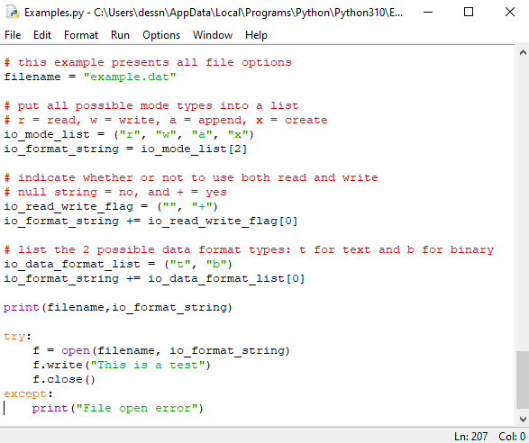
Example
Building a format string using tuples
Opening a text file for writing
Writing to the file
Closing the file

Slide 9
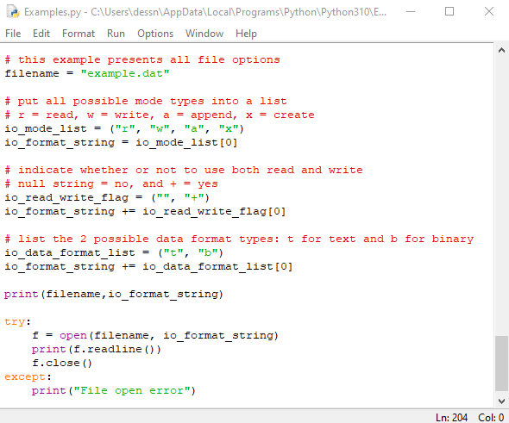
Example 2
Building a format string using tuples
Opening a text file for reading
Printing the result of reading from the file
Closing the file

Slide 10
Notes on Opening Files in Python
Attempting to open a file for reading when no file exists will generate a runtime error unless handled with try/except logic.
If no path is added to the filename, the file is accessed from the same directory as the running program.

Slide 11
Popular I/O Methods
read – returns file content.
readline – returns 1 text line from the text file. The line is returned as a string including “\n”. You may need to strip that off using the rstrip method. Conversely to writing, when reading data values, you will need to convert them from strings back into numeric using int or float functions as appropriate.
readlines – returns a list of lines from the text file.
write – writes the specified data to the file. If using text mode and storing numeric data, you must first convert your data to a string using str function and concatenate a “\n”.
writelines – writes a list of strings to the file.
see https://www.w3schools.com/python/python_ref_file.asp

Slide 12
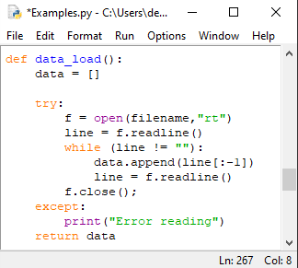
Using Repetition Logic with Files
It is common to store a lot of data; therefore, loops are common to create logic that methodically traverses your data and stores it to disk. You will also likely need logic to read data back from disk and restore it to memory.
When reading from a text file, the while statement is often coupled with readline.

Slide 13
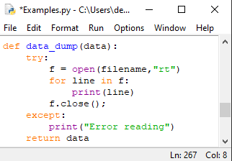
Using the for Statement To Read
The for statement has a special use case to allow data to be read from a file resulting in little code.

Slide 14
Data
Data is ideally structured in a program.
Python uses objects to structure data.
Objects can be stored too.
Record: a set of data that describes one data item or structure.
Field: a single piece of data within a record.
Sequential I/O involves performing record operations (such as reading) one after the other until the entire file has been traversed.
For unstructured data, fields can be read or written one at a time corresponding to a record.
For example, a payroll record might contain fields related to name, address, salary, start date.

Slide 15
CRUD
Create
Read
Update
Delete
These are all important file operations related to data records. In addition, searching for a specific record is a very important operation.

Slide 16
More About Exceptions
An exception is an error that occurs while a program is running, sometimes called a run-time error.
A traceback is an error that provides details as to what caused the error.

Slide 17
Exceptions 2
Good coding practice includes checking and validating the results of calls to functions and methods. Never assume that everything is going to work as planned.
Input validation is an example of an important good practice where users can make mistakes and key in the wrong data. For example, if you are expecting a number but the user accidentally (or intentionally) types non-numeric data.
Hackers often exploit lack of input validation to cause an error in a program as a means to attempt to take control of a computer.

Slide 18
Exceptions 3
An exception handler is a portion of code that gets control when an exception is raised. This allows the program to take appropriate action versus the program just stopping unexpectedly.
In Python, try/except logic provides the mechanism to handle exceptions.
The try suite is the code block where an exception could result from statements producing an error.
The handler is the code block where control is transferred to as marked by the except keyword. Multiple handlers can be added.
exceptionName is the mechanism to allow specific exceptions to be handled. If not used, the except handles all remaining exceptions not specifically handled otherwise.
The finally statement executes after the try suite and handlers have executed which is useful if there’s a return statement within the try suite or handler(s).
Syntax:
  try:
  <code block>
  except:
  <code block>
  [finally:]
  <code block>

Slide 19
Exceptions 4
Many different kinds of exceptions can occur in a typical try suite.
Python allows identification of exceptions and multiple handlers.
See https://www.w3schools.com/python/python_ref_exceptions.asp
Syntax:
  try:
  <code block>
  except [exceptionName]: # this traps a specific error type
  <code block>
  except Exception as e: # this is a catch all that will print the exception
  print(e)
  [code block]

Slide 20
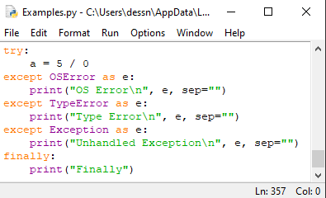
Example Exception Handler

Slide 21
Unhandled Exceptions
Be careful when planning your program.
Anticipate possible exceptions and build try/except suites.
Read Python documentation to be sure what functions can raise exceptions.
Use a general except handler after your specific handlers in case your miss something.
Now do you know why sometimes a program will generate an “Unhandled exception error”?
That information is needed by programmers so that those exceptions can be handled.

