Slide 1
IT-1113, Lecture Slides 05:
Mr. Donald Privitera, Course Coordinator
Kennesaw State University
Marietta Campus
College of Computing and Software Engineering
IT Department
dprivit2@kennesaw.edu

Slide 2
Table of Contents
Functions
Definition (Passing Parameters, Returning Values)
Scope (Local/Global)
Constants
Modules and Modular Design

Slide 3
Functions
A function is a series of statements grouped together to perform a specific task.
Functions allow code to be generalized and made reusable saving time in the future.
Functions optionally receive data passed in as one or more parameters and can optionally return one or more values. A function that does not return a value is called a void function.
Functions allow problems to be decomposed into smaller logical pieces called modularization where each task is in its own function. This is opposed to a monolithic design where all the code is in one giant program.
Functions make programs easier to understand, debug, as well as facilitate allowing many people to work together.
In Python, function naming follow the same rules as variables.
Example use, x = sqrt(y) where sqrt is a function taking y as an argument which is passed into the function. The function then does processing and returns a value.

Slide 4
Functions 2
Functions need to be defined BEFORE they are used. Good practice is to put all function definitions at the top of your module.
Normally arguments are passed in the exact order they are specified in the function parameter definition. This is how most other languages work and is a recommended good practice.
However, Python allows keyword arguments which specify which parameter you are passing. This approach allows arguments to be passed in any order.
  Example: function(parameter=value)

Slide 5
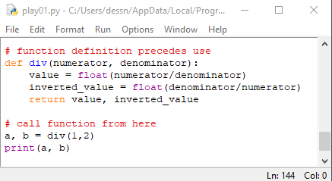
Example Function Definition & Call

Slide 6
Scope (local & global variables)
Variables have scope of being global or local.
Variables defined within functions as parameters or otherwise are considered local only to that function. Therefore, changing those values will NOT affect variables outside of that function scope. In the prior example, “a” was defined as a local variable. If “a” has been defined in the main program, those two “a” variables are completely different. Likewise, the “numerator” and “denominator” parameters can be altered within the function without affecting any identically named variables outside of the function.
Global variables are variables defined in the main() program and are accessible to any functions.
If within a function, a global needs to be changed, it must be re-declared with “global” in front of it.
It is good practice to not use global variables as they make programs more difficult to understand, debug, error prone, and it makes functions non-portable.

Slide 7
Constants
Certain values may need to be defined and frequently referenced.
Global constants store a value that cannot be changed.
For example, in a program used for multiple languages, storing all strings used in the program in one module can facilitate translations to different languages. Since those strings need not change during program execution, they are good candidates to be constants.
Python does not have an explicit constant; however, not using the “global” keyword within functions to redeclare global variables prevents changes.

Slide 8
Code Modules/Libraries
Libraries are prewritten functions and objects that can be used in a program to save time. Libraries can be thought of as a black box since you don’t need to know the details of how it works.
Python is well known for rich libraries as modules.
A module is a Python source code file.
The import keyword is used to load a module/library.
You can also load your own modules. For example, if you write a function that is useful to re-use, you can store that in a separate Python source code file and then use the import keyword to load it into your Python program.
Writing re-usable code modules makes any programming language more versatile and Python excels in this area.
For example, import numpy as np
NOTE: the “as np” is optional and allows all function/objects to be referred by np. Otherwise, all functions/objects would be referred by the full numpy.

Slide 9
Python import
When using a function within a module, you prefix the function with the module name.
Example: module_name.function_name()
Not only can you import a module which contains all functions/objects, but you can be more specific and only import specific functions/objects from a module.
Example: from math import pi
Example: import random
Example calling a function in the random module:
print( random.randint(1, 100) )

Slide 10
Input/Processing/Output Charts
Like Flowcharts help to visually show logic flow, IPO charts help to quickly see what functions do.
See: https://youtu.be/a10a11oxjrA

Slide 11
Useful Python Modules
import math
Import statistics
Import random
Import tkinter
https://docs.python.org/3/py-modindex.html

Slide 12
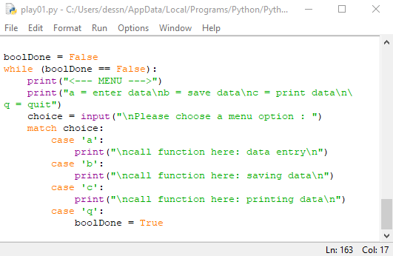
Menu Driven Programs Revisited
It is best practice to make your programs user friendly.
Present menu options to users when there’s more than one option for them to choose from.
Always prompt the user when you need input from them.
Use functions for each option to modularize your code.
The example shows a basic menu driven program structure.

