Slide 1
IT-1113, Lecture Slides 04:
Mr. Donald Privitera, Course Coordinator
Kennesaw State University
Marietta Campus
College of Computing and Software Engineering
IT Department
dprivit2@kennesaw.edu

Slide 2
Table of Contents
Repetition Structures (aka Loops)
While
For
Nested Loops
Examples

Slide 3
Loops
Repetition structures, aka loops, are needed to allow code to be used multiple times based on some condition. Loops should always be used instead of typing more code.
Loops can test for a condition either at the top or bottom of the loop.
Python only supports conditions at the top of loops.

Slide 4
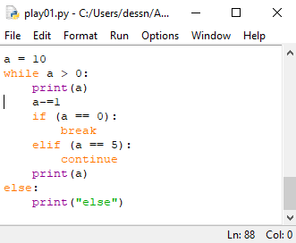
Python while Loop
The while statement tests a condition at the top of the loop (known as a pre-test) and repeatedly executes the block. The optional else keyword is used to execute code when the condition is no longer true.
It is important to make sure logic causes the loop to eventually stop otherwise an infinite loop results.
Each pass through a loop is called an iteration.
The example code shows the use of break and continue to further manage control. The break terminates the loop and does not allow control to flow to the else.
The continue reverts control immediately back to the top without executing anything after it.
Good practice limits the use of the continue and break statements as they can make code difficult to understand.

Slide 5
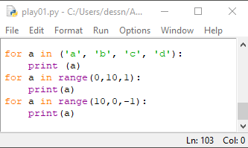
Python for Loop
The for statement is used to iterate over the elements of a sequence (such as a string, tuple, or list) or other iterable object [1].
For is a count-controlled loop which iterates a specific number of times.
The variable is called a target variable.
Like the while loop, an optional else clause can be added which will execute after the loop has completed.
continue and break may also be used with effects similar as mentioned in the while loop.
The range function simplifies iterating through a series of numbers with a starting number, ending number, and increment.
[1] - https://docs.python.org/3/reference/compound_stmts.html#the-for-statement

Slide 6
Data Controlled Loop Iterations
It is possible that data can be used to control loop iterations which can make it impossible for the programmer to know how many iterations will occur. It is therefore important to make sure the loop has a definite way of stopping.
Some loops are designed to repeat until the program is terminated. For example, getting scan information from the keyboard.

Slide 7
Sentinels
A sentinel is a special data value that signifies the end of a sequence.
End of file is a character that is sometimes used in character data files to signify the end of the data file.
A null value (0) is sometimes used ot signify the end of a string.
A sentinel must be unique so that it doesn’t happen by accident.

Slide 8
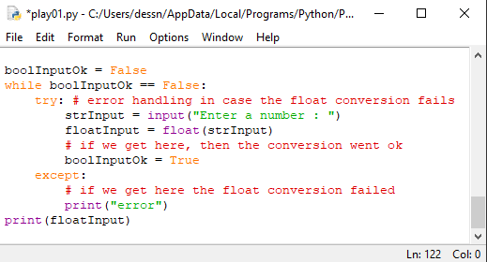
Input Validation
Often a loop is coupled with input functions to keep getting input until valid input has been confirmed.
In Python, a special construct called try/except is needed to prevent a runtime error from occurring when input is converted from a string to a number.
try/except is versatile and handles any kind of would-be runtime errors.

Slide 9
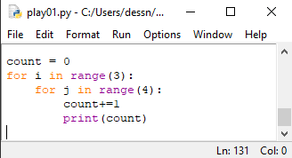
Nested Loops
Loops within loops. There is no practical limit as to how deep you can next loops.
Nesting loops becomes multiplicative as to how many total iterations occur.
The nested loop example will iterate 12 times.
The inner loop completes all its iterations before the out loop iterates.
total_iterations = inner_loop_iterations * outer_loop_iterations.

Slide 10
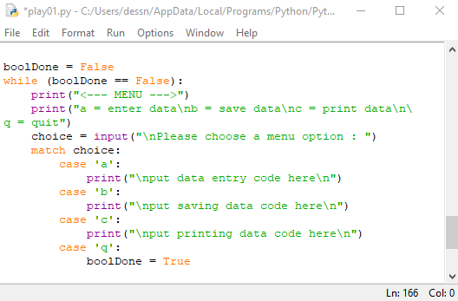
Menu Driven Programs
It is best practice to make your programs user friendly.
Present menu options to users when there’s more than one option for them to choose from.
Always prompt the user when you need input from them.
Use a loop to facilitate a menu.
The example shows a basic menu driven program structure.

