Slide 1
IT-1113, Lecture Slides 03:
Mr. Donald Privitera, Course Coordinator
Kennesaw State University
Marietta Campus
College of Computing and Software Engineering
IT Department
dprivit2@kennesaw.edu

Slide 2
Table of Contents
Conditional Branching
Blocks
If Statement
Boolean Expressions
Truth Tables
Boolean Variables
Flow Structures
if-else, if-elif-else, match
Evaluating String Expressions

Slide 3
Conditional Branching
Normally, a computer program processes statements from top to bottom in sequence one after the other. This is known as flow of control.
For programs to be more useful, programming languages must implement methods of managing the flow.
Python (and most other languages) implement conditional branching to allow flow to execute instruction only when a certain condition is met.
Python provides if, if-else, and if-elif-else statements for this purpose.

Slide 4
Python Block Statements
Before we look at Python’s if statement structures, it is first important to understand that in Python, SOURCE CODE INDENTATION IS CRITICAL TO CORRECT OPERATION OF THE PROGRAM.
Python analyzes the column that statements start in to determine blocks of code that are related, called program blocks.
Statements in the same block of code must start at the same exact column. It can be challenging sometimes to see, so it is an important detail that must be carefully observed.
The conditional branching statements rely upon program blocks to operate correctly.
Multiple nested blocks can exist.
In this way, Python is different from many other programming languages that use a begin and end keyword or operator to demarcate program block concepts.

Slide 5
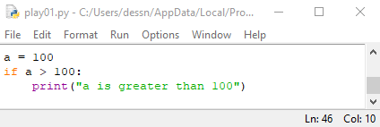
The Python if Statement
Python syntax:
if <condition>:
<statement>
[statement]
In the if clause above, the statement(s) indented in the block below the if clause will only get executed if the condition evaluates to be True. This is a single alternative decision structure because it provides exactly one alternative path of execution.
NOTE: there is a required colon after the condition.
IMPORTANT: remember all statements in the block below the if clause MUST be indented on the exact same column to be considered in the same block.

Slide 6
Boolean Expressions
A Boolean expression is an expression that evaluates to only True or False.
Relational operators are used to evaluate Boolean expressions.
CAUTION: = is for assignment only and == is for testing equality only. Be careful not to get them confused. They work completely different.
Operator | Description | Example
== | Equal | x == y
!= | Not equal | x != y
> | Greater than | x > y
< | Less than | x < y
>= | Greater than or equal | x >= y
<= | Less than or equal | x <= y

Slide 7
Boolean Expressions 2
Python has logical operators to allow compound Boolean expressions.
Operator | Description | Example
and | Returns True if both statements are true | x >= 0 and x <= 10
or | Returns True if any of the statements are true | x > 0 or y > 0
not | Inverts the Boolean result to the opposite | not(x >= 0 and x <= 10)

Slide 8
Logic Truth Tables
or
Expression | Result
F or F | False
F or T | True
T or F | True
T or T | True
and
Expression | Result
F and F | False
F and T | False
T and F | False
T and T | True
not
Expression | Result
not F | True
not T | False
Python evaluates logic expressions from left to right by default.
For compound logic expressions, Python uses short circuit evaluation.
OR – if the left operand evaluates to true then the expression is True and further evaluation is not needed.
AND – if the left operand is false then the expression is False and further evaluation is not needed.

Slide 9
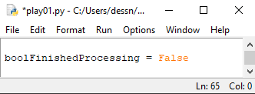
Boolean Variables
Python has a special type for Boolean variables, bool.
A bool can have one of two values: True or False.
A bool type variable is commonly used as a flag or sentinel to indicate the status of some condition.

Slide 10
Flow Structures
CONTROL STRUCTURE: a logical design that directs the flow of control (or order) in which a block of statements execute.
SEQUENCE STRUCTURE: specific statements that execute in the order they appear from top to bottom.
DECISION (SELECTION) STRUCTURE: specific statements executed based on a condition.

Slide 11
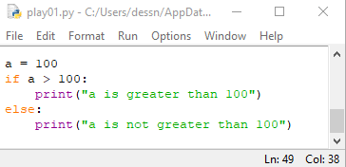
Python if-else statement
Python syntax:
If <condition>:
<statement block>
else:
<statement block>
This control structure provides exactly 2 distinct mutually exclusive flow control blocks providing a dual alternative decision structure.

Slide 12
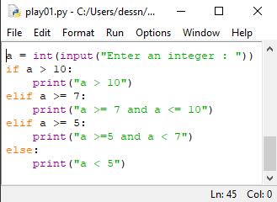
Python if-elif-else Statement
Python syntax:
if <condition>:
<statement block>
elif:
<statement block>
else:
<statement block>
This statement allows any number of elif statements to appear between the if and the else providing for a nested decision structure.

Slide 13
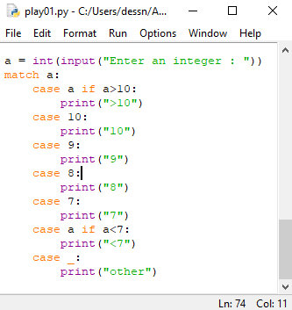
Python match Statement
The if-elif-else statement can become verbose when evaluating many values. In Python 3.10 a new statement was introduced to simplify complex conditional evaluations, the match statement.
See the example for usage and syntax.

Slide 14
Using Strings with Conditionals
In Python Boolean operators ==, !=, >, <, >=, <= work directly on strings with the notion that strings are case sensitive. Many other languages cannot use direct operators on strings and instead rely on special functions.
When comparing strings, each string is compared on a character-by-character basis with ASCII values from left to right.
If a short string is a subset of a longer string, the longer string evaluates as greater.

Slide 15
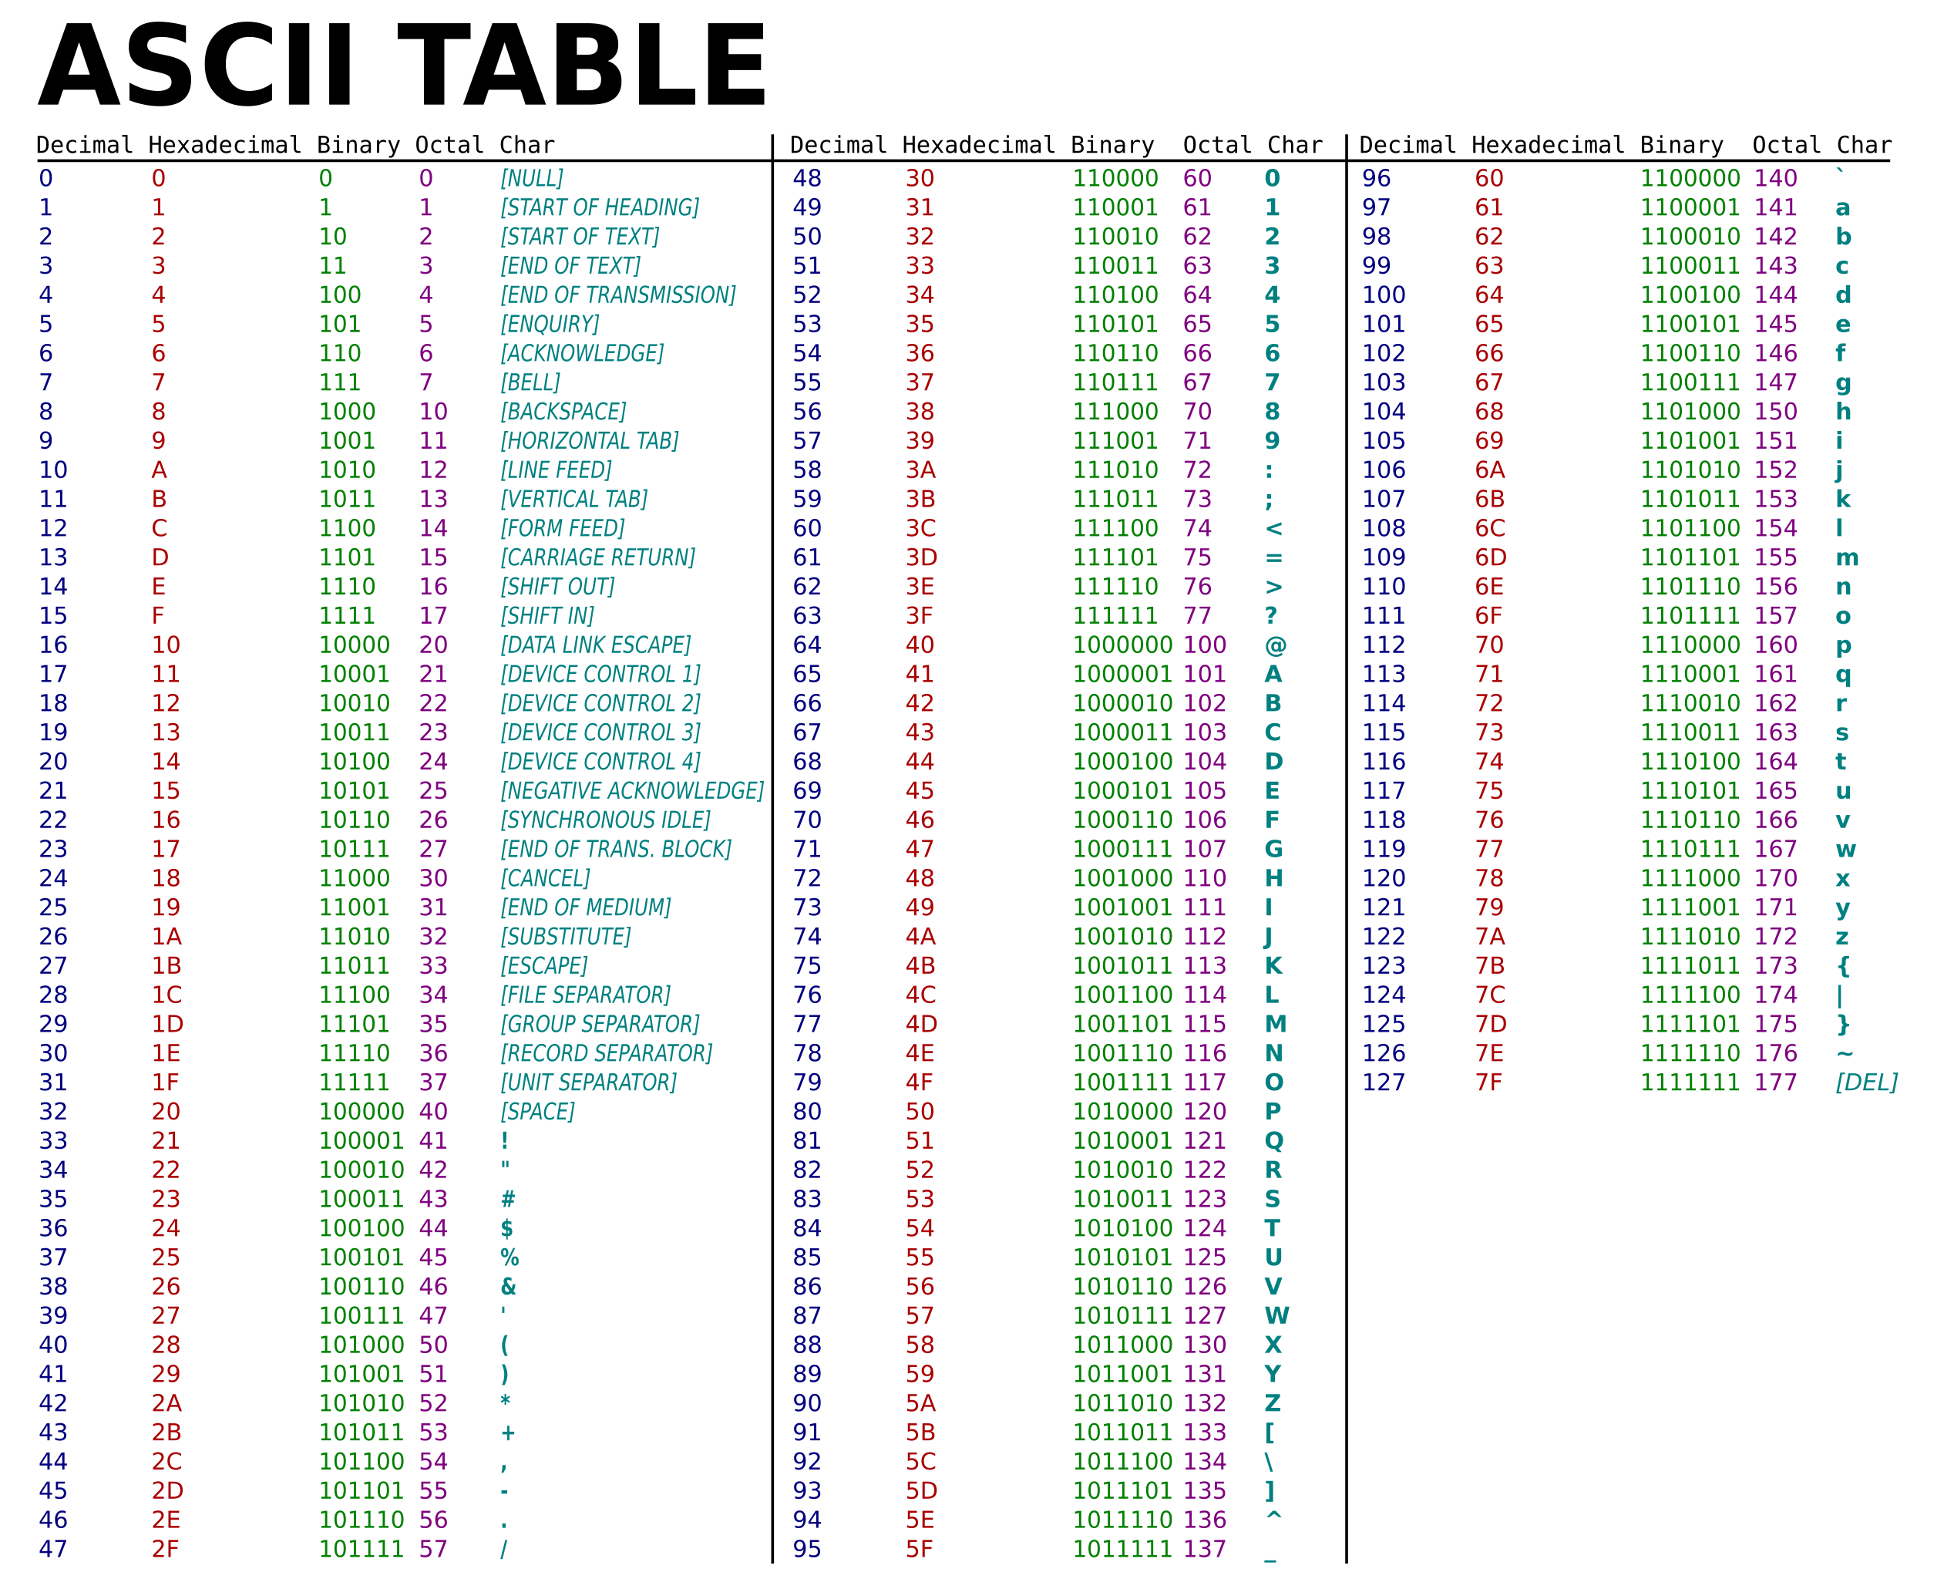
https://upload.wikimedia.org/wikipedia/commons/thumb/d/dd/ASCII-Table.svg/2522px-ASCII-Table.svg.png

Slide 16
Detailed String Comparison Analysis
h | o | h | o
104 | 111 | 104 | 111
String1
h | o | h | o
104 | 111 | 104 | 111
String3
h | e | h | e
104 | 101 | 104 | 101
String2
h | u | h | e
104 | 117 | 104 | 101
String4
String1 > String2
true
String3 > String4
false

